Slide 1
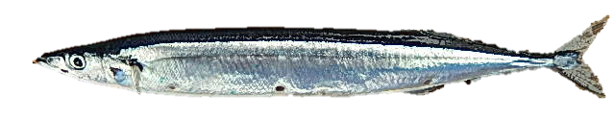
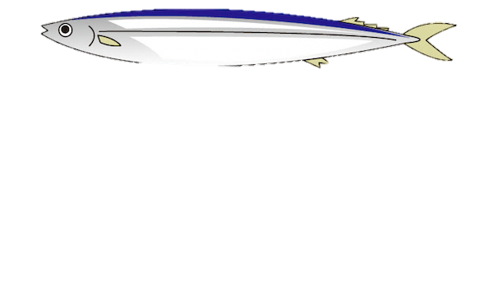
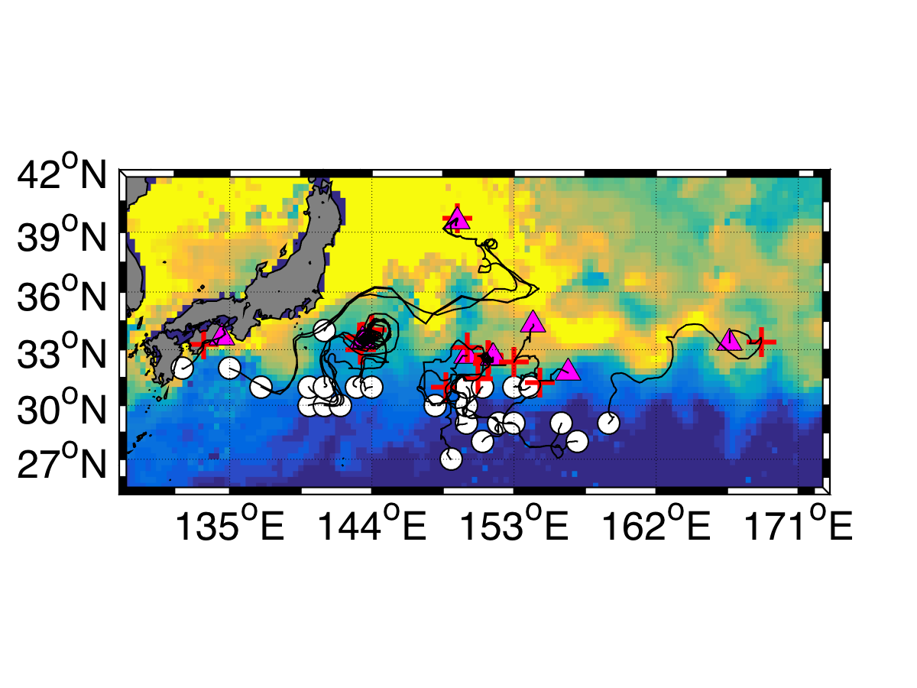
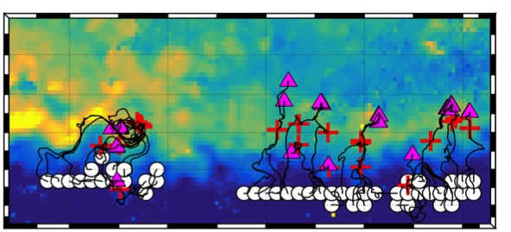
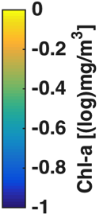
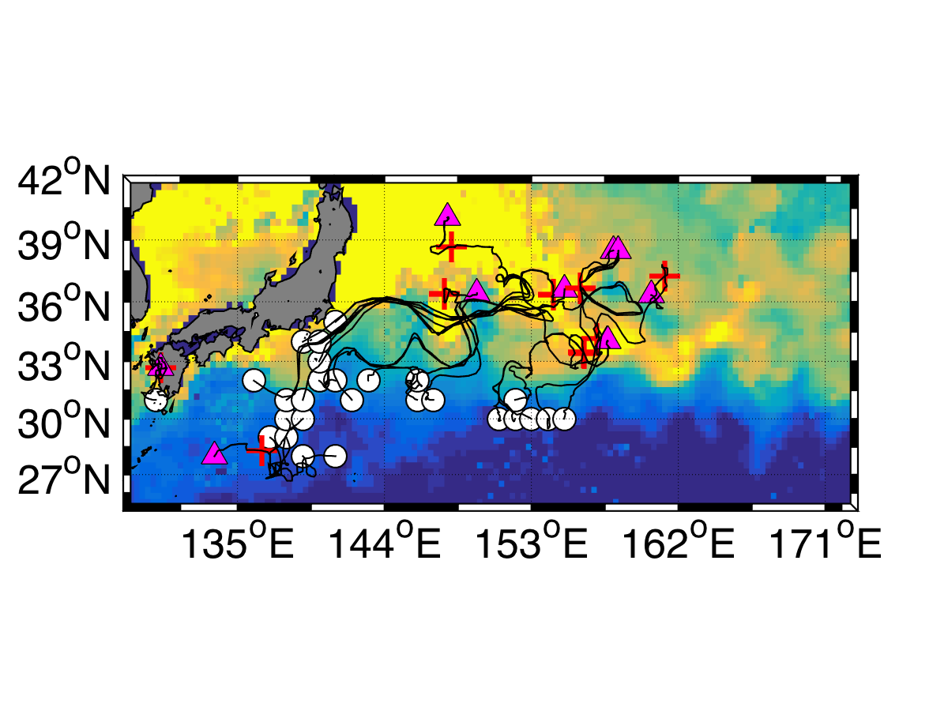
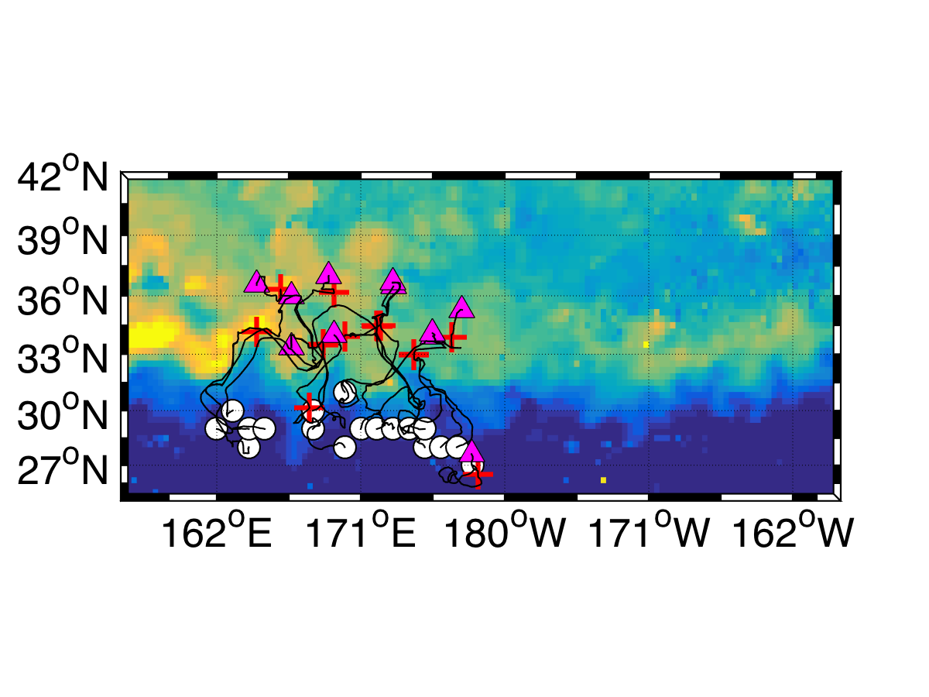
Examining the growth and migration patterns of Pacific saury (Cololabis saira) using an individual-based model & otolith microstructure analysis
Prey1
SST1
Prey2
SST2
Hitomi Oyaizu¹・Satoshi Suyama²・Sachihiko Itoh¹・Shin-ichi Ito¹・
Daisuke Ambe³・Takahiko Kameda⁴・Takeshi Terui⁵・Michio J. Kishi
¹Atmosphere and Ocean Research Institute, Tokyo University，²Tohoku National Fisheries Research Institute，
³National Research Institute of Fisheries Science ，⁴Seikai National Fisheries Research Institute ，⁵National Institute of Polar Research
Migration
Migration
① Introduction
② Objective
The growth of immature Pacific saury (Cololabis saira) could be estimated by otolith analyses (e.g., Kutita et al, 2004). However, the growth trajectory & environmental conditions experienced are not clarified from otolith analyses alone. We need to investigate the spatio–temporal variability in growth & migration of fish associated with environmental conditions comprehensively.
To clarify effects of environmental conditions on the
growth of Pacific saury in relation to their migration
route using an individual-based model (IBM) & otolith
microstructure alalyses data.
Conclusions
The model outputs are consistent with some knowledge derived from some previous studies of the growth of Pacific saury.
The growth rate during planktonic stage could control northward migration of juveniles.
The difference between the growth of saury in the eastern & western sides may be determined by 90 days after hatching.
③ Material & Methods
④ Model settings
◆ Spawning ground : in zones of a temperature range (=18.5–20.0ºC) (284 particles at 1º×1º grid )
◆ Simulation period : 2005/2/1-2007/2/1 (2 years)
◆ Simulation area : 130ºE-160ºW & 0º-90ºN
<Life cycle of Pacific saury>
Figure. 1
schematic diagram of modeling & analyses
⑤ Results & Discussion
Consistent with observation data
5–1) Validation of our model →
Modeling
(1) Comparing the length frequency distribution
(2) Comparing growth trajectory
Model outputs
Observation data
Growth trajectory of group3
Otolith increment widths
<Our model>
<Observation data>
Group1
Group2
&
second peak
Group3
5–2) Determinants of the growth difference
Validating
The temporal variation in Prey function ρ
(a) Western & group2 / & group3
(b) Eastern & group2 / & group3
The variation in weight growth rate & function ρ synchronize.
Significant difference occurs during 80–90 days after hatching (dah) between west & east, and between group 2 & group 3.
Bioenergetics model
(base on the model in Ito et al., 2004)
West vs East
Prey & Temperature
: absorption
Determinant on growth is
mainly the prey variation.
Consumption
: consumption
: Group 2 vs Group 3
Respiration
Production
SDA
Feces
Excretion
5–3) Migration route of each group
Figure. 2. schematic design of a bioenergetics model
(a) Group2 & Western
(b) Group2 & Eastern
At 90 dah (05/10/2006),
group 3 in the further
north of group 2
C_{MAX} : the maximum consumption rate
ρ : prey density dependent function (0≦ρ ≦ 1)
f(T) : temperature dependent function (0<f(T)<1)
※ ρ or f(T) → 1 : favorable environment for growth
(c) Group3 & Western
(d) Grouo3 & Eastern
Figure. 3. Migration route of
(a) group 2 distributing in the western,
(b) group 2 distributing in the eastern,
(c) group 3 distributing in the western,
(d) group 3 distributing in the eastern
side of 160°E on maps of sea surface
Chl-a at 90 dah when the formation of
second peak.
Zooplankton
: hatching
: 90 dah
Analyses
Validation :
Comparing the growth or growth trajectory of model
outputs with observation data
Analyses model outputs :
1) Dividing individuals into west & east group by
whether distributing in the western or eastern side of
160°E at sampling date
2) Dividing fishes in each group into 3 groups
based on length at sampling date. (group1: 17≤L<23,
group2: 23≤L<28, 29≤L<36 in west group(or 28≤L<32 in
east group)
: 120 dah
Two controlling processes of growth difference
(1) Larger group vs smaller group
In spring, high phytoplankton supplied
by Kuroshio Extension or Regional bloom
In May,
High zooplankton area
in south of Transition Zone
⭕
Grow faster &
migrate further northward
→ second peak is formed
❌
(2) West group vs east group
In spring, high phytoplankton transported
to Central NP with Kuroshio Extension
In May,
High zooplankton spread
from west to east
⭕
[West]
(90dah)
[East]
Difference in the growth pattern
⭕
(120dah)

