Slide 1
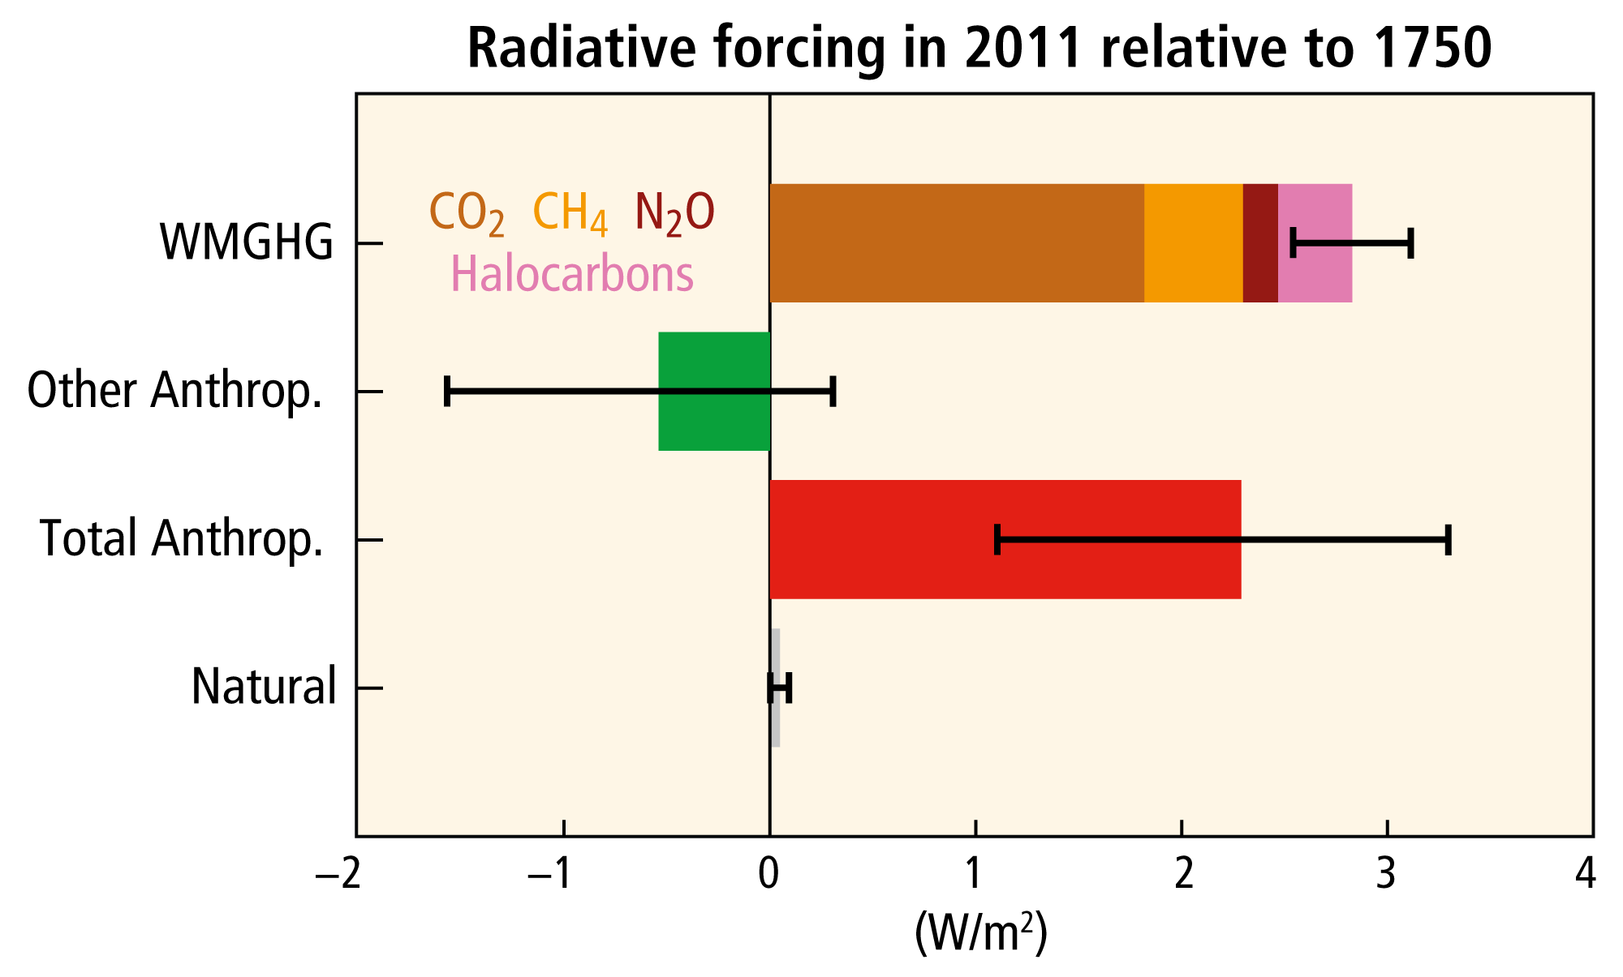
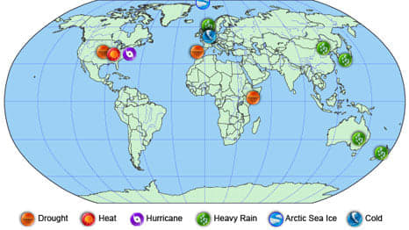
#1 Anthropogenic influence on weather and climate extremes
Ting-Hui Lee, Yong-Jhih Chen, Tzu-Ying Wu, Yu-Hung Chang,
Heming Xiao, Rong-Yu Gu, Ardhi Adhary Arbain, Hirosi Morii
Notes:
In IPCC AR5 report, it shows the total anthropogenic effects positively contribute to radiative forcing after industrial revolution.
And recently, weather and climate extremes have caused several devastating damage worldwide.
So many scientists try to link the extreme event to the rising energy on Earth, like many interesting issues that are presented during the workshop.
Our group members showed common interests in precipitation.
So for the discussion of weather and climate extremes, we focused on the extreme rainfall.
And also, we believe what we know about this topic, many of you have already known, and even more.
However, actually many of our group members are not doing the research on the extreme rainfall.

Slide 2
Framework on how to investigate the anthropogenic influences on extreme rainfall
Choose the region
Recognize the type of rainfall
What anthropogenic factors will influence the extreme rainfall
Notes:
So in this case, we would like to discuss the idea in a general way.
We would like to summarize a common framework on how to investigate the anthropogenic influences on extreme rainfall.
The first step in this framework is to choose the region that you are interested in.
This seems to be a small and simple step but it is important because if the region change, the results in following steps may be totally different.

Slide 3
Framework on how to investigate the anthropogenic influences on extreme rainfall
Choose the region
Recognize the type of rainfall
Method: satellite, in-situ, etc
Set up the criteria for extreme rainfall:
TRMM: maximum rain rate + size of convection
TRMM: echo top
What anthropogenic factors will influence the extreme rainfall
Notes:
And after choosing the region, we need to recognize the type of rainfall.
So obs. is needed. And we think that satellite and in-situ observation are more reliable than reanalysis.
Also in this step, we have to identify to how much extent is the “extreme” rainfall that we want to analyze.
In fact, some inspiring method have been addressed during the workshop. They are very helpful to identify the extreme events.

Slide 4
Framework on how to investigate the anthropogenic influences on extreme rainfall
Choose the region
Recognize the type of rainfall
What anthropogenic factors will influence the extreme rainfall
Aerosols:
Local effect: different properties of aerosols
Remote effect: affect SST and trade wind
Global warming (GHG):
Shift mid latitude jet
Affect dynamic/thermodynamic term in water budget
Land use land cover change:
Moistening effect/cooling effect on low level Q/T
Usually combined with other two factors
Notes:
Follow up for the third step, we need to find out what anthropogenic factors in this regions will influence the extreme rainfall.
Such as aerosols, CO2 concentration, land use land cover change

Slide 5
Framework on how to investigate the anthropogenic influences on extreme rainfall
Choose the region*
Recognize the type of rainfall
What anthropogenic factors to will influence the extreme rainfall
*Because the process and properties of anthropogenic is regional dependence, we should understand the environmental issues in that region first.

