Slide 1
General remarks:
Introduction to model-satellite collaborations
Satoh Masaki
Atmosphere and Ocean Research Institute, University of Tokyo
EarthCARE Modeling Workshop
Dates: 16(Wed)-18(Fri), Feb. 2022; online meeting
Time: 13-16 UTC
https://cesd.aori.u-tokyo.ac.jp/ECARE2022/

Slide 2
Quick introduction to ECARE-Modeling WS
Feb. 7, 2022
EarthCARE launch: September 2023
Start considering the use of EathCARE data for model collaborations
We will hold a follow-up workshop around one year from now (~Feb. 2023)
What’s unique about EarthCARE (among others)
  Doppler cloud radar (CPR): vertical motion of cloud particles
  High spectral resolution lidar (HSRL): details of cloud microphysics
Topics for model and ECARE collaborations:
  Models: GCMs, GSRMs, RCMs,…
  Simulators: COSP; J-Sim, ECSIM, …
  Metrics or methodology of validations: CFADs, Joint PDFs, categorization based on cloud types (ISCCP matrix), cloud objects, …
  Process understanding
  Synergy with GV, other observations

Slide 3
Requests for speakers
Main theme: How can models and ECARE collaborate? Specifically
  How to evaluate/improve models by ECARE data?
  What are the major issues/biases of models in representations of cloud, convection, precipitation and aerosols?
  Process understanding: cloud, precipitation, convection, radiation and their coupling.
  New research areas/subjects arising from ECARE.

Slide 4
Main topics https://cesd.aori.u-tokyo.ac.jp/ECARE2022/
Evaluation/improvement of cloud/convection/aerosol processes of models through ECARE observations.
Key questions/issues arising from Global Storm Resolving Models:
Lessons from DYAMOND and new initiatives.
Key questions/issues arising from GCMs or climate modeling:
Uncertainties of GCMs related to clouds/convection. Lessons from past COSP analysis on CMIP models and new initiatives.
Analysis:
Talks on topical analysis studies will be encouraged, including new research initiatives using Doppler cloud radar: e.g. global view of vertical motions/mass flux.
Satellite simulators:
Overview of existing satellite simulators and tasks for analysis of ECARE using simulators
Assimilation:
Assimilation is a significant part of the satellite-modeling collaboration. In this workshop, overviews of assimilation activities related to ECARE will be introduced. Technical details will be discussed in a separate assimilation meeting in the future. New ideas of assimilation, such as parameter estimation, might be covered.
Introduction to forthcoming field campaigns in support of ECARE and modeling collaborations.
Discussions on sciences connected to NASA/AOS (or ACCP), which is planned for launch around 2030, including possible collaborations with EarthCARE.

Slide 5
DAY1: 16 Feb. (Wed), 2022
Start: 13:00 UTC
Chair: Hajime Okamoto; Rapporter: Woosub Roh
Introduction:
Masaki Satoh (AORI/The University of Tokyo) "General remarks: introduction to model-satellite collaborations": Quick Introduction of WS
Hajime Okamoto (RIAM/CIRAP, Kyushu University) "Development of algorithms and expected products for EarthCARE mission"
Takuji Kubota (JAXA) "EarthCARE Overview"
Tobias Wehr (ESA) "EarthCARE ESA product"
Simulators:
Tempei Hashino (Kouchi Tech. Univ.) "Overview of Joint Simulator and application to GCM"
Alejandro Bodas-Salcedo (Met Office) "COSP contributions to CMIP5&6"
Assimilations:
Mark Fielding (ECMWF) "Using EarthCARE assimilation as a route to model evaluation"
Zhiquan Liu (NCAR) "Assimilation of all-sky data from geostationary imagers with the Model for Prediction Across Scales"
Wrap-up of DAY1: ~15:30 UTC
Rapporter: Woosub Roh (AORI, The University of Tokyo)

Slide 6
DAY2: 17 Feb. (Thu), 2022
Start: 13:00 UTC
Chair: Masaki Satoh; Rapporter: Tatsuya Seiki
Global Storm-Resolving Models and DYAMOND w GV:
Bjorn Stevens (MPI-M) "EarthCare and the challenge of simulating the coupled climate of the tropics using global storm-resolving models"
Silke Gross (DLR, Oberpfaffenhofen) "EarthCARE-like payload on HALO – lessons learned and plans for future validation”
Roh Woosub (AORI, The University of Tokyo) "An evaluation of NICAM using a ground-based 94 GHz Doppler radar over Tokyo"
Ann Kristin Naumann (MPI, Hamburg) "Microphysical uncertainties in ICON"
Jean-Louis Dufresne (IPSL, Paris) "The importance of optically thin low-level clouds and of considering small scale heterogeneity in cloud properties"
Process analysis/modeling:
Hiro Masunaga (Nagoya U) "Cloud-radiation interactions in the real atmosphere: A-Train, EarthCARE, and beyond”
Graham Feingold (NOAA) "Anticipated new insights into warm clouds from the EarthCARE mission”
Toshihisa Matsui (NASA/Goddard) "Dynamics and Microphysics of Cumulus Thermals within Simulations of Aerosol-Deep Convection Interactions" (about thermal bubble statistics of dynamics and microphysics from LES)
Wrap-up of DAY2: ~15:00 UTC
Rapporter: Tatsuya Seiki (JAMSTEC)

Slide 7
DAY3: 18 Feb. (Fri), 2022
Start: 13:00 UTC
Chair: Kentaroh Suzuki; Rapporter: Takuro Michibata
General Circulation Models:
Kentaroh Suzuki (AORI/The University of Tokyo) "Use of satellite observations for constraining aerosol-cloud-precipitation processes in climate models"
Richard Forbes (ECMWF) "Improving global weather prediction: the role of spaceborne radar and lidar"
Takuro Michibata (Okayama University) "Evaluation of cloud micro- and macrophysical properties in the MIROC6 with A-Train observations and COSP simulator"
Hideaki Kawai (MRI) "Examples of possible evaluation of GCMs using cloud radar and lidar satellite data"
Ming Zhao (GFDL) A study of atmospheric river (AR), tropical storm (TS), and mesoscale convective system (MCS) associated precipitation and extreme precipitation in present and warmer climates"
Andrew Gettelman (NCAR/CESM) "Confronting global models with observations of clouds and precipitation"
Chris Golaz (LLNL/E3SM) "Learning from models that won't"
Johannes Mülmenstädt (PNNL) "What model resolution is required to parameterize clouds, and how can observations tell us when we’re there?"
Wrap-up of DAY3: ~15:00 UTC
Rapporter: Takuro Michibata (Okayama University)

Slide 8
Contents
Model activities toward EarthCARE in Japan
Model Evaluations, metrics
Sensitivity to cloud microphysics parameters
Global view of atmospheric vertical motions as a new direction of science

Slide 9
Model evaluations
Models: GCMs, GSRMs, RCMs,…
Simulators: COSP; J-Sim, ECSIM, …
Metrics or methodology of validations: ISCCP matrix, CFADs, Joint PDFs, categorization based on cloud types, …
Synergy with GV, other observations for modeling
Process understanding using models
Assimilations, Not so focused on aerosols

Slide 10
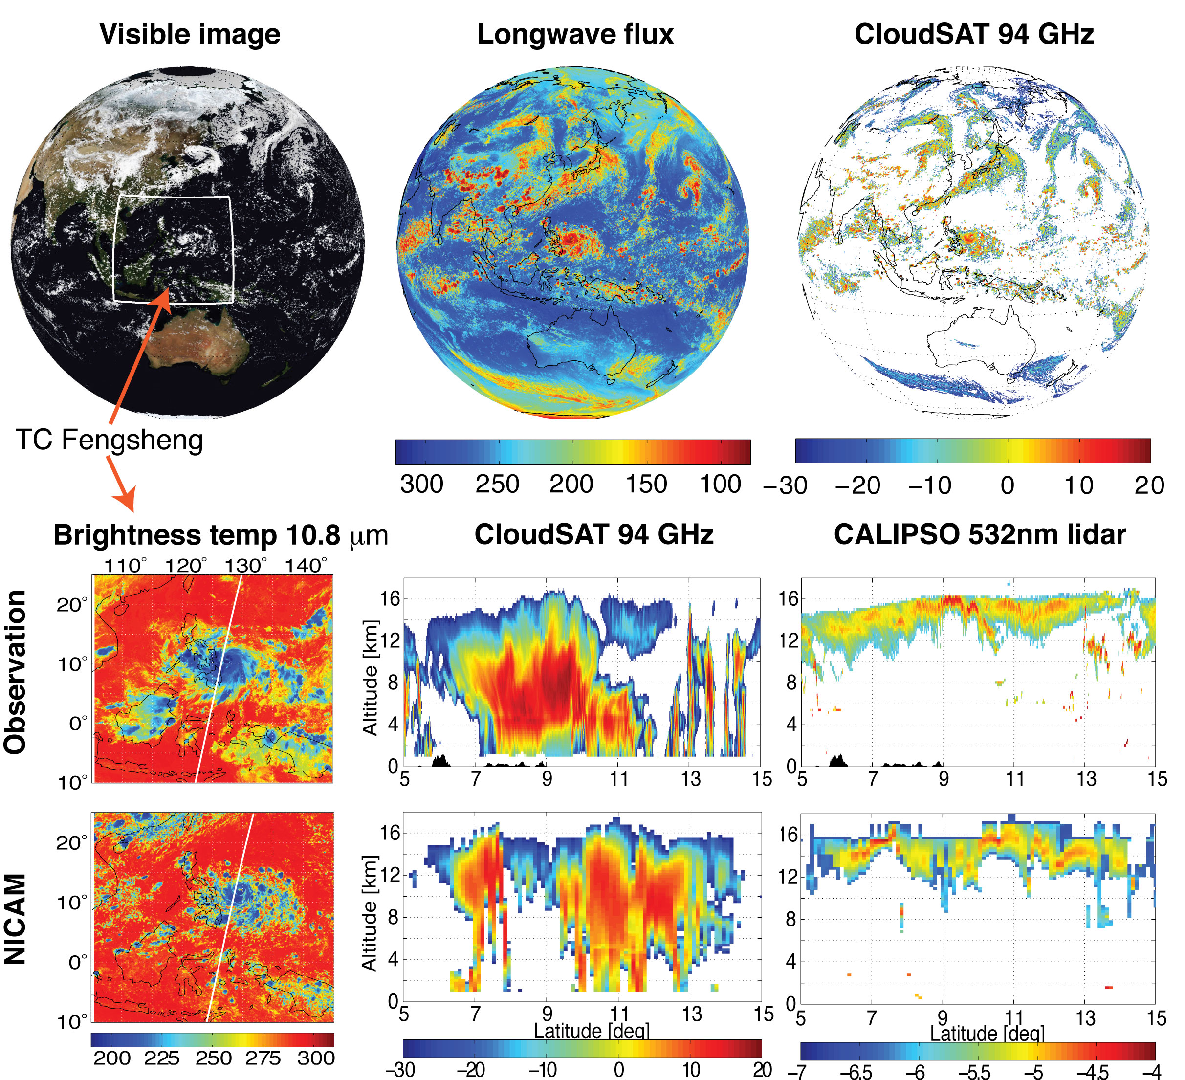
Model activities toward EarthCARE in Japan
NICAM + Joinst Simulator for Satellite Sensors
Illingworth et al. (2015,BAMS): Global simulation by the 3.5-km-gridded NICAM model: (top) simulated visible radiances, TOA upward
longwave flux (W m–2), and 94-GHz CPR signal (dBZ) on 18 Jun 2008.
(bottom) Regional segments of observed and simulated brightness temperature at 10.8 μm (K) with a Tropical Cyclone Fengsheng and height-distant cross sections for CPR (dBZ) and lidar (log10 of 1 m^{–1} sr^{–1}) signals along the CloudSat orbit (white line) on 18 Jun 2008. The observed brightness temperature was taken from Himawari.

Slide 11
EarthCARE L1 Simulations
MSI
CPR
ATLID
Satoh, M., Roh, W., Hashino, T. (2016)
Evaluations of clouds and precipitations in NICAM using the Joint Simulator for Satellite Sensors.
CGER's Supercomputer Monograph Report. Vol. 22, 110 pp, ISSN 1341-4356, CGER-I127-2016.

Slide 12
Model Evaluation by satellite observation
Traditional ISCCP evaluation
NICAM with COSP
Kodama et al. (2012, JGRA)

Slide 13
Evaluation and improvement
NICAM with COSP
Kodama et al. (2012, JGRA)
CALIPSO Cloud Fraction JJA [%]
CloudSat Cloud Fraction JJA [%]

Slide 14
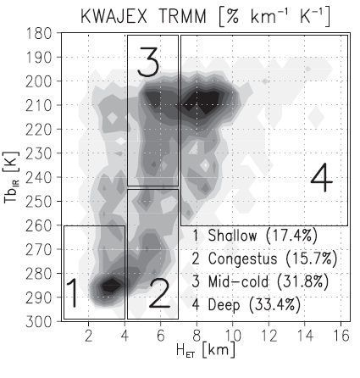
Evaluation and improvement
T3TEF: Tropical Rainfall Measuring Mission (TRMM) Triple-Sensor Three-Step Evaluation Framework (Matsui et al. 2009, JTECH, DOI:10.1175/2008JTECHA1168.1)
Joint infrared brightness temperature (TbIR) and radar echo-top height (HET) diagrams
Cumulative probability distributions of polarization-corrected TMI brightness temperature at 85 GHz
(PCTb85; circles, shallow; squares, congestus; diamonds, midcold; and triangles, deep)

Slide 15
Evaluation and improvement
Evaluation of NICAM by T3TEF
NICAM with COSP
Roh and Satoh (2014, JAS)
Now used as “Roh scheme” in NICAM
Improved!
Improved!

Slide 16
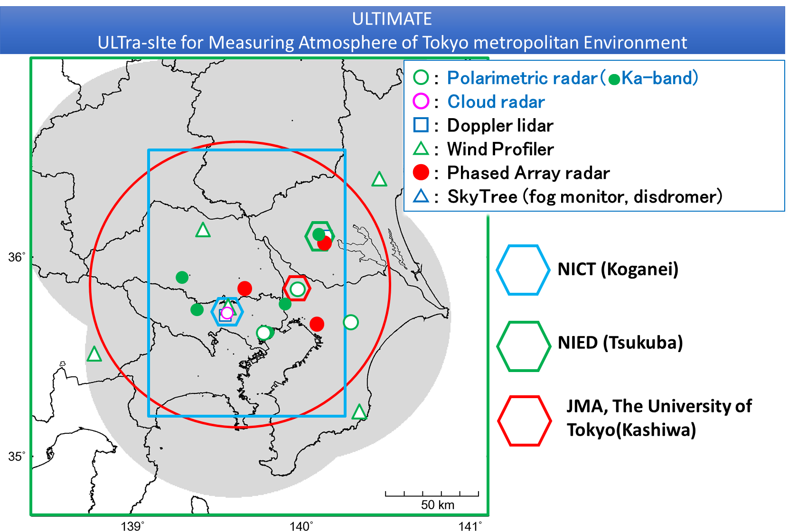
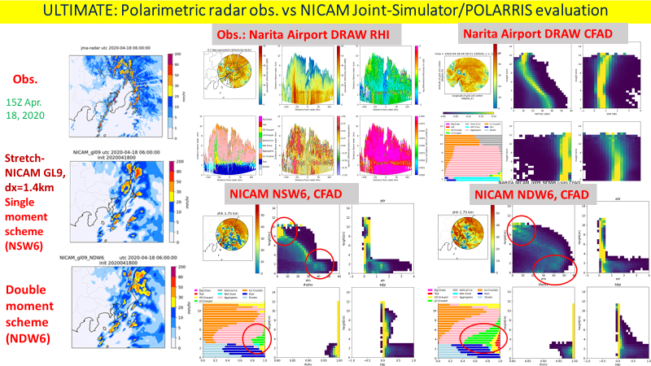
Evaluation and improvement of ground observation
ULTIMATE: ULTra-sIte for Measuring Atmosphere of Tokyo metropolitan Environment
Satoh et al. (2022, in prep.)
Courtesy of Shuuhei Matsugishi (AORI)

Slide 17
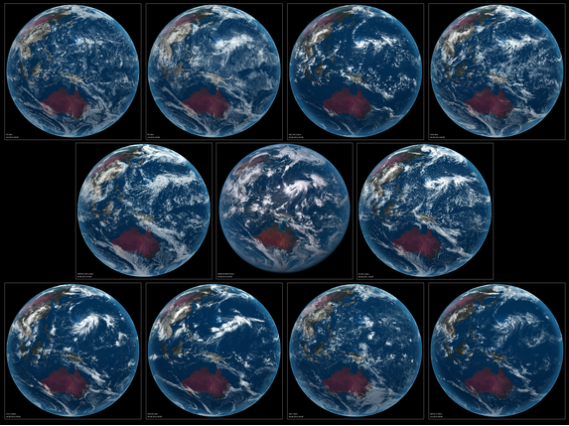
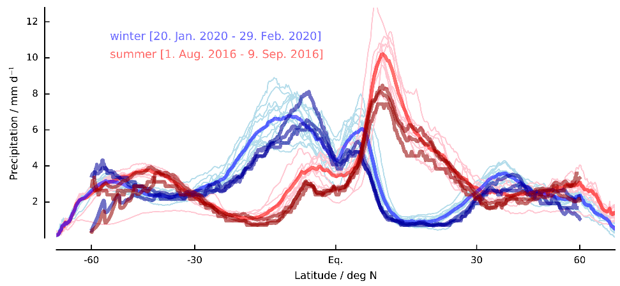
Global Storm Resolving Models, status
DYAMOND: DYnamics of the Atmospheric general circulation Modeled On Non-hydrostatic Domains
The first inter-comparison of global storm resolving models (less than 5 km).
DYAMOND summer simulations: 40 days integration: 1 August – 20 September 2016
  Atmosphere-only, AO-coupled model
DKRZ and ESiWACE provide support and space of data storage
  https://www.esiwace.eu/services/dyamond
DYAMOND winter simulations: 40 days integration: 20 January – 1 March 2020
  Atmosphere-only, AO-coupled model, coordination with EUREC4A
DYAMOND-Next under consideration: e.g. 30 years AO-coupled model experiments
  Coordination with Digital Earths
(Judt et al. 2021, JMSJ)
Robustness and Uncertainties of the DYAMOND results
All models look good cloud distribution compared to Himawari, OLR, and precipitation.
Meso-scale structure captured globally (Arnold et al. 2020)
However, a lot of variability exists for vertical structure of clouds.
Tropical cyclones statistics are within similar range, but very different structure (Judt et al. 2021)
Cloud evaluations using various observations are on-going (Roh and Satoh, 2021)
(Courtesy of T. Miyakawa & D. Klocke)
DYAMOND summary paper: Stevens et al.(2019, PEPS)
DYAMOND Special edition: J. Meteor. Soc. Japan

Slide 18
OLR on 11 August 2016
Net Shortwave Outgoing Radiation on 11 August 2016
The domain averaged OLR is relatively similar across the models
The NSR shows large differences among the models.
Vertical profiles of hydrometeors are divergent.
Roh, W., Satoh, M., Hohenegger, C. (2021, JMSJ)

Slide 19
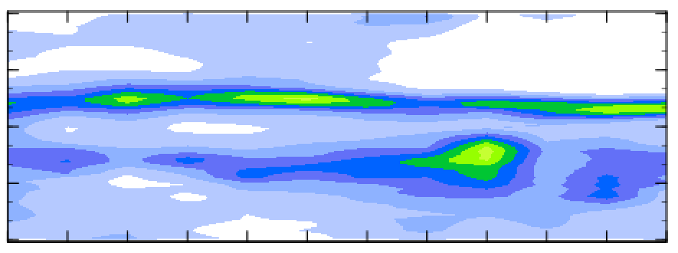
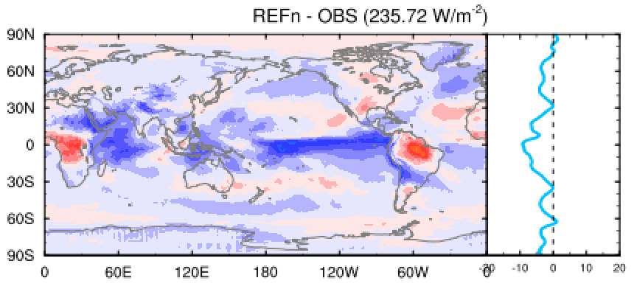
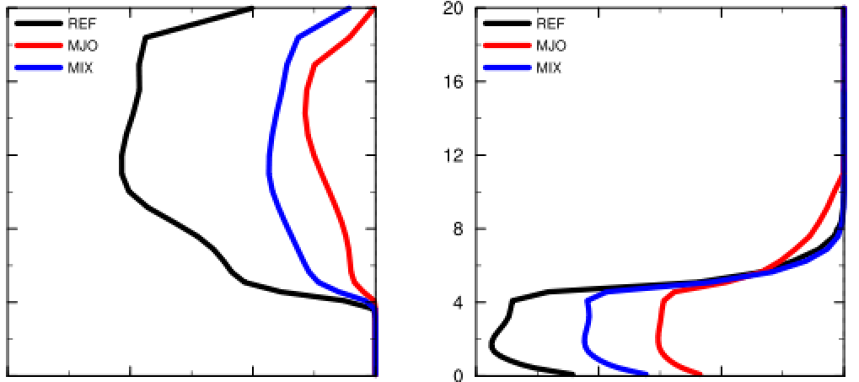
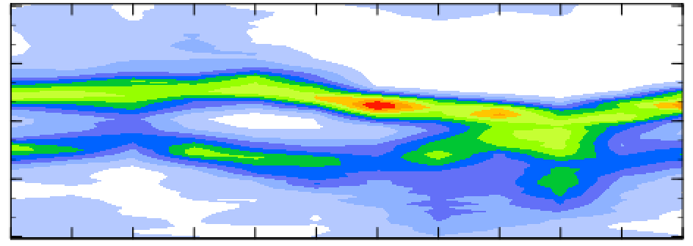
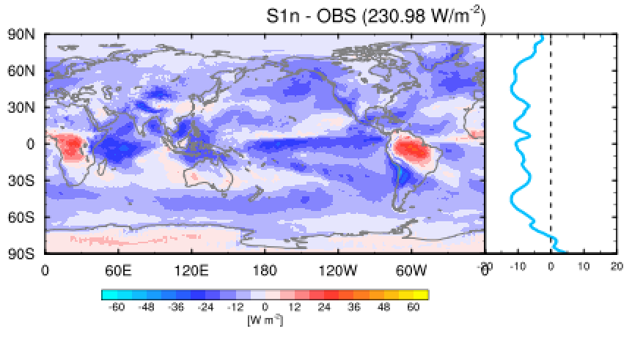
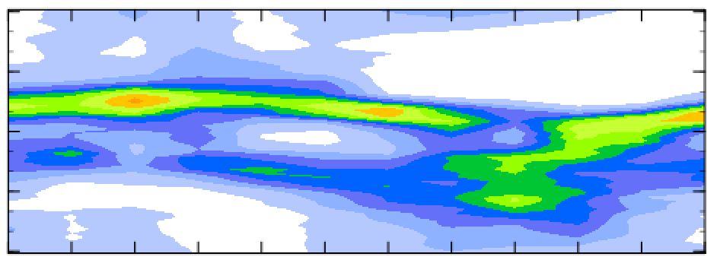
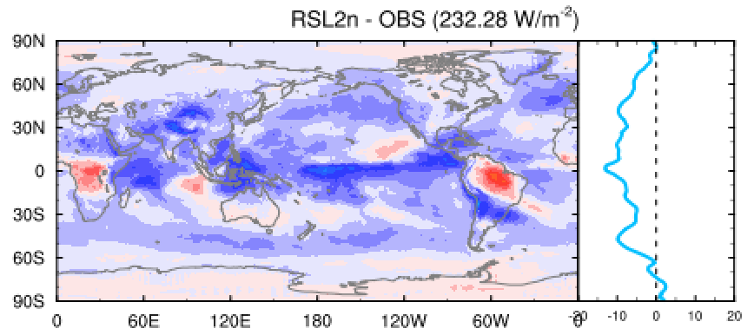
NICAM sensitivity to cloud microphysics parameters
Parameters evaluated by satellite observation are not necessarily best in performance.
Compensation of errors?
Missing processes?
Intermediate characteristics b/w MIP & MJO would be preferable.
• Retuning of the terminal velocity of snow and rain & Dropped cld. ice
• Introduction of qv, qc, qi diffusion in the vicinity of convection
Introduction of “Leonard term” (= Additional turbulent flux) for qv, qc, qi
(cf. Moeng et al. 2011)
Precipitation (160-220E)
OLR bias
30N
Vt_Snow
Vt_Rain
15N
20
20
EQ
16
MJO
16
15S
MIP
NEW
TRMM
12
12
30S
Height [km]
30N
8
8
NEW
15N
MIP
MIP
4
4
EQ
MJO
15S
0
0
[m/s]
30S
MIP
MJO
-1.5
-1.0
-0.5
0
-3.0
-2.0
-1.0
0
Two standard settings of NICAM NSW6
: MIP (Roh scheme) & MJO (Miura scheme)
30N
15N
EQ
Courtesy of Daisuke Takasuka (JAMSTEC)
15S
NEW
30S
NEW
J
J
A
S
O
N
D
J
F
M
A
M

Slide 20
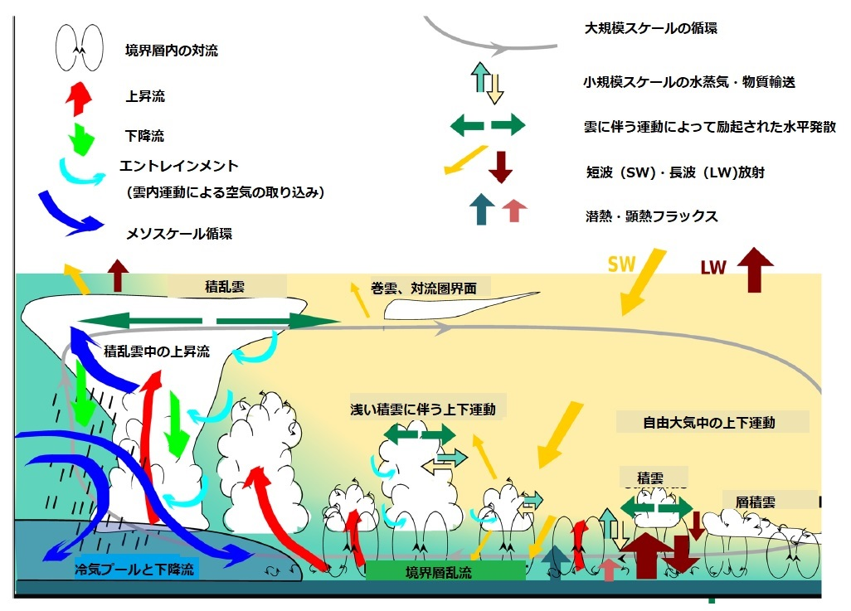
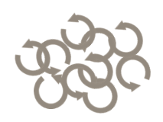
Global view of atmospheric vertical motions
Large-scale scale circulation
Convection in the boundary layer
Water vapor and mass transport on a small scale
rising tide
downward flow
Horizontal divergence associated with clouds
entrainment
(Air intake by clouds)
Shortwave (SW) and longwave (LW) radiation
Latent heat and sensible heat flux
mesoscale circulation
cumulonimbus
cirrus, tropopause
tropopause folding/isentropic meandaring
clear-air turbulence
Upwelling in clouds
gravity waves
vertical motion
associated with shallow cumulus clouds
vertical motion
in the free atmosphere
cumulus clouds
stratocumulus
Cold air pool and downdraft
boundary layer turbulence
high latitudes
equator

Slide 21
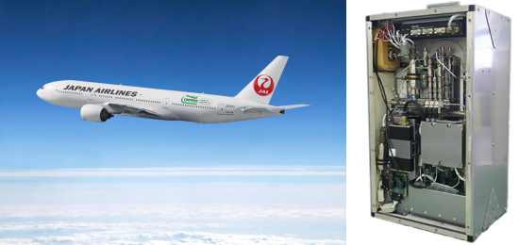
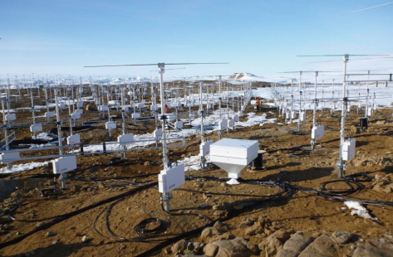
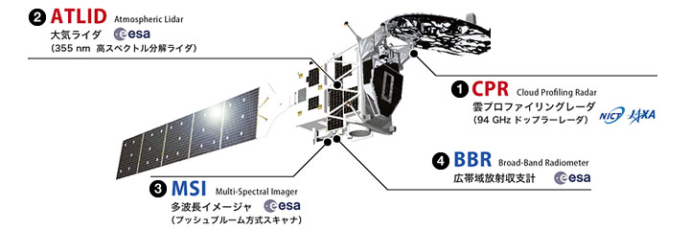
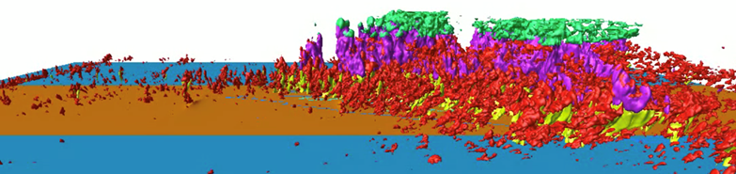
Aircraft and balloon observations
Satellite observation
Large atmospheric radar network
material transports
(CO₂, Radon)
vertical motion of
cloud and precipitation particles
Theories
PANSY Antarctica Atmospheric Radar
Vertical wind
global high-resolution integrated data
EarthCARE
Local - Global
Observation - Model
Ground observation networks
synoptic systems, tropical cyclones, tropopause folding
O(10km) global reanalysis data
convection, gravity waves, turbulence
O(1km) mesh
global storm resolving simulations
Global high-resolution model analysis
Local high-resolution model analysis
O(100m) mesh
Global LES Experiment
O(10m) mesh LES
Meso-scale, extreme weather, severe convective systems, etc.

Slide 22
Summary
EarthCARE launch: September 2023
Start considering the use of EathCARE data for model collaborations
We will hold a follow-up workshop around one year from now (~Feb. 2023)
Model activities toward EarthCARE in Japan
  L1, assimilations
  Similar activity is being considered for post-GPM (2028-)
Model Evaluations and improvements
  Methodology, metrics
  To consider use of CPR Doppler velocity data
Model sensitivity to cloud microphysics
  GSRMs sensitive to cloud microphysics parameters/schemes
  How cloud microphysics affect circulations and climate sensitivity
  Also, sensitivity of GCMs to convective parameterization
Global view of atmospheric vertical motions as a new direction of science
  Synthetic studies using various observations, high-resolution models, and theoretical studies

