Slide 1
An evaluation of NICAM using a ground-based 94 GHz Doppler radar over Tokyo
Woosub Roh¹, Masaki Satoh¹, Yuichiro Hagihara², Yuichi Ohno²
AORI, the univ. of Tokyo¹, NICT²,
17th Feb. 2022
EarthCARE modeling workshop 2022

Slide 2
Introduction
Evaluation and improvement of the cloud properties in global non-hydrostatic models are important using satellite data. One of the methods is a radiance-based evaluation using satellite data and a satellite simulator (here Joint simulator, Hashino et al. 2013), which avoids making different settings of the microphysics between retrieval algorithms and NICAM.
The satellite data with active sensors has a limitation to observe the specific case of cloud and precipitation systems. And it is needed to validate satellite observations using in-situ observation. There are intensive observation stations over the Kanto region.
The ULTIMATE (ULTra sIte for Measuring Atmosphere of Tokyo metropolitan Environment) started to verify and improve high resolution numerical simulations based on these observation data last year. The improved simulations will be validate by the EarthCARE.
I introduce the evaluation results of NICAM using a vertical pointing 94 GHz radar in NICT.
I introduce the impact of microphysics on CFADs of Doppler velocity with consideration of errors like the EarthCARE CPR.

Slide 3
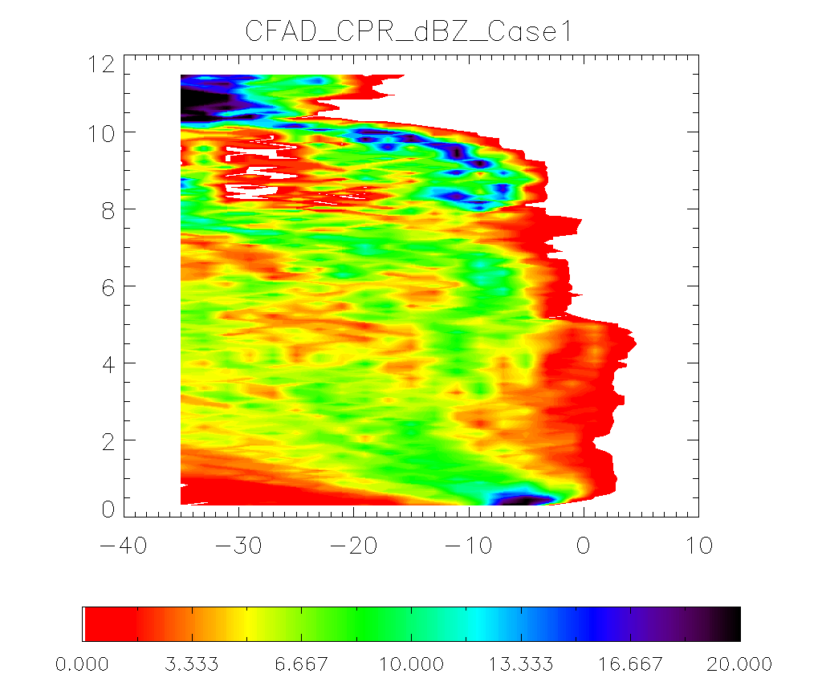
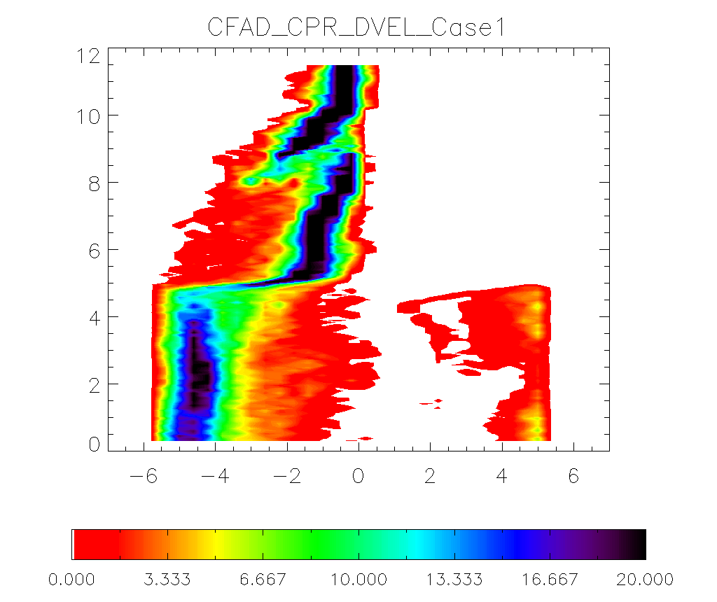
Evaluation using NICT 94 GHz CPR
Case1
NICT
Radar Reflectivity
Doppler velocity
The data is provided in courtesy by NICT Ohno-san and Horie-san.
Underestimation of radar reflectivity because of wet attenuation of CPR observation.
Observed Doppler velocity is reliable.
- CFADs of Doppler velocity shows two modes of Doppler velocity for rain and ice hydrometeors.

Slide 4
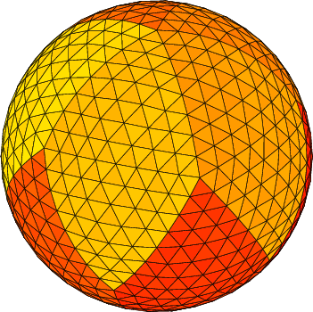
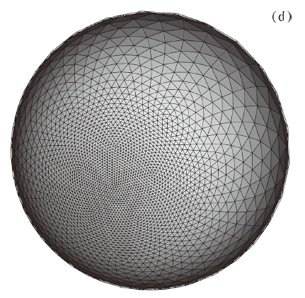
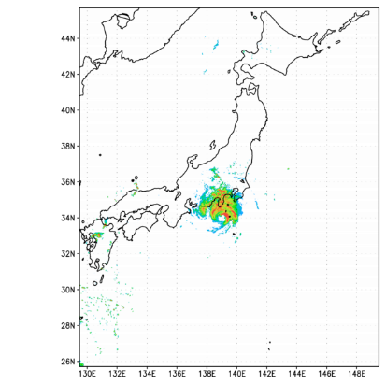
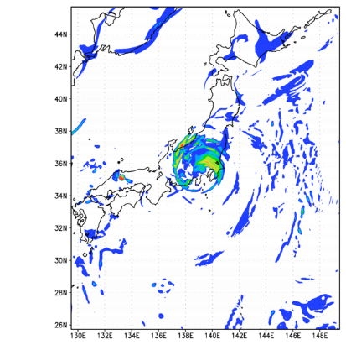
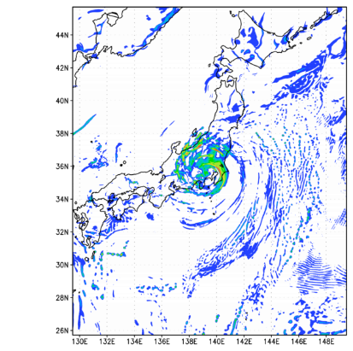
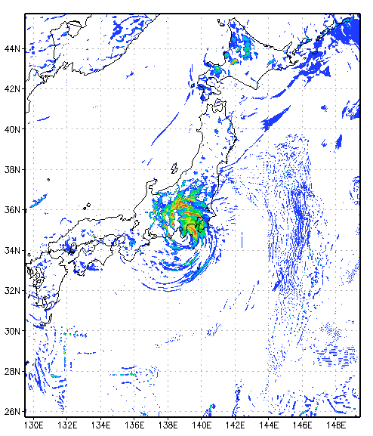
Experiment design
Nonhydrostatic Icosahedral Atmospheric Model
Microphysics scheme : NSW6, NDW6
Stretched grid system
Turbulence scheme : MYNN2
Land surface scheme : MATSIRO scheme
Integration time : 2019. 09. 08. 00UTC – 10. 00UTC
Initial data : NCEP FNL reanalysis data
Horizontal resolution : g-level 8, g-level 9, g-level 10
The minimum resolution: GL8 2.8 km, GL9 1.4 km, GL10, 700 m
Time step : 15s, 5s, 2.5s
Vertical gird number : 80
NICAM GL8 3.5 km
NICAM GL9 1.7 km
NICAM GL10 870 m
JMA-radar

Slide 5
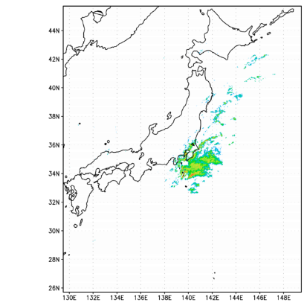
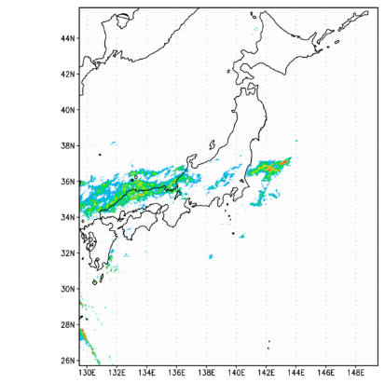
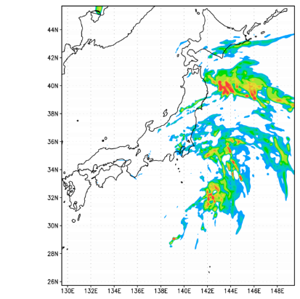
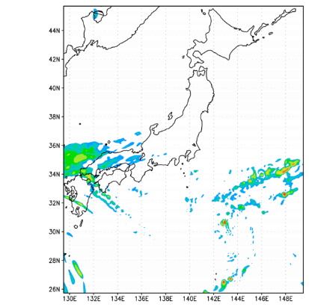
Precipitation distributions of three cases
Case1
(Heavy precip.)
Case2
(medium precip.)
Case3
(weak precip.)
OBS.
NICAM

Slide 6
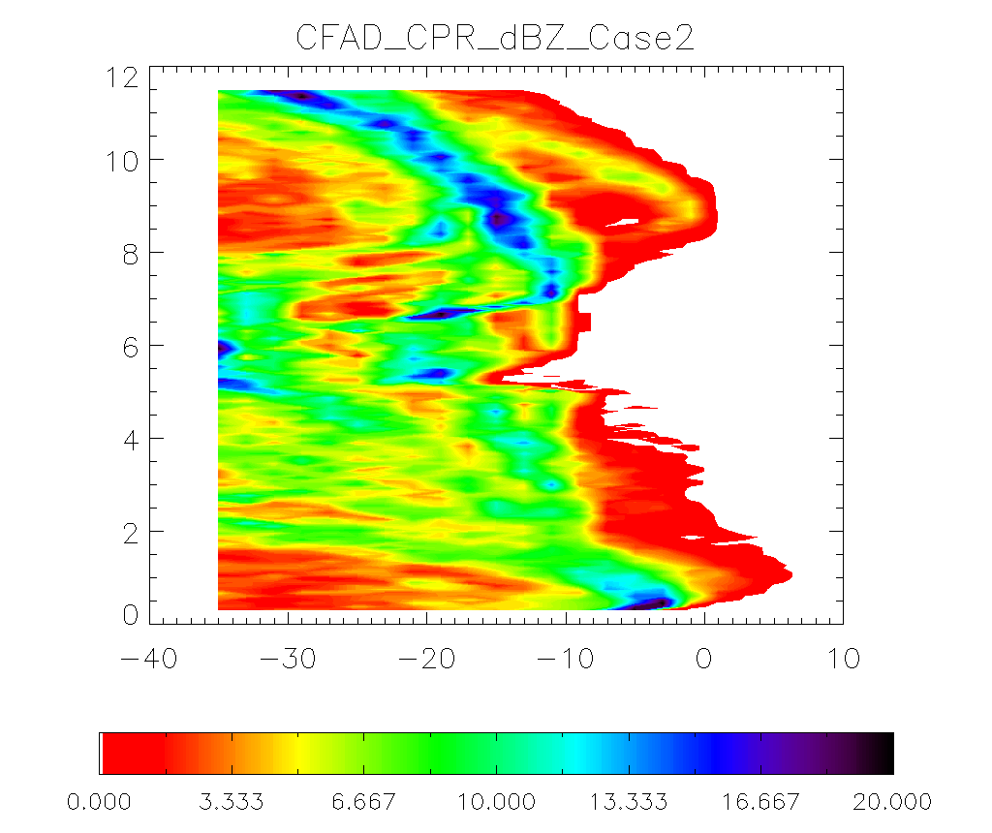
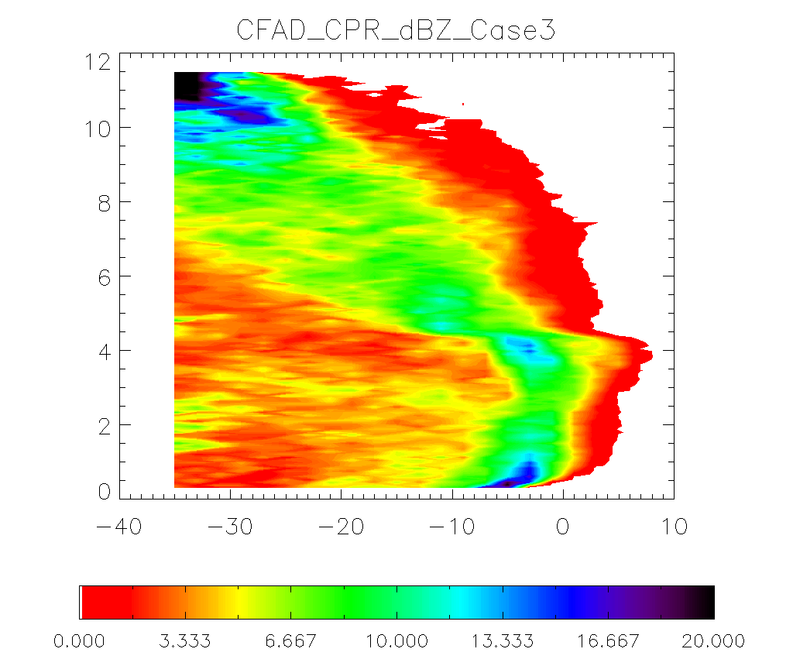
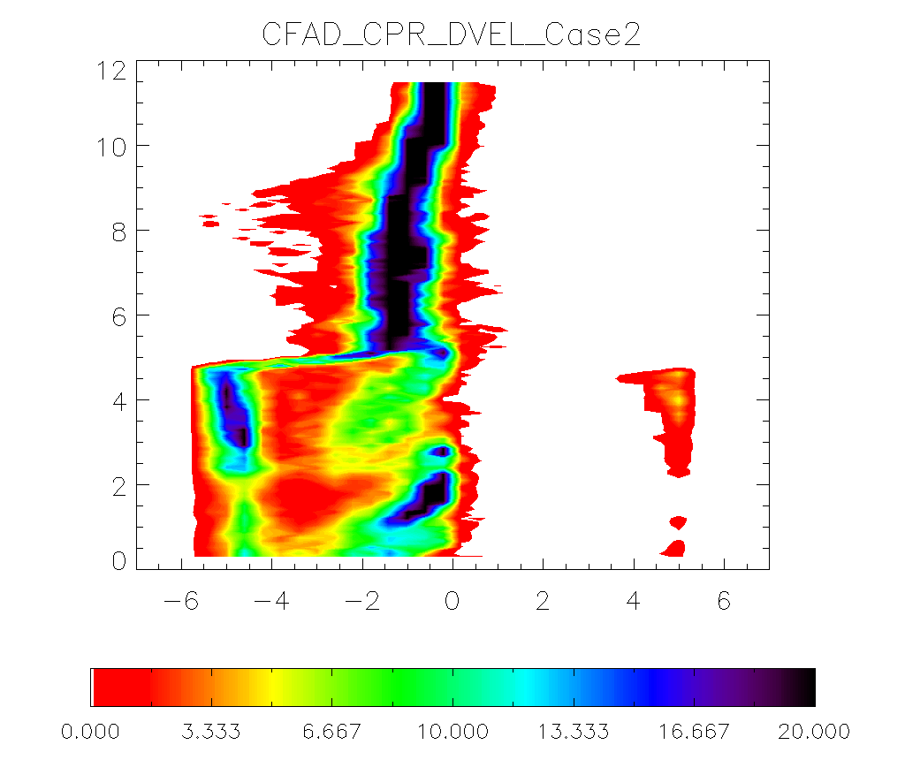
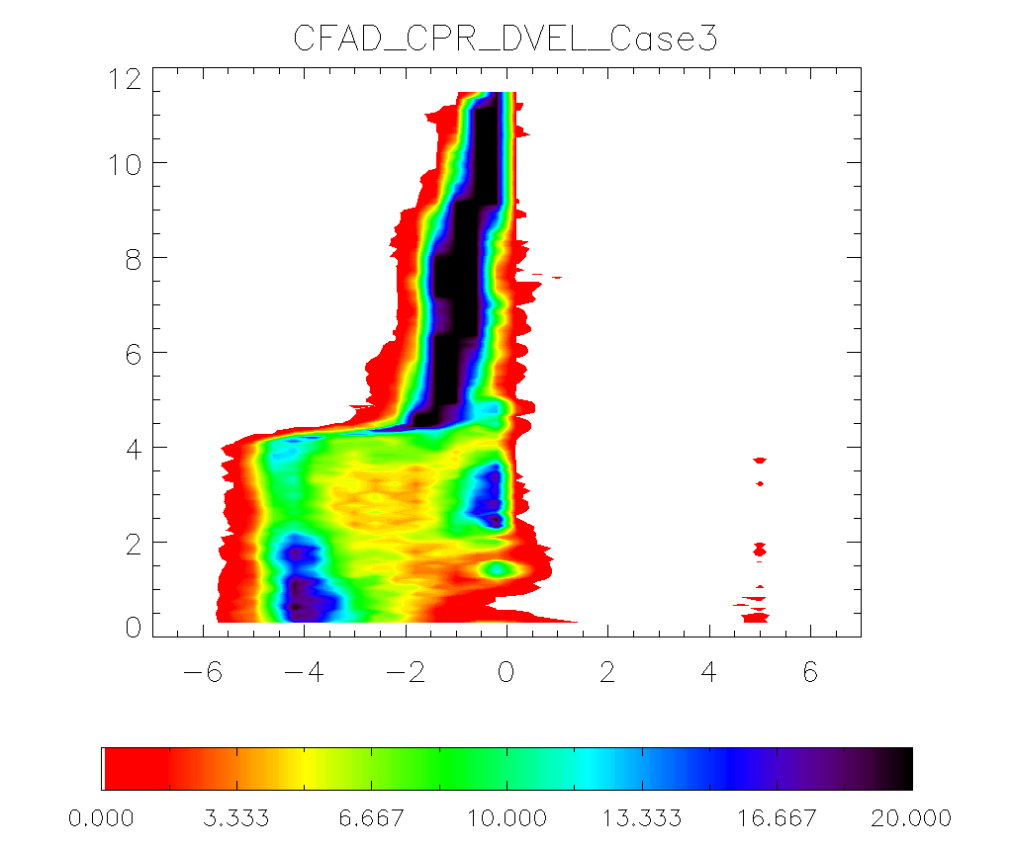
Observed CFADs of dBZ and Doppler velocity for three cases
Case1
(Heavy precip.)
Case2
(medium precip.)
Case3
(weak precip.)

Slide 7
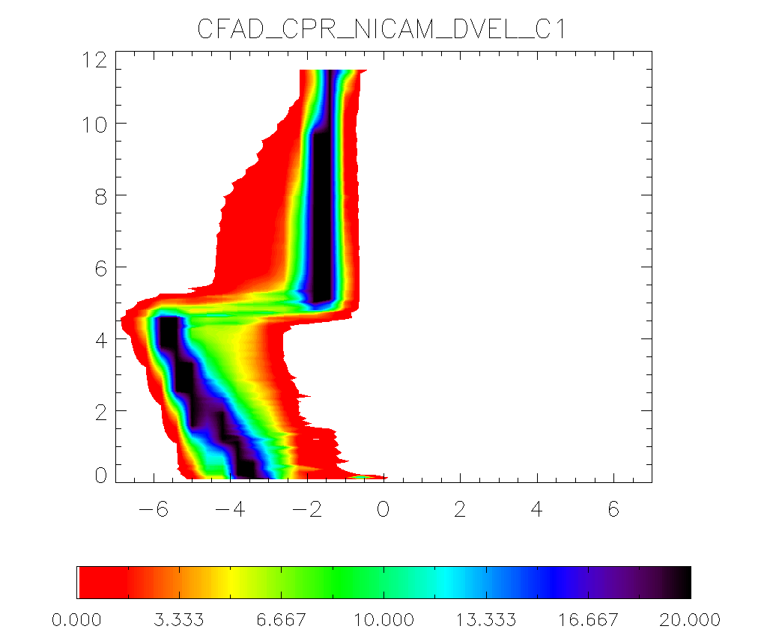
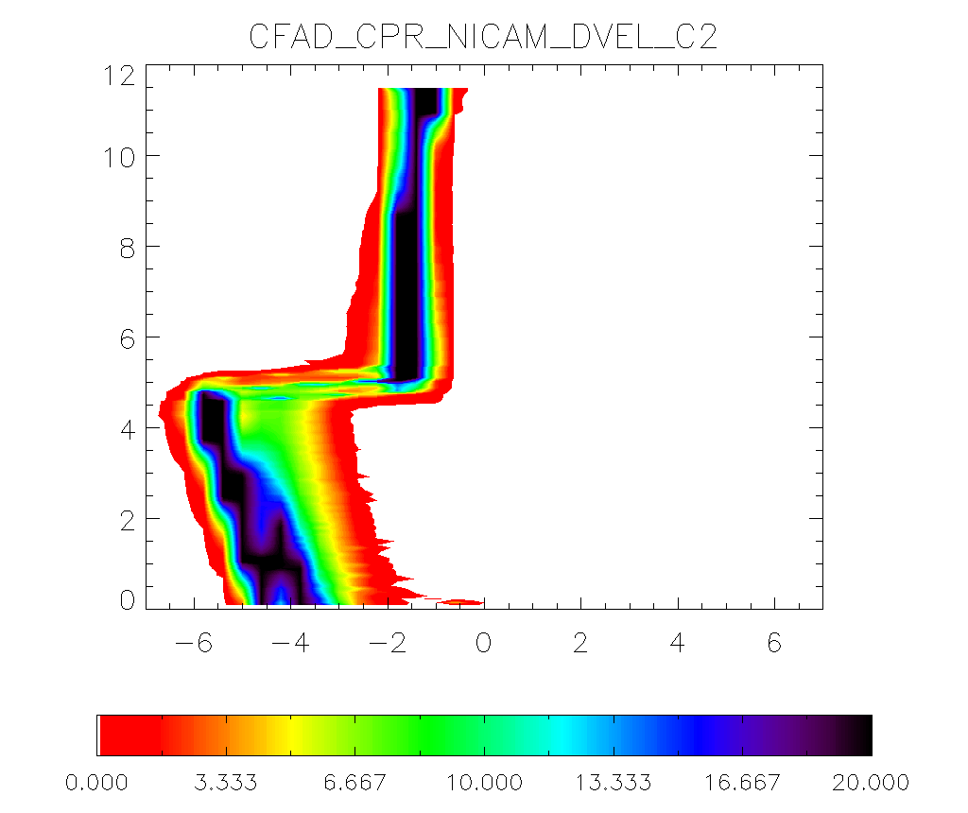
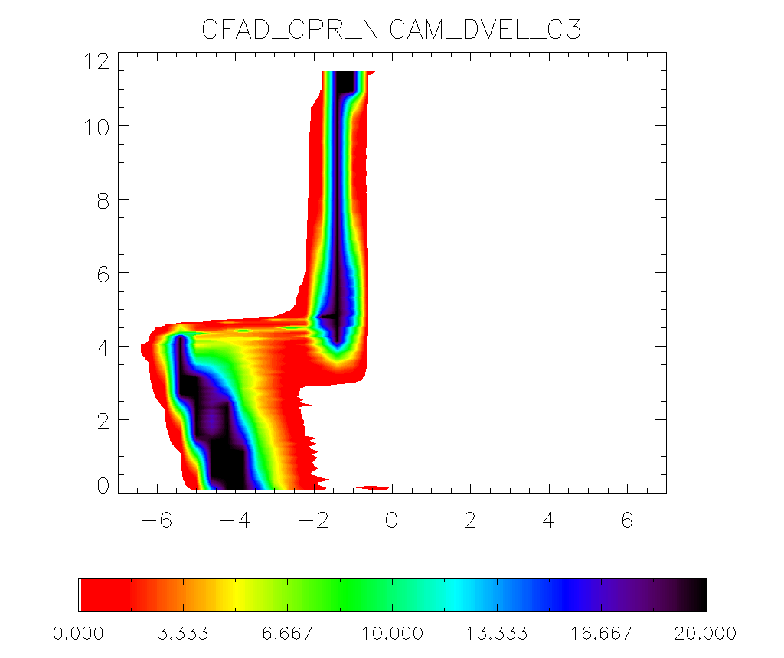
CFADs of Doppler velocity between observation and NICAM
Case1
(Heavy precip.)
Case2
(medium precip.)
Case3
(weak precip.)
NICT
NICAM

Slide 8
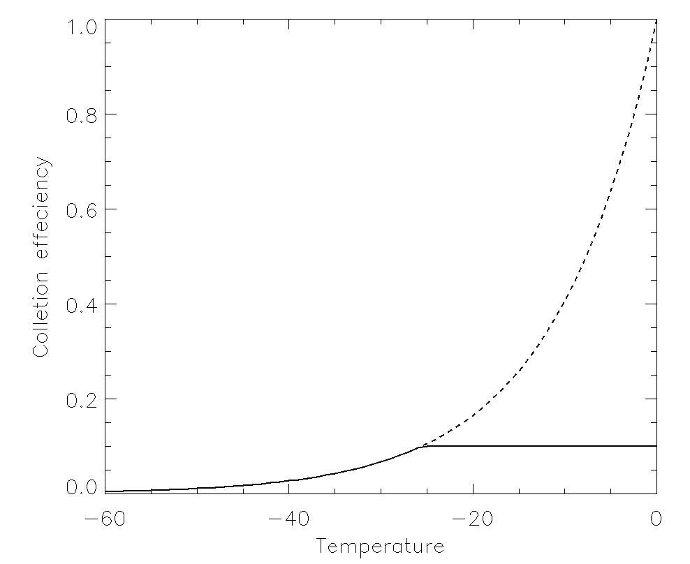
The sensitivity tests of NSW6 about the process of graupel
Increases of graupel size
Increases of graupel amount
N(D)
N0_{G}
D
N(D)=N0_{G}*exp(-λ*D)
Decrease of N0_{G}
N0_{G} = 4.0E8 → 4.0E7 → 4.0E6
Accretion rate of snow by graupel
Maximum collection efficiency (Egs)
Egs = 0 → 0.1 (solid) → 1 (dotted)

Slide 9
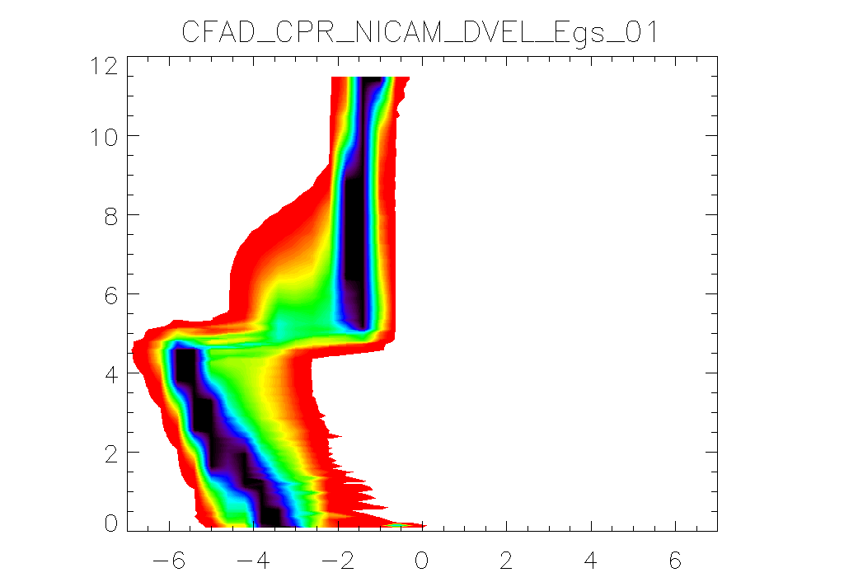
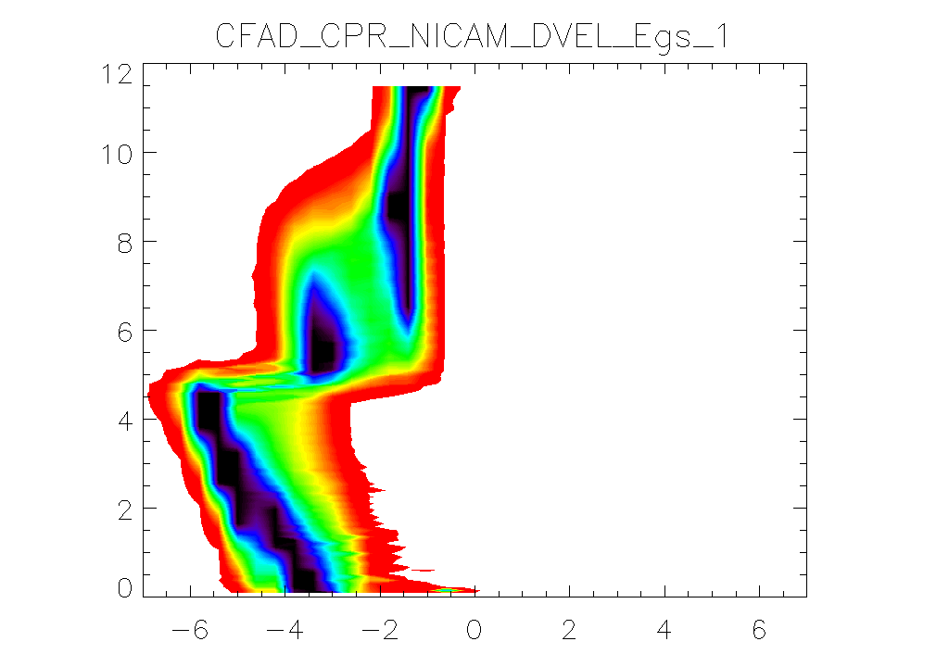
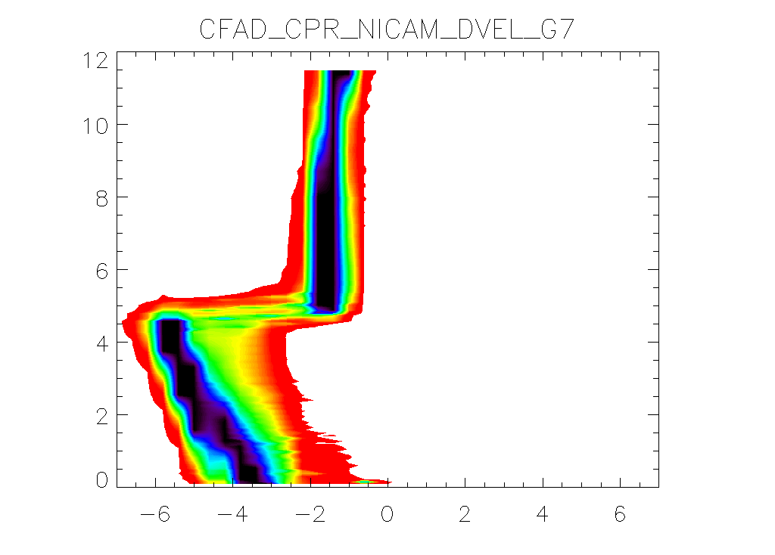
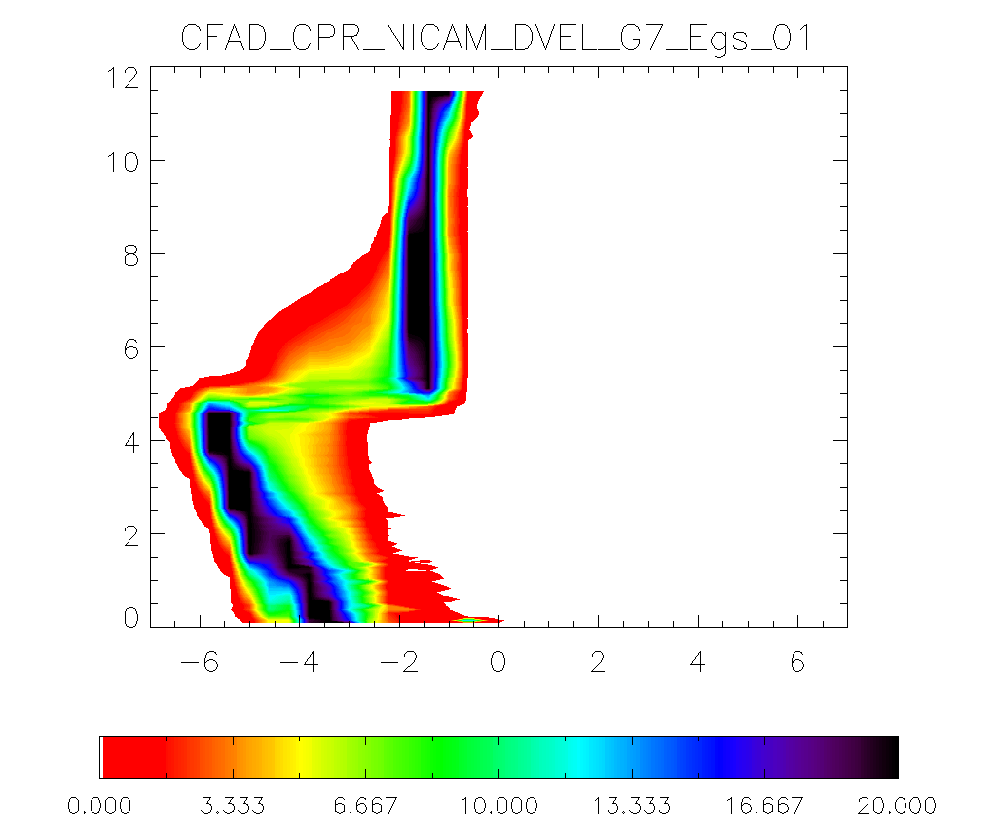
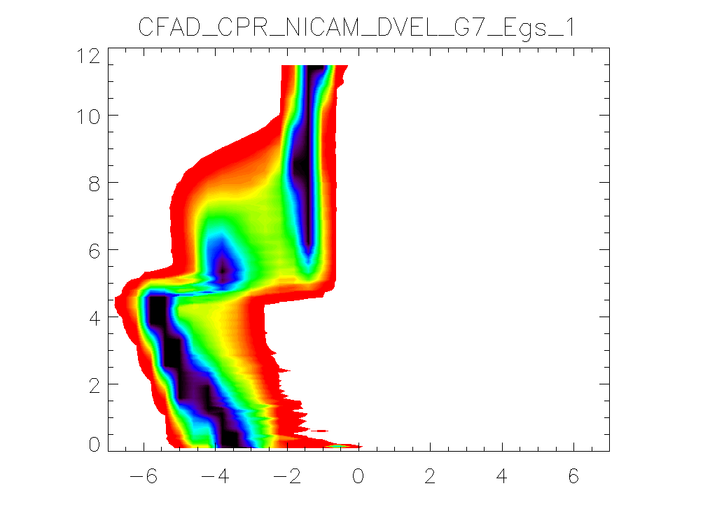
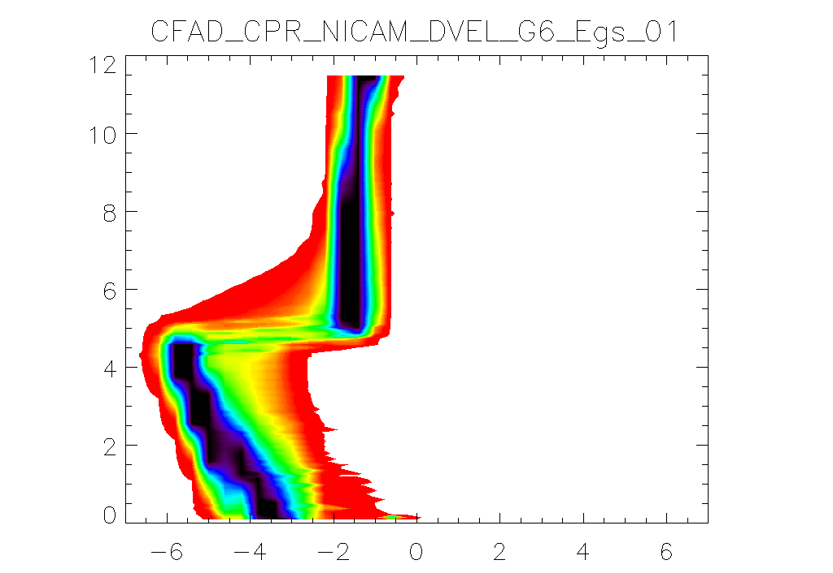
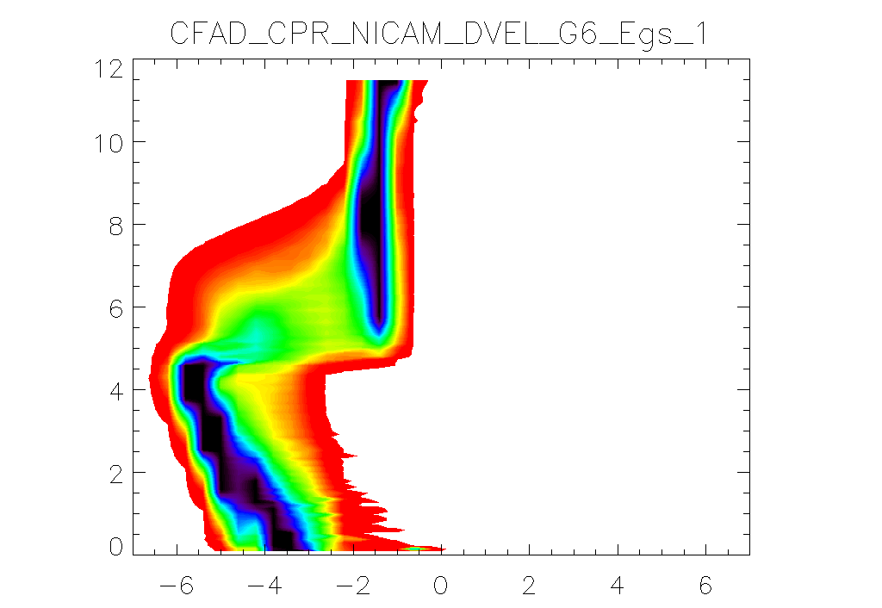
Increases of graupel amount
Egs = 0
Egs = 0.1
Egs = 1.0
N0_{G} = 4.0E8
Increases of graupel size
N0_{G} = 4.0E7
N0_{G} = 4.0E6

Slide 10
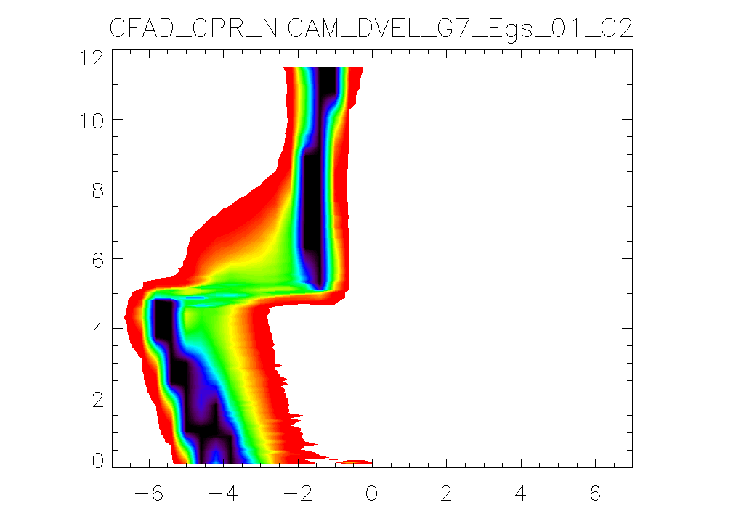
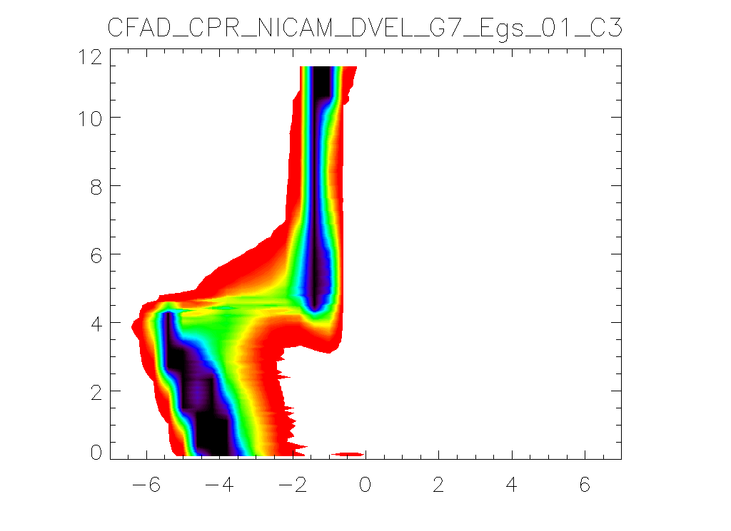
Application to other cases using the tunning of graupel
Case1
(Heavy precip.)
Case2
(medium precip.)
Case3
(weak precip.)
NICT
CON
Increases of graupel fraction

Slide 11
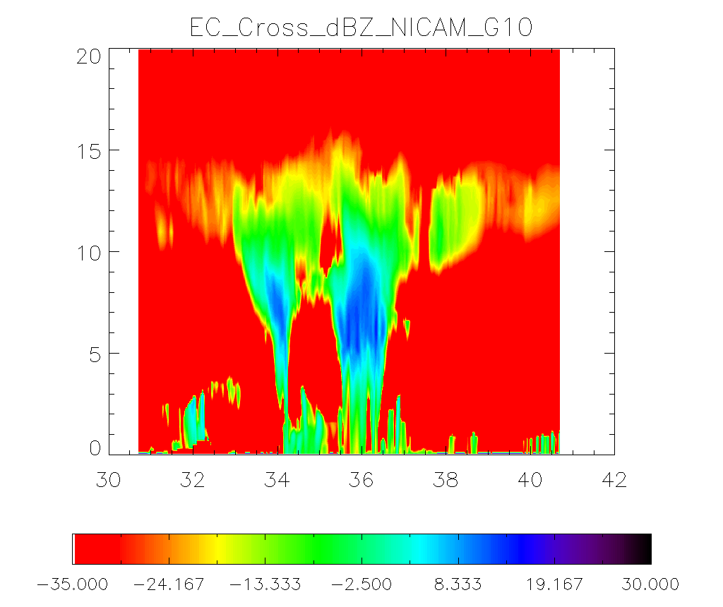
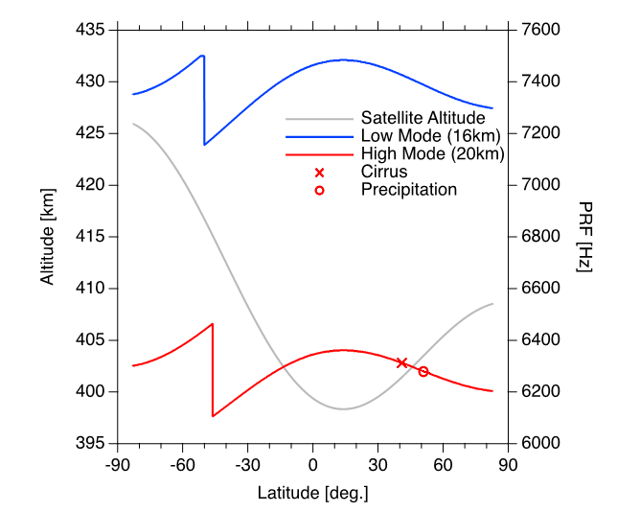
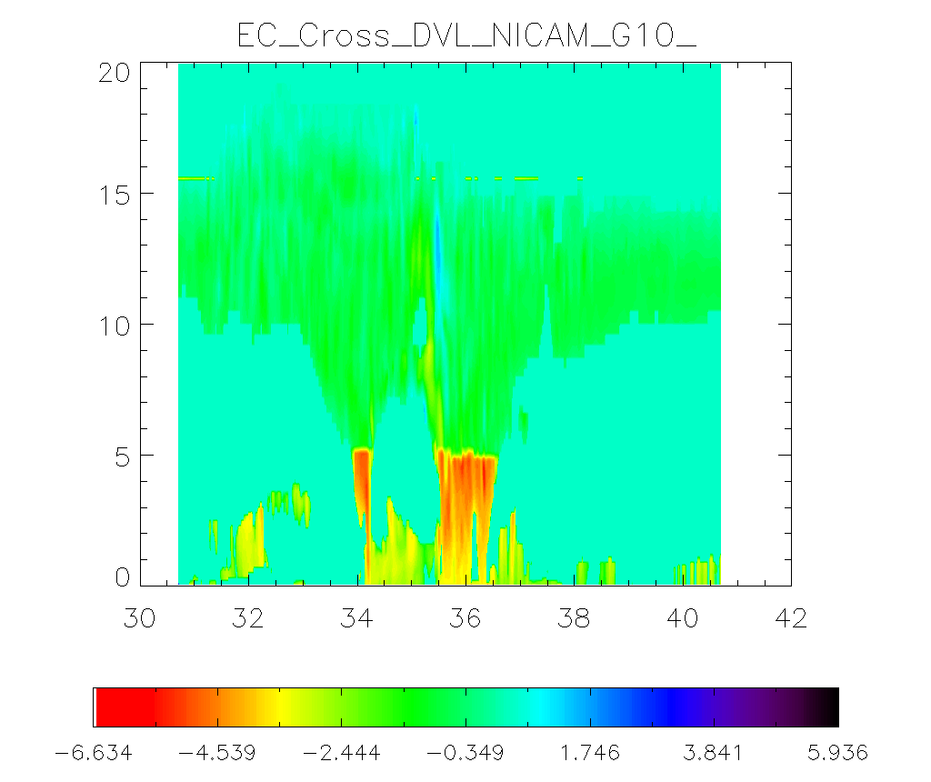
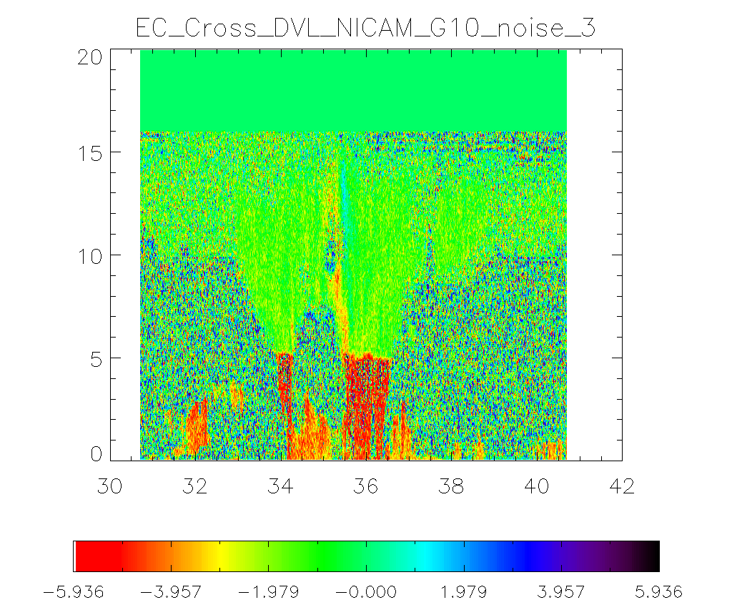
The simulation results with Doppler errors like EarthCARE CPR using J-SIM
Radar reflectivity
Hagihara et al. 2022
Without errors
Low mode (16km)
High mode (20km)
Notes:
TC Faxai NICAM 800m

Slide 12
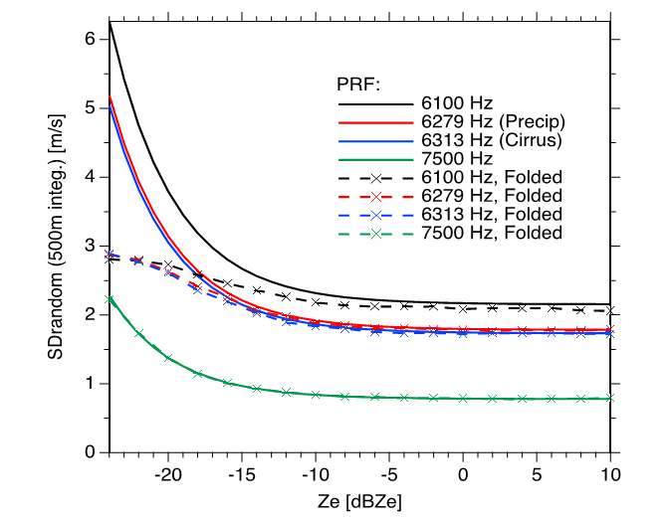
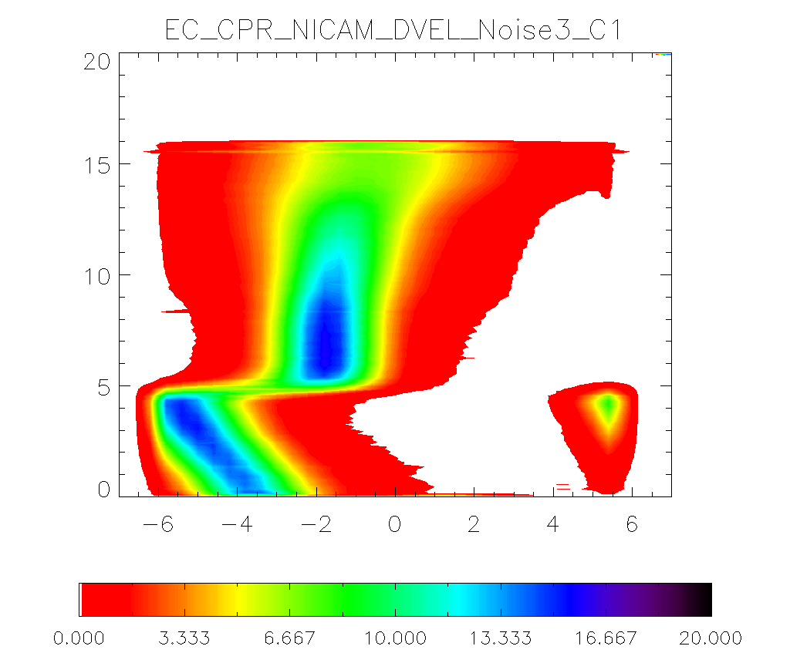
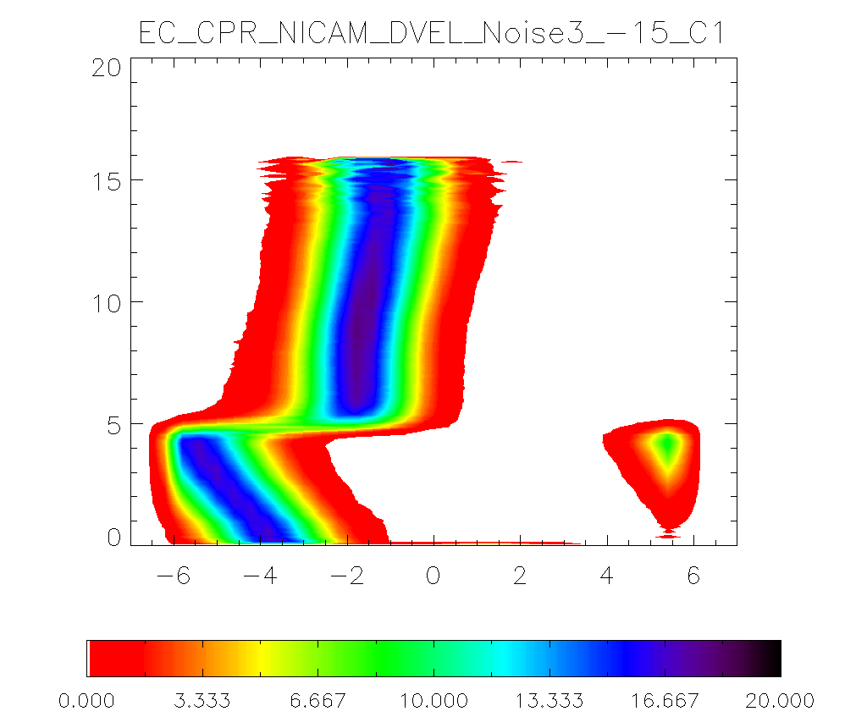
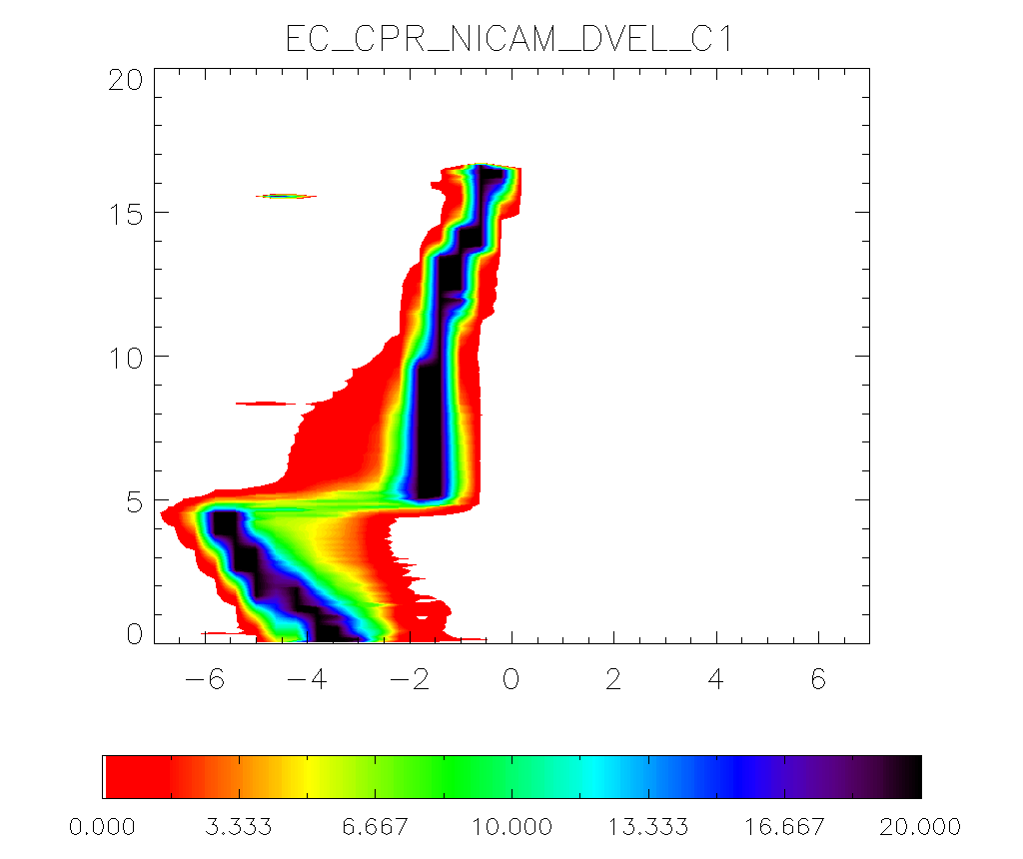
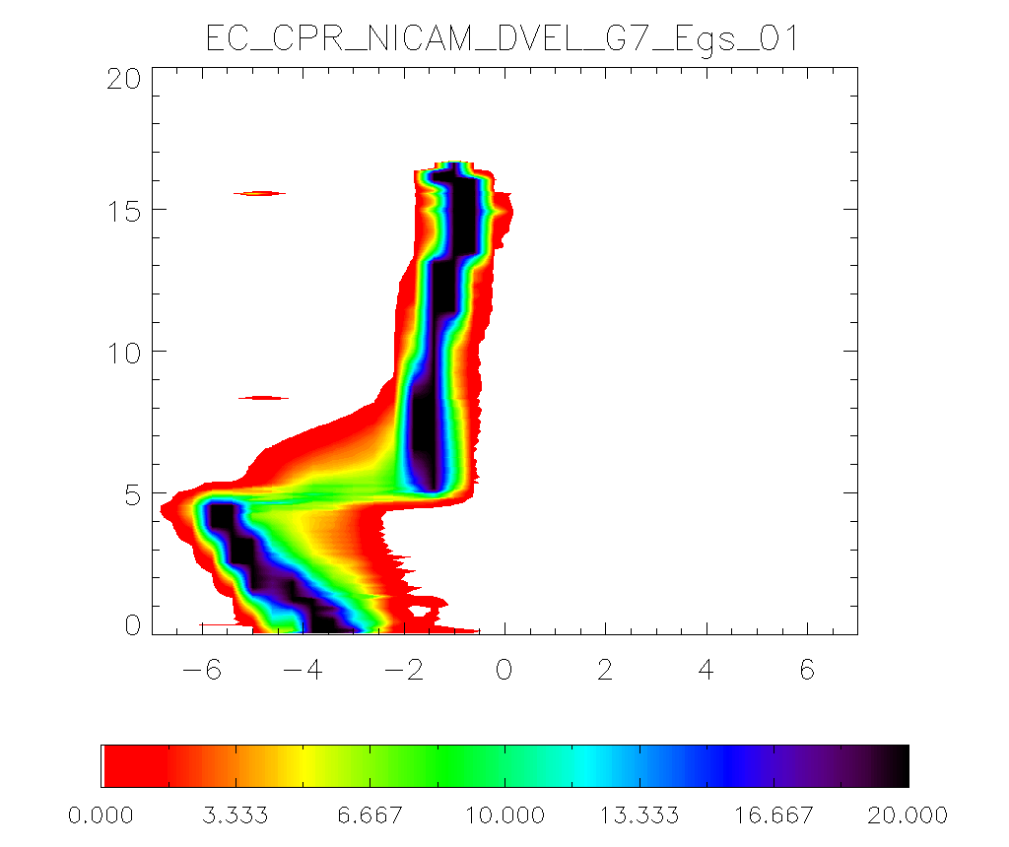
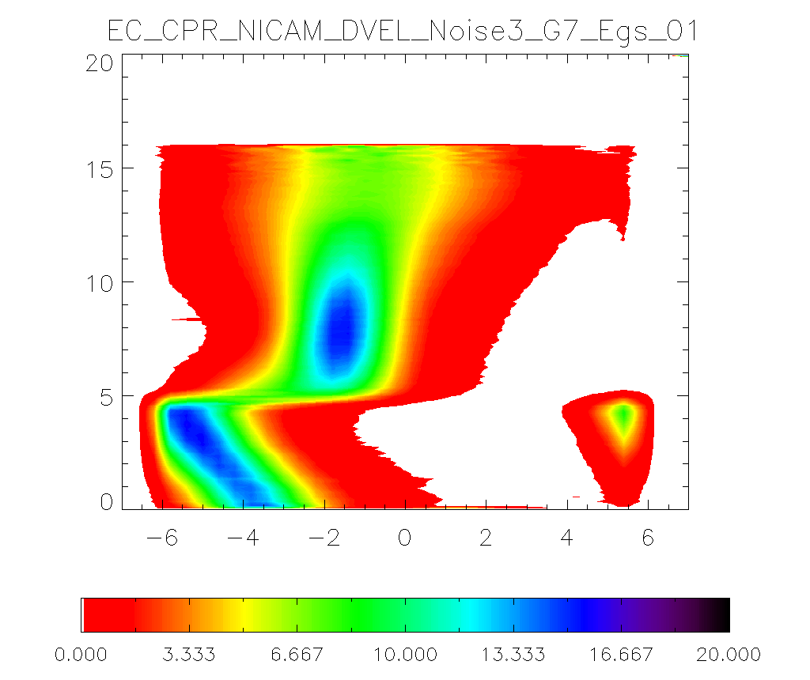
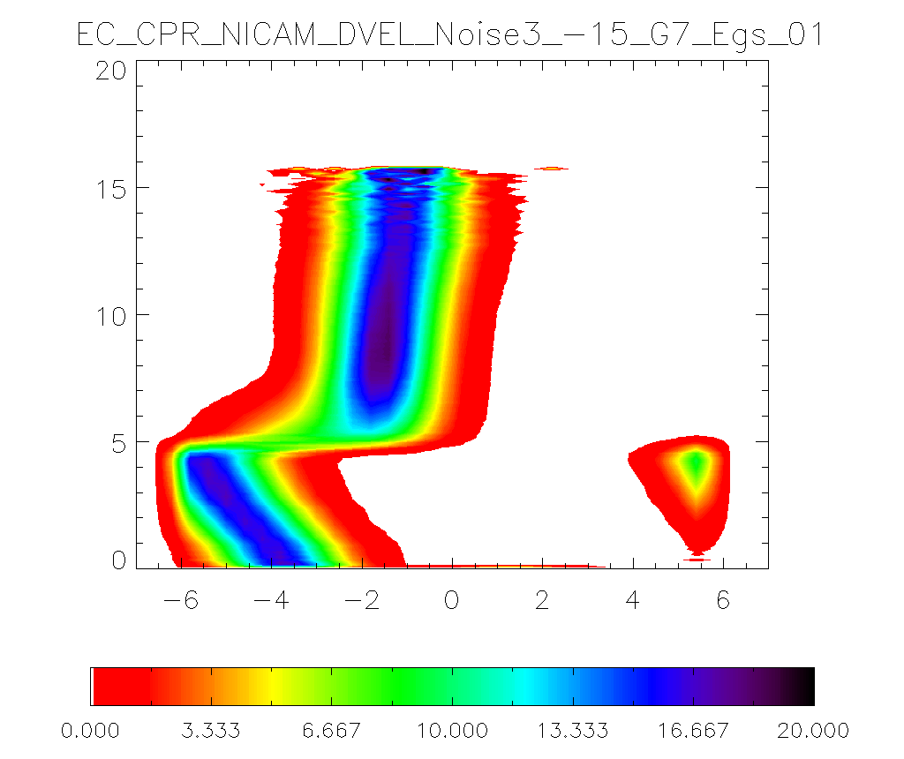
Tests using simulated Doppler velocity like ECARE CPR (Low mode) for Case 1
Without errors
(dBZ > -36.)
With errors
(dBZ > -36.)
With errors
(dBZ > -15.)
CON
Increases of graupel fraction
Hagihara et al. 2022

Slide 13
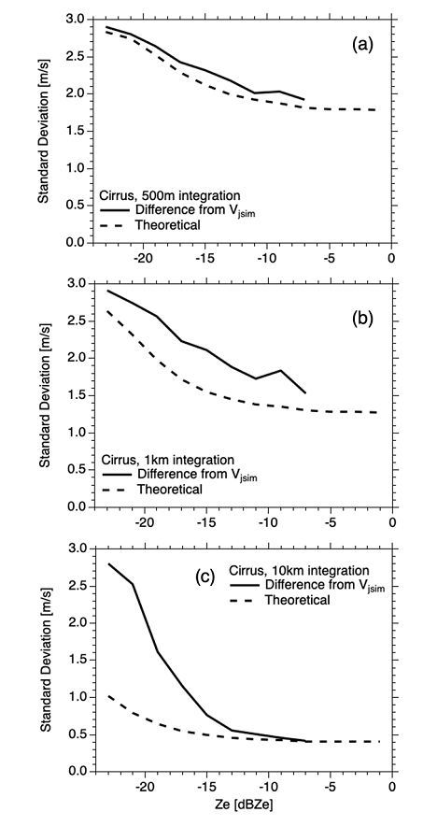
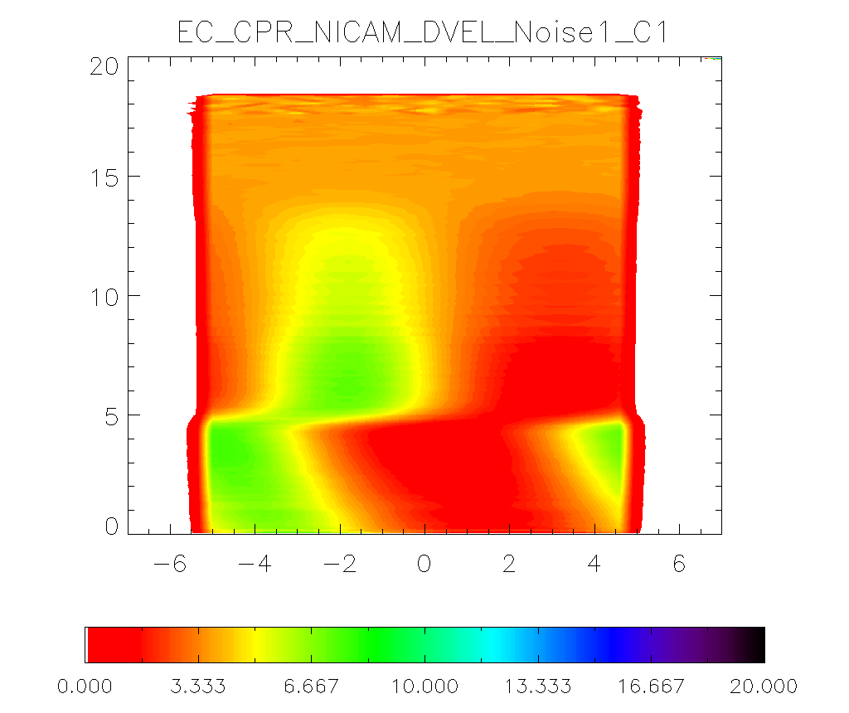
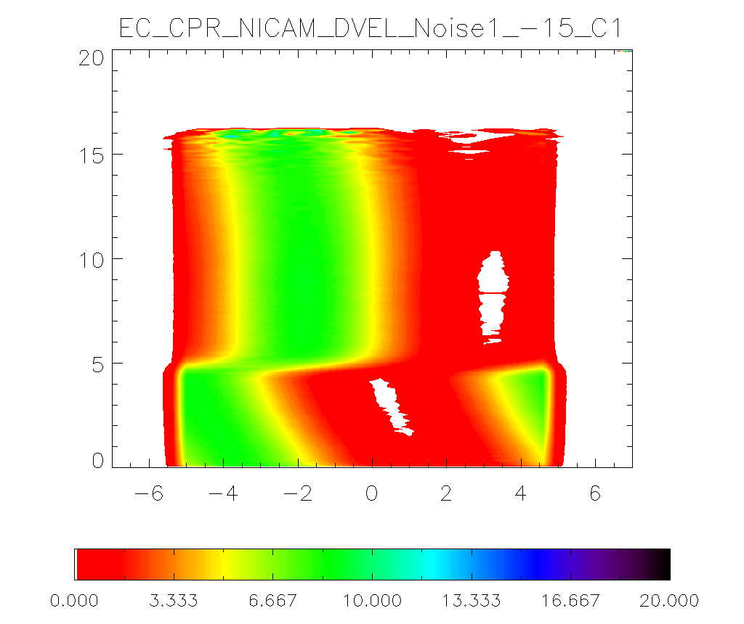
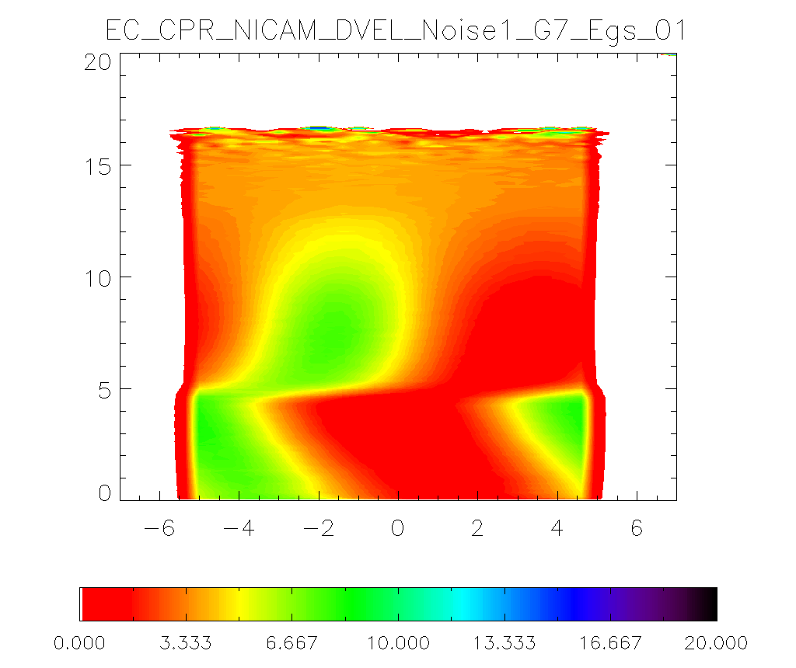
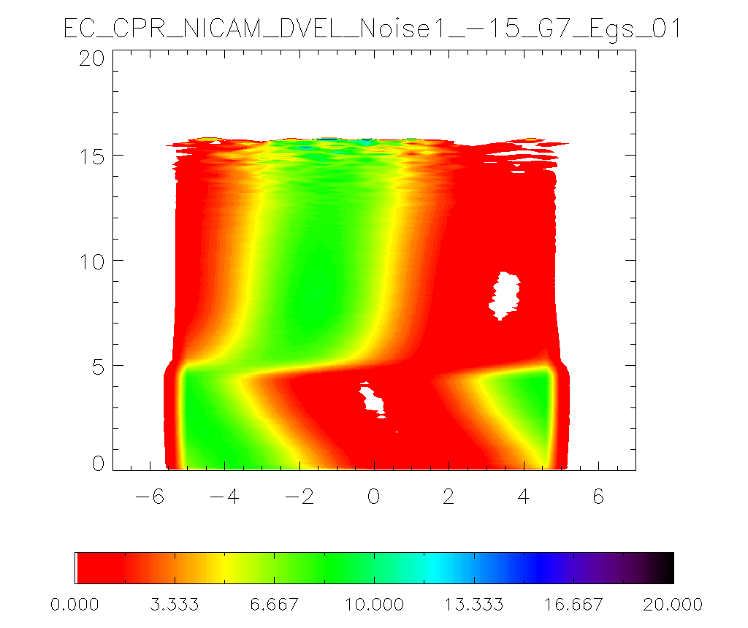
The test of simulated Doppler velocity like ECARE CPR (High mode) for Case 1
Without errors
(dBZ > -36.)
With errors
(dBZ > -36.)
With errors
(dBZ > -15.)
CON
Increases of graupel fraction
Hagihara et al. 2022

Slide 14
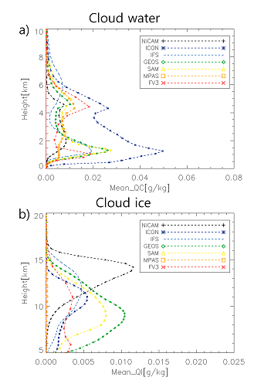
The DYAMOND (DYnamics of the Atmospheric general circulation Modeled On Non-hydrostatic Domains) project: Stevens et al. (2019, PEPS)
The DYAMOND project is the intercomparison of global high-resolution simulations with less than 5 km horizontal resolution.
We investigated Cloud properties of DYAMOND data over the Atlantic.
Roh et al. (2021, JMSJ)
The definition of cloud water and cloud ice are different each model.
When we compare the vertical profiles of ice hydrometeors, we need the same criterion each model.
The only radar reflectivity have limitation.
Radar reflectivity: the size and ice water content for snow and graupel
Doppler velocity: the density of ice hydrometeor (graupel, snow)
Lidar: sensitive to small ice particles.

Slide 15
Summary
We evaluated NICAM using NICT CPR over Tokyo.
The present version of NSW6 shows underestimation of the fraction of graupel for a tropical cyclone case.
The change of the interceptor parameter of graupel (increase of graupel size) deceases minimum Doppler velocity above the melting layer.
As an increase of collection efficiency of snow and graupel, the fraction of Doppler velocity less than -3 m/s increases between 6 and 8 km.
We compared the results with the simulated Doppler velocity like the EarhCARE CPR using Joint simulator.
The low mode (high PRFs) shows are consistent with the results of NICT results.
The EarthCARE product is useful to intercompare vertical distributions of ice hydrometeors of GSRMs.

Slide 16
Thank you

