Slide 1
EarthCARE Overview
Takuji Kubota
Earth Observation Research Center (EORC)
Japan Aerospace Exploration Agency (JAXA)
February 2022

Slide 2
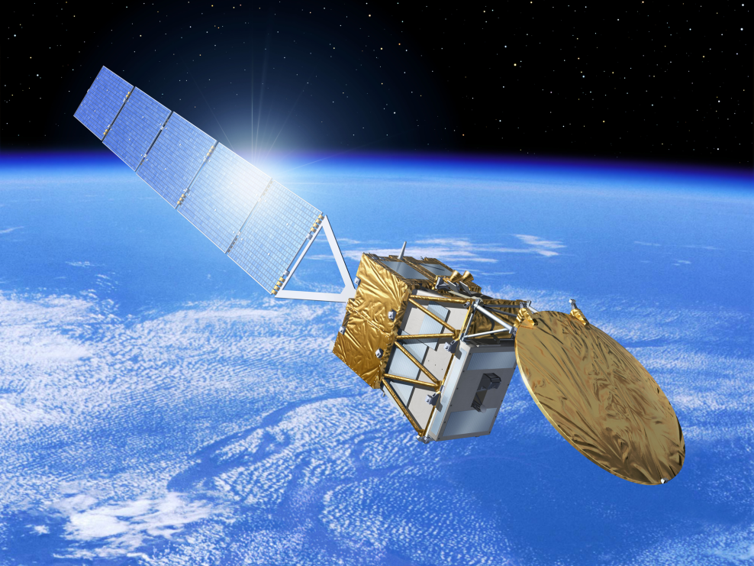



EarthCARE Satellite
EarthCARE
Earth Clouds, Aerosol and Radiation Explorer
EarthCARE is an earth observation satellite that Japan and Europe have been jointly developing to observe clouds, aerosols and radiation (Illingworth et al. 2015, BAMS).
CPR
MSI
Observation Instruments on EarthCARE
CPR Cloud Profiling Radar
BBR
CPR
ATLID
Copyright ESA
ATLID Atmospheric Lidar
ATLID
Institutions | European Space Agency（ESA）／National Institute of Information and Communications Technology（NICT）／ Japan Aerospace Exploration Agency（JAXA）
Launch | JFY2023
Mission Duration | 3-years
Mass | Approx. 2200kg
Orbit | Sun-synchronous sub-recurrent orbit Altitude: approx. 400km Mean Local Solar Time (Descending): 14:00
Repeat Cycle | 25 days
Orbit Period | 5552.7 seconds
Semi Major Axis | 6771.28 km
Eccentricity | 0.001283
Inclination | 97.050°
MSI Multi-Spectral Imager
MSI
BBR Broadband Radiometer
BBR
Synergetic Observation by 4 sensors

Slide 3
Needs vs EarthCARE
Clouds and Aerosols continue to contribute the two largest sources of uncertainty in current climate predictions.
The need for reliable information on the vertical structure of clouds and aerosol layers
Mission objectives: Improving the understanding of cloud-aerosol-radiation interactions so as to include them correctly and reliably in climate and numerical weather prediction models.
Needs
Observation Needs/Target
Vertical profiles of extinction and characteristics of aerosols
Vertical profiles of liquid, supercooled and ice water, cloud overlap, particle size and extinction
Convective updraft and ice fall speed
Horizontal structure of clouds and aerosols
Shortwave and longwave fluxes at Top of Atmosphere
Techniques
Active
Active
Active
Passive
Passive
High Spectral Resolution LIDAR
(HSRL)
Millimeter-wave
RADAR
Doppler
RADAR
Muiltispectral Imager
Broadband Radiometer
Remote Sensing Techniques
EarthCARE
Instruments
ATLID
Atmospheric Lidar
CPR
Cloud Profiling Radar
MSI
Multispectral Imager
BBR
Broadband Radiometer
3

Slide 4
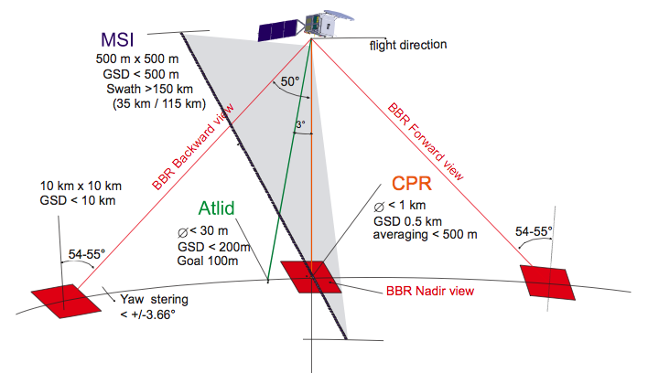
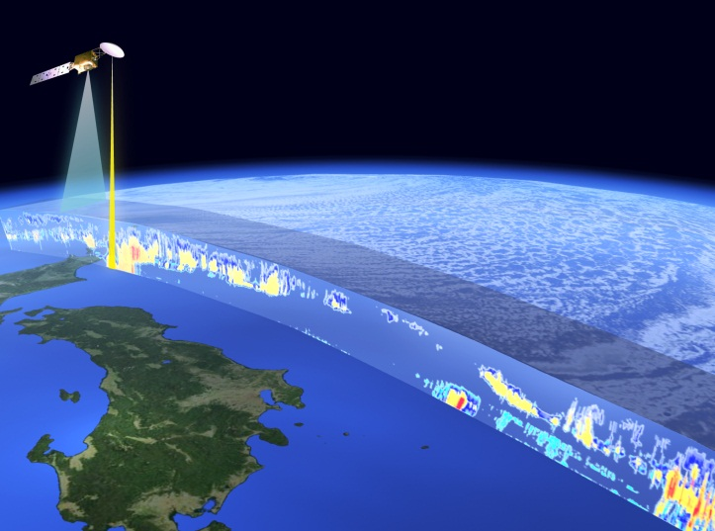
Strategy
Observation of 4 sensors (movie)
https://www.eorc.jaxa.jp/EARTHCARE/museum/movie_gallary.html
Synergetic Observation by 4 Sensors on Global Scale
3-dimentional structure of aerosol and cloud including vertical motion
Radiation flux at top of atmosphere
Aerosol – cloud – radiation interactions
Global simultaneous observations of
  - Cloud & aerosol profiles, 3D structure, with vertical motions
  - Radiation flux at Top of Atmosphere (TOA)
  - Aerosol-Cloud-Radiation interaction

Slide 5
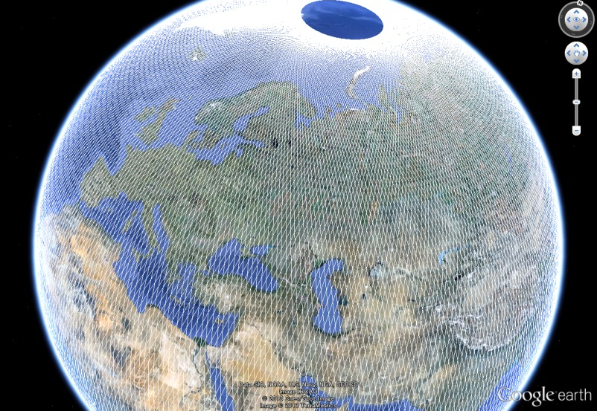
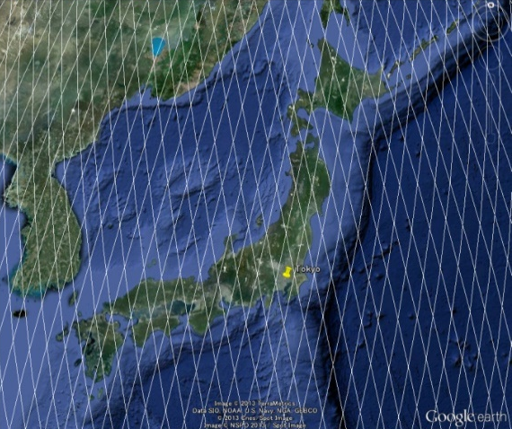
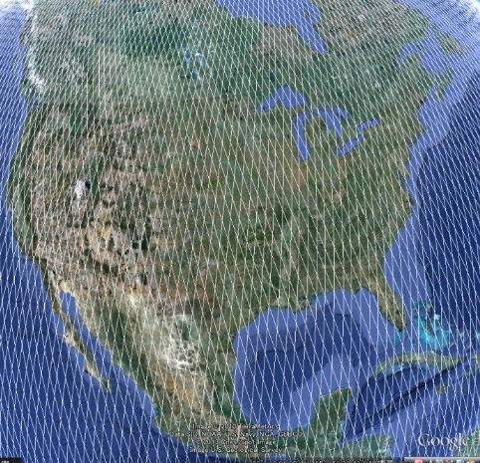
EarthCARE Orbit & Data latency
Mean Local Time : Approx. 14:00 (Descending)
2:00 (Ascending)
Europe
Japan
USA
Stations:
  Esrange/Kiruna & Inuvik (SSC)
  Two 13-m antenna at each GS location
Data latency
a. Nominal (60% of data) : max. 93 minutes
b. Worst case (blind orbits): 203 minutes max

Slide 6
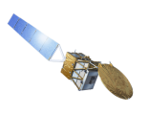
Sensors
CPR
Cloud Profiling Radar
CPR
The World’s First Satellite-borne Doppler Cloud Radar
Instrument | 94 GHz （W-band) Doppler Radar
Center Frequency | 94.05 GHz
Sampling | Horizontal : 500 m Vertical : 500m (Oversampling 100m)
Footprint | Approx. 800m （Horizontal）
Pulse Repetition Frequency | 6100 ～ 7500 Hz (Variable PRF)
Observation Height Range | Surface to 20km (low latitude), 18km, 16km, (high latitude)
CPR is a 94 GHz (W-band) Doppler Radar jointly developed by Japan Aerospace Exploration Agency (JAXA) and National Institute of Information and Communications Technology (NICT).
From its millimeter radar signal, it has the capability to observe vertical distribution and physical characteristics of cloud and drizzle.
In addition, information on the in-cloud vertical motion by Doppler measurement function has the potential to contribute to the understanding of cloud and precipitation process.
EarthCARE CPR has approximately 10 times higher sensitivity compared to CloudSat CPR onboard in the A-Train Constellation.
Observable Parameters
Satellite Flight Direction
Radar Reflectivity
Doppler Velocity
Gas Attenuation Factor
Cloud Mask
Cloud Particle Type
Liquid Water Content
Ice Water Content
Liquid Effective Radius
Ice Effective Radius
Optical Thickness
CPR Observation Direction
Nadir Direction
Vertical Sampling 500m
Footprint 800m
Horizontal Sampling 500m

Slide 7
Photo of the EarthCARE/CPR
CPR instrument @ JAXA Tsukuba Space center (Sep. 2015)
EarthCARE@Airbus（April.2021)
©Airbus

Slide 8
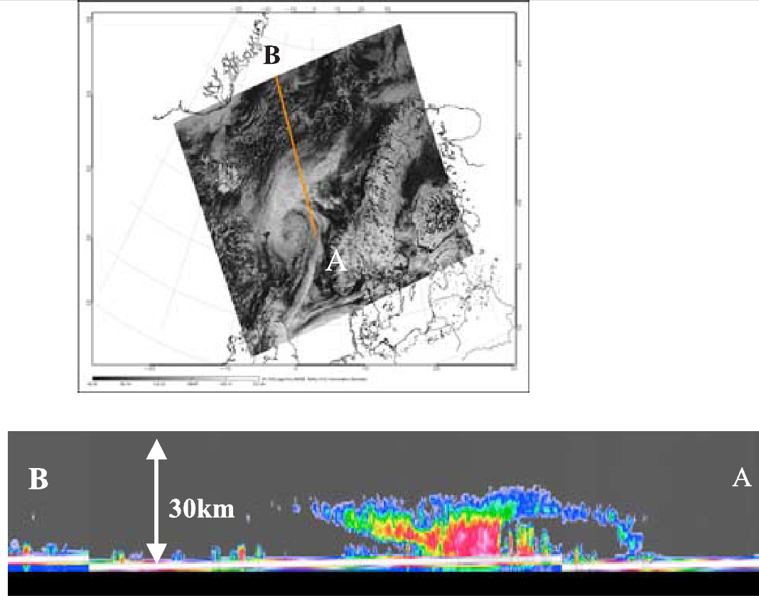
CPR Observation (by NASA CloudSat)
A orbit on 20 May 2006 (Stephans et al. 2008)
Features of EarthCARE/CPR :
More sensitivity than CloudSat/CPR
by larger antenna size (2.5 m diameter) that is, -29dBZ→-35dBZ.
Capability of the doppler velocity measurement
A MODIS image of a warm frontal system
Cloud profiling radar (CPR) reflectivity by CloudSat satellite

Slide 9
EarthCARE JAXA Product
Level 1 product will be developed by sensor provider agencies.
  i.e. JAXA will provide CPR Level 1 product
JAXA and ESA develop Level 2 geophysical products individually, under the framework of the Joint Mission Advisory Group (JMAG).
JAXA and ESA products will be distributed by both agencies.
For JAXA Level 2 Products, it is consisted by two categories;
  Standard Products
    strongly promoted to be developed and released
    processed and released from JAXA G-Portal
    all data will be able to be sent to ESA when produced
  Research Products
    promoted to be developed
    released from JAXA Earth Observation Research Center(EORC)
    some are planned to be upgraded to standard products

Slide 10
JAXA & ESA Level 1 Product & JAXA Standard Level 2 Product
CPR
ATLID
MSI
BBR
CPR
Data Release
6 months after launch
Level 1
Single Sensor
Engineering Values
L1
ATLID
L1
MSI
BBR
L1
L1
Single Sensor
Geophysical values (microphysics etc.)
CPR
CPR
ATLID
MSI
Level 2a
L2a
L2a
L2a
L2a
Data Release
9 months after launch
Echo Product
Cloud Product
CPR
L2b
Multiple Sensors (Synergy)
Geophysical values (microphysics etc.)
ATLID
2 Sensors Synergy Product
Level 2b
CPR
CPR
Data Release
18 months after launch
L2b
L2b
ATLID
ATLID
MSI
MSI
3 Sensors Synergy Product
BBR
4 Sensors Synergy Product

Slide 11
EarthCARE JAXA L2 Production Model
See appendix for the full list.
CPR
ATLID
MSI
BBR
L1
CPR Echo
ATLID
ATLID
MSI
MSI
Integrated Radar Reflectivity & Doppler Velocity
Gas Correction
Feature & Target Mask
Aerosol & Cloud Properties
Boundary Layer Height
Aerosol Extinction by Types
(Water soluble, Dust, Sea salt,
Black carbon)
Cloud Flag & Phase
Water Cloud Microphys.
(Thickness,
Effective Radius)
Water Cloud
Top Properties
(Height, Temp., Press.)
Ice Cloud Properties
Ice Cloud Top Properties (Height, Temp., Press.)
Aerosol Properties
Angstrom Parameter
CPR
L2
CPR Cloud
Doppler Velocity (inhomogeneous)
Multiple Scat. Effect
Cloud Mask & Phase/Shape
Cloud Microphys.
Rain & Snow Properties
1 sensor
Vertical Air Motion
Sedimentation Velocity
2 sensors
CPR – ATLID
CPR - ATLID
ATLID-MSI
ATLID-MSI
Cloud Mask & Phase/Shape
Cloud Microphys.
Mass Ratio of Ice Plates
Rain & Snow Properties
Vertical Air Motion
Aerosol Direct Radiative Forcing (TOA)
Aerosol Direct Radiative Forcing (BOA)
Aerosol Ectinction by Types (Water soluble, Dust, Sea salt, Black carbon)
Aerosol Size Info.
BBR-MSI
BM‐RAD Product
(ESA)
SW and LW radiances
BBR-MSI-ATLID
CPR – ATLID-MSI
CPR – ATLID-MSI
BMA‐FLX Product
(ESA)
Radiative Flux @ TOA & BOA
Cloud Mask & Phase/Shape with doppler
Cloud Microphys.
Cloud Mask & Phase/Shape with doppler
Cloud Microphys.
Rain & Snow Rate
Vertical Air Motion
3 sensors
Standard Product
4 Sensors
Research Product
SW & LW Flux
SW & LW Heating Rate
4 sensors

Slide 12
JAXA Algorithm development with the Joint-Simulator L1 synthetic data
Level 2 algorithm development ongoing
  Developments by 6 Algorithm PIs are ongoing.
  Now All JAXA EarthCARE L2 algorithms can input synthetic data with the JAXA/ESA L1 formats from the Joint-Simulator and output physical variables in the JAXA L2 format.
JAXA L2 ATBD is provided in the JAXA/EORC Website:
http://www.eorc.jaxa.jp/EARTHCARE/index.html
EarthCARE L1 Simulation by the Joint-Simulator using NICAM-SPRINTARS data

Slide 13
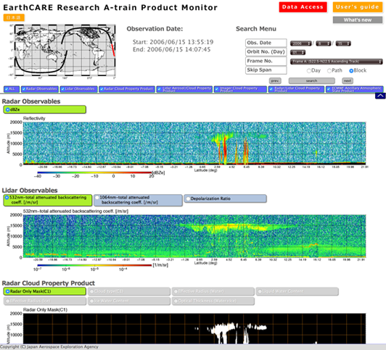
JAXA A-Train Product for EarthCARE
JAXA has provided the "EarthCARE Research A-Train Product" since Oct. 2017.
  http://www.eorc.jaxa.jp/EARTHCARE/research_product/ecare_monitor_e.html
Latest algorithms for EarthCARE
Algorithms for
A-Train satellites
JAXA
A-Train Product
Validation using heritages of the ground observations,
“Japanese validation rehearsal”
Applications:
Cloud/Aerosol/Radiation Process study,
Model evaluations,
…etc.
Toward long-term dataset with the A-Train and the EarthCARE…

Slide 14
Promotion for weather/climate model communities
Academic Research
Improvement of climate prediction accuracy
Improvement of severe weather prediction accuracy
IPCC Domestic Committee
Univ. of Tokyo^{*3} /JAMSTEC/RIKEN
[NICAM]
Univ. of Tokyo/NIES/JAMSTEC
[MIROC]
JMAMRI
[MRI-ESM]
Nagoya Univ.
[CReSS]
IPCC
Reflection to Policies
Monitoring of air pollution (aerosol)
Improvement of
forecasting accuracy
JMA/MRI & Kyusyu Univ.
[MASINGAR]
Kyushu Univ.
[SPRINTARS]
Japan Meteorological Agency
[Operational Model]
JMA/MRI
[Asuca]
ECMWF [Operational Model]
JMA/MRI
[Volcanic ash monitoring]
NIES
[VENUS/NICAM-Chem]
General Users
National Institute of
Polar Research
JAXA G-Portal/EORC
Website
ESA Website
Operational Use
Model Input
[Name of Model]
Exit Strategy
Via ESA
Academic Research

Slide 15
Summary
EarthCARE Overview
  EarthCARE is an earth observation satellite that Japan and Europe have been jointly developing to observe clouds, aerosols and radiation. (Overview paper: Illingworth et al. 2015, BAMS, https://doi.org/10.1175/BAMS-D-12-00227.1 )
  will be launched in JFY2023
  Features of the EarthCARE/CPR developed by Japan
    More sensitivity than CloudSat/CPR by larger antenna size (2.5 m diameter) that is, -29dBZ → -35dBZ.
    Capability of the doppler velocity measurement
Algorithm status
  Developments by 6 Algorithm PIs are ongoing.
  JAXA L2 ATBD is provided in the JAXA/EORC Website:
  http://www.eorc.jaxa.jp/EARTHCARE/index.html
JAXA A-Train Product for EarthCARE
  http://www.eorc.jaxa.jp/EARTHCARE/research_product/ecare_monitor_e.html
Applications with weather/climate models
  Data assimilation, evaluations of climate models, …

Slide 16
Appendix:
JAXA EarthCARE Product list

Slide 17
EarthCARE Products
JAXA & ESA Product (L1b/c:Stand-alone)
Sensor(s) | Processing Level | Product Name (Product ID for ESA) | Primary Parameter | Grid Spacing |  | File Unit File Format | Data Volume per day*
 |  |  |  | Horizontal | Vertical
CPR | L1b | CPR One-Sensor Received Power and Doppler Product | Received Echo Power / Radar Reflectivity Factor / Doppler Velocity / Pulse Pair Covariance / Spectrum Width | 0.5 km | 0.1 km | 1/8 orbit HDF | 51.3GB
 |  |  | Surface Radar Cross Section | 0.5 km | -
ATLID | L1b | A-NOM | Rayleigh and Mie Backscattering coefficient * Mie component has horizontal and vertical depolarization component | 0.285 km | 0.103 km | 1/8 orbit netCDF | 91.6GB
MSI | L1b | M-NOM | Radiation Intensity * Visible(0.67μm), Near IR(0.865μm), SW IR(1.65μm, 2.21μm), LW IR(8.80μm, 10.80μm, 12.00μm) | 0.5 km | - | 1/8 orbit netCDF | 83.9GB
BBR | L1b | B-NOM | SW and LW Radiation (Forward, Nadir, Backward) | 10 km | - | 1/8 orbit netCDF | 2.3GB
Sensor(s) | Processing Level | Product Name (Product ID for ESA) | Primary Parameter | Grid Spacing |  | File Unit File Format | Data Volume per day*
 |  |  |  | Horizontal | Vertical
MSI | L1c | M-NOM | L1b Radiation Intensity (interpolated to the location of a reference band) | 0.5 km | - | 1/8 orbit netCDF | 18.3GB
* 125 files per day is assumed without compression. ATLID, MSI, BBR is ESA product.

Slide 18
JAXA Standard Products (L2a:Stand-alone)
Sensor(s) | Processing Level | Product Name | Primary Parameter (Red: Spatial-integrated values will be also generated) | Grid Spacing |  | File Unit File Format | Data Volume per day*
 |  |  |  | Horizontal | Vertical
CPR | L2a | CPR One-sensor Echo Products | Integrated Radar Reflectivity Factor Integrated Doppler Velocity Gas Correction Factor | 1 km | 0.1 km | 1/8 orbit HDF | 116.0GB
CPR | L2a | CPR One-sensor Cloud Products | Cloud Mask / Cloud Particle Type / Liquid Water Content / Ice Water Content / Effective Radius of Liquid Water Cloud / Effective Radius of Ice Water Cloud | 1 km | 0.1 km | 1/8 orbit HDF | 131.8GB
 |  |  | Optical Thickness | 1 km | -
ATLID | L2a | ATLID One-sensor Cloud and Aerosol Products | Feature Mask | 0.2 km | 0.1 km | 1/8 orbit HDF | 70.8GB
 |  |  | Target Mask | 1 km | 0.1 km
 |  |  | Aerosol Extinction Coeff. / Aerosol Backscat. Coeff. / Aerosol Lidar Ratio / Aerosol Depolarization Ratio | 10km | 0.1 km
 |  |  | Cloud Extinction Coeff. / Cloud Backscat. Coeff. / Cloud Backscat. Coeff. / Cloud Depolarization Ratio | 1 km | 0.1 km
 |  |  | Cloud Depolarization Ratio | 1 km | 0.1 km
MSI | L2a | MSI One-sensor Cloud Products | Cloud Flag including Cloud Phase / Optical Thickness of Liquid Water Cloud / Effective Radius of Liquid (1.6 μm) / Effective Radius of Liquid (2.2 μm) / Cloud Top Temperature / Cloud Top Pressure / Cloud Top Height | 0.5 km | - | 1/8 orbit HDF | 163.6GB
* 125 files per day is assumed without compression.
Notes:
L2単体標準プロダクトリストである．
CPR，ATLID，MSIがあり，主要な変数は書いてある通りである．
雲マスク(Cloudd Mask)や雲の微物理量（Cloud Microphysics）やエアロゾルの特性（Aerosol Properties）などがある．

Slide 19
JAXA Standard Products (L2b:Synergy)
Sensor(s) | Processing Level | Product Name | Primary Parameter (Red: Spatial-integrated values will be also generated) | Grid Spacing |  | File Unit File Format | Data Volume per day*
 |  |  |  | Horizontal | Vertical
CPR + ATLID | L2b | CPR-ATLID Synergy Cloud Products | Cloud Mask / Cloud Particle Type / Radar Reflective Factor with Attenuation / Liquid Water Content / Ice Water Content / Effective Radius of Liquid Water Cloud / Effective Radius of Ice Water Cloud | 1 km | 0.1 km | 1/8 orbit HDF | 136.7GB
 |  |  | Optical Thickness | 1 km | -
CPR + ATLID + MSI | L2b | CPR-ATLID-MSI Synergy Cloud Products | Cloud Mask / Cloud Particle Type / Radar Reflective Factor with Attenuation / Liquid Water Content / Ice Water Content / Effective Radius of Liquid Water Cloud / Effective Radius of Ice Water Cloud | 1 km | 0.1 km | 1/8 orbit HDF | 136.7GB
 |  |  | Optical Thickness / Liquid Water Path / Ice Water Path | 1 km | -
4 sensors | L2b | Four Sensors Synergy Radiation Budget Products | SW Radiative Flux / LW Radiative Flux | 10 km | - | 1/8 orbit HDF | 7.3GB
 |  |  | SW Radiative Heating Rate / LW Radiative Heating Rate | 10 km | 0.5 km
* 125 files per day is assumed without compression.
Notes:
複合プロダクトである．２センサ，３センサ，４センサの複合ある．
雲に関するものと最終的な放射プロダクトがある．
（あとは文書を読む）

Slide 20
JAXA Research Products (L2a:Stand-alone)
Sensor(s) | Processing Level | Status | Product Name | Primary Parameter (Red: Spatial-integrated values will be also generated) | Grid Spacing |  | File Unit File Format
 |  |  |  |  | Horizontal | Vertical
CPR | L2a | Red R | CPR One-sensor Doppler Products | Doppler velocity correction value (considering inhomogeneity) / Doppler velocity unfolding Value / Radar Reflective Factor with Attenuation | 1 km | 0.1 km | 1/8 orbit HDF
 |  | ER | CPR One-sensor Rain and Snow Products | Rain Water Content / Snow Water Content / Rain Rate / Snow Rate | 1 km | 0.1 km | 1/8 orbit HDF
 |  | ER | CPR One-sensor Vertical Velocity Products | Vertical Air Motion / Sedimentation Velocity | 1 km | 0.1 km | 1/8 orbit HDF
ATLID | L2a | ER | ATLID One-sensor Aerosol Extinction Products | Aerosol Extinction Coefficient (Water Soluble) / Aerosol Extinction Coefficient (Dust) / Aerosol Extinction Coefficient (Sea Salt) / Aerosol Extinction Coefficient (Black Carbon) | 1 km | 0.1 km | 1/8 orbit HDF
MSI | L2a | ER | MSI One-sensor Ice Cloud Products | Optical Thickness of Ice Cloud with Reflection method / Effective Radius of Ice Cloud (1.6 μm) / Effective Radius of Ice Cloud (2.2 μm) / Ice Cloud Top Temperature / Ice Cloud Top Pressure / Ice Cloud Top Height | 0.5 km | - | 1/8 orbit HDF
 |  | ER | MSI One-sensor Aerosol Products | Aerosol Optical Thickness (Ocean) / Aerosol Optical Thickness(Land) / Angstrom Exponent (Ocean) | 0.5 km | - | 1/8 orbit HDF
“Red R” = Research product, would be processed in JAXA EORC Research and Application System, and to be upgraded to standard after one year or later when the release accuracy is approved.
“ER” = Research product, would be processed in JAXA EORC Research and Application System. “LR” = Research product, would be processed in Japanese Laboratories
Notes:
研究プロダクトも単体や複合がある（さらっと流す）．

Slide 21
JAXA Research Products (L2b:Synergy)
Sensor(s) | Processing Level | Status | Product Name | Primary Parameter (Red: Spatial-integrated values will be also generated) | Grid Spacing |  | File Unit File Format
 |  |  |  |  | Horizontal | Vertical
CPR + ATLID | L2a | Red R | CPR-ATLID Synergy Particle Mass Ratio Products | Mass Ratio (2D_Ice/IWC) | 1 km | - | 1/8 orbit HDF
 |  | ER | CPR-ATLID Synergy Rain & Snow Products | Rain Water Content / Snow Water Content / Rain Rate / Snow Rate | 1 km | 0.1 km | 1/8 orbit HDF
 |  | ER | CPR-ATLID Synergy Vertical Velocity Products | Vertical Air Motion / Sedimentation Velocity | 1 km | 0.1 km | 1/8 orbit HDF
ATLID + MSI | L2a | ER | ATLID-MSI synergy Aerosol Components Products | Aerosol Extinction Coefficient (Water Soluble)／Aerosol Extinction Coefficient (Dust)／ Aerosol Extinction Coefficient (Sea Salt)／ Aerosol Extinction Coefficient (Black Carbon)／Mode Radius | 10 km | 0.1 km | 1/8 orbit HDF
CPR + ATLID + MSI | L2a | LR | CPR-ATLID-MSI Synergy Cloud Doppler Products | Cloud Mask / Cloud Particle Type / Liquid Water Content / Ice Water Content / Effective Radius of Liquid Water Cloud / Effective Radius of Ice Water Cloud (with Doppler) | 1 km | 0.1 km | 1/8 orbit HDF
 |  |  |  | Optical Thickness／ Liquid Water Path／Ice Water Path (with Doppler) | 1 km | - | 1/8 orbit HDF
 |  | LR | CPR-ATLID-MSI Synergy Rain and Snow Products | Rain Water Content / Snow Water Content / Rain Rate / Snow Rate | 1 km | 0.1 km | 1/8 orbit HDF
 |  | LR | CPR-ATLID-MSI Synergy Vertical Velocity Products | Vertical Air Motion / Sedimentation Velocity | 1 km | 0.1 km | 1/8 orbit HDF
 |  | LR | CPR-ATLID-MSI Synergy Emission Method Products | Effective Radius of Ice Cloud derived from Emission Method／Optical Thickness of Ice Cloud derived from Emission | 0.5 km | - | 1/8 orbit HDF
“Red R” = Research product, would be processed in JAXA EORC Research and Application System, and to be upgraded to standard after one year or later when the release accuracy is approved.
“ER” = Research product, would be processed in JAXA EORC Research and Application System. “LR” = Research product, would be processed in Japanese Laboratories
Notes:
研究プロダクトも単体や複合がある（さらっと流す）．

