Slide 1

Anticipated new insights into warm clouds from the EarthCare mission
Graham Feingold¹
Tak Yamaguchi^{1,2}, Franziska Glassmeier³, Fabian Hoffmann⁴, Tom Goren⁵, Jan Kazil^{1,2}
¹NOAA Chemical Sciences Laboratory Boulder Colorado
²CIRES, U. of Colorado, Boulder
³TU Delft, Netherlands
⁴LMU, Munich, Germany
⁵U. of Leipzig, Germany

Slide 2
Leveraging EarthCare with other assets
EarthCare
PoR + Met
Analysis Tools
Models
Active and Passive
Remote Sensing
  Geostationary (Geo)
  Multi-Dimensional
  Geophysical Variable ‘Maps’
  LES
  Meteorological Reanalysis
  Global CRMs
  GCMs
  Compositing
  Simulators
Notes:
I think it is clear that a major component of EarthCare – besides its advanced instrumentation on a single platform – is that it will be ably supported by a number of important components - the so-called PoR - as well as other analysis tools.

Slide 3
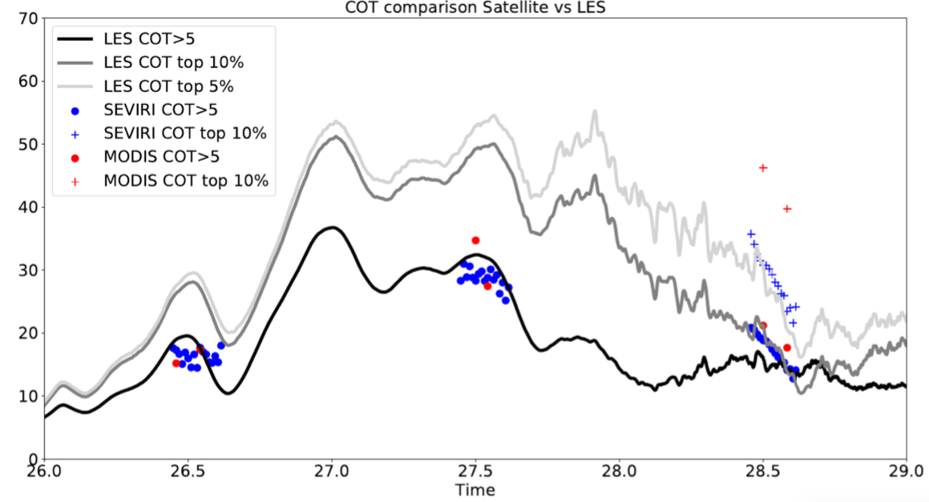
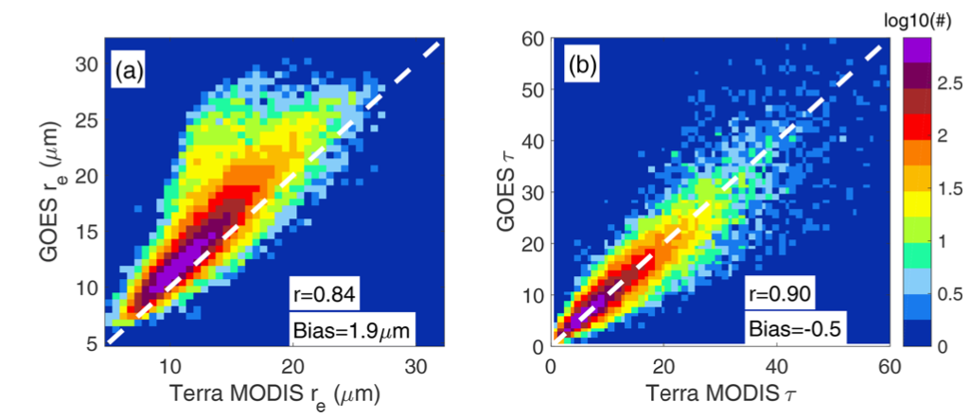
EarthCare + Geostationary:
Extending EarthCare’s time resolution
timeseries of cloud microphysical properties (daytime)
GOES vs. MODIS
Issues: viewing angles, instrument differences, SZA, ...
SEVIRI
MODIS
LES
Cloud optical thickness
Goren et al. (2019)
Painemal et al. (2021)

Slide 4
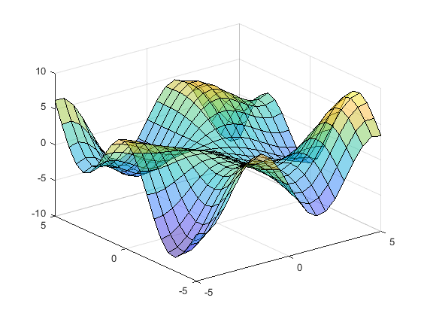
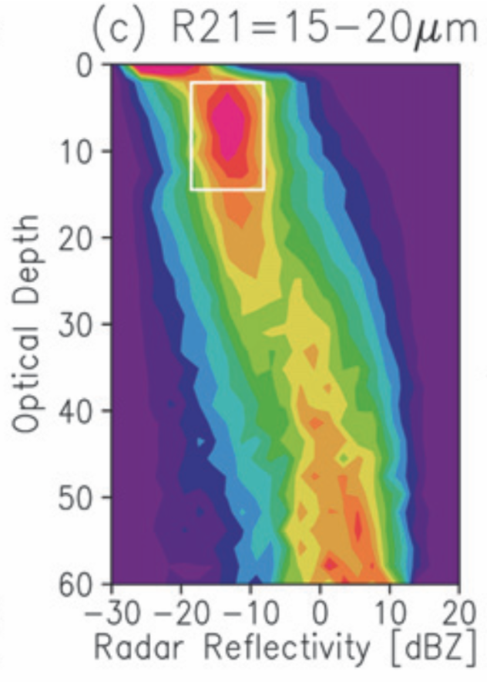
Evaluating Models:
Multi-Dimensional Geophysical Variable (GV) Retrievals
Condensation
Tells you what is there and why
  Process
  Model Constraints
ECare variables
  Albedo, τ_{c}, Z, N_{d}, CF, LWP, CRE, w, τ_{a}, extinction(z)
Thoughtful combinations of GVs, to constrain various aspects of models
  Simulators
  Attention to aggregation scale
Meteorology (ERA5 or similar)
Coalescence
GV3
GV1
GV2
Suzuki et al. 2010

Slide 5
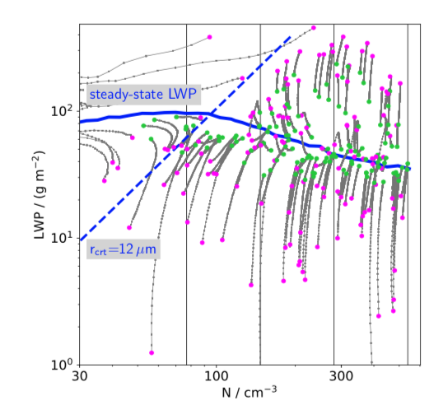
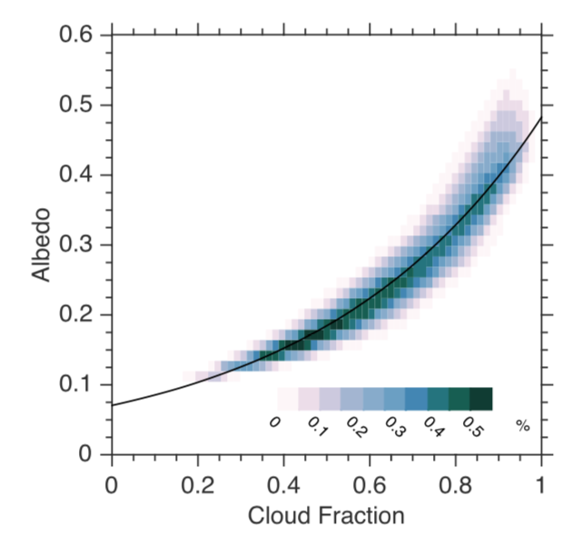
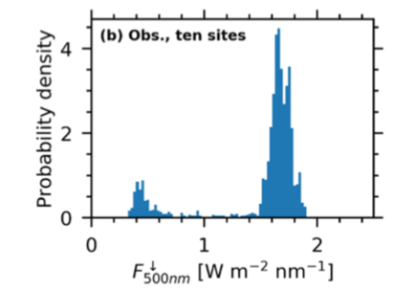
Microphysics
Radiation
Albedo vs CF
Engstrom (2015)
LWP
Albedo
Glassmeier (2021)
GV maps encode physical processes!
N_{d}
Cloud fraction
Geophysical Variable Maps
Gristey (2020)
Suzuki (2010)
Downwelling SW irradiance
See also Matsui et al. (2014)

Slide 6
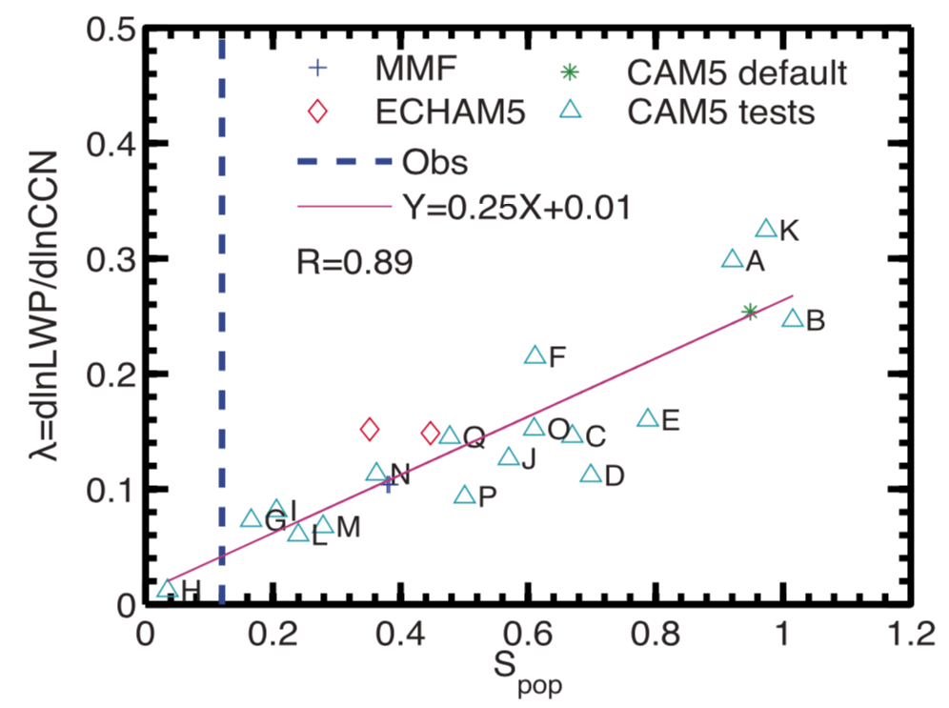
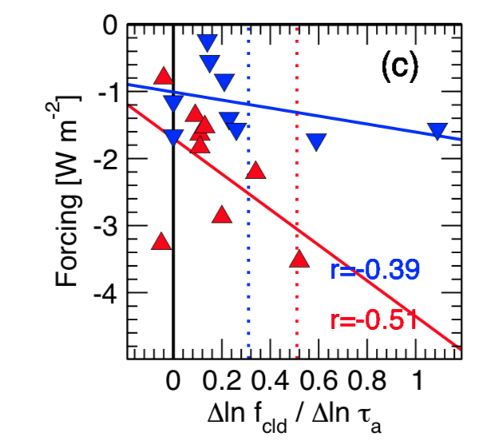
Microphysics
Radiation
Emergent Constraints
Albedo vs CF
Engstrom (2015)
LWP
Albedo
dLWP/dN
Glassmeier (2021)
N_{d}
Cloud fraction
τ – Z CFADs
S_{pop}
Wang et al. (2012)
Geophysical Variable Maps
Gristey (2020)
Suzuki (2010)
Downwelling SW irradiance
Quaas (2009)

Slide 7
Science Themes
ACI and Mesoscale Organization
  Stratocumulus to Cumulus Transition (SCT)
    Role of smoke
    Role of drizzle
  Pockets of open cells (POCS)
Timescales of ‘LWP adjustments’ (dLWP/dN)
Albedo vs. cloud fraction
How to evaluate/improve models by ECARE data?
What are the major issues/biases of models in representations of cloud, convection, precipitation, and aerosols?
Process understanding: cloud, precipitation, convection, radiation, and their coupling
New research areas/subjects arising from ECARE
Notes:
Key themes: to some extent address all 4 of the

Slide 8
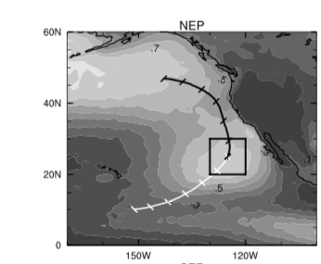
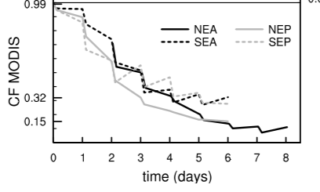
1. ACI and Mesoscale Organization: SCT
Sc → Cu Transition
Continental US
MODIS cloud fraction
Sandu et al. (2010)
Contours: cloud fraction
Forward trajectory
Transition from solid stratocumulus to broken cumulus as SST increases/subsidence decreases

Slide 9
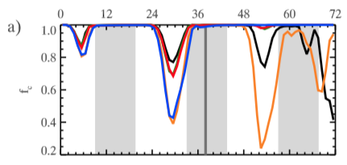
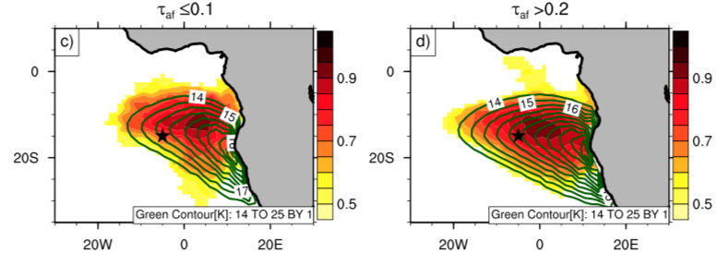
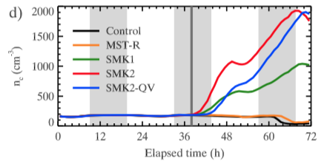
LES: Smoke delays transition
1. ACI and Mesoscale Organization: SCT
Role of Smoke
Sc → Cu Transition
MODIS: smoke delays transition
Approach:
Geo to identify transitions
ECare: drizzle + CF, τ, r_{e} , aerosol profiles, smoke contact with cloud
Compositing based on ERA-5/diurnal cycle
Lagrangian LES
τ_{a} < 0.1
τ_{a} > 0.2
Delayed
breakup
CF
CF
Cloud fraction
Adebeyi et al. (2015)
Drop conc.
cm⁻³
Yamaguchi et al. (2015) Lagrangian LES
Notes:
Diurnal cycle information is important because of the absorption of SW radiation by smoke
Understand co-variability of meteorology and aerosol

Slide 10
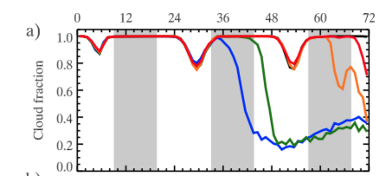
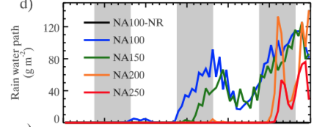
Role of Drizzle
1. ACI and Mesoscale Organization: SCT
Sc → Cu Transition
Time, h
LES suggests a potentially important role for drizzle induced transition due to local scavenging of aerosol.
Is their observational evidence?
Approach:
Geo to identify transitions
ECare: drizzle + CF, τ, r_{e} , w, aerosol profiles
Compositing based on ERA-5
Lagrangian LES
Cloud fraction
Earlier breakup in raining cases
Rain water path
g m⁻²
Yamaguchi et al. (2017) Lagrangian LES

Slide 11
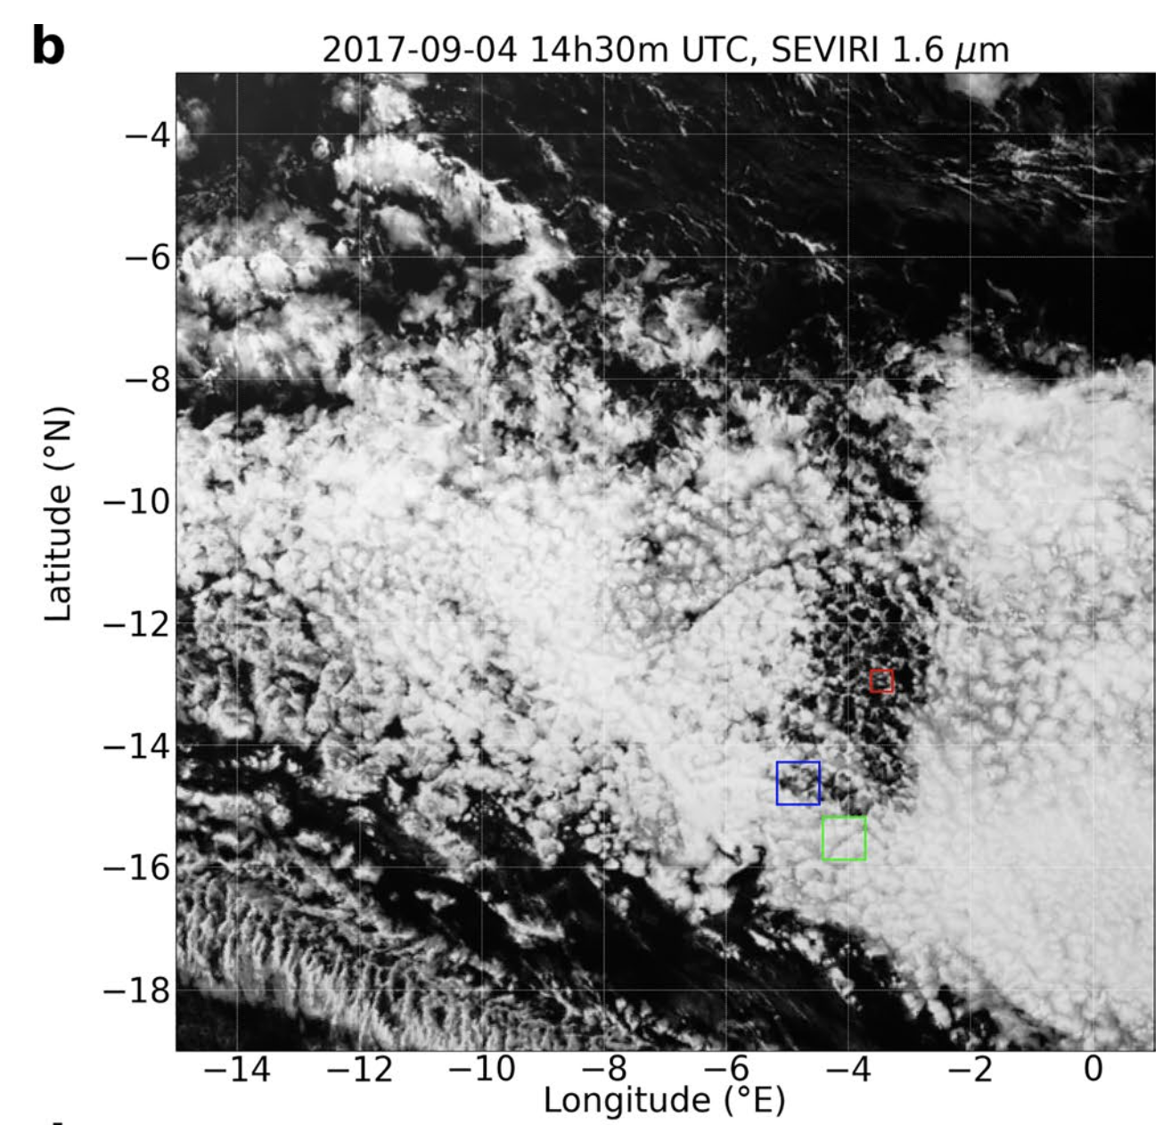
Pocket of open cells
1. ACI and Mesoscale Organization: Pockets of Open Cells
Strong role for drizzle-induced transition due to local scavenging of aerosol
Approach:
Geo to identify transitions
ECare: drizzle + CF, τ, r_{e} , w in cell walls, aerosol profiles in POC
Compositing based on ERA-5
LES
Closed-Open
SE Atlantic
SEVIRI 2017-09-04 (Kazil et al. 2021)

Slide 12
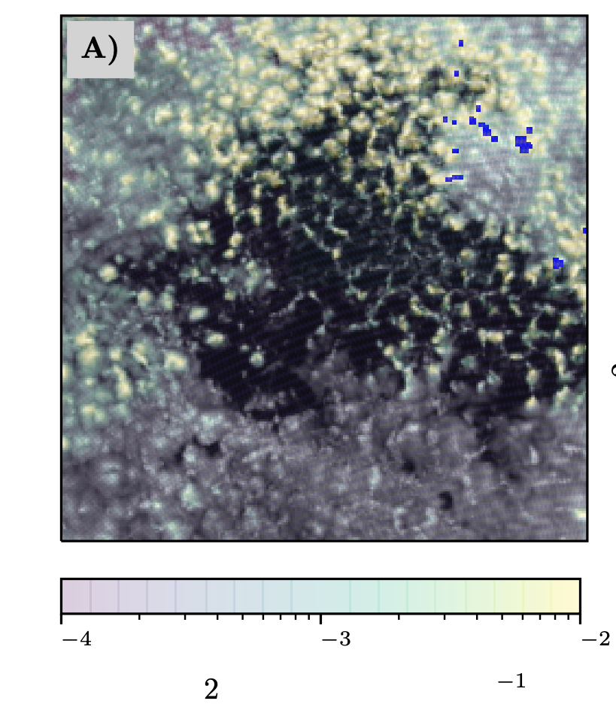
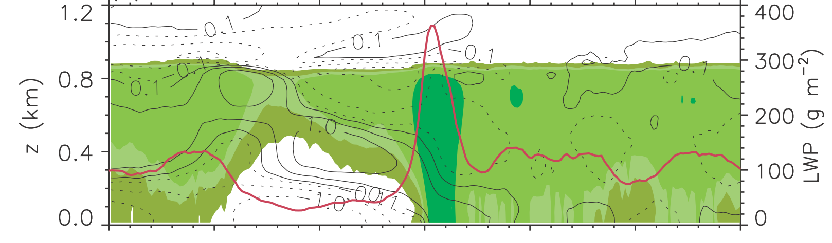
1. ACI and Mesoscale Organization: Closed-Open Cells
Highest rain rate at edge of POC
Closed-Open
LES: Highest LWP, rain rate, and TKE at edge of POC
Color contour: rain
Red line: LWP
Line contours: u-wind
High TKE re-circulation zone
Use of ECare w measurements
GOES + AMSR-2 rain rates (color)
Smalley et al. (2021)
Wang and Feingold (2009)
Notes:
Lidar + radar + imager for LWP

Slide 13
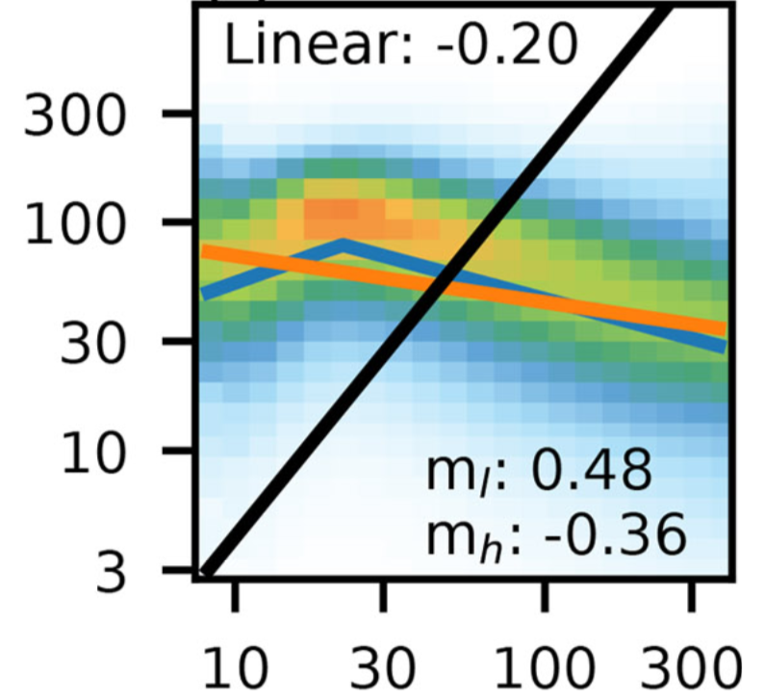
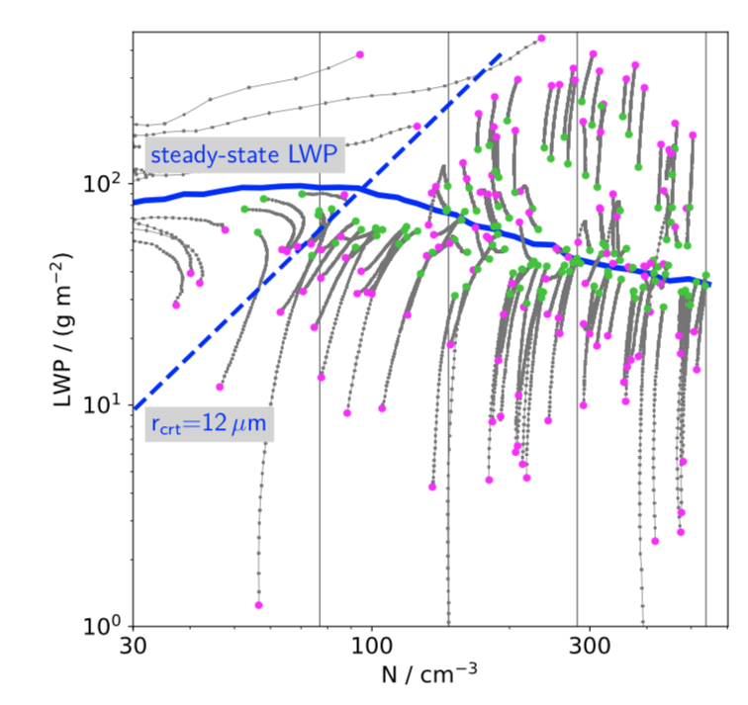
2. LWP Adjustments dLWP/dN: non-monotonicity
LWP adjustments
A-Train (snapshots)
Large ensemble of LES: evolution of individual runs
Approach:
ECare + Geo
Compositing based on ERA-5/diurnal cycle
LES connects to processes
r_{e}
LWP, g m⁻²
N_{d}, cm⁻³
N_{d}, cm⁻³
start
end
Glassmeier et al. (2021)
Gryspeerdt et al. (2019)
Notes:
Challenge is to infer process from snapshots
LES allows us to connect to Processes

Slide 14
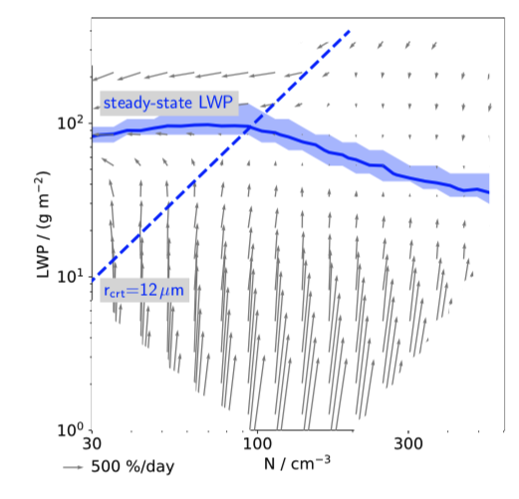
2. LWP Adjustments: Satellite and LES flow fields
LWP adjustments
Satellite-based (flow field)
LES emulator: dLWP/dN flow field
Approach:
ECare + Geo
Compositing based on ERA-5/diurnal cycle
Explore timescales of dLWP/dN
F
Flow Field
LWP, g m⁻²
N_{d}, cm⁻³
N_{d}, cm⁻³
Glassmeier et al. (2021)
Notes:
Emphasise that LES (and analytical approaches like MLM theory) help to connect to Processes

Slide 15
3. Albedo - Cloud Fraction
Albedo vs. CF
Shape of these traces encodes micro/macrophysics
Rate of opening/closing of POCs using ECare + Geo + Met
Large Ensemble of LES
Non-drizzling,
closed cells
Satellite (MODIS)
Points colored by N
Scene Albedo vs. CF
Albedo
Low N, no rain
Low N, rain,
open cells
Engstrom curve
Cloud fraction
Engstrom et al. (2015)
Adapted from Feingold et al. (2016)

Slide 16
Summary Points
Summary
EarthCare opportunities
EarthCare
Geostationary, reanalysis, other..
New instruments
New Geophysical Variables (GVs)
Better aerosol, drizzle
Conditional sampling by w
System wide constraints using multiple GVs
Geo for high Δt temporal resolution
ERA-5 meteorology
Compositing
LES, Global Cloud Resolving, Climate Model evaluation in GV spaces of interest
Improved Process Understanding
Improved Earth System Predictability at a range of scales
Notes:
In the face of equifinality, how can we determine which models will have the most predictive power?” It would appear that analyses of as many orthogonal components of the system as possible, including higher- order statistics, would be the best path.

