Slide 1
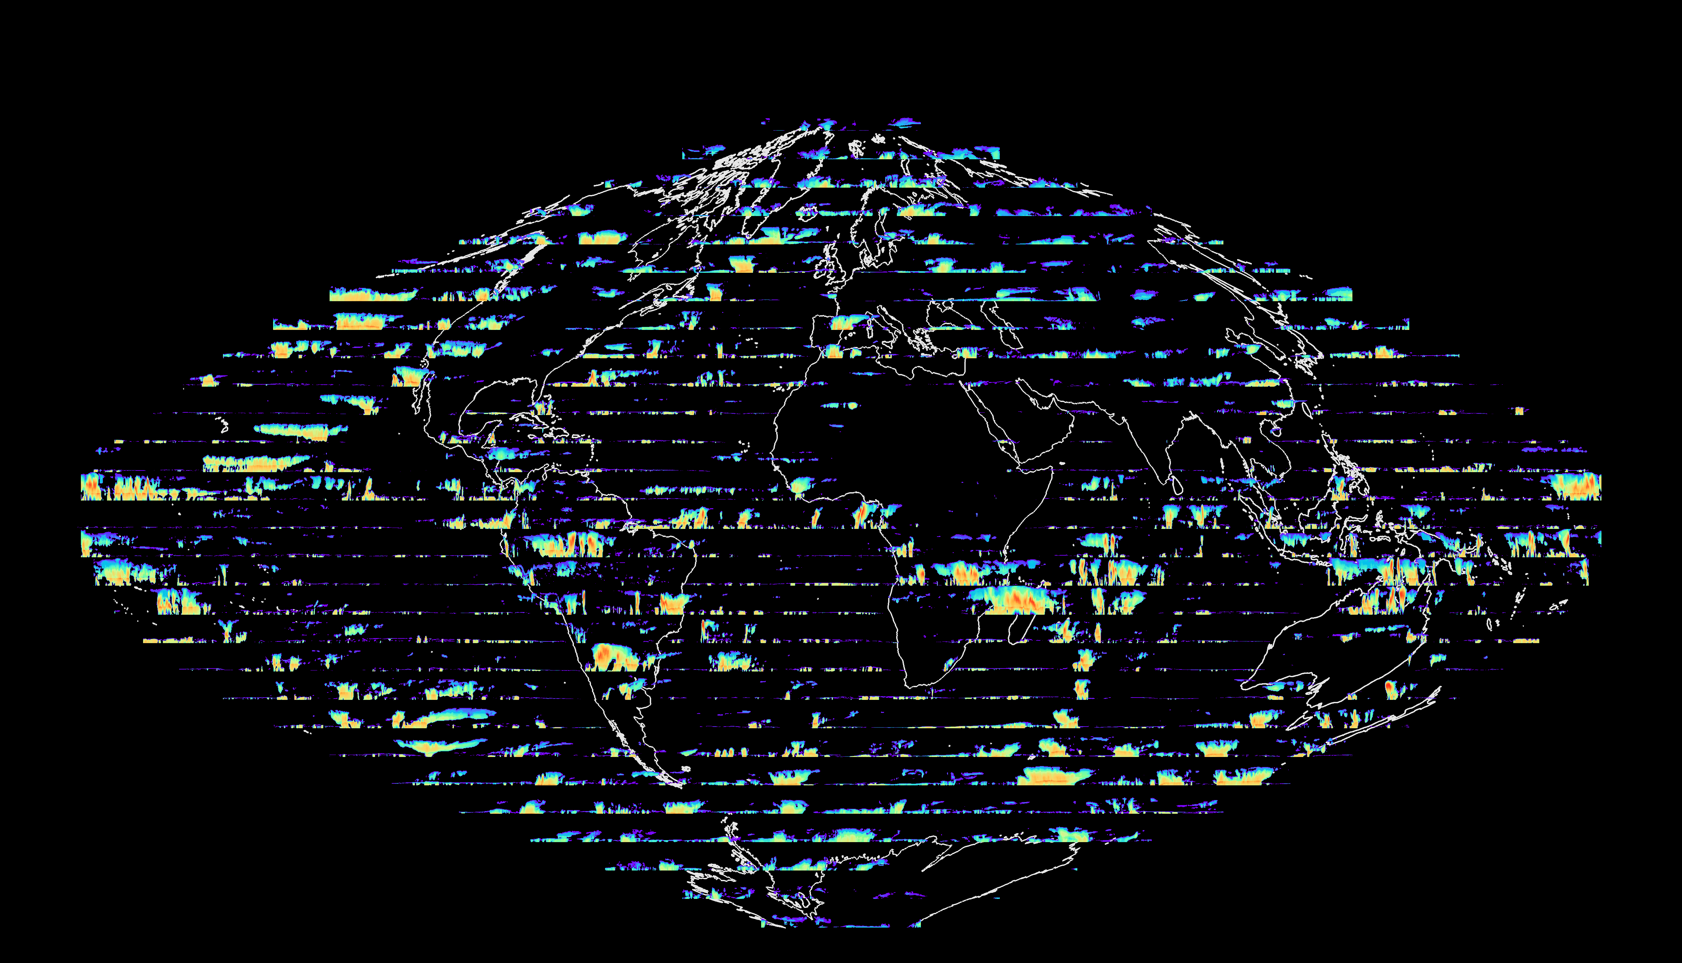
Exploiting data assimilation for model improvement
Mark Fielding
+ Marta Janisková, Richard Forbes, and colleagues
ECMWF
mark.fielding@ecmwf.int
How can assimilating EarthCARE improve forecasts AND improve the representation of cloud processes?

Slide 2
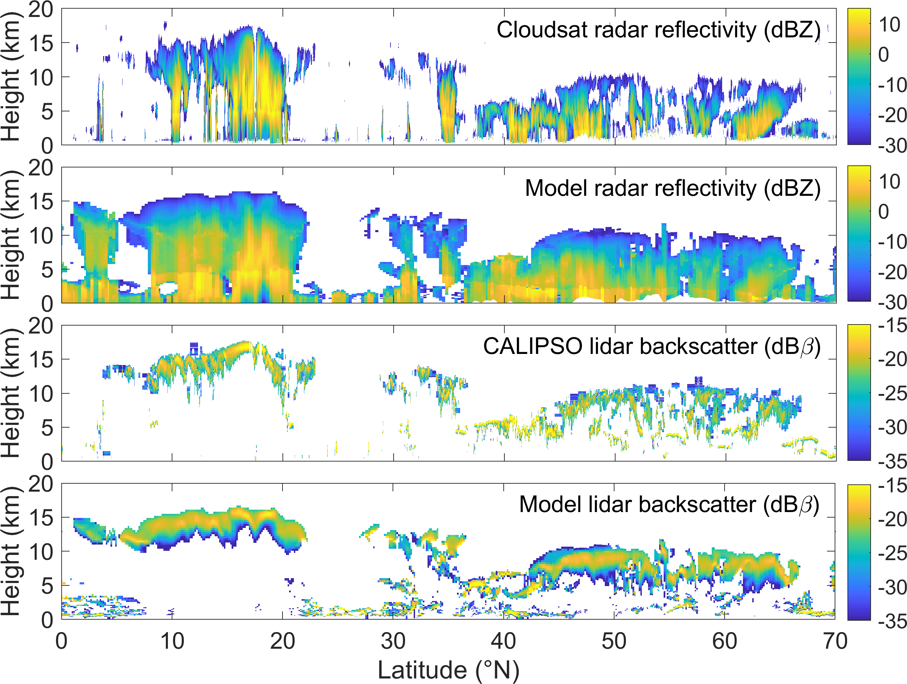
Background
ECMWF and ESA have been developing the capability to monitor and assimilate EarthCARE radar and lidar observations since 2003.
Key outcomes
Observation operators for space-borne radar and lidar (Di Michele 2012, Fielding and Janisková 2021, QJRMS)
1D+4DVAR feasibility studies (Janisková 2015, QJRMS)
Flow dependent observation error characterization (Fielding and Stiller 2019, JGR)
4D-Var assimilation feasibility studies with CloudSat and CALIPSO (Janisková and Fielding 2021, QJRMS)

Slide 3
The ways developments for data assimilation can be exploited to improve model forecasts
Indirect
Model validation using observation operators as instrument simulators
Monitoring of instruments/products to detect instrument/model problems
Direct
Traditional DA – observations are combined with model to provide best estimate of initial state
Future research
Reducing microphysical uncertainty via observation operator parameter estimation, exploiting synergies across observation spectrum
Interactive state and parameter estimation data assimilation

Slide 4
Online observation operators provide direct comparison with observations
CloudSat
Instant qualitative check on cloud structure
Useful for evaluating model analysis/reanalysis or forecast skill.
Not necessary helpful for process understanding, but could be useful for evaluating ‘rare events’ – tropical cyclones, volcanic eruptions etc.
Can be difficult to process data from higher resolution simulations -> online observation simulators could reduce computational demands
1 km
4 km
9 km
9 km (conv. on)
DYAMOND ‘summer’ simulations

Slide 5
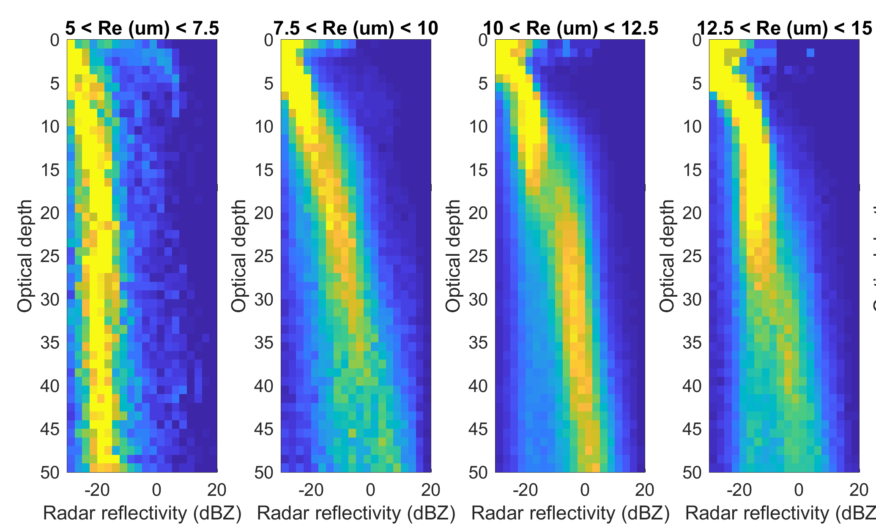
Synergistic approaches are key to process understanding
Spatial matching of observations and model not always required.
Interpretations still susceptible to assumptions in instrument simulators.
IFS scm using two moment microphysics
dBZ
Height (km)
+ double moment simulator
Height (km)
dBZ
days
Simulate CFODDs (see Suzuki et al., 2010) to compare with MODIS/CloudSat observations
Two-moment version of observation operator to represent more complex microphysics schemes
See Richard Forbes’s and Andrew Gettelman’s talks for more examples

Slide 6
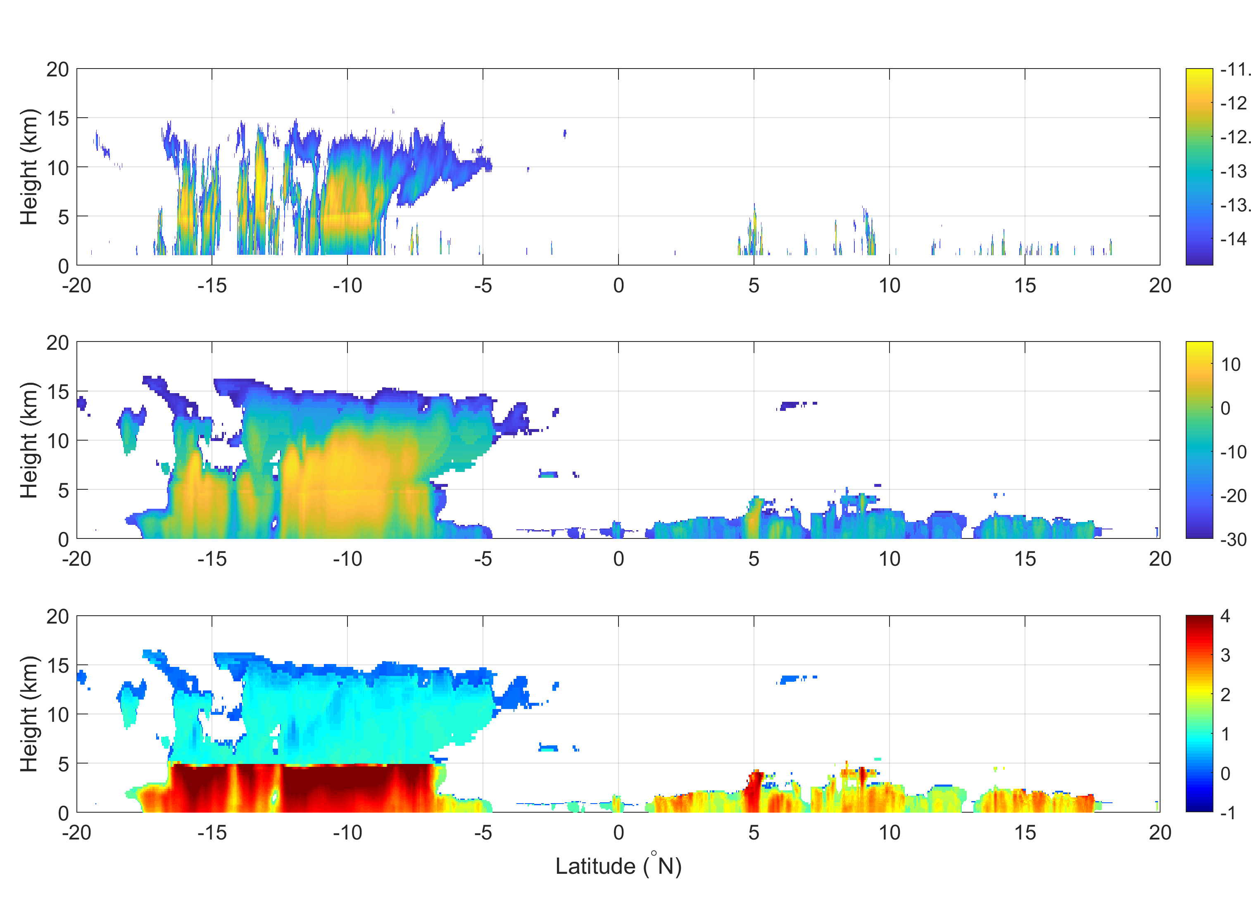
How can we maximise EarthCARE’s potential?
CloudSat uncalibrated reflectivity
EarthCARE will have improved sensitivity to boundary-layer clouds
Observation operator updated to include Doppler velocity and HSRL channels
Use model simulations to help with quality control and provide stepping stone from CloudSat to EarthCARE
Make observation operator publicly available (perhaps through RTTOV?)
IFS radar reflectivity (dBZ)
IFS Doppler velocity (m s⁻¹)
Doppler velocity will allow investigation of precipitation processes
DYAMOND 4 km global simulations from 20 January 2020

Slide 7
What impact can we expect from assimilating EarthCARE radar and lidar?
4D-Var experiments using CloudSat & CALIPSO show improvements to medium range forecast skill!
Temperature (T)
Temperature
RED
worse
worse
worse
0.04
better
Vector Wind (VW)
0.02
better
Vector Wind
Difference in RMS error normalised by RMS error of control
0.0
Geopotential (Z)
-0.02
Relative humidity
-0.04
BLUE
better
Improvements to forecast of TOA radiation based on verification against independent CERES observations
11-month combined period: 1 August 2007 – 31 August 2008
Forecast error reduction grows with forecast lead time

Slide 8
Outlook for direct assimilation of EarthCARE observations
Assimilation of radar reflectivity and lidar backscatter has a measurable impact on global forecasts (e.g., ~0.5-1 % reduction in forecast error of upper-tropospheric winds at days 4-6).
Observing system has grown over the past 15 years: will impact be the same?
As global NWP models resolve increasingly finer scales, expect data assimilation of high-resolution observations to become more important, particularly for prediction at shorter time scales.
What additional benefit would assimilating other EarthCARE observations bring, e.g., Doppler velocity, cloud extinction, MSI radiances?
How do radar/lidar observations interact with other routinely assimilated observations?

Slide 9
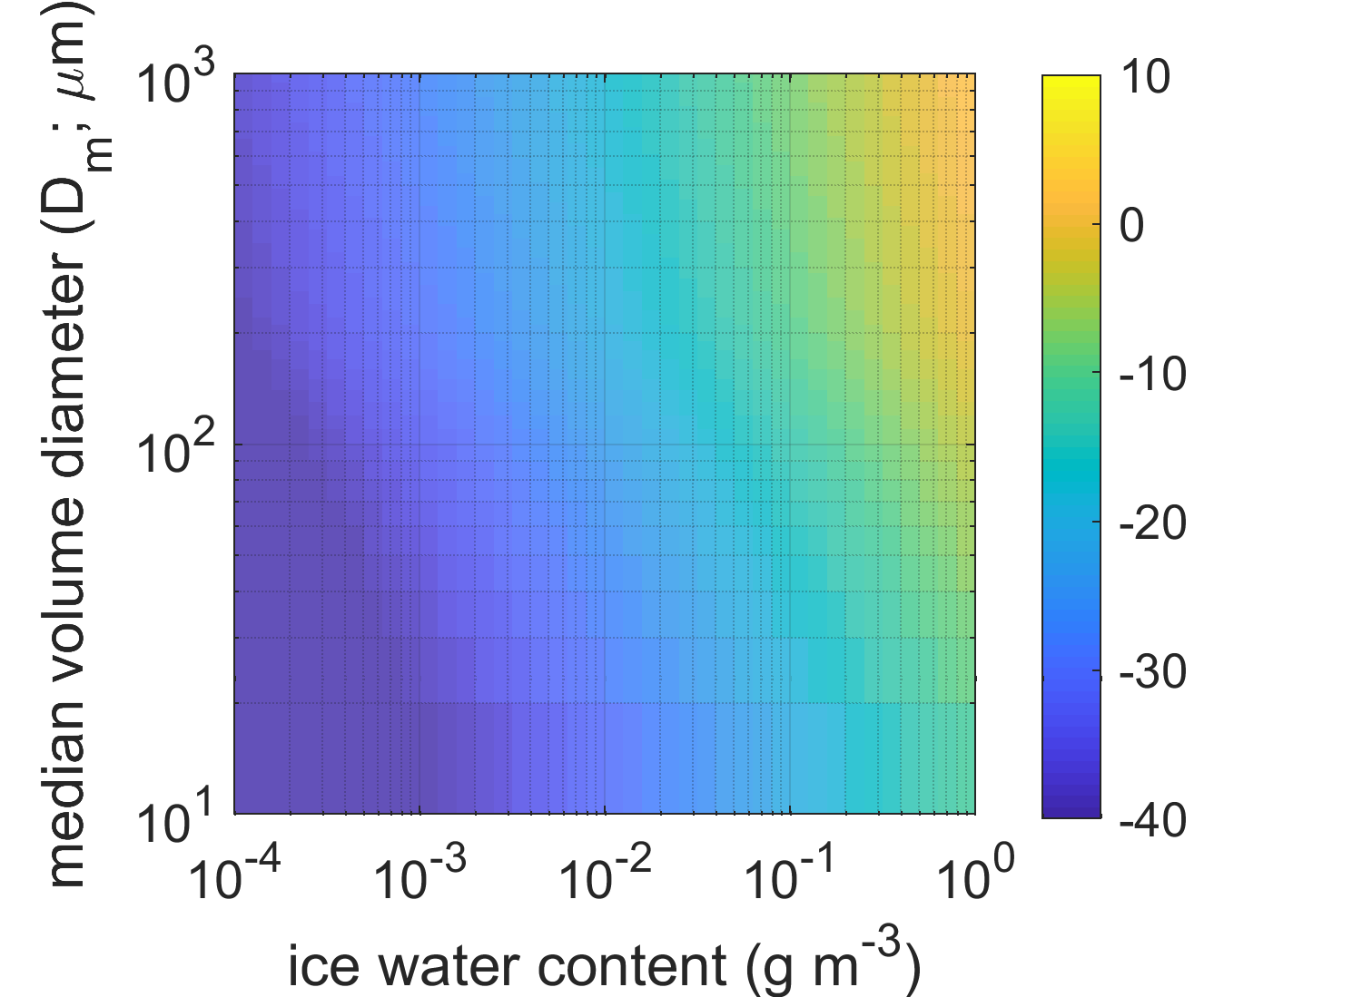
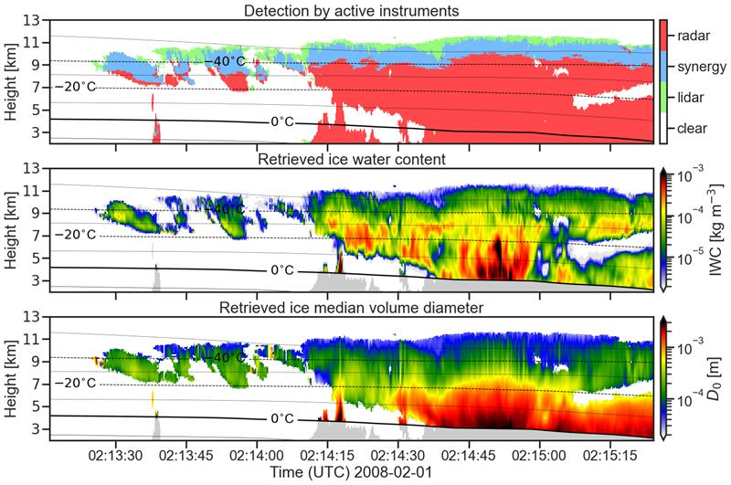
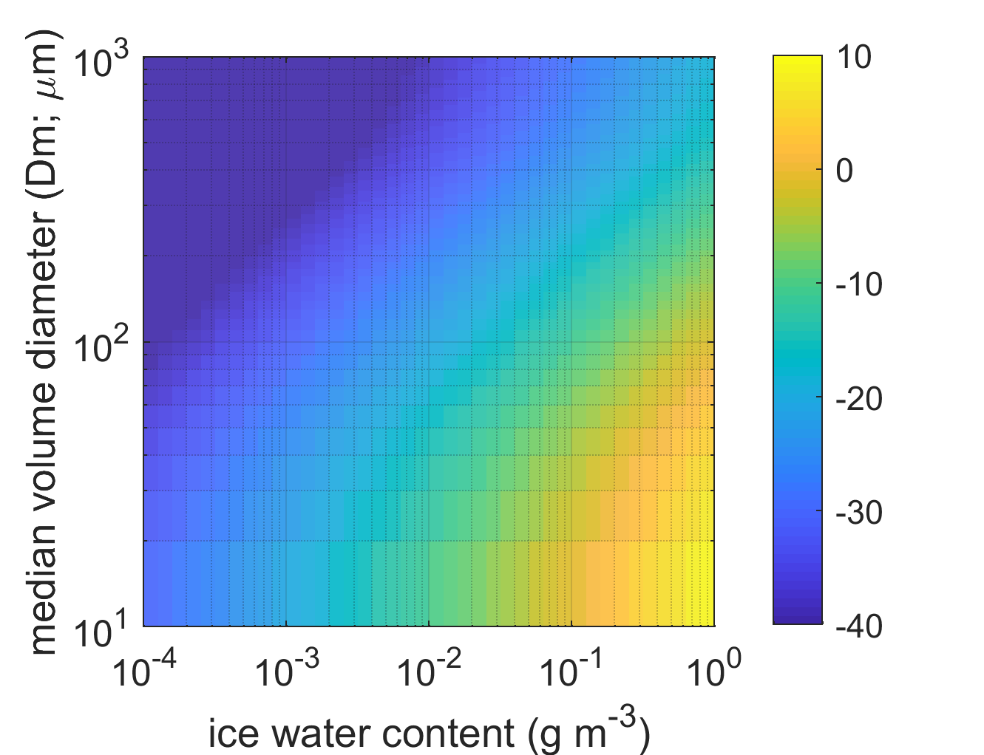
Microphysical parameter estimation via radar/lidar/passive synergy
Significant proportion of uncertainty in observation operator is due to microphysical uncertainties
Radar and lidar are sensitive to different moments of cloud/ice particle size distributions
For a given iwc: radar reflectivity increases with particle size
dBZ
For a given iwc: Lidar backscatter decreases with particle size
dBβ
Could additional microphysical parameters be retrieved during 4D-Var assimilation?
CAPTIVATE retrievals and plotting courtesy of Shannon Mason

Slide 10
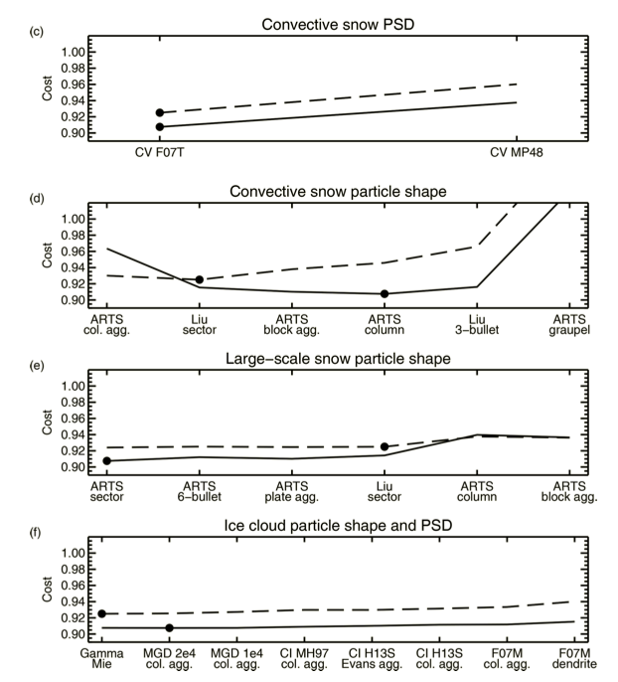
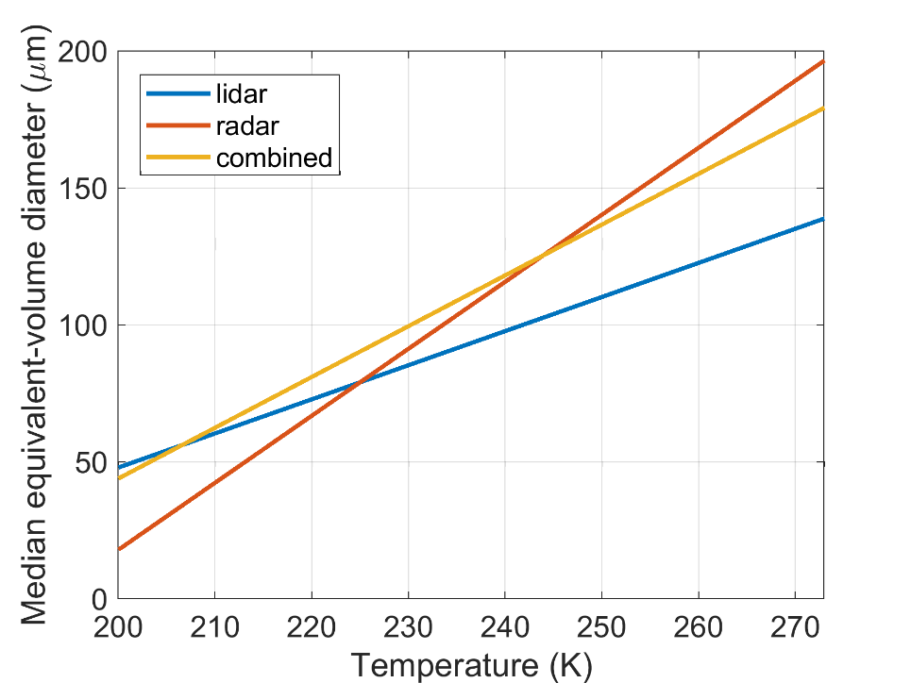
Proof of principle: off-line parameter estimation of observation operator microphysical assumptions
Radar and lidar
Microwave radiances
Multi-parameter minimization
Minimize cost function, J, assuming model analysis ice water content, w_{a} is truth:
where
Can these be combined?
D_{m}
D_{m}
Geer 2021, AMT

Slide 11
Could data assimilation be used for state and parameter estimation?
Physical parameterization schemes all require assumptions that are potential constrained by observations (e.g., cloud particle sizes, fall speeds, updrafts…)
Theoretically possible to simultaneously estimate large-scale atmospheric state and model parameters (e.g., Solar constant estimation at ECMWF, Lopez 2013)
Radar and lidar provide unique constraints on microphysics, but are more observations required?
Practically, a huge challenge!
E.g., need to estimate all uncertain parameters at once, need to avoid unphysical parameters, potential correlations between parameters, requires same model in DA as full non-linear model…

Slide 12
Summary
Preparations for the data assimilation of EarthCARE provide a framework for exploiting its observations for model improvement.
Instrument simulators should be combined synergistically to have greatest impact.
Being aware of microphysical uncertainties in simulators is critical to avoid mis-interpretation of results.
Combined state and parameter estimation DA could create a step-change in the representation of physical processes in NWP models.

