Slide 1


Cloud-radiation interactions in the real atmosphere:
A-Train, EarthCARE, and beyond
Hiro Masunaga
ISEE, Nagoya University

Slide 2
Cloud-radiation interactions
1
A-Train (CloudSat, CALIPSO etc.) and EarthCARE
  Each carry a superb collection of satellite instruments to measure clouds and radiation.
  Only intermittently sample snapshots, disconnected from the context of temporal evolution.
Composite analysis against a sun-async. satellite
  Allows to accumulate sporadic polar-orbiting satellite measurements into a “continuous” time series.
  Masunaga (2012, 2013, …)

Slide 3

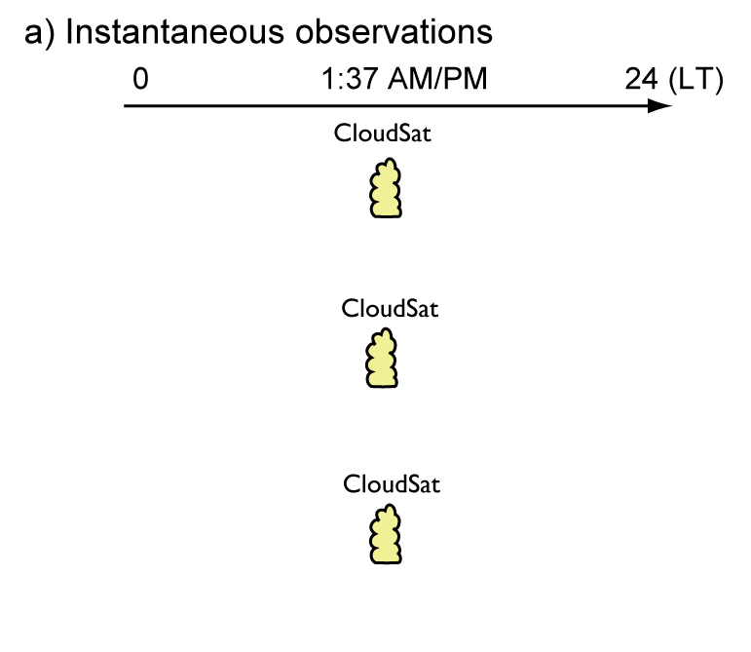
Making a composite time series
CloudSat

Slide 4

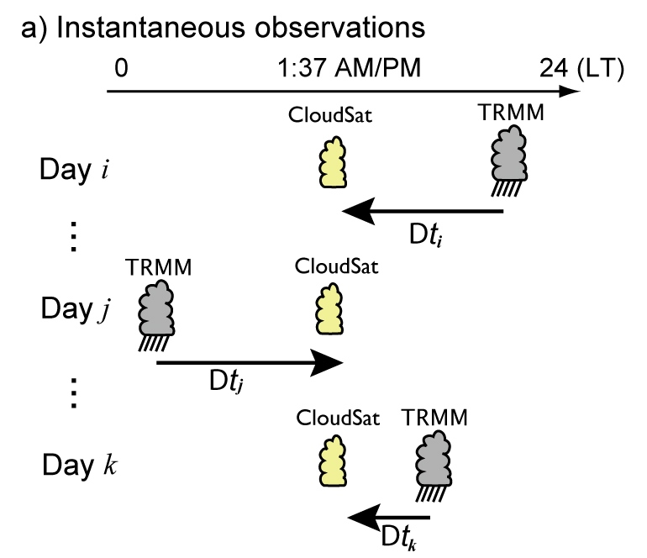
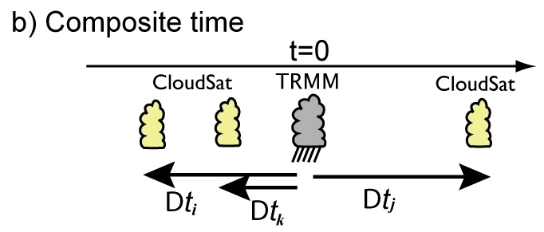
Making a composite time series
CloudSat is sorted in time against TRMM PR .
Region: 20°S-20°N
over ocean only
Period: Jul 2006 – Dec 2009

Slide 5
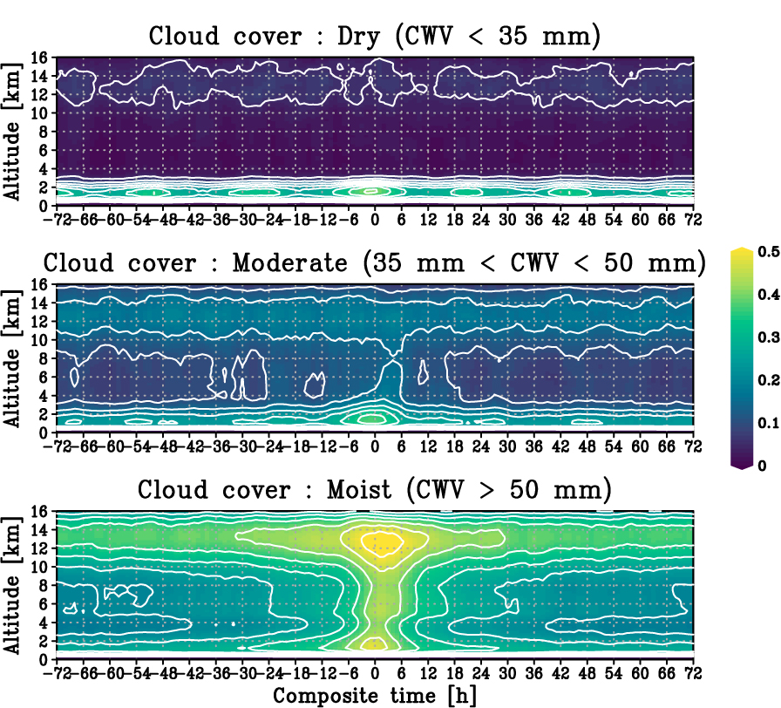
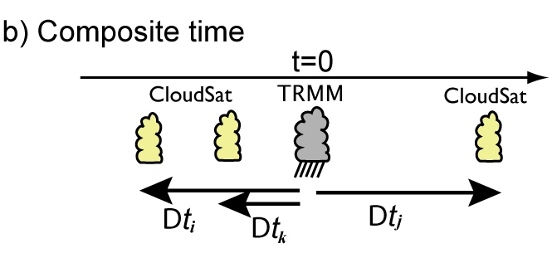
Composite time series
Evolution of CloudSat/CALIPSO cloud fraction
Composite time [h]
Cloud cover defined over R=100 km domain

Slide 6
Separation by background moisture
Breakdown by column water vapor (CWV) at t=0
CWV₀ is monitored at t=0 by TRMM TMI.
Three composite classes
Dry: CWV₀ < 35 mm
Moderate: 35 <CWV₀< 50 mm
Moist: CWV₀ > 50 mm

Slide 7
Composite time series
Evolution of CloudSat/CALIPSO cloud fraction
Composite time [h]
Cloud cover defined over R=100 km domain

Slide 8
Composite time series
Evolution of CloudSat/CALIPSO cloud fraction
Composite time [h]
Cloud cover defined over R=100 km domain

Slide 9
Composite time series
Evolution of CloudSat/CALIPSO cloud fraction
shallow cumuli
shallow cumuli
Cirrus appears even before deep convection.
shallow cumuli
Cloud cover defined over R=100 km domain
Masunaga and Bony, J. Atmos. Sci., 2018

Slide 10

An enhanced Q_{R} could promote convection.
Steady-state moist static energy (MSE) balance
vertical
MSE
advection
surface
turbulent
flux
column
radiative
heating
$$D_{t}\left\langle h\right\rangle =−\left\langle ω∂_{p}h\right\rangle +F_{T}+\left\langle Q_{R}\right\rangle ≈0$$
Feedback?
(e.g., Raymond and Zeng, QJRMS, 2000)

Slide 11
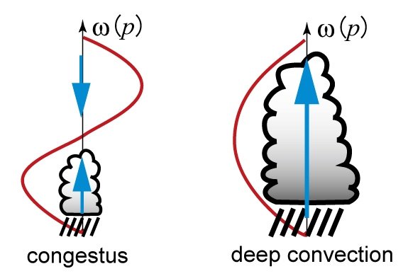



MSE budget thinking revisited
Steady-state moist static energy (MSE) balance
vertical
MSE
advection
surface
turbulent
flux
column
radiative
heating
$$D_{t}\left\langle h\right\rangle =−\left\langle ω∂_{p}h\right\rangle +F_{T}+\left\langle Q_{R}\right\rangle ≈0$$
$$>0 in the Tropics.$$
$$−\left\langle ω∂_{p}h\right\rangle >0$$
$$−\left\langle ω∂_{p}h\right\rangle <0$$
Steady balance
does not hold.
Steady balance
2nd baroclinic or “congestus” mode
1st baroclinic or “deep” mode

Slide 12
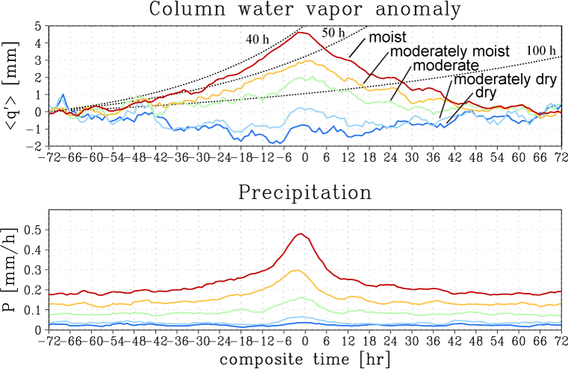
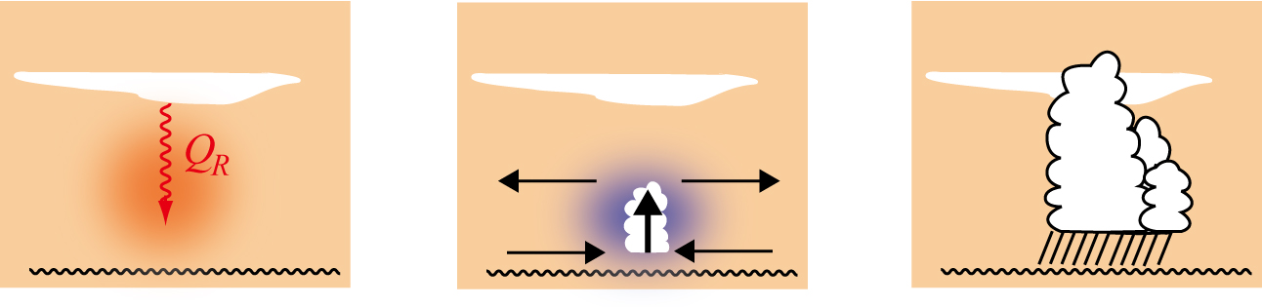
Cirrus radiatively triggers deep convection
c
Composite time [h]
Masunaga and Bony, J. Atmos. Sci., 2018

Slide 13
Cirrus radiatively triggers deep convection
c
Moist anomaly grows.
Composite time [h]
Masunaga and Bony, J. Atmos. Sci., 2018

Slide 14
Key science questions
A
Hourly/daily evolution of convective clouds
  Shallow convection can grow on its own (GMS<0), while deep convection is destined to die out (GMS>0).
    Models may or may not well reproduce this.
  Cirrus radiative effect may help shallow convection grow into deep convection.
  More work is needed to grasp a more complete picture of the cloud-radiation interactions governing tropical convection
    Convective self-aggregation, iris effect, etc.

Slide 15
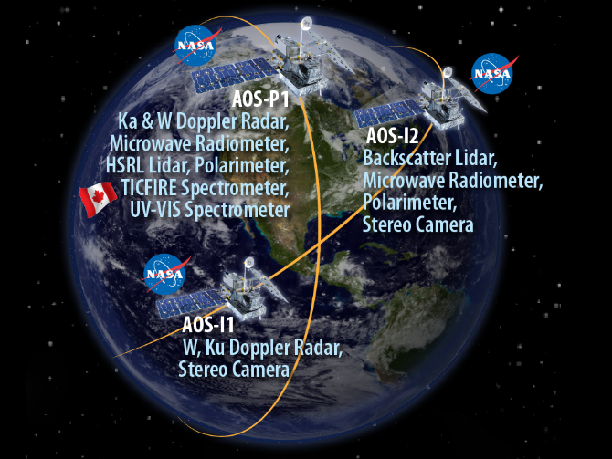
Satellite pairs for the composite time series
A
A-Train era
  CloudSat/CALIPSO/CERES versus TRMM
EarthCARE era (2023-)
  CPR/ATLID/BBR versus GPM
AOS era (2028/30-)
  W/Ka Doppler with HSRL etc. versus Ku Doppler
https://aos.gsfc.nasa.gov/mission.htm

