Slide 1
EarthCARE Modeling Workshop, Feb 18, 2022
Examples of possible evaluation of GCMs using cloud radar and lidar satellite data
Hideaki Kawai, and Tsuyoshi Koshiro
Meteorological Research Institute, JMA

Slide 2
Examples
Cloud top height of low clouds
Marine fog
Phase of clouds
Fall velocity of cloud ice

Slide 3
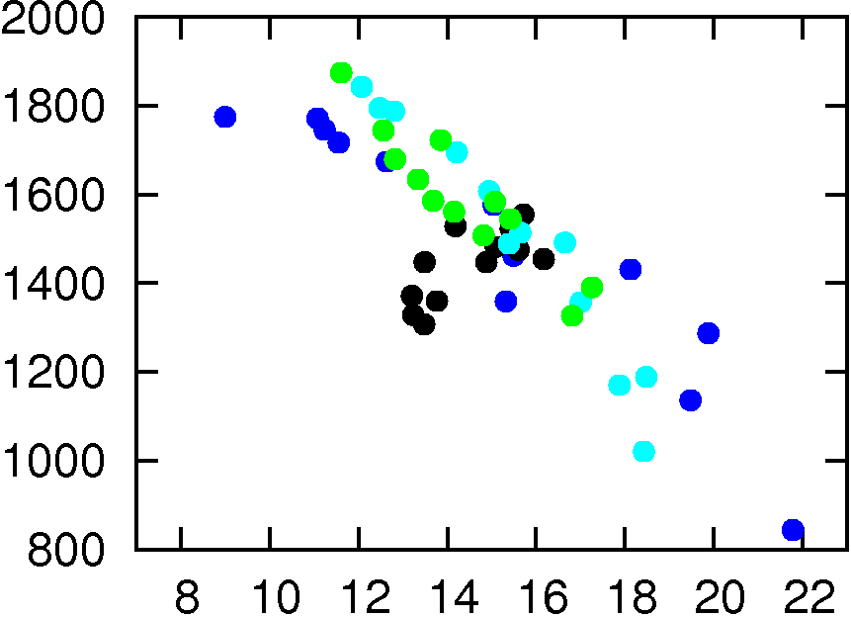
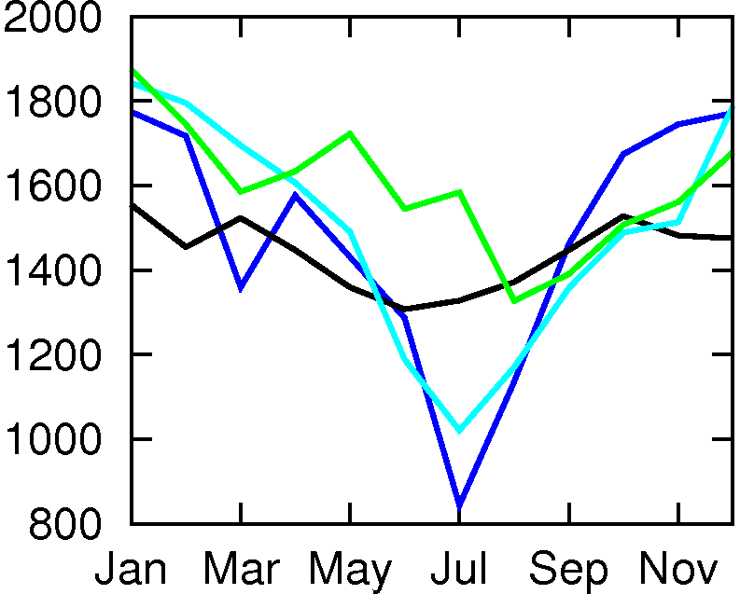
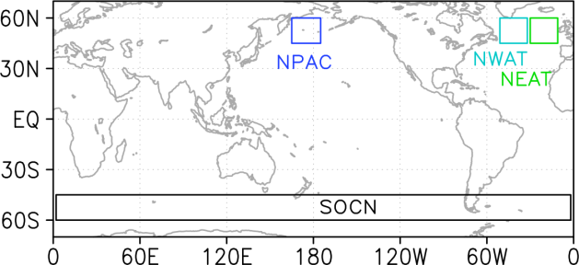
Cloud top height of mid-latitude low clouds
Kawai et al. (2015, JMSJ)
Seasonal Variation
CTH and stability index
[m]
R = −0.83
[m]
North Pac.
NW Atlantic
NE Atlantic
Southern Ocn.
CTH (CALIPSO)
CTH (CALIPSO)
LTS (Low. Trop. Stability) [K]
θ₇₀₀−θ_{surf}
Monthly data (12 for each location) are plotted.
CALIPSO enabled this study!
High vertical resolution is needed for low cloud studies.
In the past
Estimation of CTH was terribly inaccurate.
Difficult to study mid-latitude low clouds.

Slide 4
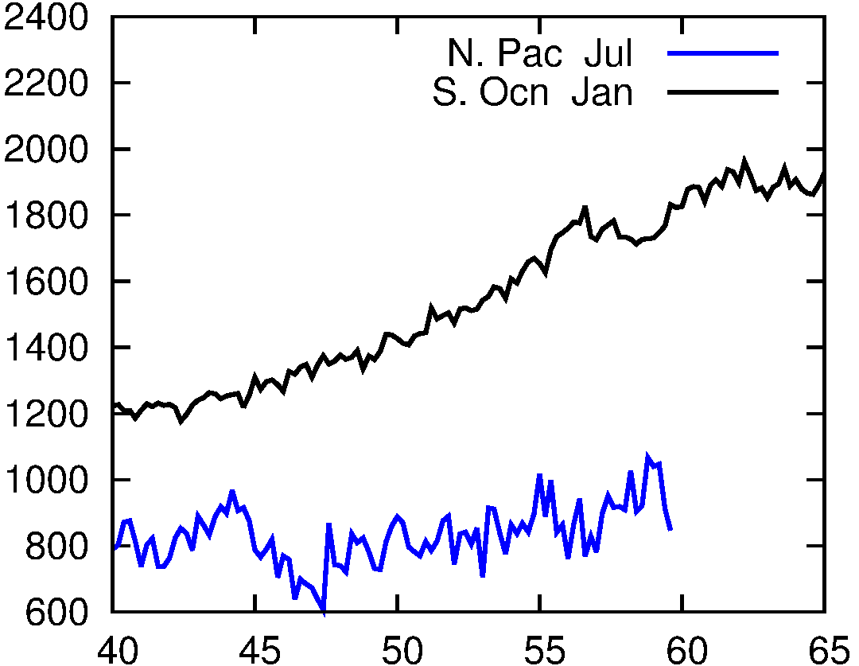
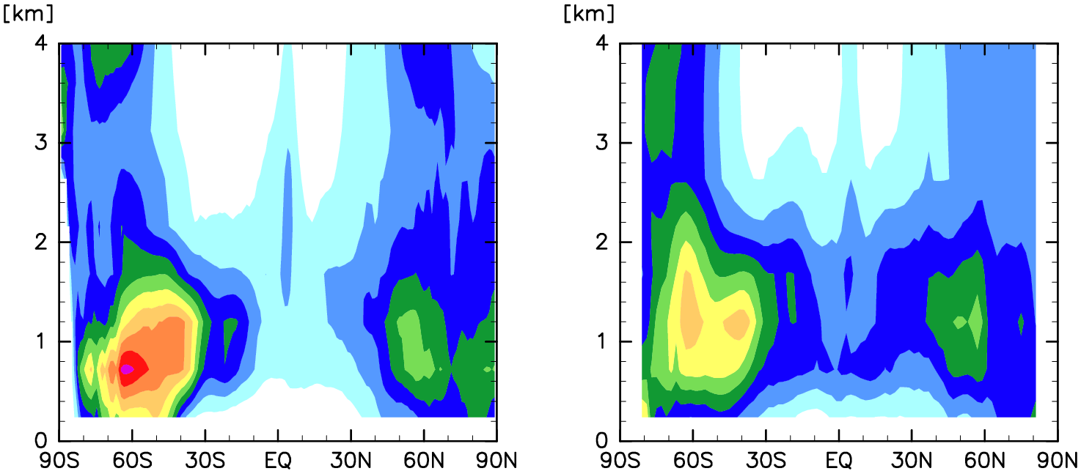
Geographical variations in CTH in SH and NH
[m]
SH summer:
CTH is higher toward south.
CTH is higher than NH summer.
NH summer:
Cloud top height is low and almost constant.
CTH (CALIPSO)
Southern Ocean
Zonal (Jan)
N. Pacific
165E-165W (Jul)
MRI-ESM2 (COSP)
CALIPSO Obs.
CTH is too low in the model.
CTH increases poleward in obs. But it decreases in the model.
10-yr mean
9-yr mean
by T. Koshiro

Slide 5
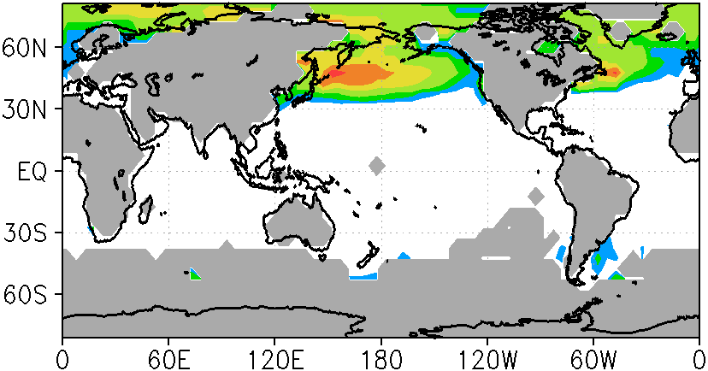
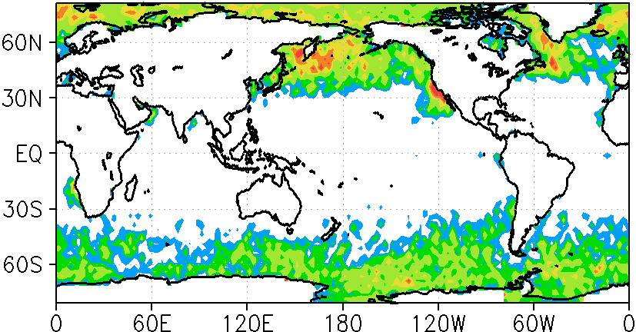
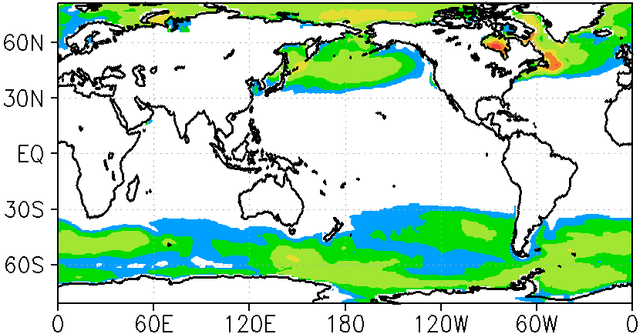
Frequency of fog occurrence
Kawai et al. (2015, JMSJ)
July
Shipboard Obs. Climatology
KU Cloud mask (CALIPSO) 0-240m
(EECRA)
(2007-2009)
Southern Ocean in Winter, Ship obs. were few
MRI-CGCM3 (lowest model level CF)
[%]
CALIPSO seems to capture fogs relatively well (Impossible for other satellites)!
Can observe areas where shipboard obs. are impossible.
High frequency obs.

Slide 6
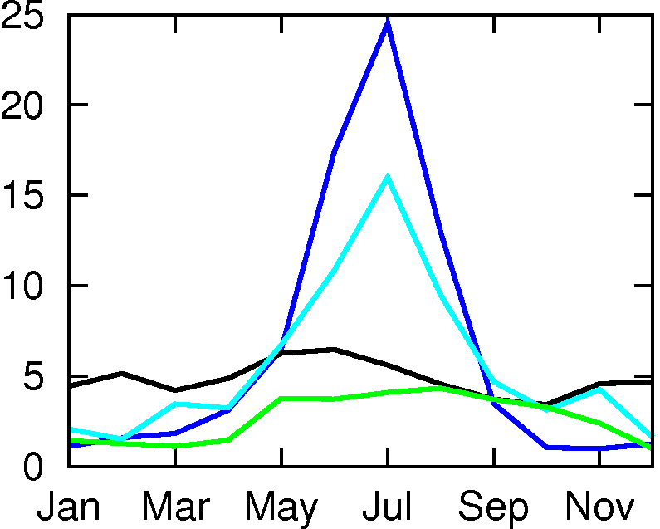
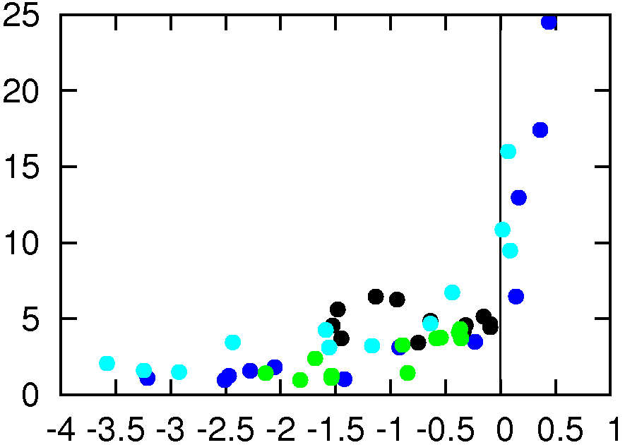
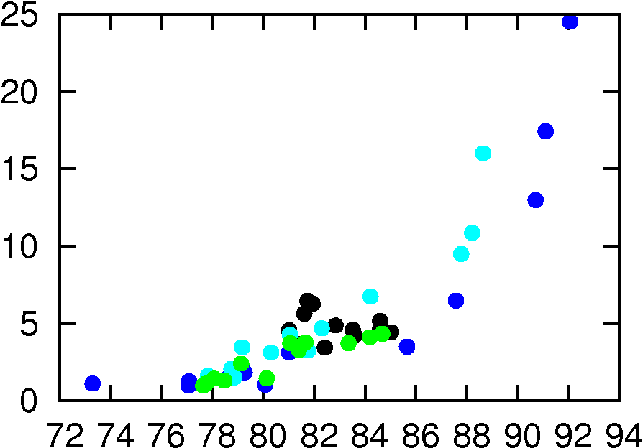
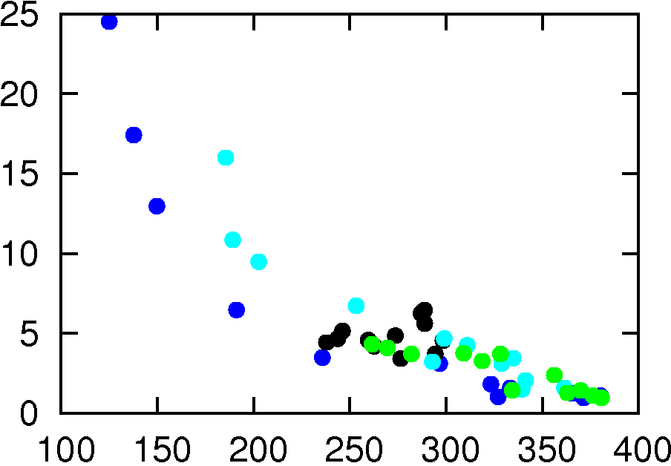
Occurrence of fogs
Seasonal Variation
[%]
North Pac.
NW Atlantic
NE Atlantic
Southern Ocn.
fog frequency
Fog is defined as cloud (CALIPSO) in a bin of 0-240m.
Occurrence of fogs and meteorological factors
[%]
fog frequency
2mT − SST [K]
2m RH [%]
LCL [m]
Meteorological data: ERA-Interim
Monthly data (12 for each location) are plotted.

Slide 7
Improvement in clouds in MRI-ESM2
Old model: MRI-CGCM3
New model: MRI-ESM2
TCC bias
obs.: ISCCP
* much less over the Southern Ocean
* Much Improved over the SO and off Peru
TOA SW bias
(upward)
obs:
CERES-EBAF
* Too much SW reflection over Tropics
* Much less SW reflection over the SO
* Improved over Tropics
* Improved over the SO and off Peru
Yukimoto et al. (2019), Kawai et al. (2019)
historical 1986-2005 (Annual mean)

Slide 8
Various improvements related to clouds…
Kawai et al. (2019, GMD)
Stratocumulus parameterization (turbulence scheme)
Cloud microphysics
Vertical resolution
Convection scheme (shallow convection)
Cloud overlap scheme for radiation
Radiation process
Bug
Aerosol mode radii
Cloud ice fall calculation

Slide 9
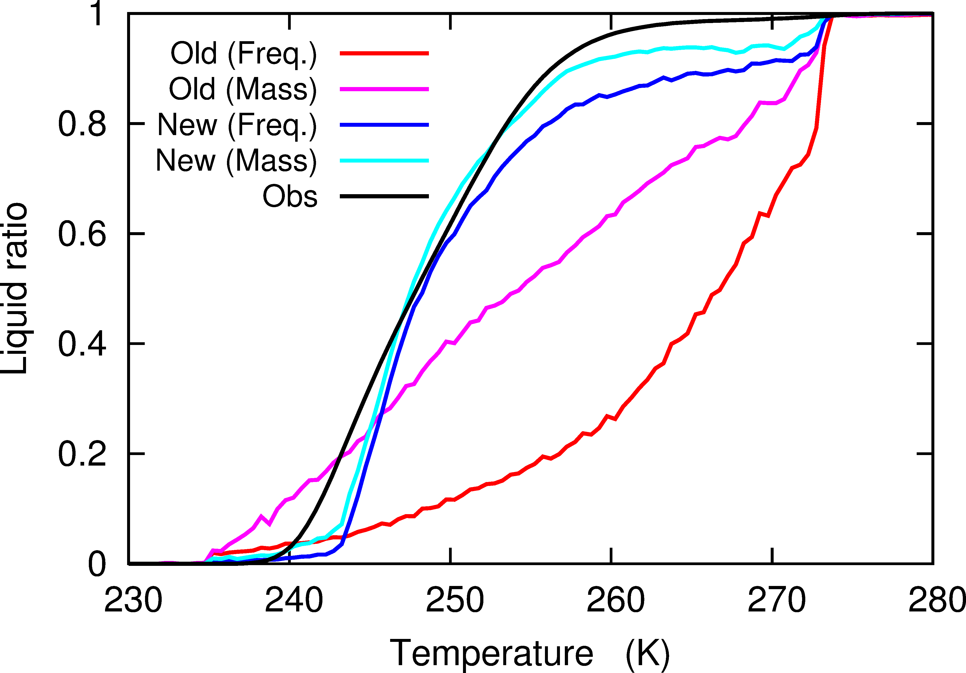
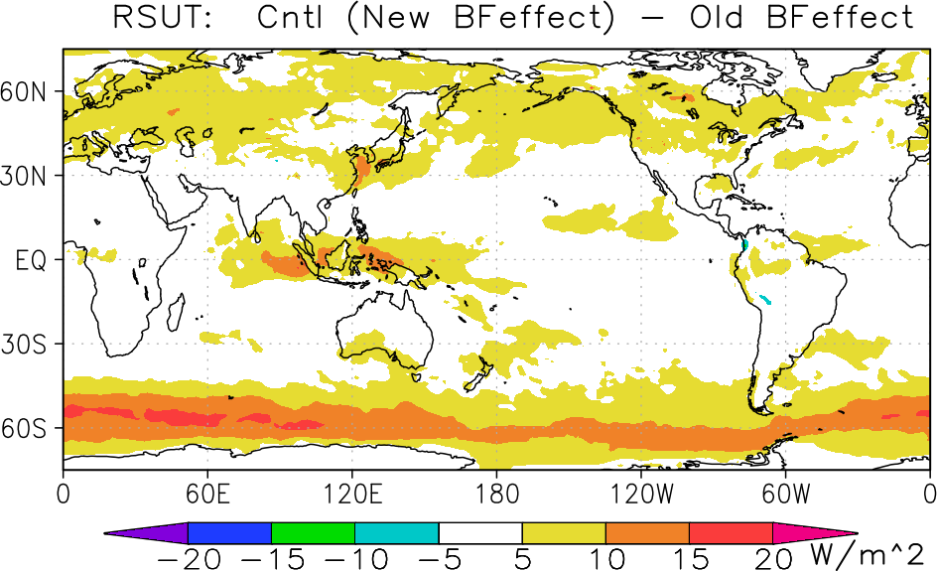
Impact of modified cloud microphysics
Liquid Water Ratio
TOA SW radiation (upward)
New WBF effect － Old WBF effect
10-yr mean
Model （Improved WBF effect）
Model （Old WBF effect）
Observation: CALIPSO (Hu et al., 2010)
Snapshot (10 days, July)
800-500 hPa
Observation: High liquid water ratio
Modified treatment of WBF effect in the model cloud microphysics:
Supercooled water was increased.
Optical thickness of clouds increased.
SW reflection is increased over the Southern Ocean.

Slide 10
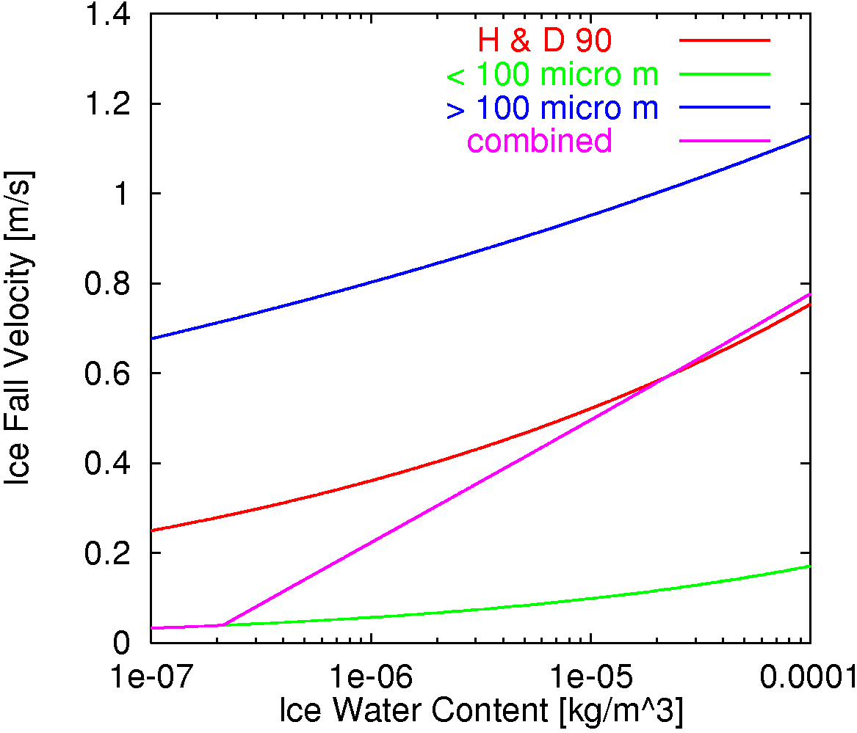
Fall velocity of ice cloud
Kawai (2005)
in Old Model
in New Model
Two ice velocities for small ice and large ice that were deduced using observed size distribution function are utilized.
$$v_{cice}=3.29(IWC_{<100})^{0.16}$$
Too fast to treat as a sedimentation in GCMs
Reach surface in a moment
(Heymsfield and Donner 1990)
Small Cloud Ice
>100μm(new)
~0.5 [m/s]
[m/s]
[kg/m³]
Δz
~650 [m]
Large Cloud Ice
Conventional H&D90
Weighted Average (new)
Δt
can be ~1800 [s] for low res. models
<100μm(new)
Can cloud ice fall be treated using a single velocity?
v_{ice}Δt > Δz
Very slow
~900 [m]
These ice velocities can be evaluated by EarthCARE data?

Slide 11
How should we calculate ice fall properly?
GCMs
More realistically
at t
at t+Δt
at t+Δt
single size
smaller ice
larger ice
~0.5 [m/s]
~0.05 [m/s]
~0.2 [m/s]
~0.6 [m/s]
~1.3 [m/s]
Δz
~650 [m]
+
+
+
Even this concept is not realistic calculation.
Heymsfield et al. (2013, JAS)

Slide 12
Summary
Four examples of possible evaluation of GCMs using cloud radar and lidar satellite data are introduced.
Cloud top height of low clouds Kawai et al. (2015)
Marine fog Kawai et al. (2015)
Phase of clouds Kawai et al. (2019)
Fall velocity of cloud ice Kawai et al. (2019), Kawai (2005)
Other important cloud properties for GCMs that could be obtained from cloud radar and lidar satellite.
Cloud water content
Cloud ice content

Slide 13
References
Kawai, H., 2005: Improvement of a Cloud Ice Fall Scheme in GCM. CAS/JSC WGNE Research Activities in Atmospheric and Oceanic Modelling/WMO, 35, 4.11-4.12.
Kawai, H., S. Yabu, Y. Hagihara, T. Koshiro, and H. Okamoto, 2015: Characteristics of the Cloud Top Heights of Marine Boundary Layer Clouds and the Frequency of Marine Fog over Mid-Latitudes. J. Meteor. Soc. Japan, 93, 613-628.
Kawai, H., S. Yukimoto, T. Koshiro, N. Oshima, T. Tanaka, H. Yoshimura, and R. Nagasawa, 2019: Significant Improvement of Cloud Representation in Global Climate Model MRI-ESM2. Geosci. Model Dev., 12, 2875-2897.
Kawai, H., T. Koshiro, and M. J. Webb, 2017: Interpretation of Factors Controlling Low Cloud Cover and Low Cloud Feedback Using a Unified Predictive Index. J. Climate, 30, 9119-9131.
Koshiro, T., M. Shiotani, H. Kawai, and S. Yukimoto, 2018: Evaluation of relationships between subtropical marine low stratiform cloudiness and estimated inversion strength in CMIP5 models using the satellite simulator package COSP. SOLA, 14, 25-32.
Nagasawa, R., 2012: The Problem of Cloud Overlap in the Radiation Process of JMA’s Global NWP Model. CAS/JSC WGNE Research Activities in Atmospheric and Oceanic Modelling/WMO, 42, 4.15-4.16.
Yukimoto, S., et al., 2019: The Meteorological Research Institute Earth System Model version 2.0, MRI-ESM2.0: Description and basic evaluation of the physical component. J. Meteor. Soc. Japan, 97, 931-965.

