Slide 1
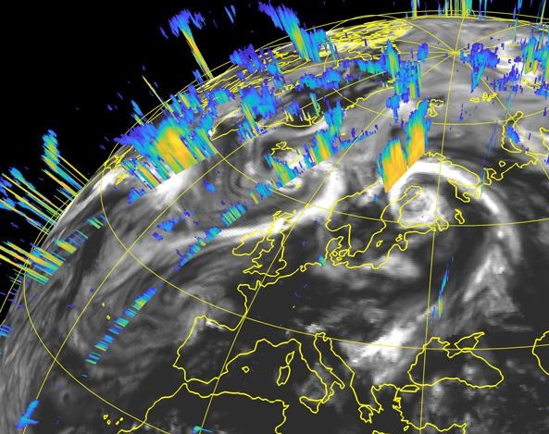
Confronting Global Models with Observations of Clouds and Precipitation
Andrew Gettelman (NCAR)
X. Huang, C. McCluskey (NCAR)
R. Forbes, M. Fielding (ECMWF)
R. Marchand (UW-Seattle)
Mark Fielding, ECMWF Newsletter

Slide 2
Outline
Where are ESMs going?
What are major issues for Clouds and Precipitation?
How can EarthCARE Help?
Larger vision: Model-Data Fusion

Slide 3
Where are ESMs Going?
One path forward: GSRMs
But: also want them traceable to lower resolution Global, Regional
Merging with mesoscale models (especially cloud processes)
Scalable (cross-scale) complexity: chemistry, aerosols, cloud processes (e.g. rimed ice)
New methods
Emulators, Machine Learning (new generation of ‘empirical’ parameterizations)
Better analysis, optimization methods
Satellite Simulators
Data Assimilation for Climate (especially for clouds)

Slide 4
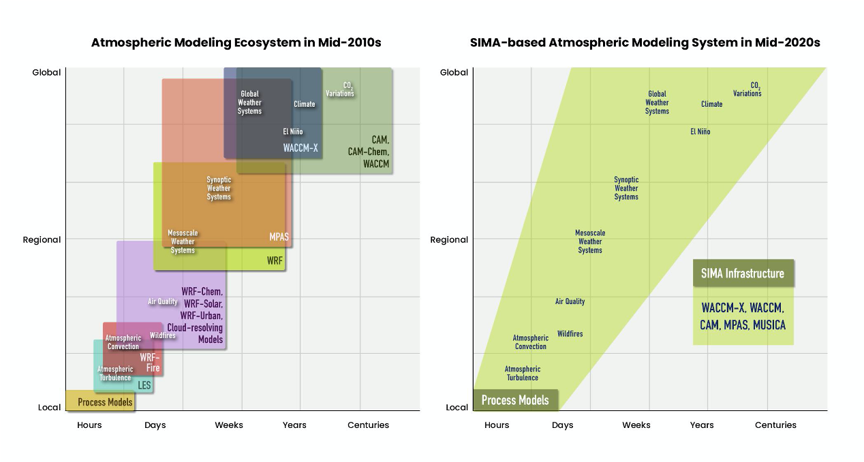
NCAR’s vision…similar to others System for Integrated Modeling of the Atmosphere (SIMA)

Slide 5
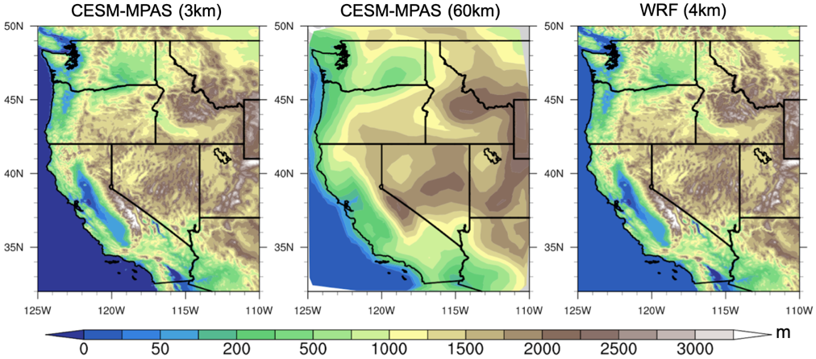
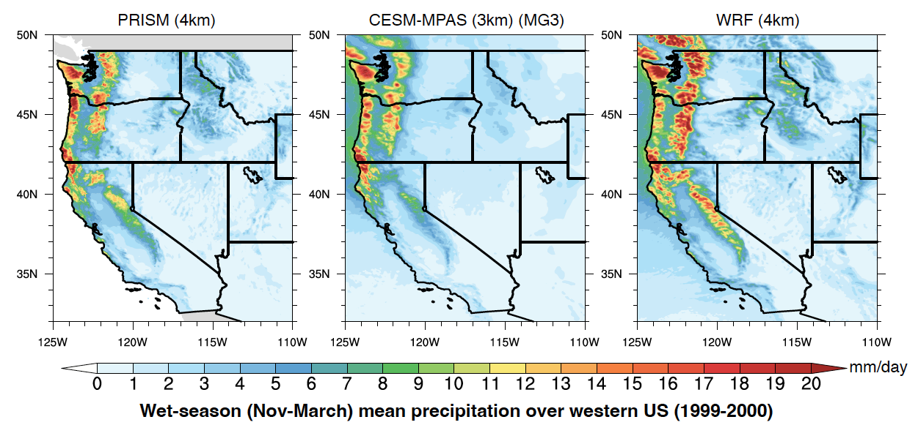
Climate Extremes: Variable-Resolution (60→3 km)
Observational dataset: PRISM 4km (Daly et al., 2017)
Global Model: CESM-MPAS: 3km regional, non-hydrostatic dynamics. Global model physics (2-moment microphysics with graupel)
Regional climate model: WRF (CONUS) 4km (Rasmussen et al., 2021)
Topography
W. USA Wet-season (Nov-Mar) precipitation (1999-2004)
CESM-MPAS results are compare well to observations
Smaller biases than WRF mesoscale model
Precipitation
X. Huang, NCAR

Slide 6
Major Issues for Clouds, Precip and Aerosols (IMHO)
Heard lots about warm clouds. Let’s talk about cold clouds
Cloud Phase: critical for radiative effects at high latitudes AND for cloud feedbacks. Also weather impacts
Cloud Microphysics: size distributions govern process rates
Aerosol activation (cloud-aerosol interactions). Vertical velocity
Issue: shallow velocity may be more important.
Precipitation Intensity: weather impacts

Slide 7
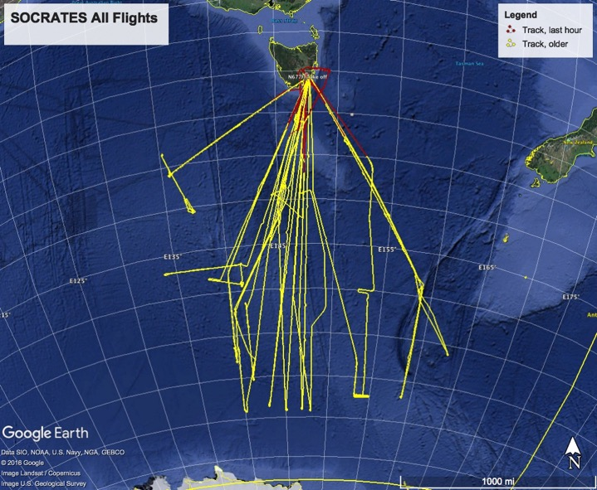
Cloud Phase
SOCRATES in-situ flights over the S. Ocean used to understand & improve models
CAM6: Too little ice. This contributes to high climate sensitivity.
Model
Observations
Gettelman et al 2020

Slide 8
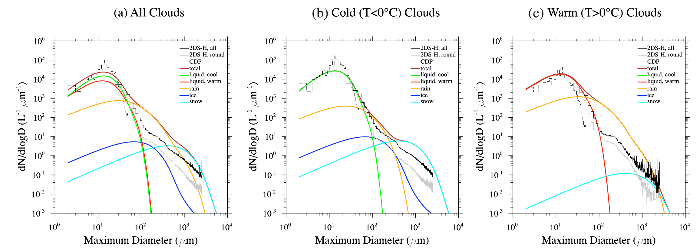
Microphysics, Size distributions
Advanced GCMs/GSRMs can be compared directly to cloud microphysical size distributions (here from SOCRATES).
Comparison is GCM cloud microphysics along aircraft flight tracks with in-situ data
Note potential issue with too large rain sizes
Gettelman et al 2020

Slide 9
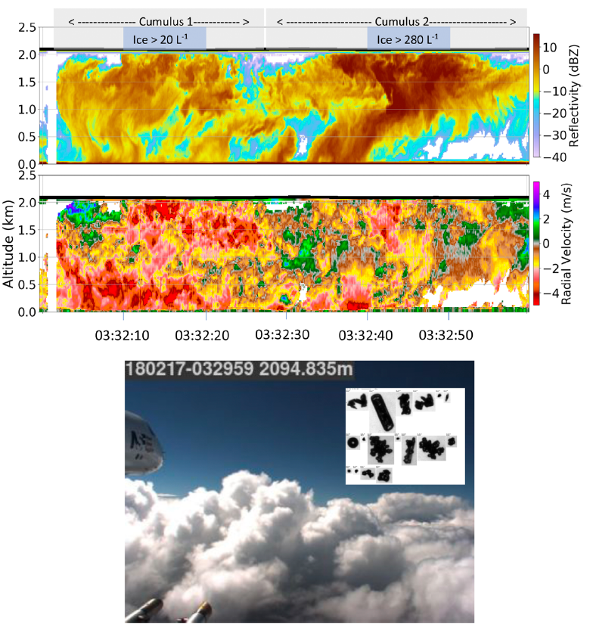
Cloud Dynamics & Microphysics
Cloud dynamics (velocity) influences/controls cloud microphysics & aerosol activation
Leads to different cloud drop/crystal number, precipitation & radiative effects
S. Ocean SOCRATES example
60s ~ 10km
McFarquhar et al 2020
Notes:
Fig. 14. Aircraft pass on 17 Feb 2018, through the tops of two closely spaced cumuli at a temperature of −9°C, as shown by the downward-pointing airborne Doppler radar on the G-V aircraft [(top) radar reflectivity and (middle) vertical velocity; positive values denote upward motion of particles]. The black horizontal line at the top shows the aircraft location as it passed through the cloud tops. Shaded gray boxes demarcate the two clouds, with shaded blue boxes identifying 10-s regions with the highest maximum ice number concentrations (corrected for possible shattering artifacts) as labeled. (bottom) Snapshot from forward video also shows the multiple thermal structure of these cumuli as the aircraft approached. (inset) Particle images from PHIPS probe indicated rimed ice and liquid drops were present, necessary for rime splintering to be active, as well as the expected products of rime splintering, pristine, and rimed columns.

Slide 10
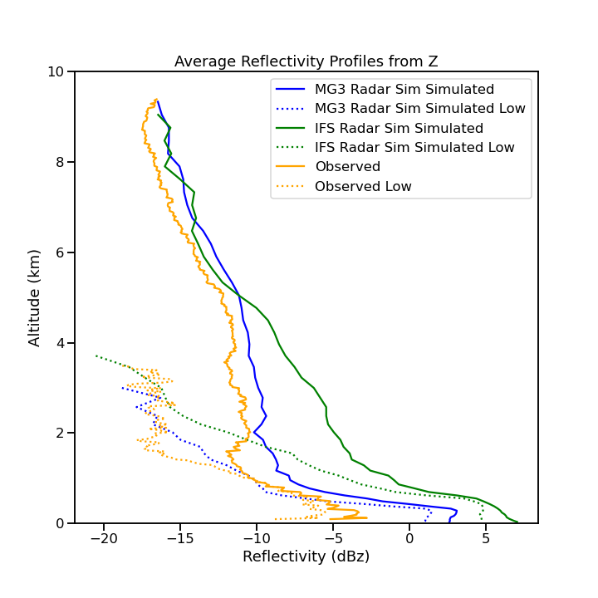
Microphysics: Comparing to Reflectivity
Comparisons over Macquarie Island in S. Ocean between a precipitation radar and single column simulations with one-moment and 2-moment microphysics in the ECMWF-IFS SCM.
Observation
2-moment micro
One-moment micro
Gettelman, Forbes, Fielding, in Prep

Slide 11
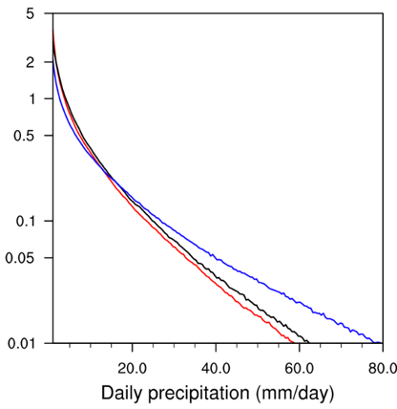
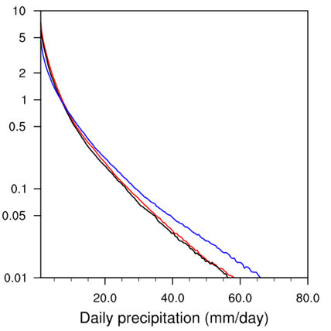
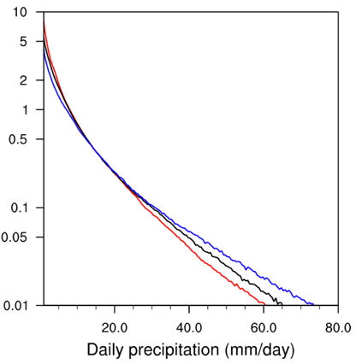
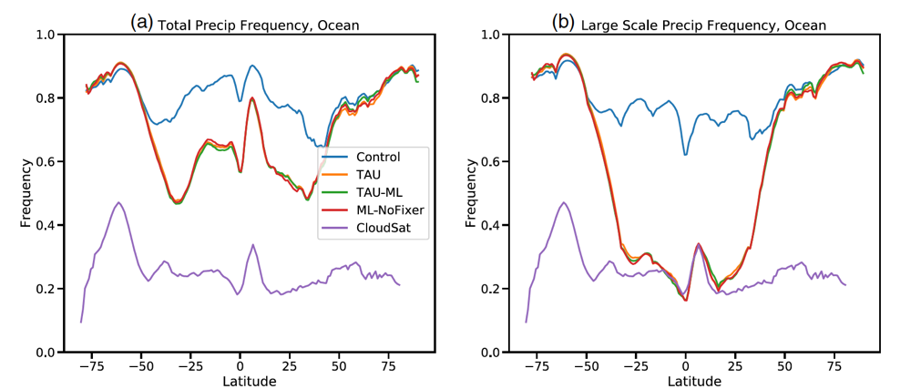
Precipitation Intensity & Frequency
Daily precipitation Intensity PDF
Daily precip. Intensity from 4km Mesoscale Model (WRF), 3km Global Model (CESM) and 4km Observations
CESM captures observed PDF better than WRF, especially for more extreme precipitation (upper tail)
California
Oregon
Washington
X. Huang, NCAR
Precipitation Frequency
Control v. Observations and
Bin precipitation and ML Emulator.
Using stochastic collection from a bin scheme improves large scale precipitation frequency in shallow clouds
Gettelman et al 2021, JAMES

Slide 12
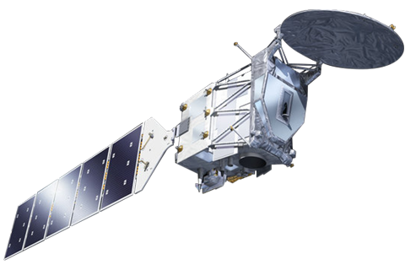
Where can help?
Doppler velocity: what are the intensity and scales of motion in shallow and deep clouds
Reflectivity: solid measurement we can simulate in models and if the microphysics is wrong we will know it
Better simulators. We aren’t just trying to get means right we are using more integrated models from weather to climate, and want more direct process information
What simulator are we going to use? J-SIM? COSP? RTTOV?
Suggest maybe we take the COSP model interface and make it modular
Assimilation of cloud information for model evaluation

Slide 13
Goal: Improving Prediction
Improving prediction relies on models AND observations together
A ‘model-data fusion’
Better models
Better observations
Better techniques (assimilation, evaluation of models and obs)

Slide 14
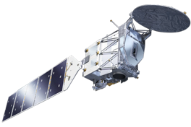
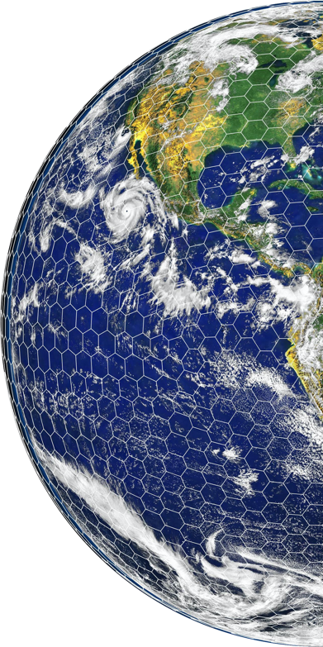
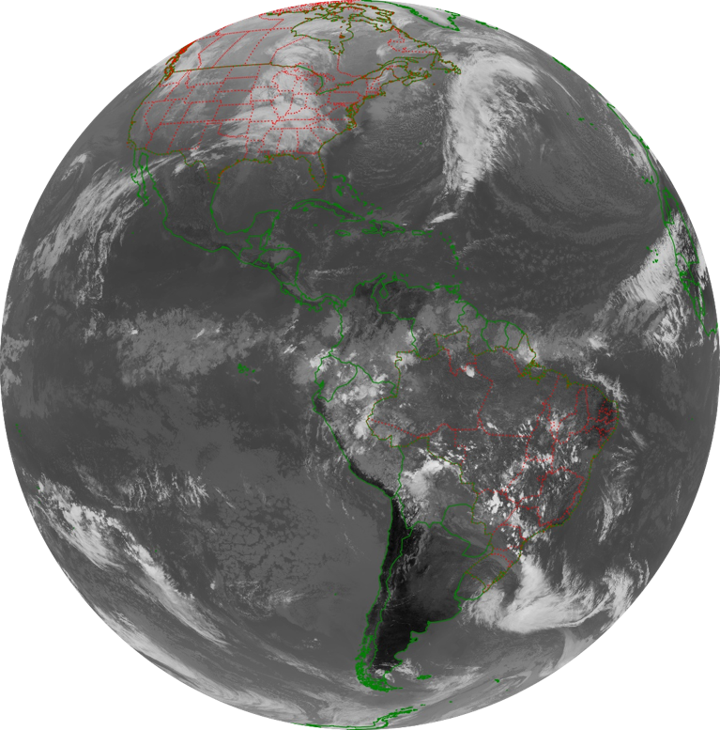
Vision: Model – Data Fusion
EarthCARE
Obs Simulator
A Prioiri Info
Observations
Data Cube or ‘Twin’
Prediction
Signal (Voltage)
Radiance
‘Applications’
Model
Empirical Models/Training
Assimilation
Retrieval
Gettelman et al, 2022, Science Advances
Notes:
Fielding cloudsat image from ECMWF newsletter.
https://www.ecmwf.int/en/about/media-centre/news/2020/tests-show-cloud-radar-and-lidar-data-improve-weather-forecasts

Slide 15
Summary
Key cloud microphysics problems:
Cloud Phase
Aerosol-Cloud Interactions (dynamics!)
Precipitation
Key places to make progress with Earth Care
Vertical motion, reflectivity, cloud phase
New methods: Model-Data Fusion
Simulators
Assimilation

