Slide 1
サブメソスケール解像生態系モデリング
高解像度化はどこまで必要か？
Submesoscale modeling for low-trophic-level ecosystem：
What is an appropriate downscaling?
Hiroshi Kuroda (Fisheries Research Agency）
Thanks to “SKED” and KAKEN
(The Study of Kuroshio Ecosystem Dynamics for Sustainable Fisheries)

Slide 2
Final Goal
Generally, the Kuroshio region is typically oligotrophic,
but there is a productive ecosystem nursing a variety of fishes.
I’d like to elucidate why such a rich ecosystem can be formed
and maintained in the Kuroshio region?
Key words
I. Shelf-slope regions inshore side of the Kuroshio
※Interaction between the Kuroshio and coastal water.
II. High-resolution modeling
※To clarify roles of submesoscale variations
※Our target: submesoscale with O(1) day & O(10 )km
III. Nutrient supply processes
※Particularly, nutrient supply into the ML in winter

Slide 3
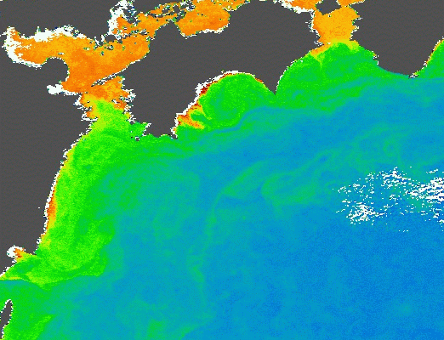
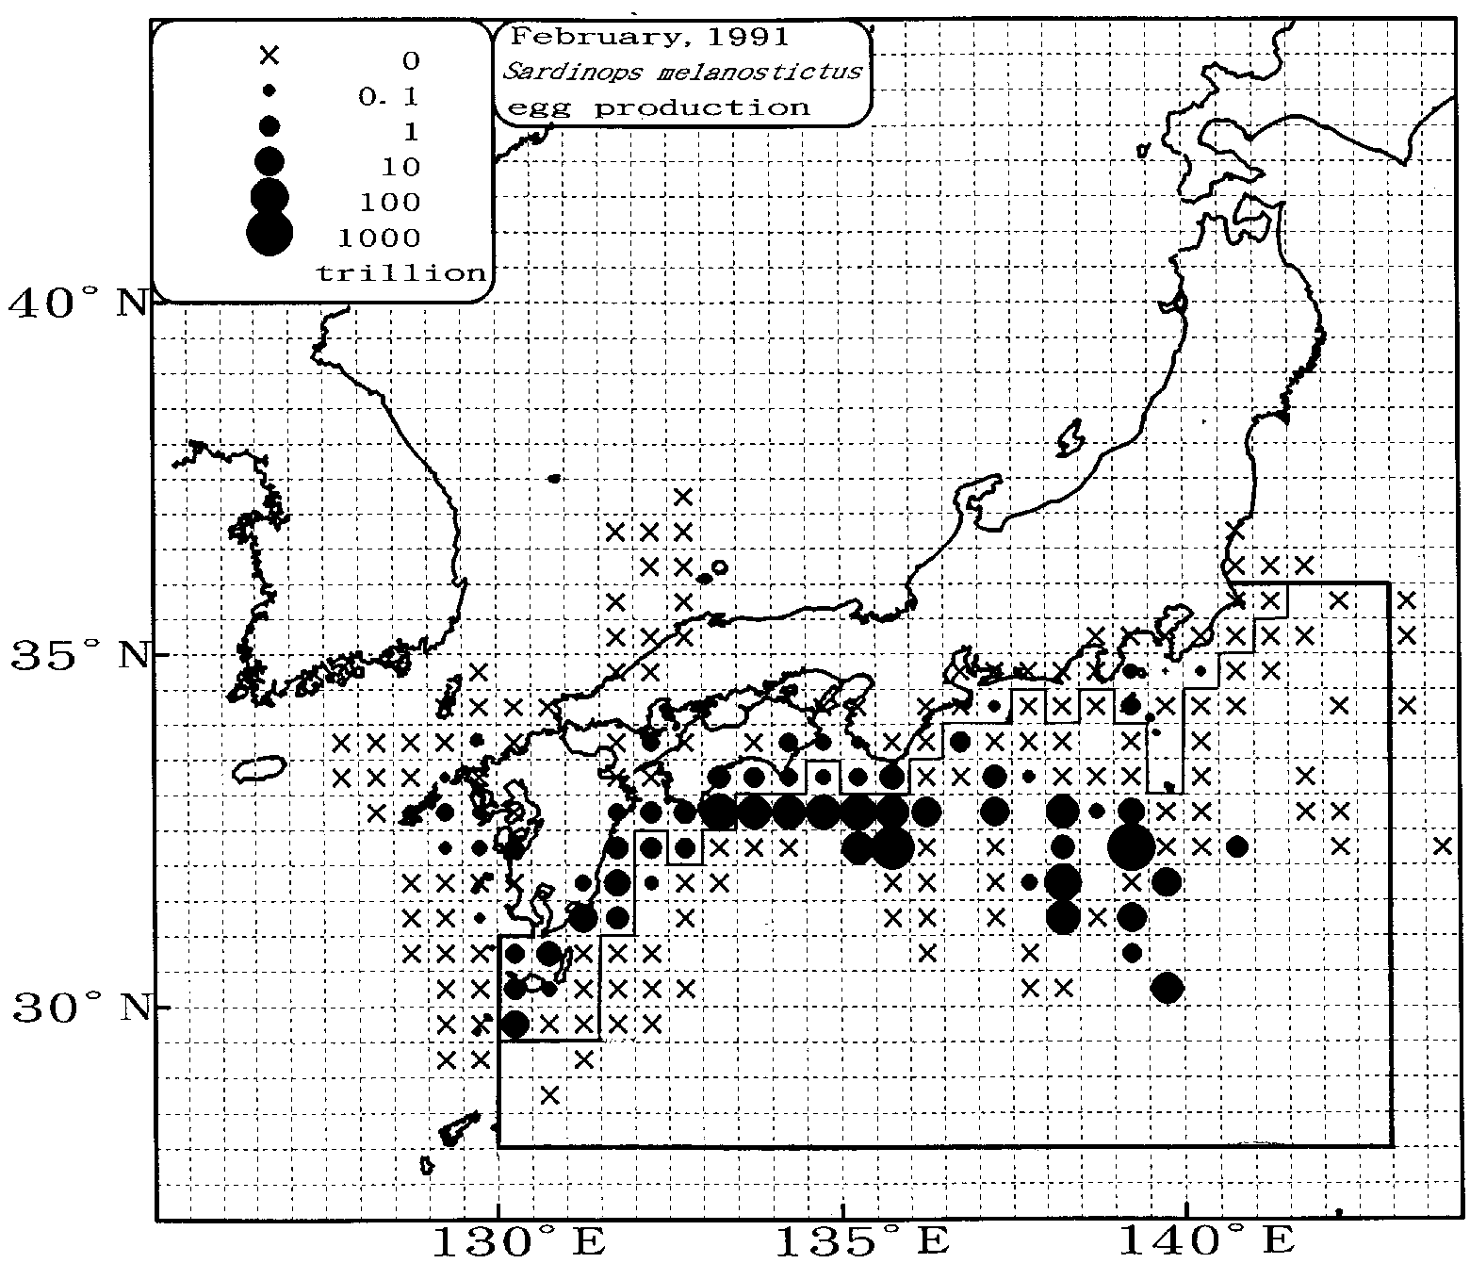
Inshore side of the Kuroshio
Properties
・Production higher than the
offshore Kuroshio region.
・Spawning grounds (sardine, ..)
Why can the higher production
be maintained?
Nutrient source
Around Tosa Bay,
（1）Nutrients from the land
Nigi et al. (2008)
Yoo & Nakata (2002)
（2）Nutrients from the offshore
Ichikawa & Hirota (2004)
Hirota et al. (2001)
12 Jan. 2002 Satellite CHL-a
Tosa Bay
http://kuroshio.eorc.jaxa.jp/
MODIS
Feb. 1992
Distribution of Pacific sardine eggs
Watanabe et al. （1997）

Slide 4
Background
Winter Mixed Layer
Cooling
Sea Surface
One-Dimensional Process
①Cooling at the sea surface
②Low temperature water is formed
at the sea surface.
③Convection between the surface and
subsurface water (entrainment of rich
nutrients from the subsurface)
④Well-mixed layer is formed near the
sea surface
convection
Notes:
冬季混合層について

Slide 5
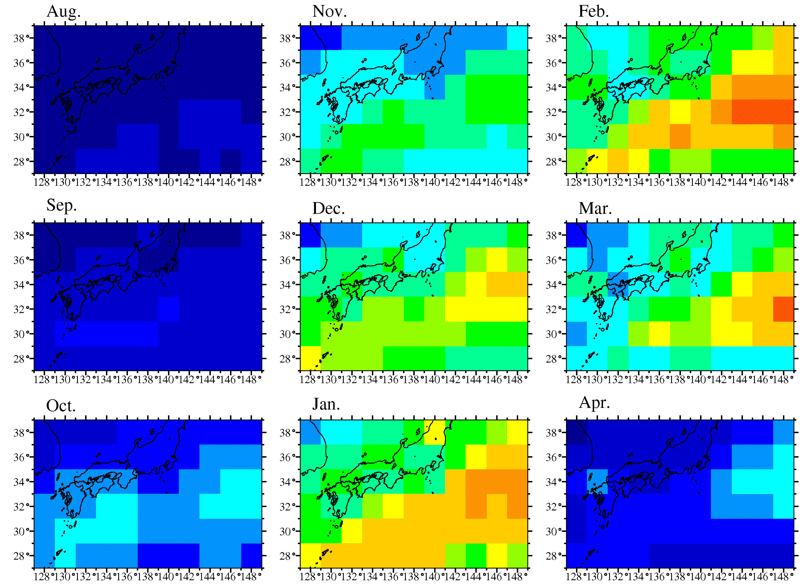
Climatological seasonal cycle of mixed layer depth ( 2°)
de Boyer Montégut et al. (2004, JGR)
(m)

Slide 6
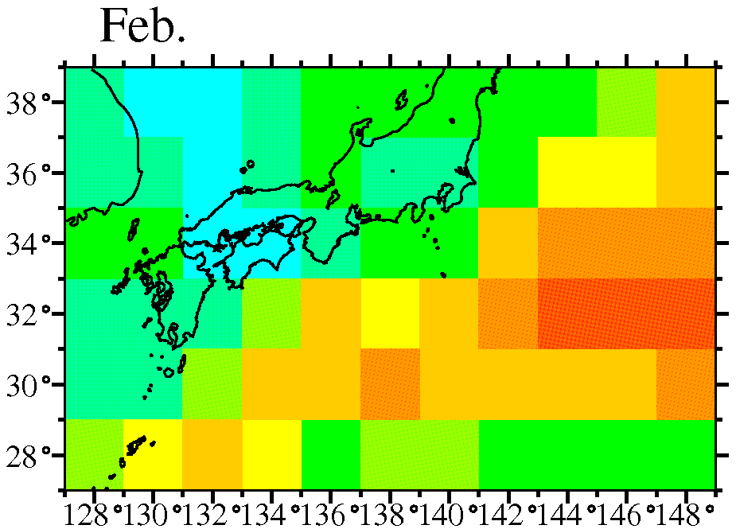
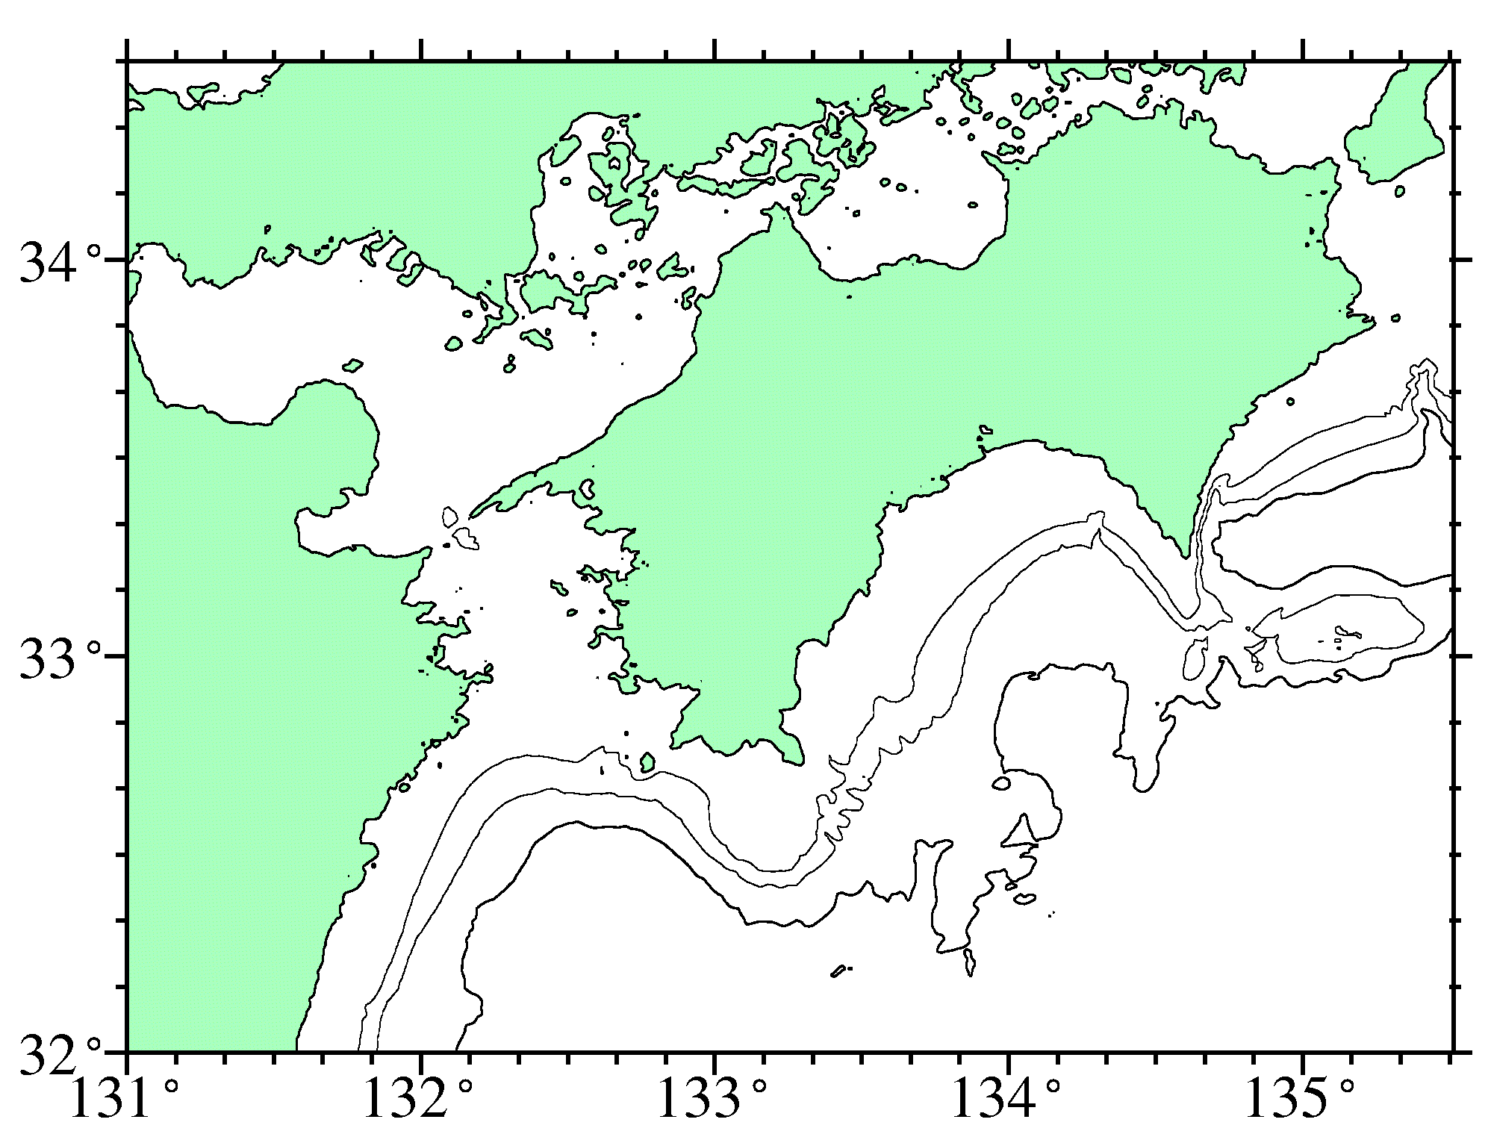
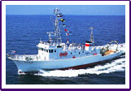
Analysis Data
Station : Stn.A
Observed period ：1991~2004
Observed freq. ：monthly
Instrument : CTD&STD&XBT
Vertical resolution ：1m
Tosa Bay
Definition of the mixed layer
the same as de Boyer Montégut et al. (2004)
Stn.A
water depth: 650m
R/V Kotaka

Slide 7
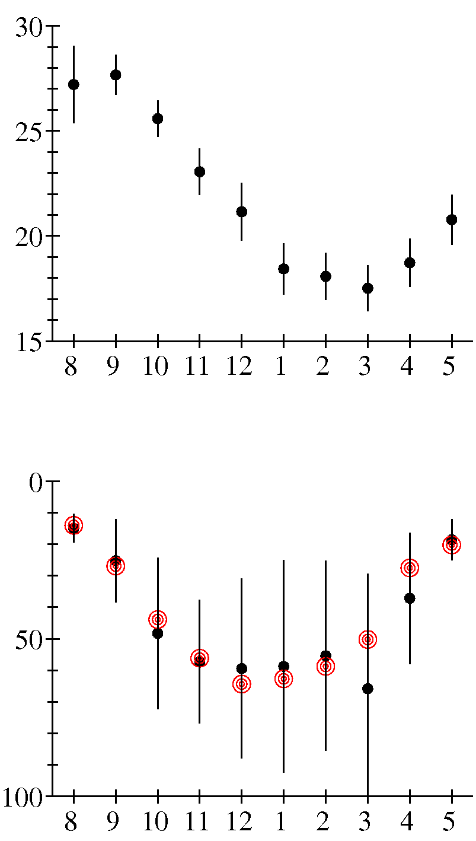
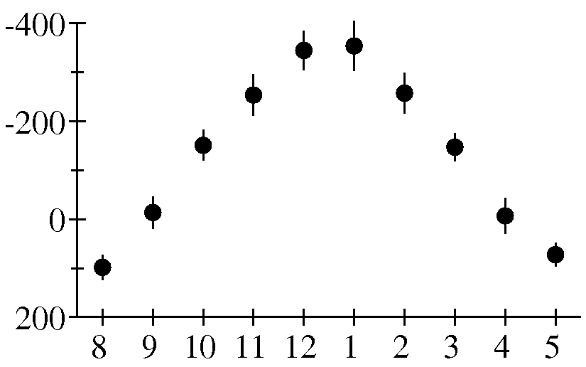
Monthly ML temperature & depth
at Stn.A in Tosa Bay
●：monthly mean
vertical bar：±1 S.D.
◎：monthly climatology
de Boyer Montégut et al. (2004, JGR)
ML Temperature
Temperature (degC)
Net Heat Flux at the sea surface
Time (month)
estimated via bulk formulation (COARE)
using JRA25+GHRSST
ML Depth
ML Depth
(m)
Heat flux（W/m²）
Time (month)
Time (month)

Slide 8
Comparison of ML Depth
Shelf vs. Shelf Edge vs. Slope
ML Depth (m)
Time (Year)
Correlation Coefficient of ML Depth
 | Jan.~Mar.
Shelf vs. Slope | 0.19
Shelf vs. Shelf Edge | 0.56
Slope vs. Shelf Edge | 0.30
e-folding scale ~10-20km
i.e., O(10km)~O(1)day according to Capet et al. (2008)

Slide 9
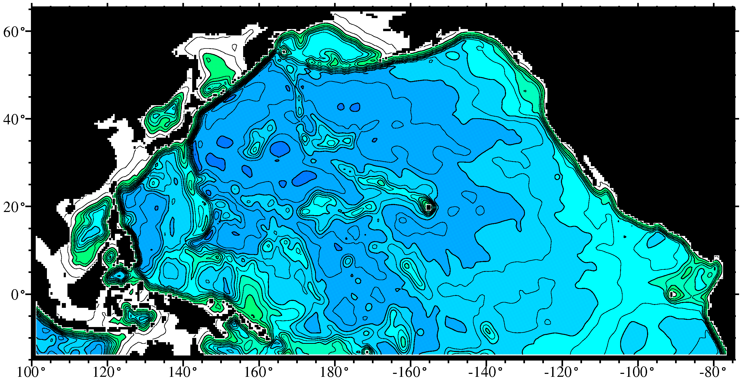
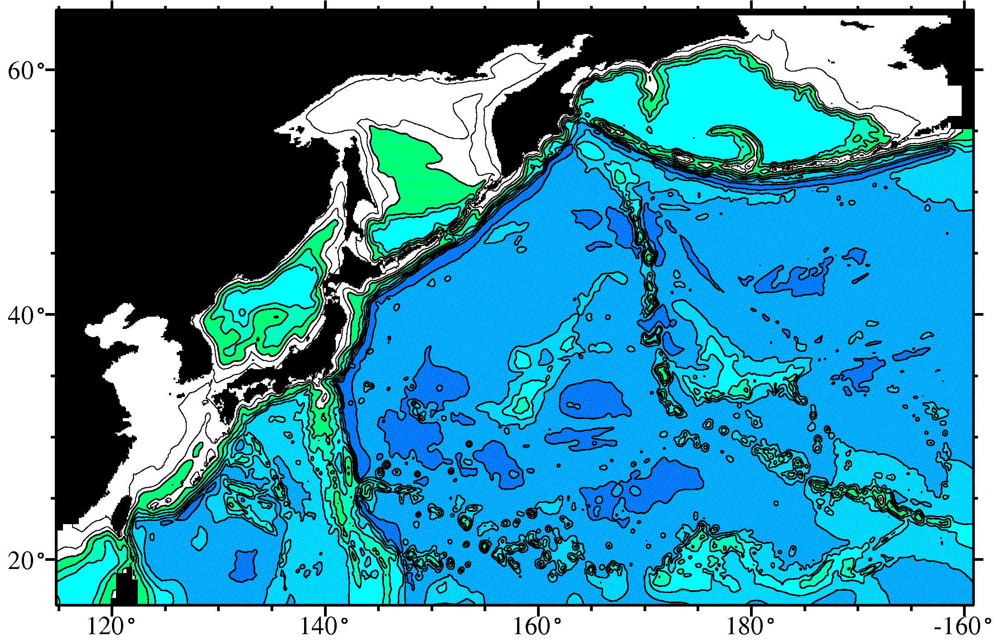
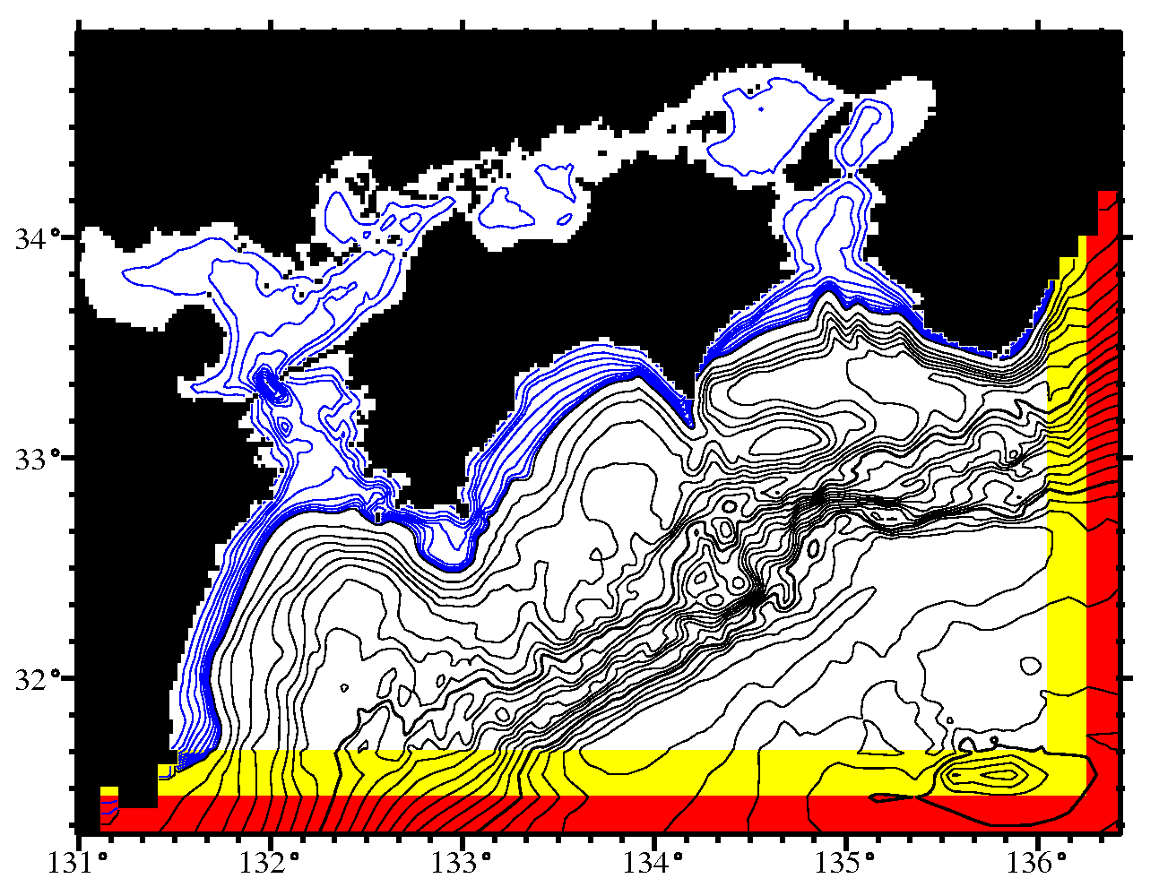
Dynamical Downscaling System
one-way
nesting system
Ocean Model
ROMS
Regional
Ocean
Modeling
System
1/2 degree
Basin-scale
(O(10³) km)
1/10 degree
Mesoscale
(O(10²) km)
Forcings
・At the sea surface,
monthly mean fluxes
・At the lateral boundaries,
daily or 6-hourly means
from each parent model
1/50 degree
Submesoscale
(O(10¹) km)
Kuroda et al. (2013, CSR)
Notes:
9
四国沖高解像度モデルの設計図
keywords：ROMS基盤、3重のone-way nesting、月別気候値海面フラックスで駆動
※気候値海面フラックス
・½°と1/10°モデル：1986-2006年におけるJRA25気象再解析値（6-hourly）とGHRSST（daily）から計算
・1/50°モデル：2003-2009年におけるMSMの解析値および予測値（hourly）とJRA25気象再解析値から計算

Slide 10
Spin-up schedule of three models
9th
1 Jan.
16th
1 Jan.
20th
31 Dec.
1/2-degree model
Initial value
woa2001 Jan.
(momentum=0)
1/10-degree model
Initial value
from 1/2-degree
model output
1/50-degree model
Initial value
from 1/10-degree
model output
5-year simulation
Analysis: 17th year to 20th year
Notes:
スピンアップ実験のスケジュール
計20年間の計算を実施
½°モデルを単独で8年間駆動、その後、1/10°モデルを駆動。16年目からの1/50°モデルを駆動し、5年間計算。
解析には、17-20年目を使用。

Slide 11
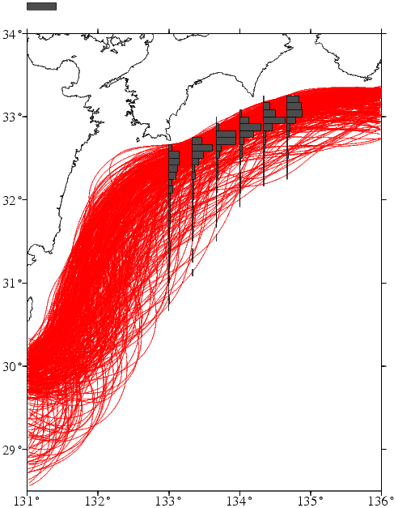
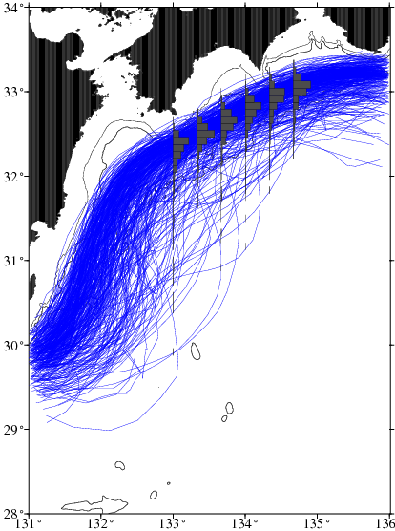
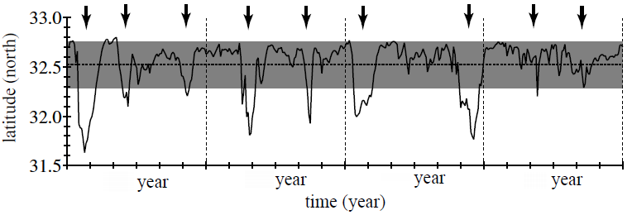
Reproducibility of 1/10°Model
Kuroshio-axis position
50%
1/10°Model
17th -20th year
QBOC
1992-2003
Mean Kuroshio-axis distance from Capes Ashizuri and Muroto
1/10°
Model
17th 18th 19th 20th

Slide 12
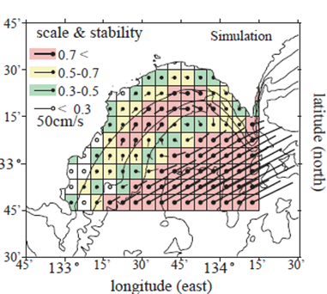
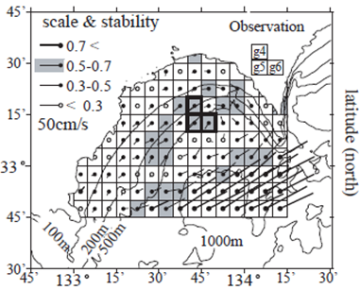
Reproducibility of 1/50-degree model
(Climatological mean surface current over Tosa Bay)
1/50-degree model
Current velocity and stability
（during 17-20th year）
Observed climatology
ADCP&GEK
Kuroda et al. (2008, JO)

Slide 13
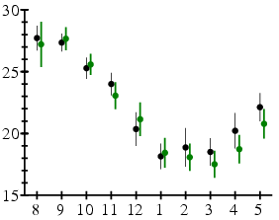
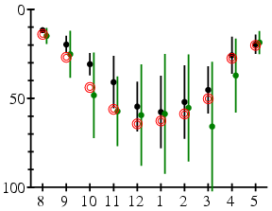
Reproducibility of 1/50-degree model
ML at the center of Tosa Bay （ML definition: ΔT=0.2℃）
Monthly time series of ML at Stn. A
ML temperatrue
model
ML depth
R/V Kotaka
(degC)
(m)
clomatology
de Boyer Montégut
et al. (2004)
Time (month)
Time (month)
Tosa Bay
Stn.A
water depth: 650m
Kuroda et al. (2014, OD)

Slide 14
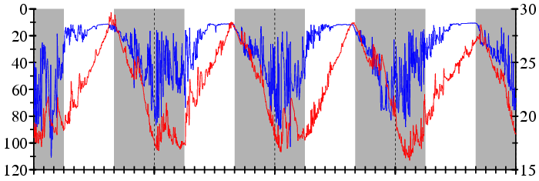
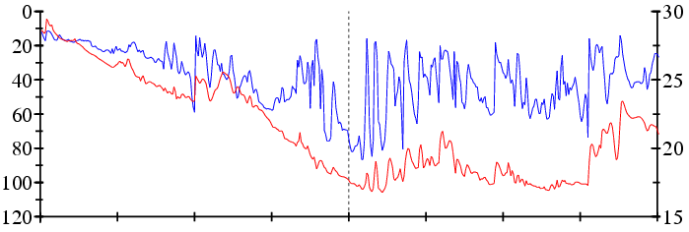
12-hourly time series of mixed layer at Stn. A in Tosa Bay
from the 17th to 20th year
ML depth
ML temperature
gray area: September to March
ML temperature
(deg.C)
ML depth (m)
17th
18th
19th
1 Jan.
20th
1 Jan.
1 Jan.
1 Jan.
ML temperature
(deg.C)
ML depth (m)
9
10
11
12
1
2
3
4
Time (month)

Slide 15
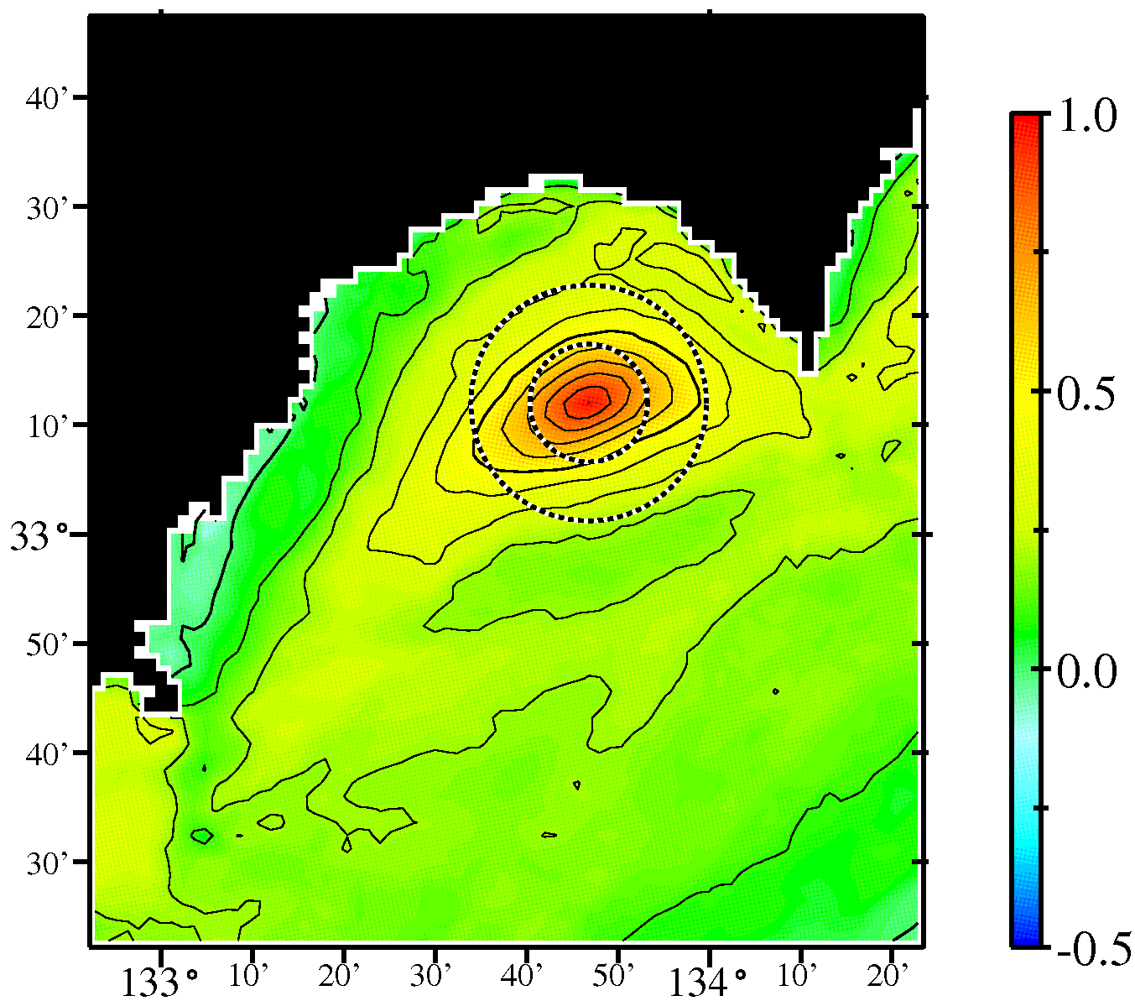
Correlation coefficients of ML depth
for Stn. A（From Jan. to Mar.）
scale
20km
0.2
Radius
centered at Stn. A
・Small circle= 10km
・Large circle = 20km
e-folding scale
～10-20km
0
0.3
0.1
0.2>
0.2
∴ submesoscale : a couple of days and 10-20km

Slide 16
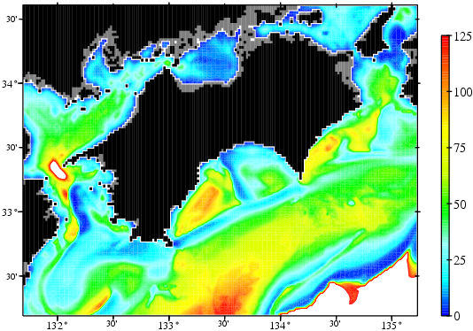
ML depth (m)
ML temperature
(deg.C)
9
10
11
12
1
2
3
4
Time (month)
Snapshot of ML depth
20 Jan. in 18th simulation year
m
Spatial features
・patch-like deeper ML
（Yellow and orange）
・streak-like shallower ML
（Blue color）
Stn.A
Kuroshio

Slide 17
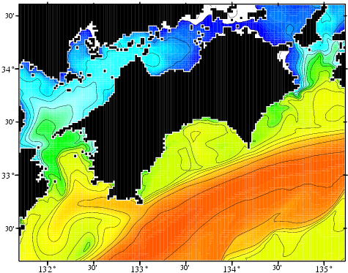
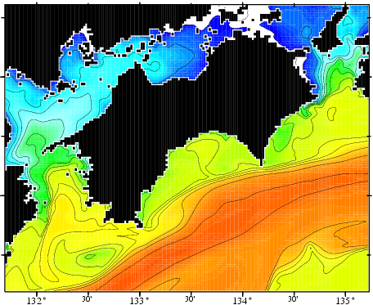
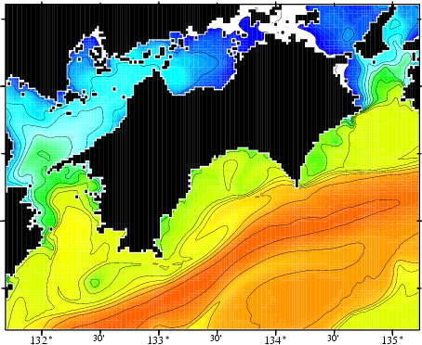
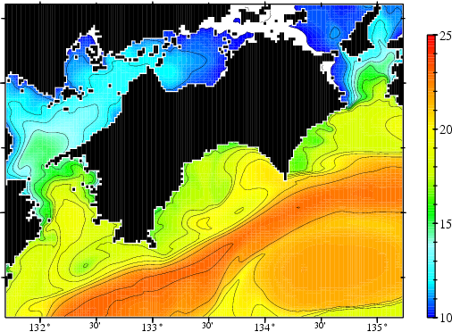
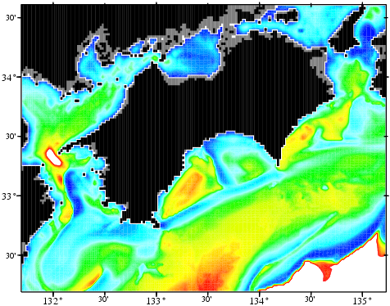
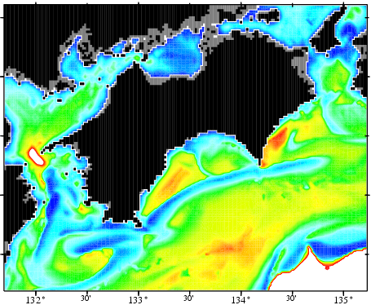
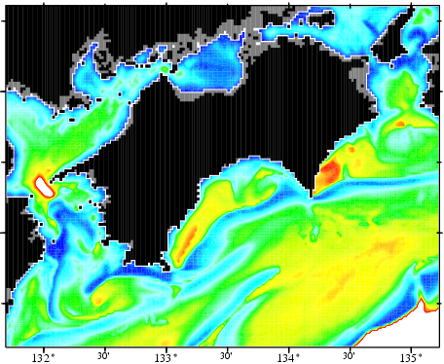
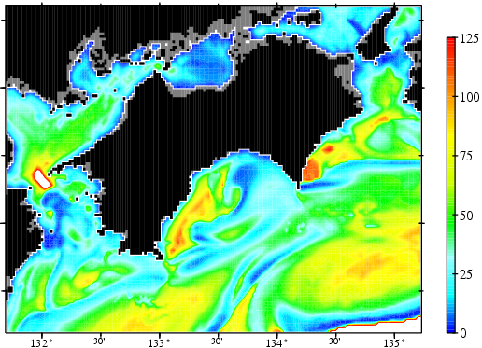
Daily snapshots
SST (upper panels) and ML depth (lower panels)
20 Jan.
21 Jan.
22 Jan.
23 Jan.
m
Submesoscale variations attributed to the Kuroshio frontal disturbance

Slide 18
Heat balance within the ML
at the center of Tosa Bay（Stn. A）
Longwave+
Sensible+ Latent
heat flux
Vertical diffusion
（at the bottom of ML）
Shortwave
penetration
Heat flux through the sea surface
Advection
Horizontal
diffusion
Entrainment
Diagnostic estimation based on a method of
Kim et al. (2006, JPO) using simulated results
※This method permits the closure of heat budget within the ML

Slide 19
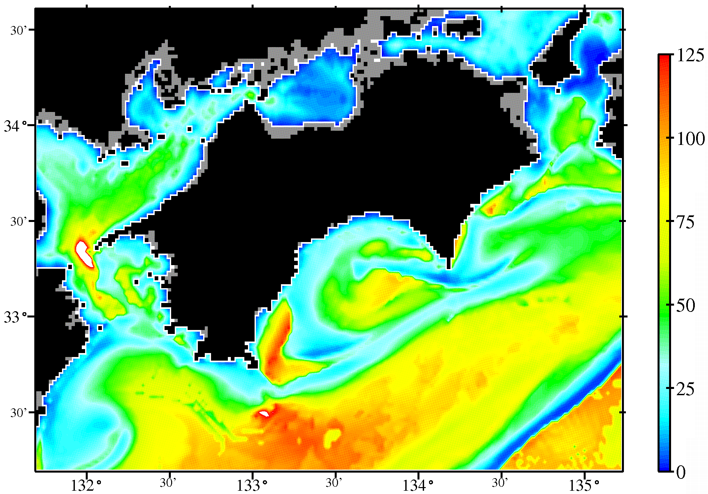
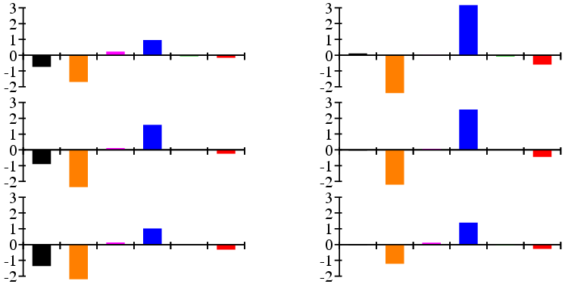
Contribution of each term on heat balance equation
(at the center of Tosa Bay (Stn. A))
Part 1: Monthly Mean
1.
tendency
2.
Heat flux through
the sea surface
3
Vertical diff.
4.
Advection
5.
Horizontal diff.
6.
Entrain-
ment
Oct.
Jan.
ML temp.
Nov.
Feb.
ML dep.
Dec.
Mar.

Slide 20
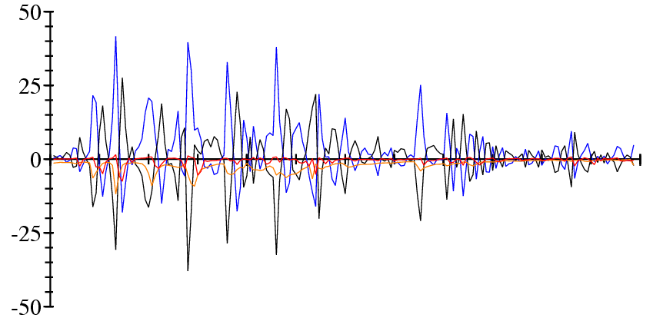
Contribution of each term on heat balance equation
(at the center of Tosa Bay (Stn. A))
Part 1: 12-hourly Mean
Tendency
Heat flux through
the sea surface
Advection
Entrain-
ment
12-hourly mean time series （Jan. to Mar. in 18th year）
minus tendency
sea surface heat flux
advection
entrainment
The sign of tendency is reversal.
Jan.
Feb.
Mar.

Slide 21
Eddy-advection decomposition of
monthly mean advection
mean
High freq.
（<30-day period）
Low freq.
(>30-day period)

Slide 22
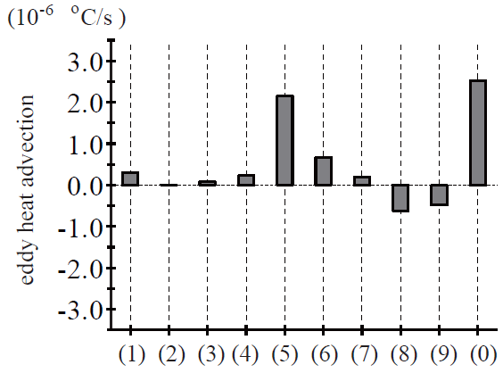
Contribution of
eddy heat advections
to the monthly
mean advection
（4-year means
in Feb.）
Eddy advection
（Feb. (4-year mean)）
High freq.＝Eddy heat advection due to Intra-monthly variation

Slide 23
Summary
Seasonal variation of the winter ML in Tosa Bay exhibits two regimes.
①Sep. to Nov.
The monthly mean ML depth (temperature) increases (decreases).
②Jan. to Mar.
The monthly mean ML depth and temperature are almost constant.
monthly mean heat balance within ML
sea surface cooling+ entrainment ～advection
Eddy heat advection due to Intra-monthly variations
Submesoscale variations attributable to the Kuroshio frontal disturbances
High-frequency submesoscale variations contribute significantly to
low-frequency monthly and seasonal mean heat balance (Jan. to Mar.).

Slide 24
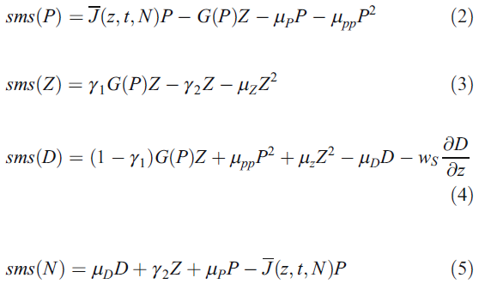
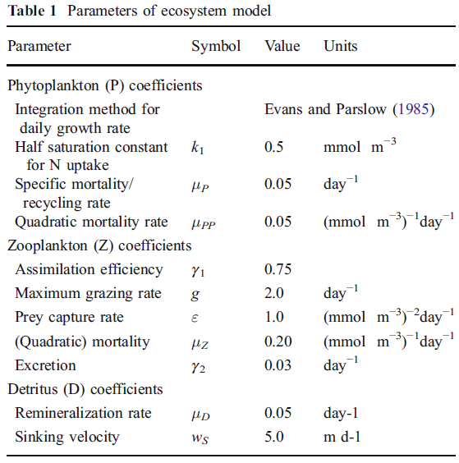
Coupling of simple NPDZ model with ocean circulation model
Oschlies (2001), Sasai et al. (2010)
P
grazing
Z
photo-
synthesis
mortality
P²
mortality
Z²
recycle
excretion
N
D
reproduction
sinking
Modified points from ROMS default NPZD
・We added the recycling path （P→N）.
・We changed mortality eq. of P and Z to squared one.
・We changed grazing eq.
・We change the leftover path to D.
・We added excretion path (Z→N).
・We turned some parameter values.

Slide 25
Dynamical downscaling system online-coupled with NPZD
one-way
nesting system
Ocean Model
ROMS
Regional
Ocean
Modeling
System
1/2 degree
Basin-scale
(O(10³) km)
1/10 degree
Mesoscale
(O(10²) km)
Forcings
・At the sea surface,
monthly mean fluxes
・At the lateral boundaries,
daily or 6-hourly means
from each parent model
1/50 degree
Submesoscale
(O(10¹) km)
Notes:
土佐湾のおけるサブメソ変動の重要性（10km, 数日）

Slide 26
Time schedule of integration
8 Yr.
12 Yr.
dynamical
downscaling
16Yr.
17Yr.
OGCM OGCM+NPZD
(restoring NO3)
1/2°
1/10°leteral BC
18-hour mean[u,v,t,s,η]&NPZD
（365.25-day periodic condition）
16 Yr.
24Yr.
30Yr.
1/10°
OGCM+NPZD
1/50°laterl BC
6-hourly mean[u,v,t,s,η]
&NPZD
1/50°
OGCM+NPZD
We neglected nutrients load from the land.
➔What to extent can the model reproduce?

Slide 27
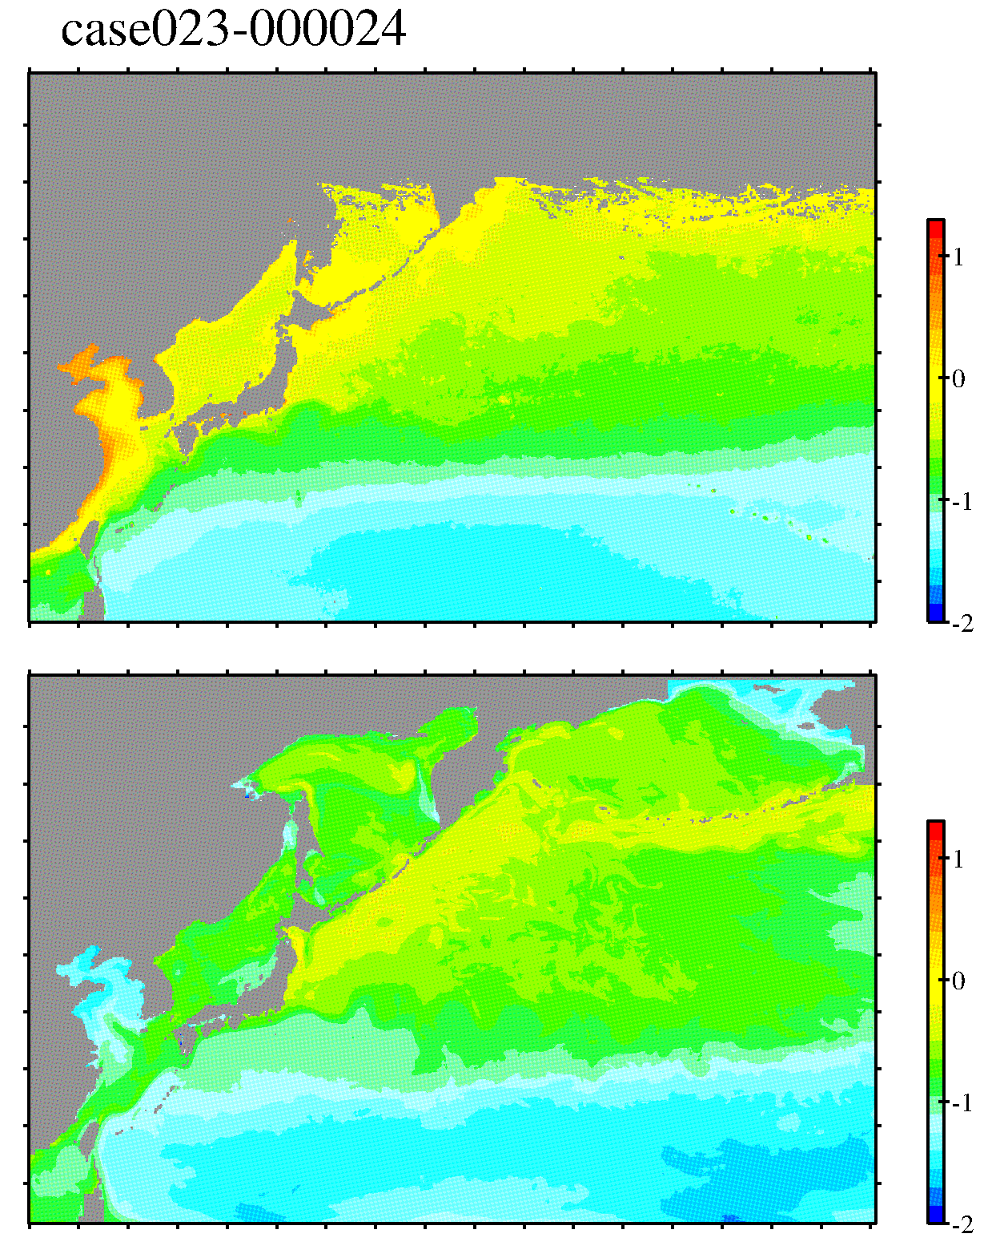
1/10°NPZD vs. MODIS/Aqua climatology (CHL-a at the sea surface)
log₁₀(mg/m³)
MODIS/
Aqua
log₁₀(mg/m³)
MODEL
（1/10°）

Slide 28
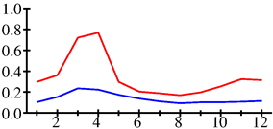
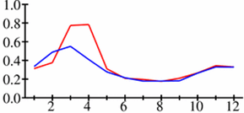
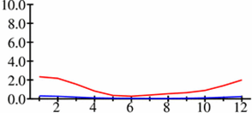
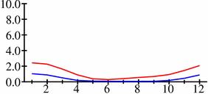
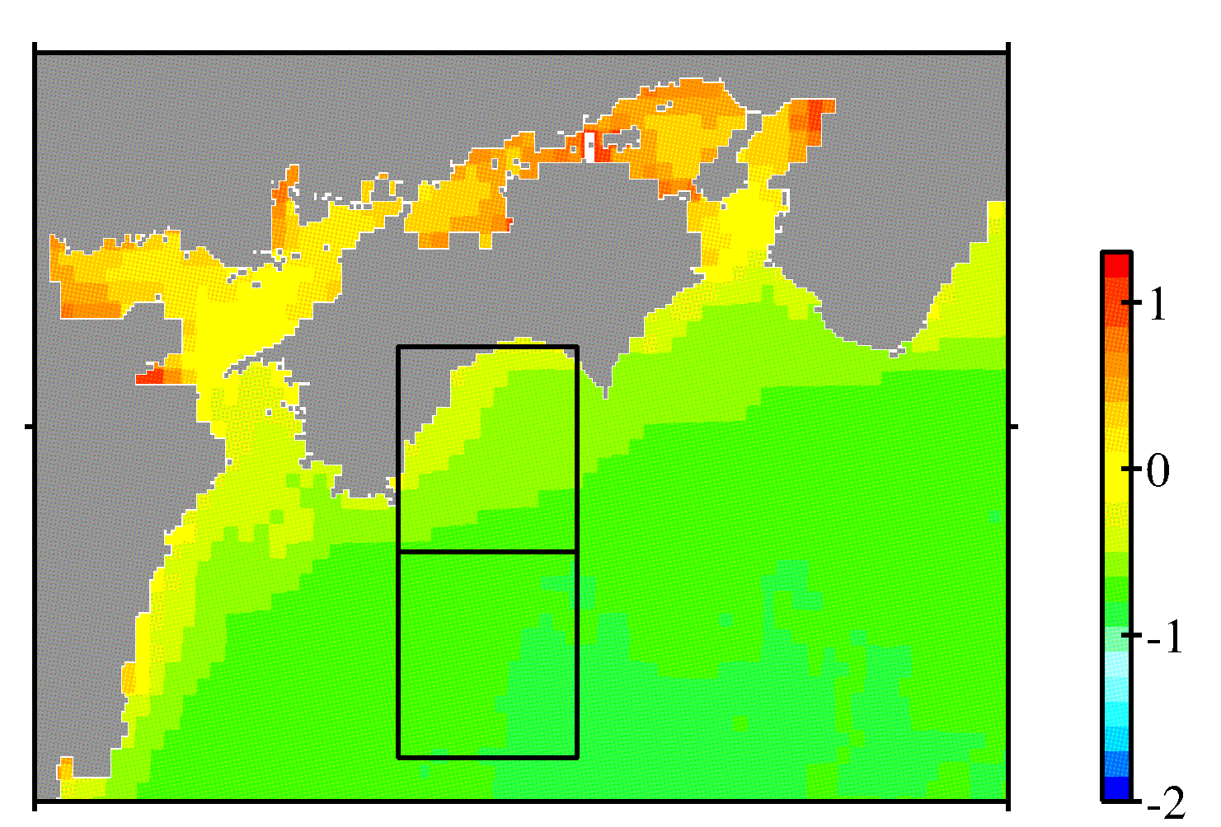
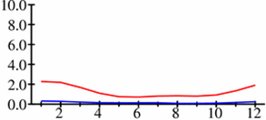
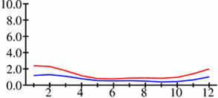
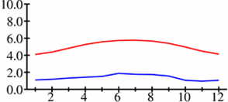
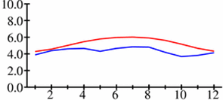
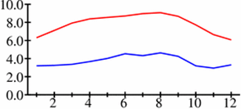
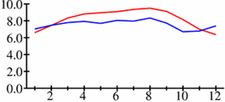
B1（Inshore side
of the Kuroshio）
mg/m³
1/10°
mg/m³
1/50°
CHL-a
0m
mmolN/m³
mmolN/m³
NO₃
0m
mmolN/m³
mmolN/m³
B1
NO₃
30m
mmolN/m³
mmolN/m³
Observation
NO₃
100m
Model
mmolN/m³
mmolN/m³
NO₃
150m
time(month)
time(month)

Slide 29
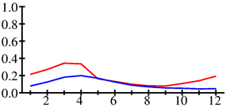
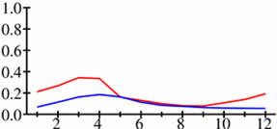
B2（main stream
othe Kuroshio）
mg/m³
1/10°
mg/m³
1/50°
CHL-a
0m
mmolN/m³
mmolN/m³
NO₃
0m
mmolN/m³
mmolN/m³
NO₃
30m
B2
mmolN/m³
mmolN/m³
Observation
NO₃
100m
Model
mmolN/m³
mmolN/m³
NO₃
150m
time(month)
time(month)

Slide 30
Comparison between 1/10° and 1/50°model
Snapshots at 7 Jan. 12:00 in 30th year
North-south vertical section : density（contour） & NO₃（color）
1/10°
Latitude (North)
25σ_{θ}
Depth (m)
26σ_{θ}
log(mmolN/m³)
26.8σ_{θ}
1/50°
Latitude (North)
Modified points
・Density front at the sea surface
・Sharp horizontal density gradients
below the density front
・Dome-like isopycnal structure
25σ_{θ}
26σ_{θ}
Depth (m)
log(mmolN/m³)
26.8σ_{θ}
27σ_{θ}

Slide 31
Comparison between 1/10° and 1/50°model
Snapshots at 7 Jan. 12:00 in 30th year
Vertical section : density（contour） & NO₃（color）
Difference （1/50°minus 1/10°）
Contour（0.1-σ_{θ}interval）: Density diff.
Color: NO₃ diff.
Red：positive, blue：negative
Latitude (North)
(mmolN/m³)
B2
B1
The 1/50-degree model improved density and nitrate concentration
particularly at the depths of 100-200m on the shelf-slope region.
※This structure is not temporal but steady.

Slide 32
1/50°Model：Nitrate & CHL-a at the sea surface
HEATING：25th 12-14 April （Daily snapshot）
COOLING：25th 1 Feb
NO₃ （0m）
Log
(mmol/m³)
Chl-a （0m）
Log
(mg/m³)
NO₃:(0m)
Log
(mmol/m³)
NO₃ （0m）
Log
(mmol/m³)
Chl-a （0m）
Log
(mg/m³)
Chl-a:(0m)
Log
(mg/m³)
NO₃ （0m）
Log
(mmol/m³)
Chl-a （0m）
Log
(mg/m³)

Slide 33
MODIS_Aqua
3 April 2008
↑
CHL-A
SST→

Slide 34
MODIS_Aqua
23 April 2009
↑
CHL-A
SST→

Slide 35
Q. What is an appropriate downscaling?
A. It depends on dominant physical processes on a target region.
If the shelf-slope region around Japan is a target region,
the grid size needs to be less than 2 km.
e.g., the Kuroshio frontal width ~10km
the shelf-break front ~10km (Sakamoto et al., 2010)
ref., data availability, research purpose, …
Important things in my mind…
※It may be undesirable to make higher resolution coupled models
in a blind way.
※Meticulous works are essential because the coupled model depends significantly on the reproducibility of the physical model.
※ It’s needed to, first of all, validate and analyze simulated physical processes of submesoscale variations, then study coupled processes,
and go back to the physical process if needed.

Slide 37
Schematic view and ongoing study
Advection
(eddy-advection)
From Land
nearshore front
Upwelling
(topographic)
Kuroshio
Entrainment
(ML development)
offshore front
From ECS

