Slide 1
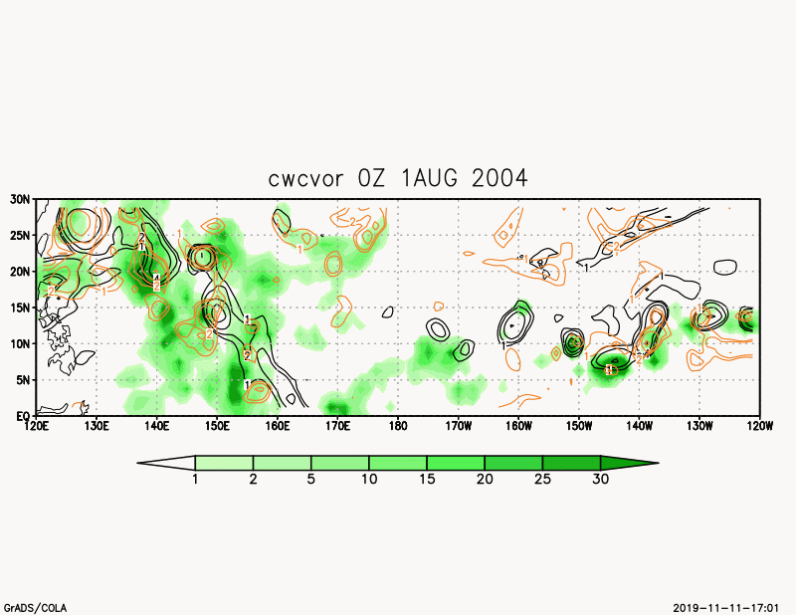
MRI-AGCM
Fig. S1 (a) Animation oｆ ｖorticity at 850hPa and 500hPa, and cloud water content at 500hPa in MRI-AGCM.

Slide 2
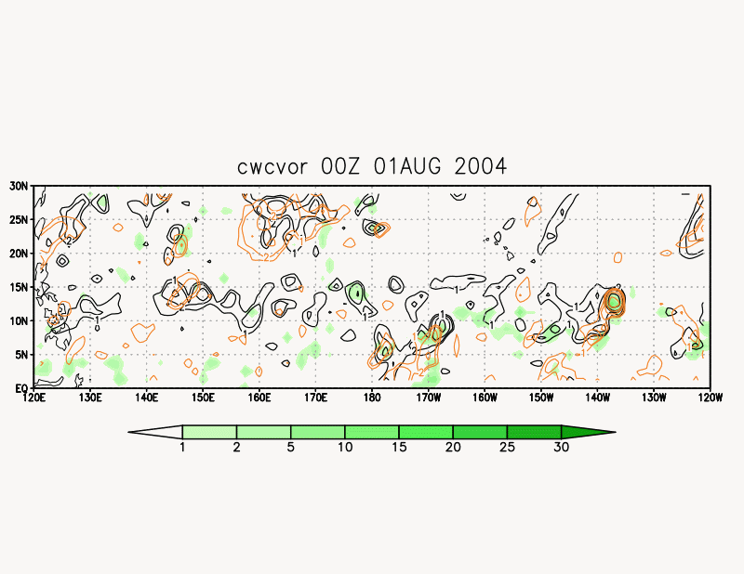
NICAM
Fig. S1 (b) Animation oｆ ｖorticity at 850hPa and 500hPa, and cloud water content at 500hPa in NICAM.

