Slide 1
Mesoscale Vortex that Caused Marine Accidents due to a Sudden Gusty Wind in the Southwestern Part of the Sea of Japan on 1 Sep. 2015
NHM Workshop
30 Nov. 2016
*Eigo Tochimoto¹, Sho Yokota²,
Hiroshi Niino¹, and Wataru Yanase¹
1: Atmosphere and Ocean Research Institute, The University of Tokyo
2: Meteorological Research Institute

Slide 2
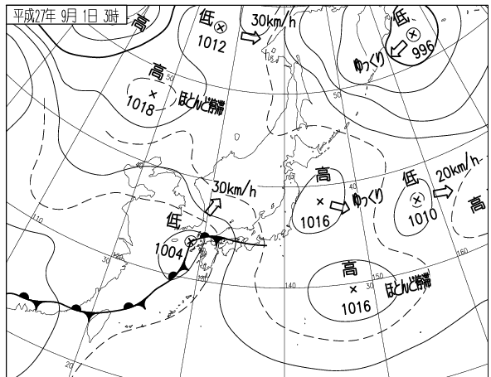
A sudden gusty wind on 1 Sep. 2015
Around 03-04 JST (UTC+9 hour) 1 Sep. 2015, a sudden gusty wind upset 6 fishery boats, causing 5 fatalities and 1 missing people
Weather map 03 JST 1 Sep. 2015
H
H
L
A meso-alpha-scale (~1000 km) low is located west of the Kyushu islands.
L
H
H
-
-
1
Notes:
On 1 Sep. 2015, a sudden gusty wind occurred. It upset 6 fisery boats and cause 5 fataities and 1 missing people

Slide 3
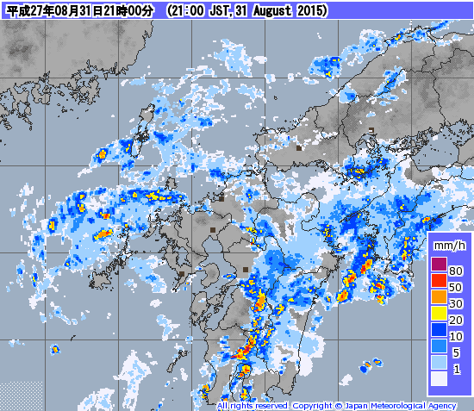
JMA radar

Slide 4
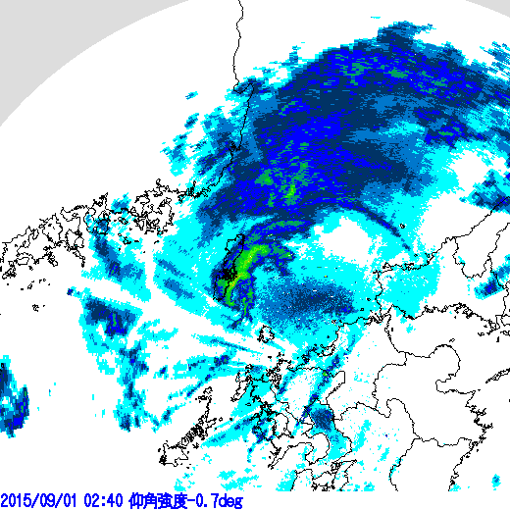

Fukuoka radar bottom elevation angle
Tsushima
Notes:
There is a spiral shaped system east of Tsushima

Slide 5
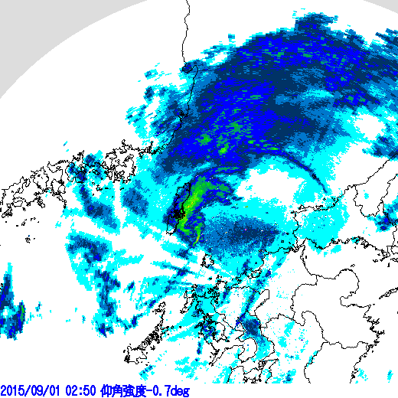

Slide 6
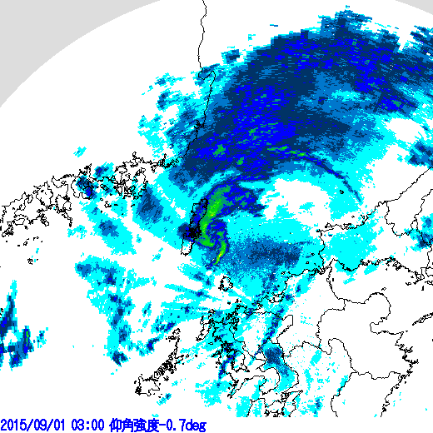

Slide 7
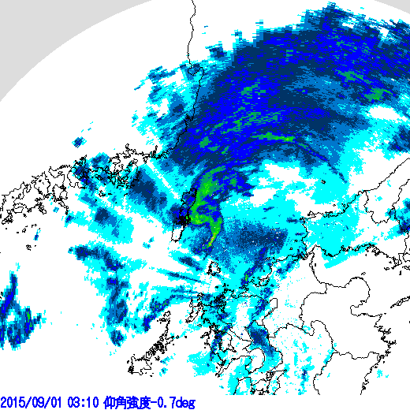

Slide 8
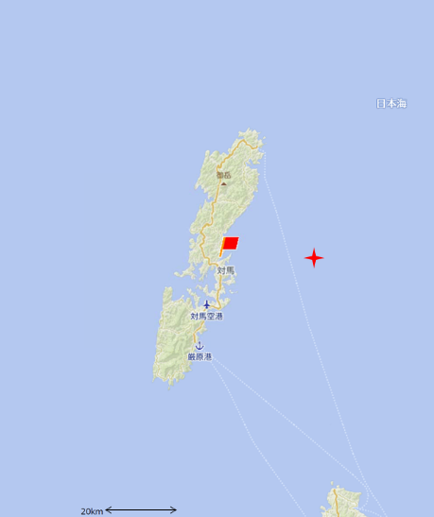
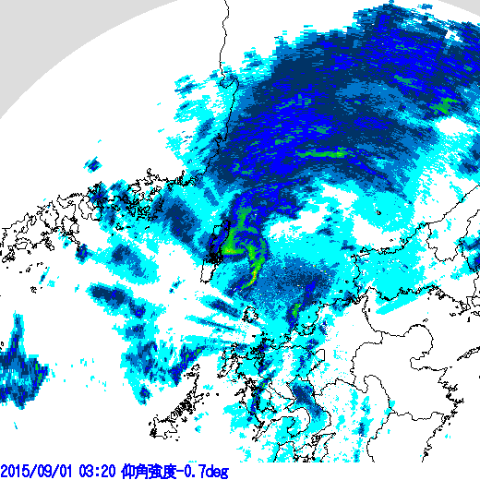

Slide 9
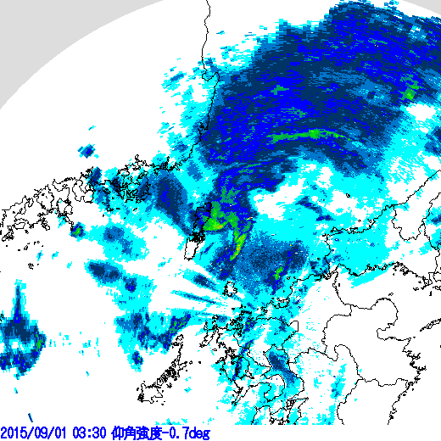

Slide 10
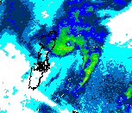
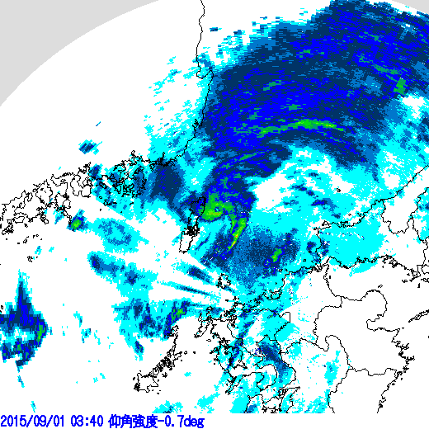

Slide 11
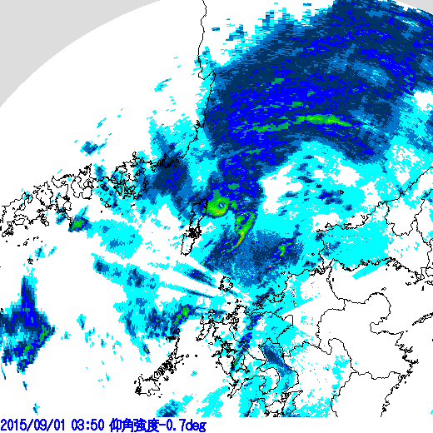

Slide 12
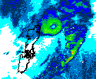
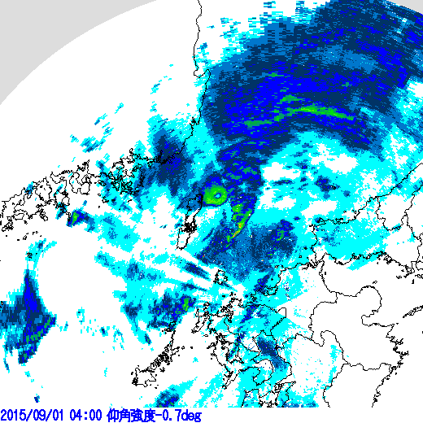

Slide 13
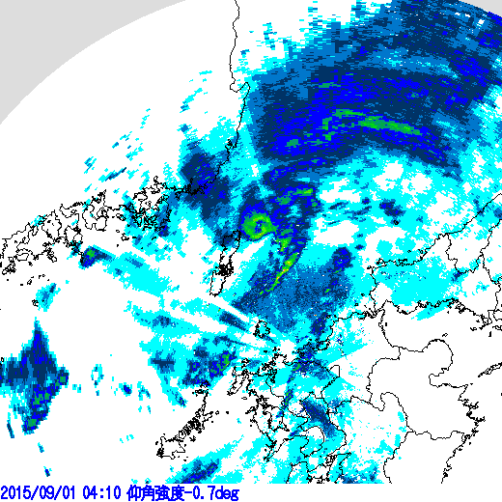

Slide 14
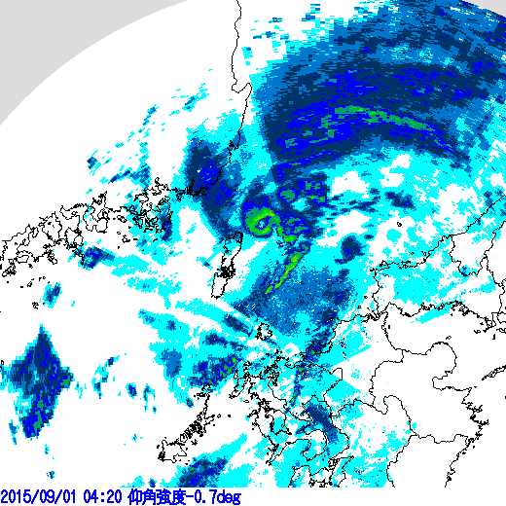

Slide 15
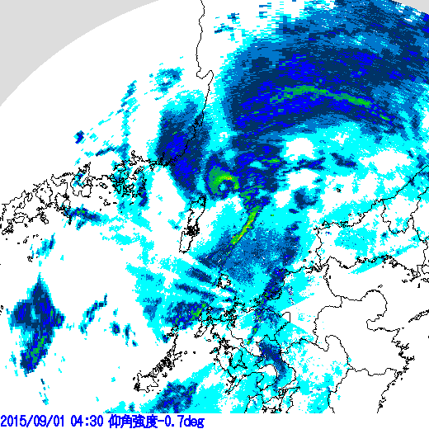

Slide 16
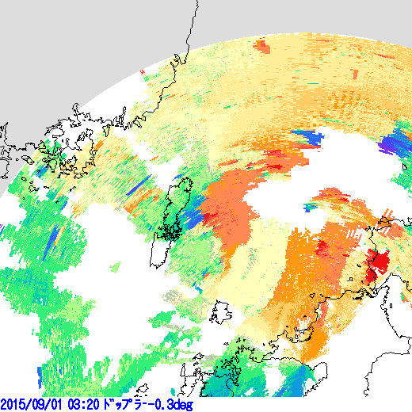

The feature of meso-beta-scale (~20-30 km) vortex is detected by a doppler radar.

Slide 17
A meso-beta-scale vortex formed within a meso-alpha-scale low on a stationary front.
The gusty wind occurred within the meso-beta-scale vortex.
There is a few study to examine a gusty wind on the sea.
It is important to clarify the genesis mechanism of a gusty wind.

Slide 18
Goal of the study
The multi scale structure between the meso-alpha-scale low (~ 1000 km) , the meso-beta-scale vortex (~20 km), and the gusty wind.
Genesis mechanism of the gusty wind.

Slide 19
Model
JMA-NHM
  Optimized for K-computer
① Meso-β vortex
  Initial time
    09 UTC 31
  2 km horizontal resolution
② Gusty wind
  Simulation with 2km resolution started from 1500 UTC 31
  →Nested run with 350 m resolution started from 1730 UTC
  →Nested run with 50 m resolution started from 1830 UTC

Slide 20
  2 km NHM
Model | JMA-NHM
The number of grids | 750x750x50
Horizontal resolution | 2 km
Vertical resolution | 40 m−900 m (stretched)
Initial time | 09 UTC 31 08 2015
Cumulus parameterization | Not used
Cloud microphysics | Bulk model (six species)

Slide 21
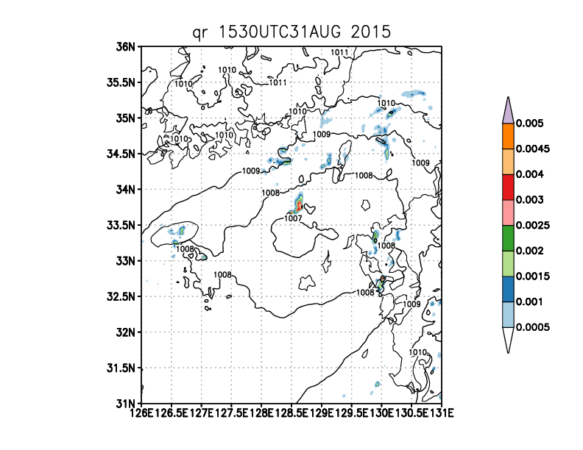
Qr@20m & SLP

Slide 22
Vertical and horizontal structure of the meso-beta vortex
Vorticity & pressure perturbation
& potential temperature
Vorticity @250m level & SLP
x10⁻³
x10⁻³
Shallow structure
Warm-core like structure
Tsushima

Slide 23
Potential temperature (left) & water vapor(right ) @20m level
Warm and Moist air intrudes from the south to the vortex

Slide 24
Environmental parameters
CAPE
SREH
Exceeding 200 m²s⁻²
900 m²s⁻²〜1200m²s⁻²

Slide 25
Low-level water vapor
Mixing ratio @20m level
Large amounts of water vapor exceeding 0.018 kg kg⁻¹ intrude from the south

Slide 26
The evolution of vorticity @ 120m level
（vorticity; color shading SLP: bold lines）
x10⁻² s⁻¹
Horizontal shear between northeasterly and southeasterly

Slide 27
The evolution of vorticity @ 120m level
（vorticity; color shading SLP: bold lines）
x10⁻² s⁻¹

Slide 28
The evolution of vorticity @ 120m level
（vorticity; color shading SLP: bold lines）
x10⁻² s⁻¹

Slide 29
The evolution of vorticity @ 120m level
（vorticity; color shading SLP: bold lines）
x10⁻² s⁻¹

Slide 30
The evolution of vorticity @ 120m level
（vorticity; color shading SLP: bold lines）
x10⁻² s⁻¹

Slide 31
The evolution of vorticity @ 120m level
（vorticity; color shading SLP: bold lines）
x10⁻² s⁻¹

Slide 32
Vorticity (color shading ) & potential temperature (bold lines) @ 120m level
There is relatively large temperature gradient around the vortex.

Slide 33
The meso-beta vortex formed in the region between northeasterly and southeasterly.
Active convections that were caused by the convergence in the shear region may play important role in the formation and development of the vortex.
The gusty wind occurred within the vortex
  An experiment that can resolve a gusty wind is performed.

Slide 34
  50 m NHM
Experiments | NHM with 2km horizontal resolution | NHM with 350 m horizontal resolution | NHM with 50m horizontal resolution
The number of grids | 750x750x50 | 3000x3000x70 | 2000x2000x100
Vertical resolution | 40m-904m | 40m-618m | 10m−443m
Initial time | 1500 UTC 31 Aug | 1730 UTC 31 Aug | 1830 UTC 31 Aug
Cumulus | Not used | Not used | Not used
Microphysics | Six species and the number concentration of ice | Six species and the number concentration of ice, snow, and graupel | Six species and the number concentration of ice, snow, and graupel

Slide 35
Qr@30m & SLP
19:40:50 UTC 09 2015
19:18:10 UTC 09 2015
A spiral shaped system is successfully simulated
Vertical velocity

Slide 36
Vertical distribution of mixing ratio (color shading) &
Vertical velocity (black contour lines)
There is vault-like structure, which is similar to supercell storms.
Notes:
Large amounts of water substances overhang the strong upward velocity, which is valult-like structure similar to supercell storms.

Slide 37
Time series of the maximum vorticity and velocity @ 30 m level
T1
T2
UTC
Max vorticity and velocity occasionally exceed 1 s⁻¹ and 50 m s⁻¹, respectively.
Notes:
It shows high fluctuations.

Slide 38
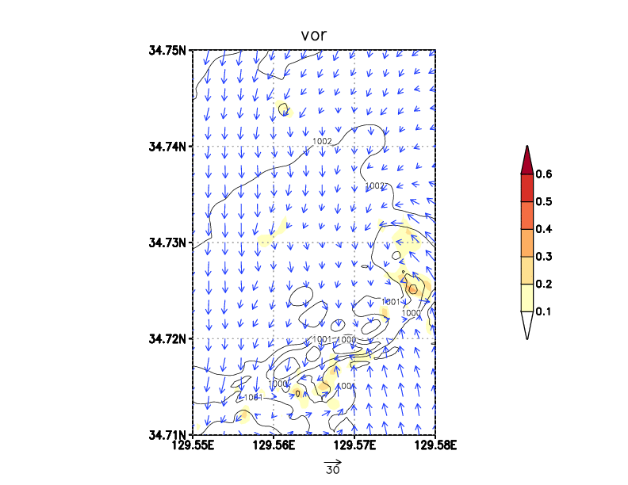
①
vorticity@30 m & SLP
T1

Slide 39
19:18:10 UTC 09 2015
①
Vorticity @30 m & SLP
W @30 m
Micro-scale vortices with horizontal scale < 1km form within the meso-beta vortex
Shear instability？

Slide 40
W @30m
T-60
T-40
T-20
T＝０
Potential temperature @30m

Slide 41
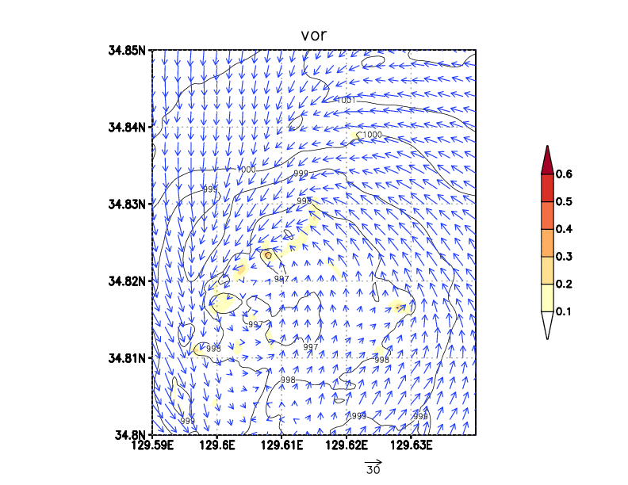
T2
②
Vorticity @30 m & SLP

Slide 42
19:40:50 UTC 09 2015
②
Vorticity @30 m & SLP
W@30 m
Micro-scale vortices with horizontal scale < 1km form within the meso-beta vortex
Shear instability？

Slide 43
W @30m
T-60
T-30
T＝０
Potential temperature @30m

Slide 44
W
Time series of maximum values for W & Vorticity & pressure anomaly
Vorticity
Pressure anomaly

Slide 45
Summary
A meso-beta-scale vortex formed northeast quadrant of a meso-alpha low center.
The meso-beta vortex formed within the horizontal shear between northeasterly and southeasterly within the meso-alpha scale low.
The vortex has shallow structure
A warm core like structure
Micro-scale vortices repeatedly formed and developed within the meso-beta vortex
  Shear instability produced micro-scale vortices ?
  Vortices were intensified with strong updrafts.
Is it supercell ?
  Hook structure
  Vault structure
  However, the vorticity of the meso-beta vortex is the strongest near the surface.

Slide 46
Future Works
Genesis mechanism of meso-beta vortex
  Vorticity budget、circulation analysis
Genesis mechanism of micro-scale vortex
  Circulation analysis
Other cases
  21 Aug. 2011 a sudden gusty wind on the sea near the Kyushu
  Similar to the case of 2015

Slide 47
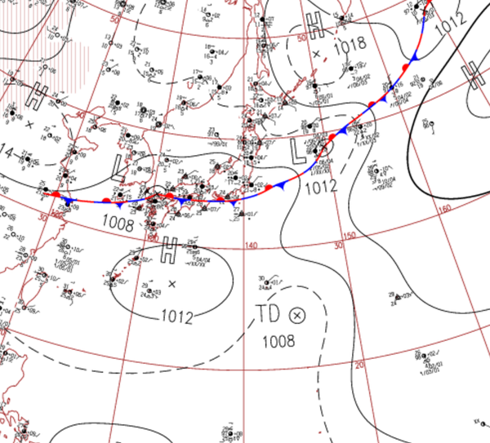
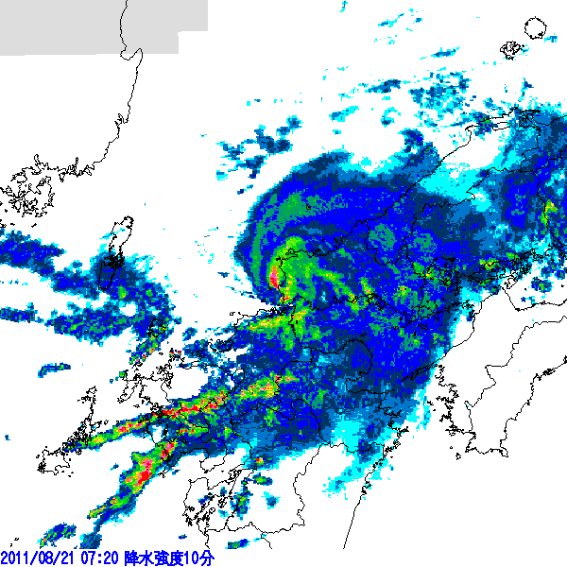
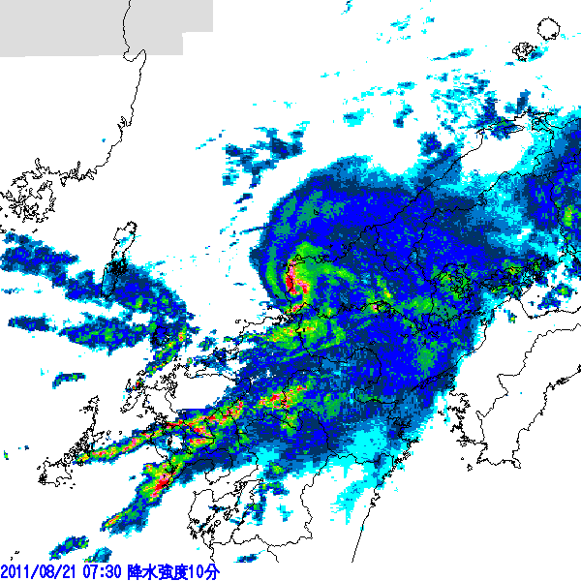
21 Aug. 2011
Three upset of fisher boat
One fatality
One missing people

Slide 48
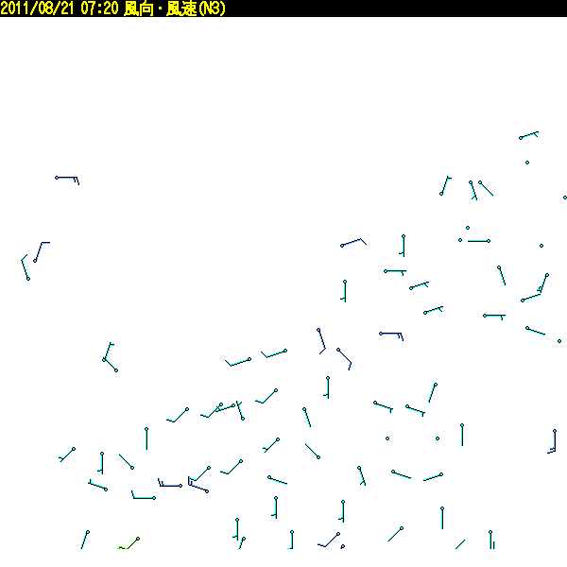
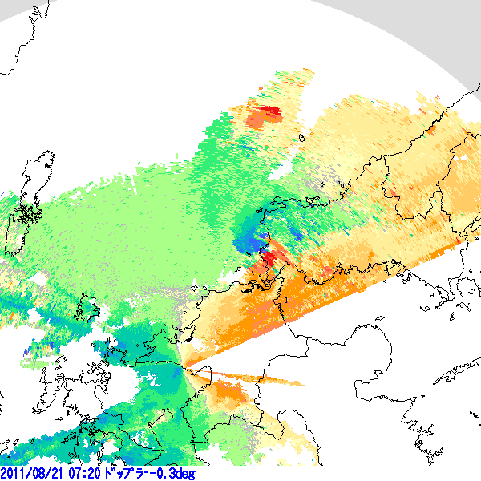
Fukuoka radar

Slide 49
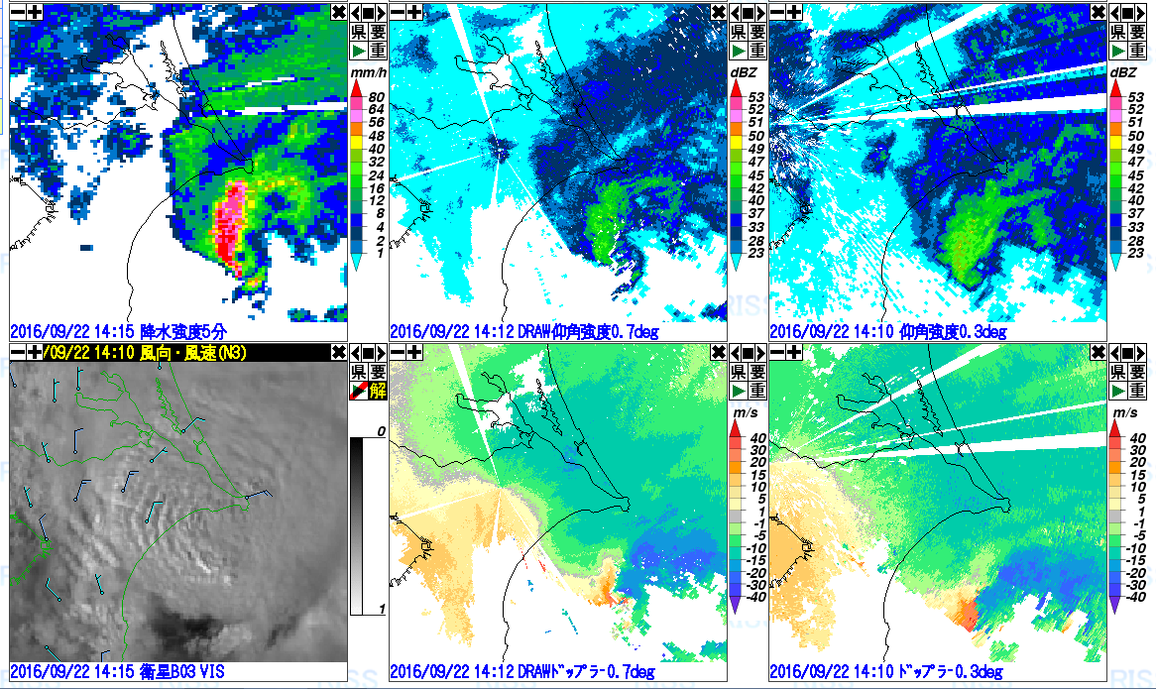
Radar composite
Narita radar
Tokyo radar

Slide 50
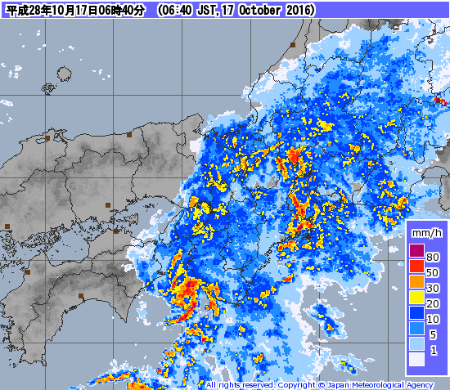
17 Oct. 2016

Slide 51
後方流跡線解析
粒子の位置
z*=530 m
19時20分
高度 m

Slide 52
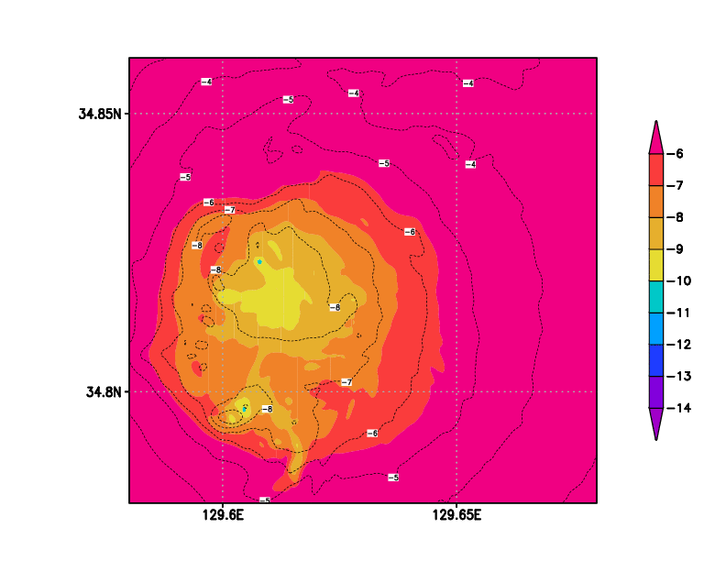
気圧偏差
カラー：30m高度
コンター：300m高度

Slide 54
Qr@30mと海面気圧の分布
19:40:50 UTC 09 2015

Slide 57
19:18:10 UTC 09 2015

Slide 58
上昇流＆渦度@500m
上昇流＆渦度@1000m
明瞭な下層メソサイクロンは見られない

Slide 59
19:18:10 UTC 09 2015
上昇流＆渦度@500m
上昇流＆渦度@1000m

