Slide 1
Cubed-sphere modelling activities at CSIRO
John McGregor
CSIRO Oceans and Atmosphere
Aspendale, Melbourne
Acknowledgement: Marcus Thatcher
NHM Conference
Hakone
1 December 2016

Slide 2
CCAM history
Atmospheric GCM on cubed-sphere (IAMAP, 1997)
Variable-resolution GCM using Schmidt transformation (from 1997)
Reversible grid and dynamics finalized 2005
Since then added many extra physics options
Added coupled ocean (also on C-C grid) and sea-ice
Highly vectorized with MPI, have run up to 14,000 cores
New dynamical core in flux form on UJ grid (nearly finalized)

Slide 3
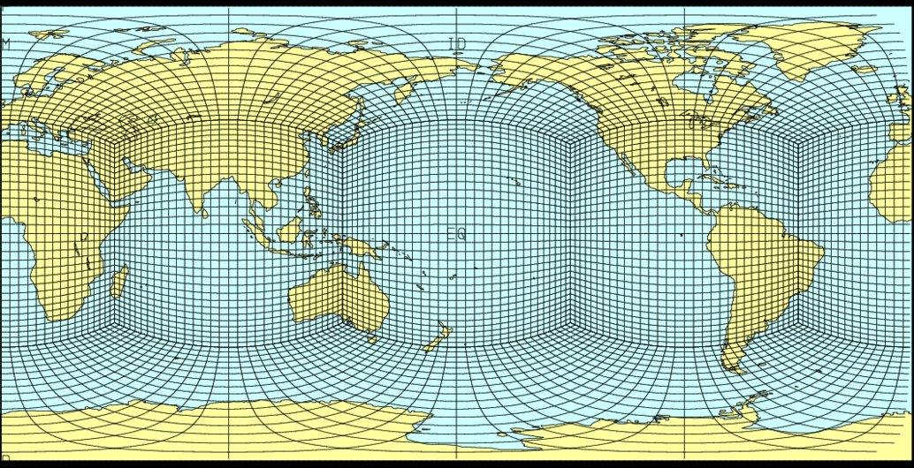
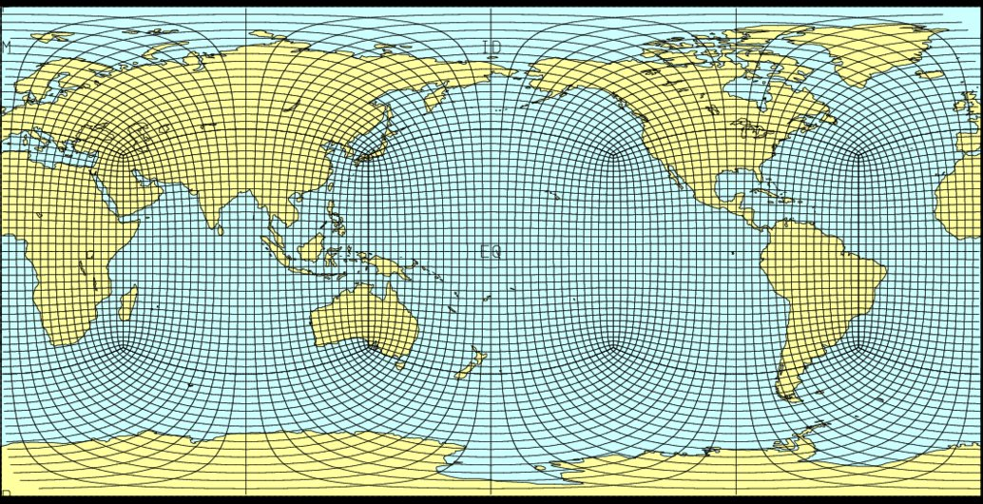
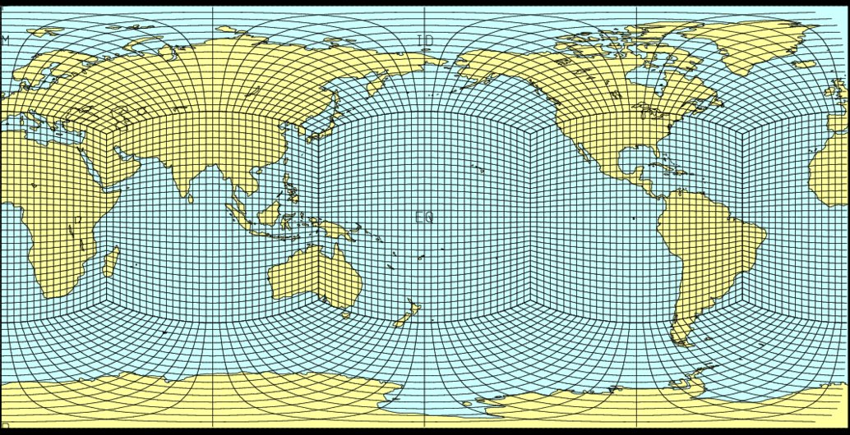
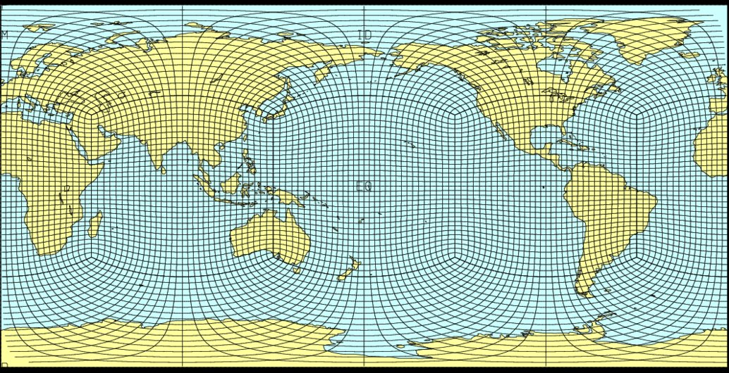
Original Sadourny grid
Alternative cubed-sphere grids
Conformal cubic grid
Equi-angular grid
Uniform Jacobian grid
All C32
3

Slide 4
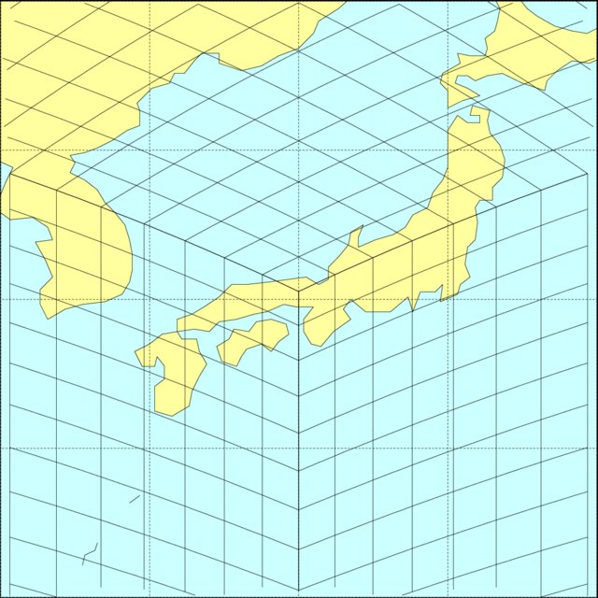
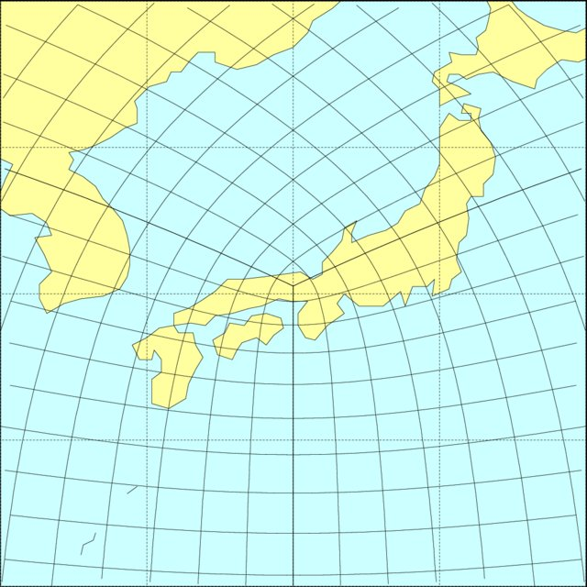
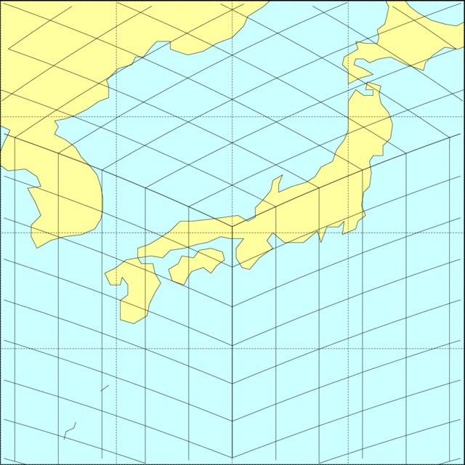
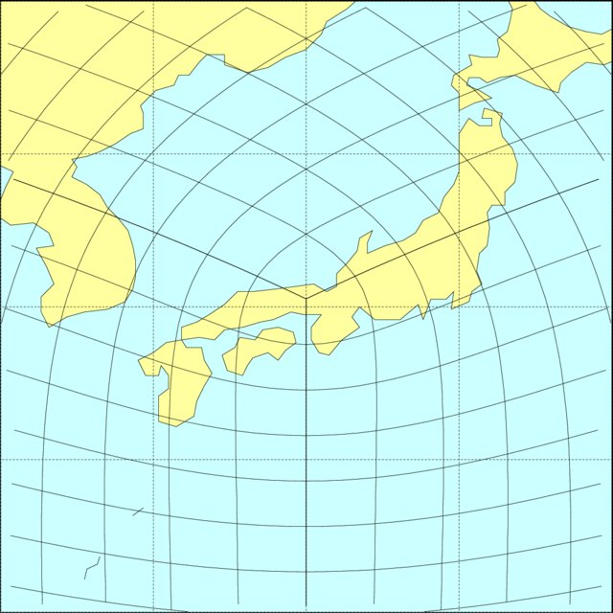
Vertex views of C48 grids
Sadourny
Conformal cubic
Equi-angular
Uniform Jacobian
(Purser/Tsugawa)
4
EA

Slide 5
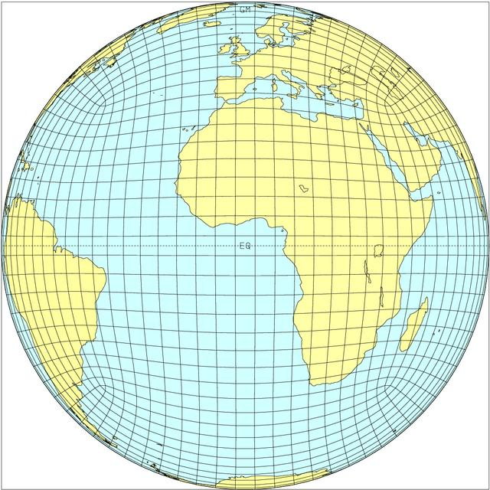
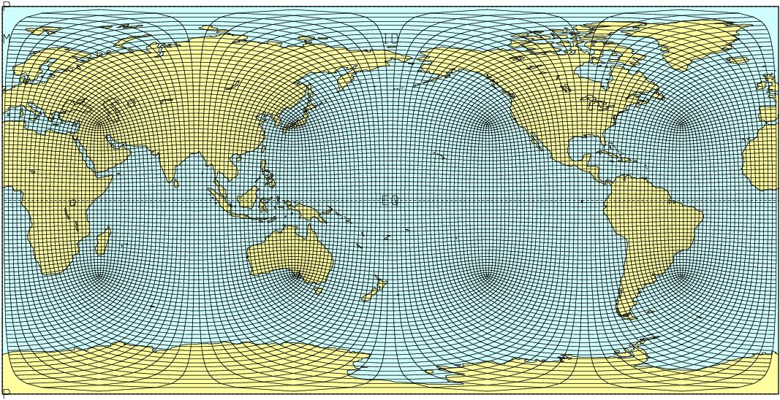
The conformal-cubic atmospheric model
CCAM is formulated on the conformal-cubic grid
Orthogonal
Isotropic
Semi-Lagrangian
Reversible staggering
Miller-White non-hydrostatic (extremely efficient)
Example of quasi-uniform C48 grid with resolution about 200 km

Slide 6
An important issue for dynamical cores is how to stagger the winds to accurately balance the pressure gradients, whilst also accurately handling the Coriolis terms, i.e. obtain good geostrophic adjustment.
The approach in CCAM and VCAM is based on “reversible staggering” of velocity components.

Slide 7
Location of variables in grid cells
All variables are located at
the centres of quadrilateral
grid cells.
In CCAM, during
semi-implicit/gravity-wave
calculations, u and v are
transformed reversibly to the
indicated C-grid locations.
Produces same excellent
dispersion properties as
spectral method (see
McGregor, MWR, 2006), but
avoids any problems of
Gibbs’ phenomena.
2-grid waves preserved.
Gives relatively lively winds,
and good wind spectra.

Slide 8
Reversible staggering
pivot
| X | X * | X | m-1 m-1/2 m m+1/2 m+1 m+3/2 m+2 m+3/4
Where U is the Unstaggered velocity component and u is the staggered value, define (Vandermonde formula)
accurate at the pivot points for up to 4th order polynomials
solved iteratively (u U or U u), or by cyclic tridiagonal solver over 4 faces of the cube
excellent dispersion properties for gravity waves

Slide 9
Convection scheme
Handles both deep and shallow convection
Mass flux scheme including downdrafts
Recently improved treatment of entrainment and detrainment
“Scale-aware” with smooth transition from large Δs (say 200 km) to 1 km - resolved part handled by Rotstayn cloud microphysics scheme

Slide 10
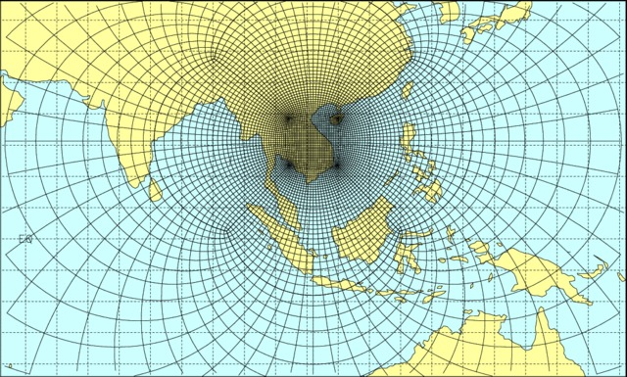
Variable-resolution conformal-cubic grid
The C-C grid is moved to locate panel 1 over the region of interest.
The Schmidt (1975) transformation is applied
- it preserves the orthogonality and isotropy of the grid
- same primitive equations, but with modified values of map factor
C48 grid (with resolution about 20 km over Vietnam)

Slide 11
Nonhydrostatic treatment
Uses the quasi-elastic equations of Miller and White (1984), White (1989)
Requires advection of omega
Produces a modified Helmholtz equation (of the CCAM semi-implicit treatment)
Very small computational overhead
Example shows cold bubble test
performed on sphere with extremely stretched grid, initially at rest with isentropic lower atmosphere, no Coriolis
C48 L35 with grid spacing of 500 m on central panel
radius of initial bubble 4 km, depth 4 km
after 900 s, vortex spreads to 10 km

Slide 12
CCAM simulations of cold bubble, 500 m L35 resolution, on highly stretched global grid.

Slide 13
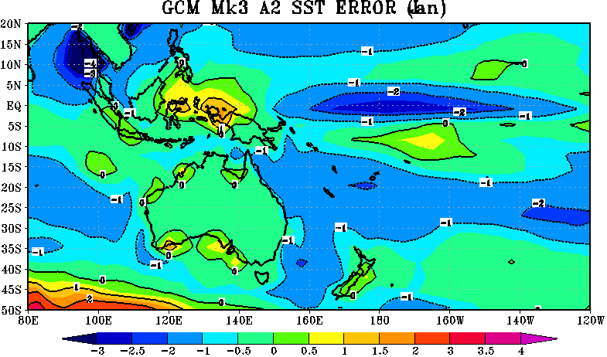
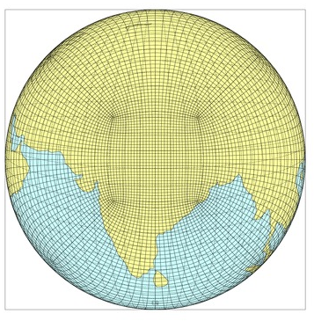
CCAM downscaling methodology
First run a quasi-uniform 100 km global CCAM run driven by bias-corrected (for present-day) SSTs
The 100 km run is then downscaled to 14 km or 8 km (for example) by running CCAM with a stretched grid, but applying a digital filter every 6 h to inherit large-scale patterns of the 100 km run
Quasi-uniform C96 CCAM grid with resolution about 100 km, showing every 2nd grid point
Stretched C96 grid with resolution about 14 km over Nepal, showing every 2nd grid point

Slide 14
Reversibly staggered, coupled
atmosphere–ocean climate model
A reversibly staggered atmosphere-ocean coupled version of CCAM has also been developed.
Ocean model is on same grid as atmosphere, and uses same time step. Directly coupled.
After implementing a geometric multi-grid solver and using RMA for the scale-selective filter, CCAM was found to scale to 10,000+ cores, which is competitive with atmosphere-only models.
Preliminary results show improvements for the simulation of cyclones and allows for feedbacks with currents in coastal regions.
Notes:
Motivation to improve SSTs

Slide 15
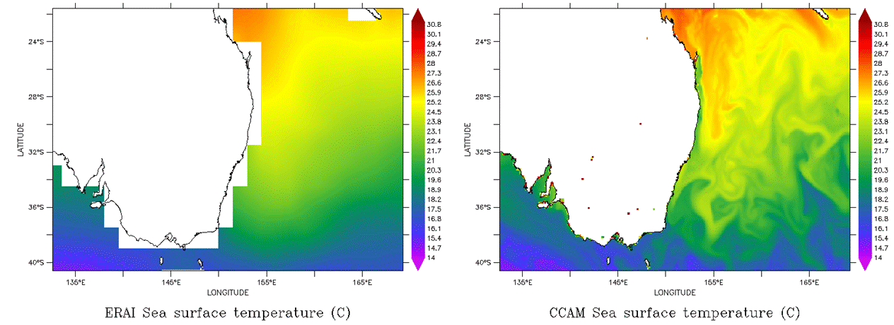
Coupled run downscaling ERAI reanalysis
Variable resolution global atmosphere/ocean/sea-ice run for several years, 10 km resolution around Australia
Digital filter applied hourly to SSTs, with length scale 500 km
Shows instantaneous SSTs. The broad SST patterns of ERA-interim are retained, but fine detail is added.

Slide 16
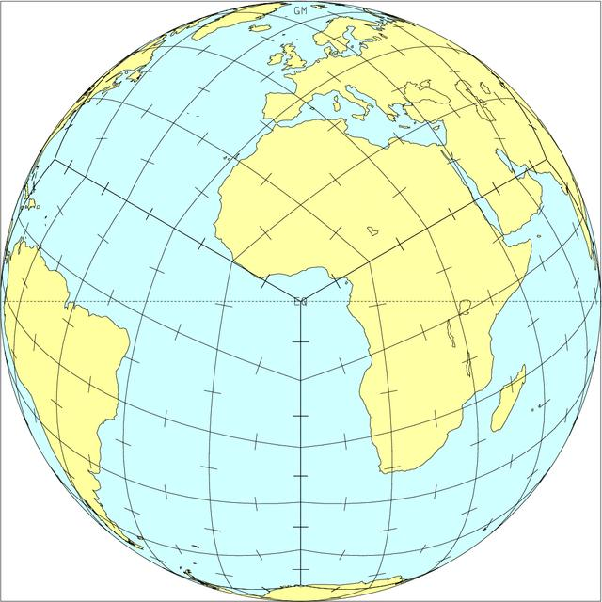
Equiangular grid (for VCAM) showing orientation of the contravariant wind components
Shows suitability of the gnomonic grid (equi-angular or uniform Jacobian) for reversible interpolation – thanks to smooth changes of orientation of the contravariant components

Slide 17
Dynamical core for VCAM - Variable Cubic Atmospheric Model
uses Uniform Jacobian (UJ) grid (previously equi-angular)
- provides uniform resolution
- less issues for resolution-dependent parameterizations
reversible staggering transforms the contravariant winds to the staggered positions needed for calculating divergence and gravity-wave terms
forward-backward (F-B) split-explicit solver for gravity waves
- no need for Helmholtz solver
- linearizing assumptions avoided in gravity-wave terms
- avoids semi-Lagrangian off-centring issues
flux-conserving form of equations
- preferable for trace gas studies
finite volume advection with TVD preserves sharp gradients

Slide 18
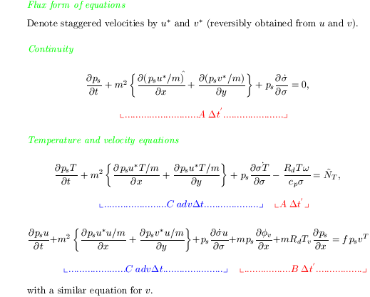

Slide 19
Advection
Low-order and high-order fluxes combined using Superbee limiter
Cartesian components (U,V,W) of horizontal wind are advected – will soon instead advect contravariant components
F_{low}=q_{y}V_{j+1/2}
v_{cov}
(q_{x}, q_{y})
q
u_{cov}
U_{i-1/2}
F_{low}=q_{x}U_{i+1/2}
V_{j-1/2}
3D transverse components are included in both low and high order fluxes,
calculated at the edges of the grid cells. Some similarities to 2D LeVeque method.
No grid imprinting is seen, especially when using UJ grid.

Slide 20
Solution procedure
Start τ loop
Estimate Coriolis terms
Stagger winds and Coriolis estimate
Nx(Δt/N) forward-backward loop
Average ps to (psu, psv) τ+n(Δt/N)
Calculate (div, sdot, omega) τ+n(Δt/N)
Calculate (ps, T) τ+(n+1)(Δt/N)
Calculate phi and staggered pressure gradient terms
Update staggered (u,v) applying Coriolis terms
End Nx(Δt/N) loop
Calculate unstaggered (u, v)
Apply Coriolis correction
Perform TVD advection (of T, qg, Cartesian_wind_components) using average ps*u, ps*v, sdot from the N substeps
Calculate physics contributions
End τ loop

Slide 21
F-B is all performed in staggered space
Before F-B, stagger u, v, (fu) ^{τ}, (fv) ^{τ}
Whole F-B is done in staggered space
During F-B, use (fu) ^{τ}, (fv) ^{τ} in momentum eqns
At end of F-B, unstagger the net pressure-gradient terms, and apply these over the full Δt (implicit Coriolis) by solving the simple simultaneous equations:
U^{τ+1} = U^{τ} +Δt∗pgx_{unstaggered} + Δt∗f(V^{τ+1} +V^{τ})/2
V^{τ+1} = V^{τ} +Δt∗pgy_{unstaggered} - Δt∗f(U^{τ+1} +U^{τ})/2
This is a predictor-corrector treatment for Coriolis
Behaviour is almost identical to more-expensive reversible unstaggering-staggering with Coriolis calculated in unstaggered space

Slide 22
Treatment of pressure gradient terms using first principles
Calculate dphi/dx on pressure surfaces at u-staggered positions (similarly to description by Kurihara 1968)
Requires vertical interpolation on adjacent columns and use of standard lapse rate below ground, many calculations but NO MPI involved
Easy for split-explicit models, but not practicable for semi-explicit models, which usually employ an eigenvector decomposition in the vertical
Before introducing this method had noise near orography, needing hybrid vertical coordinates
Now no noise and
no longer need hybrid coordinates
z
P=P_{A}
P_{A}
z₂
z₁
P_{S}
surface
cell
centre
cell
bndry
cell
centre
22

Slide 23
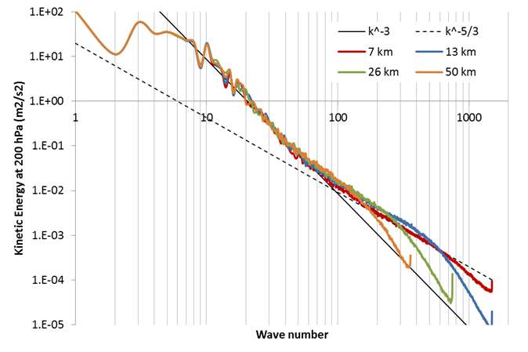
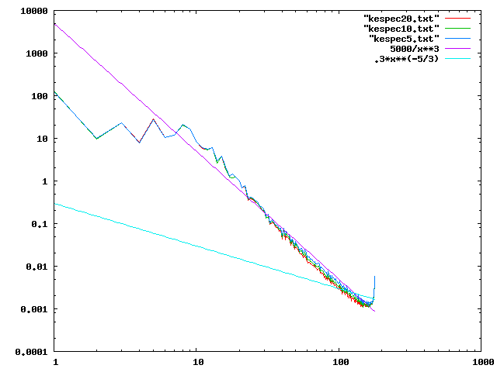
Kinetic energy spectra
CCAM 7 km to 50 km grids
(curving up is an artefact of the diagnostic routine)
VCAM C96 100 km grid
3 km MPAS
Skamarock
et al. (2014)

Slide 24
Asia 5y precipitation DJF & JJA
TRMM
CCAM
VCAM
DJF
JJA

Slide 25
VCAM status
Settled on Uniform Jacobian grid
Similar computational efficiency to CCAM
Almost finalized
Alternative methods for advection of winds tried, but little sensitivity
Still needs non-hydrostatic treatment

Slide 26
Some CCAM collaborations
Other groups running CCAM for regional climate simulations or seasonal or NWP:
CSIR South Africa
BMKG (Indonesia Weather Service) and LAPAN
Univ. Hanoi, Vietnam
PAGASA (Philippines Weather Service)
Qld Climate Change Centre
NIWA (New Zealand)
Starting India and Sri Lanka
Starting Nanjing Univ. – CCAM now “open source”
PredictWind – forecasts for sailing

Slide 27
Thank you!

