Slide 1
Development of a non-hydrostatic atmospheric model using the Chimera grid method for a steep terrain
Kazushi Takemura, Ishioka Keiichi, Shoichi Shige
Graduate School of Kyoto University
4th International Workshop on Nonhydrostatic Models

Slide 2
Background
Following the rapid growth of computers,
atmospheric model’s resolution has been increasing.
In high-resolution models
  the terrain is resolved in more detail
  steeper and more complex terrain
  can be resolved.
However…
the conventional representation method of terrains causes a serious error on such steeper and more complex terrain.
Low-resolution
High-resolution

Slide 3
Background: topography Hakone
35.28N
1400
SRTM30
( approx. 900m resolution)
Height(m)
650
A
B
1400
SRTM3
( approx. 90m resolution)
Height(m)
35.2N
138.98E
139.05E
We are here
650
A
B
Cross section

Slide 4
Previous research
Terrain-following coordinates
(Gal-chen and Somerville 1975)
  Commonly used to represent terrain
  Transforming vertical coordinate along terrain
  Deformed on steep terrain and inducing a serious error
Numerically generated coordinates
(Satomura 1989)
  Transforming vertical and horizontal coordinates numerically.
  High orthogonality , less deformation

Slide 5
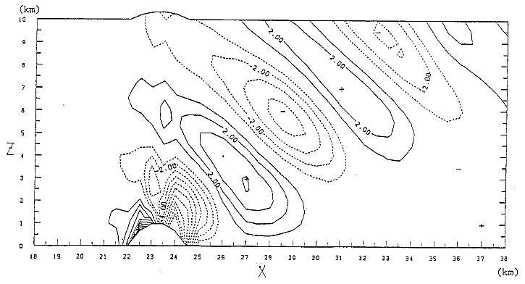
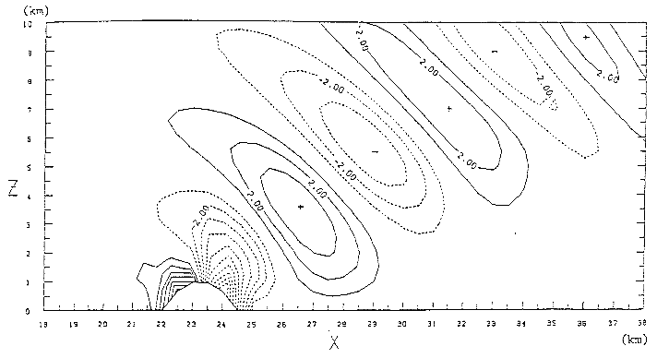
Previous research: Satomura 1989
Mountain wave simulation over a semi-circular mountain
Terrain following coordinates
Numerically generated coordinates
  The numerically generated coordinates succeeded in improving representation of steep terrain.

Slide 6
Problem of previous research
  Over complex terrain which the slope angle changes rapidly (e.g. cliff),
  coordinate cannot be generated properly.
  Grid point are too dense
  Coordinates are deformed
Thus, more improvements are necessary
if such complex terrain is to be represented adequately.
We have been developing a non-hydrostatic model using the Chimera grid method to represent steep and complex terrain
(Takemura et al. 2016).

Slide 7
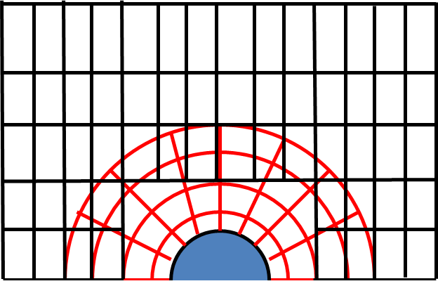
The Chimera grid method
The Chimera grid method is also referred to
  overlapping grids
  overset grids
  composite overlaid grids
The computational region is represented by a composite of overlapping grids.
  Black：Global grid represents the entire computational region
  Red：Local grid represents only around complex boundary
Local grid: terrain detail
Global grid: global region

Slide 8
Use of the Chimera grid method 1
（Kageyama and Sato 2004)
In the field of Earth Science, the Chimera grid method is mainly used for global model. (e.g. Yin-Yang grid)

Slide 9
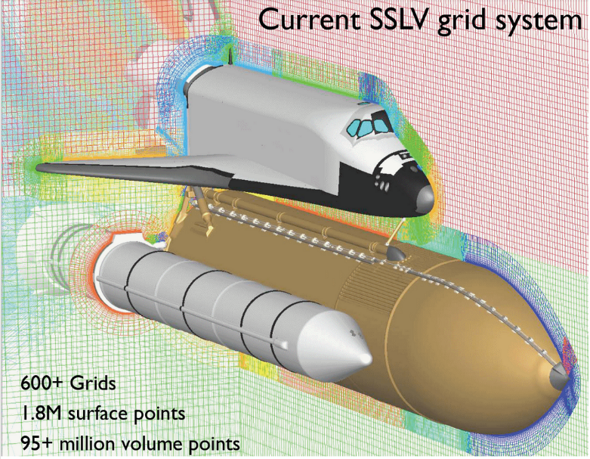
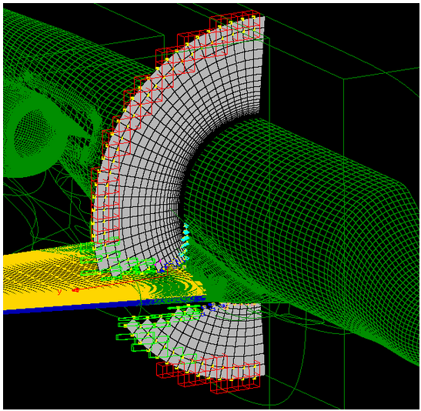
Use of the Chimera grid method 2
(Wyman 2014)
In the filed of Computational Fluid Dynamics, this method is commonly used to represent complex boundary.
(e.g. body of space shuttle and airplane wing)

Slide 10




Chimera grid method: How to compute
Each grid is partially overlapping around each grid boundary.
  Black Line : Grid 1
  Red Line : Grid2
Boundary point is obtained by interpolating between surrounding points of the other grid.
  Bl –linear interpolation
  Higher order interpolation
$$η_{1}$$
$$ξ_{2}$$
$$ξ_{1}$$
$$η_{2}$$
Grid 1
Grid 2
Grid2 points
Grid1 boundary
Grid1 points
Grid2 boundary

Slide 11
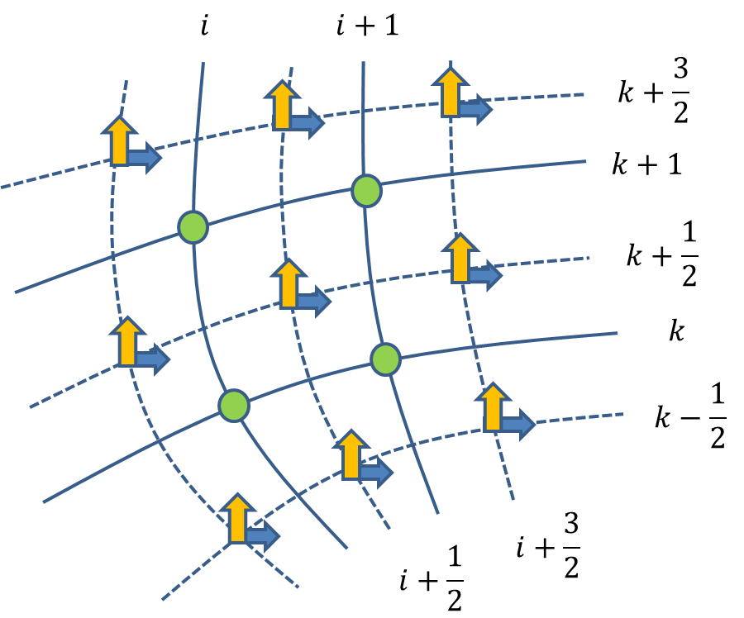
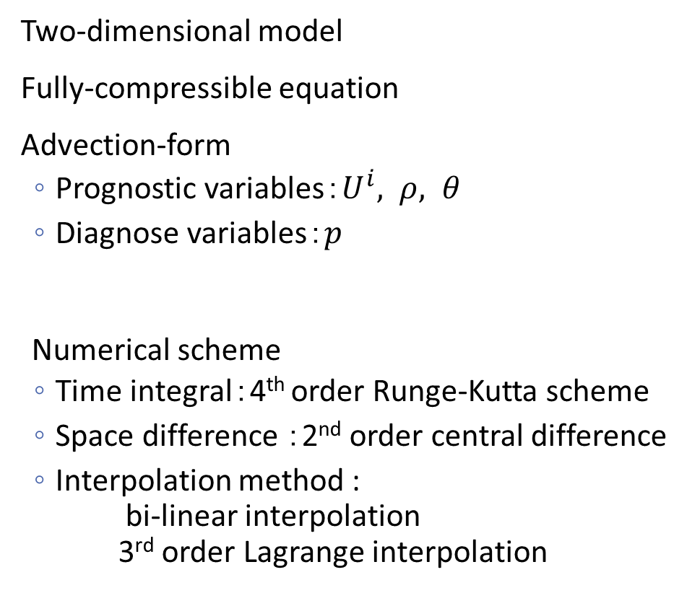

Model description
Two-dimensional model
Fully-compressible equation
Advection-form
  Prognostic variables：$U^{i}, ρ, θ$
  Diagnose variables：$p$
Numerical scheme
  Time integral：4th order Runge-Kutta scheme
  Space difference ：2nd order central difference
  Interpolation method :
  bi-linear interpolation
  3rd order Lagrange interpolation
Layout of variables
  $:ρ,p,θ$
  $:U^{1}$
  $:U^{2}$

Slide 12

Experiment: mountain wave over a semicircular mountain
This is test case for steep terrain (Satomura 1989,
Yamazaki and Satomura 2010)
Comparing analytic solution with numerical solutions of each method:
  Terrain-following coordinates
  Numerically generated coordinates
  The Chimera grid method
    Bi-linear interpolation
    Lagrange interpolation
Slope angle change rapidly
Very steep
height
H=1000m
Semi-circular mountain
Buoyancy frequency
N=0.01 1/s
Horizontal wind
U=10m/s

Slide 13
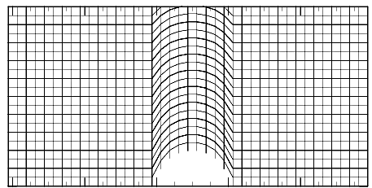
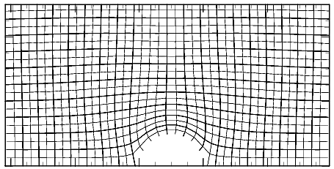
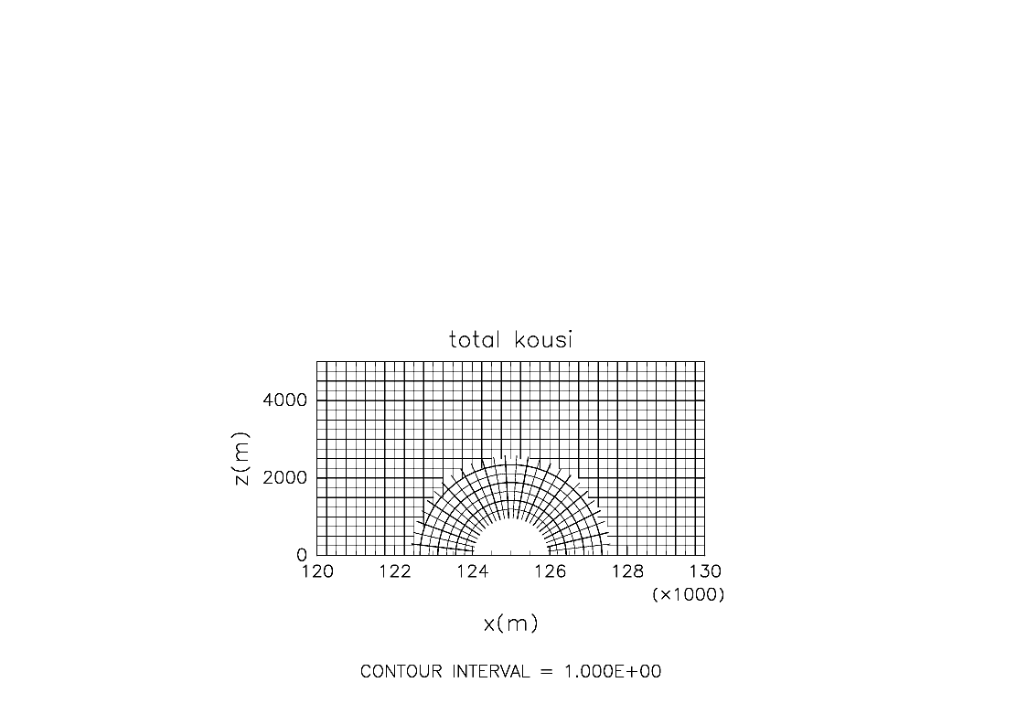
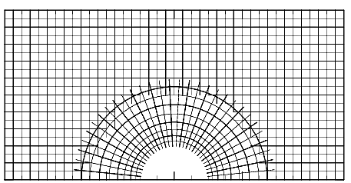
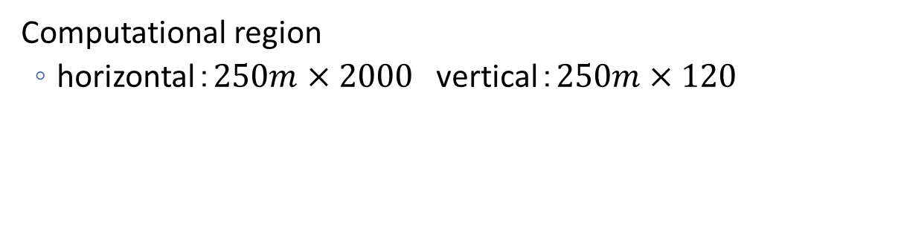
Grid for each method
Terrain-following coordinates
Numerically generated coordinate
5
Height(km)
0
Chimera grid method
with bi-linear interpolation
Chimera grid method
with Lagrange interpolation
5
Height(km)
0
-3
-1
1
3
-3
-1
1
3
Horizontal distance (km)
Horizontal distance (km)
Computational region
  horizontal：$250m×2000$ vertical：$250m×120$

Slide 14

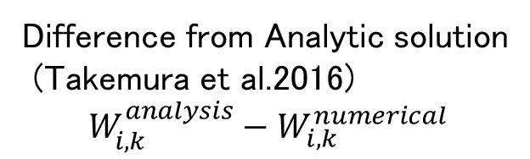
Result：error from analytic solutions
Analytical solution
(Miles 1969
Courtesy of S. Masuda）
Terrain-following
Numerically generated
15
15
10
Height (km)
10
5
Height (km)
5
0
Chimera grid with Lagrange interpolation
Chimera grid
With linear interpolation
0
15
-5
0
5
10
horizontal (km)
10
Height (km)
Difference from Analytic solution
(Takemura et al.2016)
$$W_{i,k}^{analysis}−W_{i, k}^{numerical}$$
5
0
-5
0
5
10
-5
0
5
10
Horizontal (km)
Horizontal (km)

Slide 15
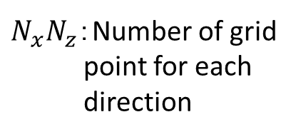
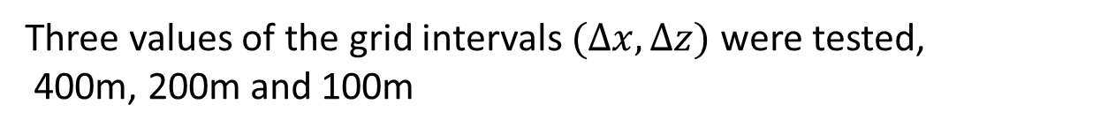

Quantitative comparison
Comparing error around mountain
  Windward 3km ~ leeward 3km
  Height 0 ~ 3 km
15
10
Height (km)
5
Error of horizontal and vertical wind velocity
$$ε_{U}=\frac{1}{N_{x}N_{z}}\sum{\left|U_{i,k}^{analysis}−U_{i, k}\right|}$$
$$ε_{W}=\frac{1}{N_{x}N_{z}}\sum{\left|W_{i,k}^{analysis}−W_{i, k}\right|}$$
0
-5
0
5
10
Horizontal distance (km)
$N_{x}N_{z}$：Number of grid point for each direction
Three values of the grid intervals $(∆x, ∆z)$ were tested,
400m, 200m and 100m
Notes:
Next, we performed an quantitative comparison of the Chimera grid method and the numerically generated coordinates. The domain for the error evaluation is horizontally from windward 3km to leeward 3km and vertically from 0km to 3km. Error is defined as average of difference from analytic solution of horizontal and vertical velocity. Three values of the grid intervals $(∆x, ∆z)$ were tested, 400m, 200m and 100m

Slide 16
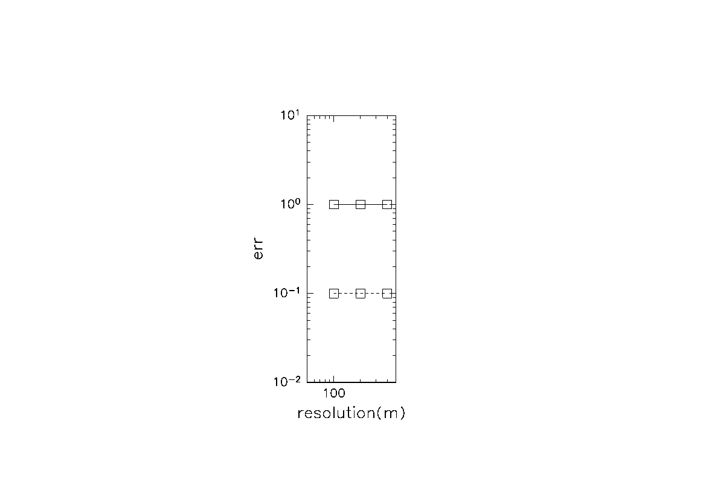





















Result: error of horizontal wind and vertical wind
$$5$$
Numericaly generated
The error for the Chimera grid method is
  almost equal or smaller
than that for the numerically generated coordinates.
This is likely due to the fact that the Chimera grid method is less deformed at the foot of mountain.
$$ε_{U}$$
$$ε_{W}$$
$$2$$
$${10}^{0}$$
Chimera grid
Bi-linear interpolation
$$5$$
error $ε$
$$ε_{U}$$
$$ε_{W}$$
$$2$$
Chimera grid Lagrange interpolation
$${10}^{−1}$$
$$5$$
$$ε_{U}$$
$$ε_{W}$$
$$50$$
$$100$$
$$500$$
Grid interval $∆x$ (m)

Slide 17
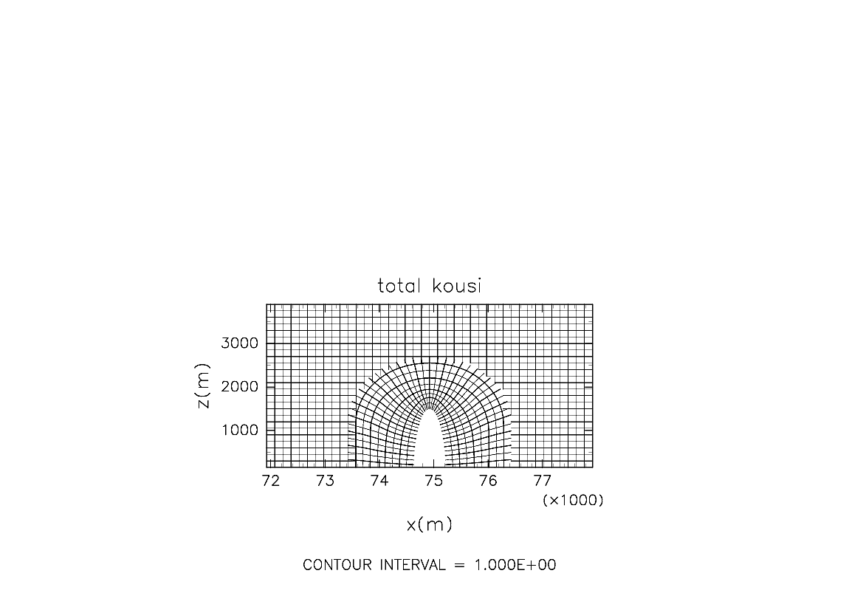
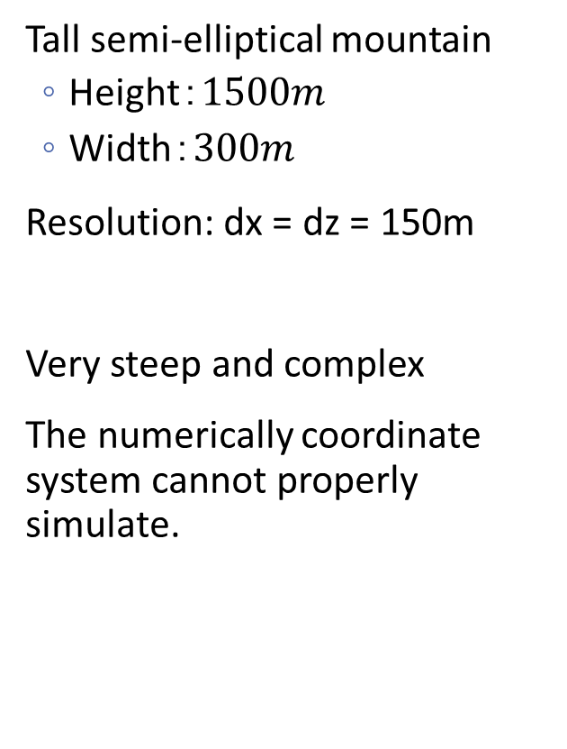
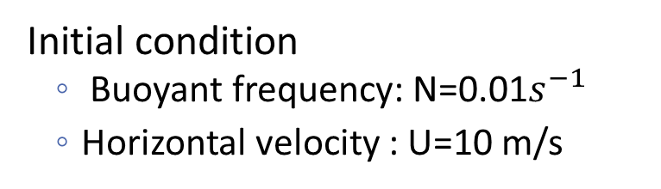
Experiment: mountain wave over a tall semi-elliptical mountain
Tall semi-elliptical mountain
  Height：$1500m$
  Width：$300m$
Resolution: dx = dz = 150m
Very steep and complex
The numerically coordinate system cannot properly simulate.
4
Height (km)
0
-3
0
3
Horizontal distance(km)
Initial condition
  Buoyant frequency: N=0.01$s^{−1}$
  Horizontal velocity : U=10 m/s

Slide 18
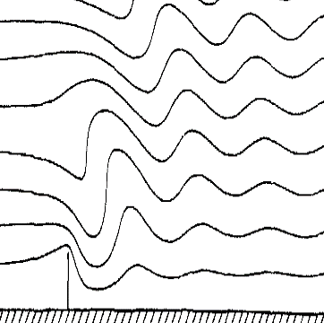
Result: mountain wave over tall semi-elliptic mountain
Potential temperature field of numerical solution (Takemura et al. 2016)
Stream line of analytical solution
(Huppert and Miles 1969)
10
10
Height (km)
5
5
Height (km)
0
0
0
10
20
Horizontal Distance(km)
Horizontal Distance (km)
The Chimera grid method succeeded in simulating mountain wave over complex terrain qualitatively.

Slide 19
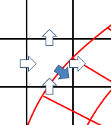
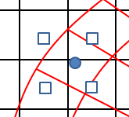





Interpolation and Conservation
$$Γ_{L}$$
In the Chimera grid method, interpolation method is divided into two types in terms of conservation.
$$η_{G}$$
$$ξ_{L}$$
$$ξ_{G}$$
$$η_{L}$$
Non-conservative interpolation
  Interpolating boundary values
Conservative interpolation
  Interpolating boundary fluxes
Boundary point ：
Surrounding point：
Boundary flux：
Surrounding flux：

Slide 20
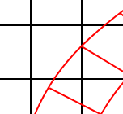


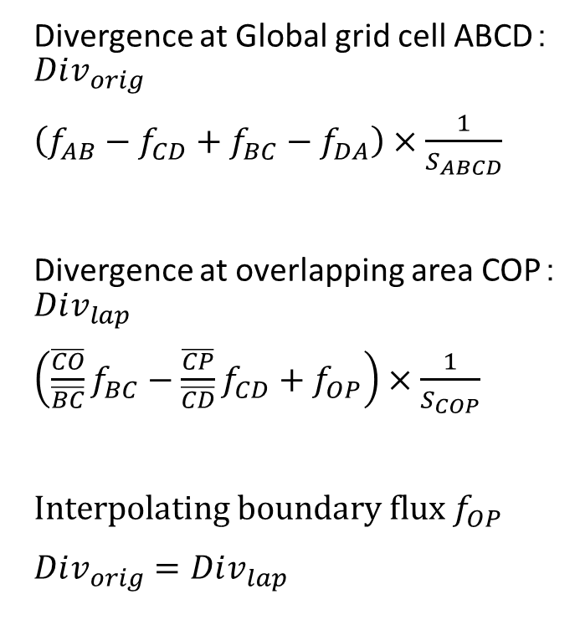





Conservative interpolation（ Peng et al. 2006）
Divergence at Global grid cell ABCD：$Div_{orig}$
$\left(f_{AB}−f_{CD}+f_{BC}−f_{DA}\right)×\frac{1}{S_{ABCD}}$
Divergence at overlapping area COP：$Div_{lap}$
$\left(\frac{\overline{CO}}{\overline{BC}}f_{BC}−\frac{\overline{CP}}{\overline{CD}}f_{CD}+f_{OP}\right)×\frac{1}{S_{COP}}$
Interpolating boundary flux $f_{OP}$
$Div_{orig}=Div_{lap}$
A
$$f_{DA}$$
D
$$f_{AB}$$
P
$$f_{OP}$$
$$f_{CD}$$
O
B
$$f_{BC}$$
C
$f_{AB}, f_{BC}, f_{CD}, f_{DA}$:Global grid cell fluxes
$f_{OP}$ ：Local grid flux

Slide 21
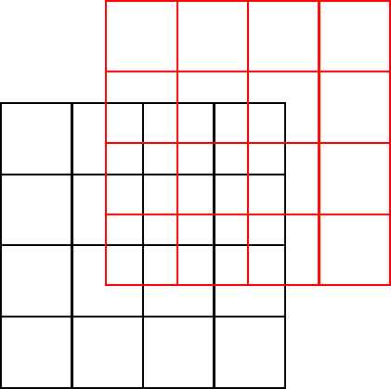

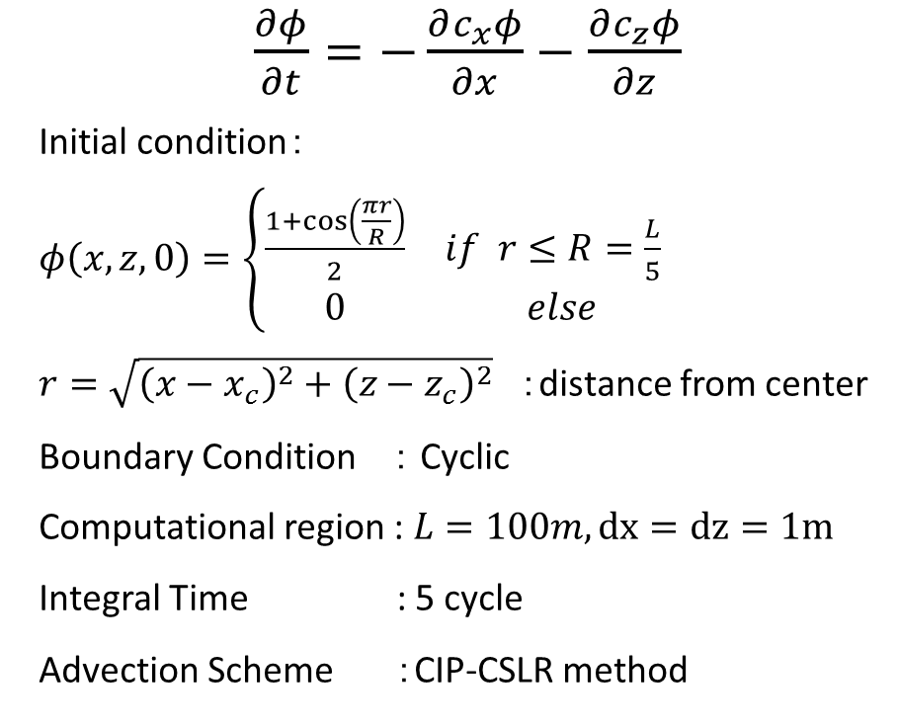
Advection test
$\frac{∂φ}{∂t}=−\frac{∂c_{x}φ}{∂x}−\frac{∂c_{z}φ}{∂z}$
Initial condition：
$φ\left(x,z,0\right)=\left\{\begin{matrix}\frac{1+\cos\left(\frac{πr}{R}\right)}{2} & if r≤R=\frac{L}{5} \\ 0 & else\end{matrix}\right.$
$r=\sqrt{{\left(x−x_{c}\right)}^{2}+{\left(z−z_{c}\right)}^{2}}$ ：distance from center
Boundary Condition ： Cyclic
Computational region : $L=100m, dx=dz=1m$
Integral Time : 5 cycle
Advection Scheme ：CIP-CSLR method
$$c_{x}=1m/s,c_{z}=0m/s$$
Grids are staggered at center.

Slide 22




Result
$φ$ after 5 cycles
$$(×{10}^{−4})$$
Relative error of conservation
2
Conservative
0
-2
$l_{2}$ norm
Non-conservative
0.05
0
$$(×{10}^{−5})$$
$l_{∞}$ norm
7
0
0
1
2
3
4
5
Cycle

Slide 23
Summary
We have developed a non-hydrostatic model adopting the Chimera grid method for steep terrain.
  Succeeded in reducing the error that are produced by using terrain-following coordinate and numerically generated coordinate over the semi-circular mountain.
  Succeeded in simulating a mountain wave qualitatively over the tall semi-elliptical mountain which cannot be represented appropriately by using the numerically generated coordinate.
Now we are trying to introduce conservative interpolation method to ensure global conservation.

