Slide 1
Improving computational stability with time-splitting of vertical advection considering 3-dimensional CFL condition
Kohei Kawano¹, Kohei Aranami¹, Tabito Hara¹, Kengo Matsubayashi¹, Masami Sakamoto¹, Yuji Kitamura²
1. Numerical Prediction Division, Japan Meteorological Agency
2. Meteorological Research Institute

Slide 2
Outline
Background
Motivation
Explanation of ASUCA’s
Time integration scheme(RK3)
Advection scheme
CFL condition (1D and 3D)
Time-splitting of vertical advection
How to time-split RK3?
Additional use of dimensional splitting

Slide 3
Motivation
Newly developed non-hydrostatic numerical model called ASUCA has been launched into operation as the 2km LFM since 2015.
JMA even plans to introduce ASUCA into the 5km grid spacing operational model (MSM) this winter.
Vertical resolution will be enhanced in MSM
vertical resolution is finer than LFM
while longer time step is required because horizontal grid spacing is coarser than LFM
For the operational use
sufficient computational stability
practical computational efficiency
Example of vertical resolution
hPa
MSM
LFM

Slide 4
Time integration
Runge-Kutta(RK3)
Wicker and Skamarock(2002)
③
②
①
n
n+1
Δt
①
②
③

Slide 5
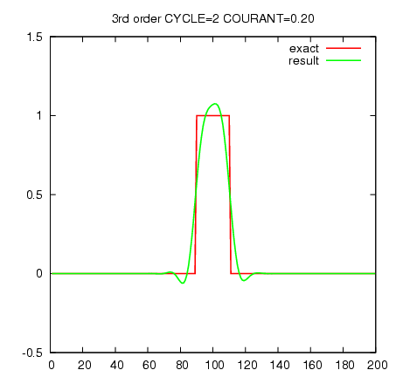
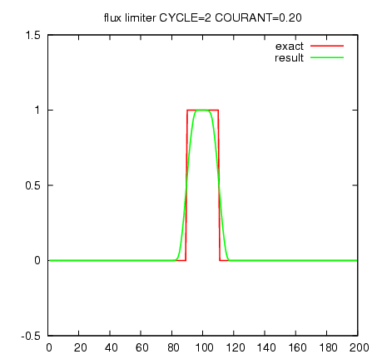
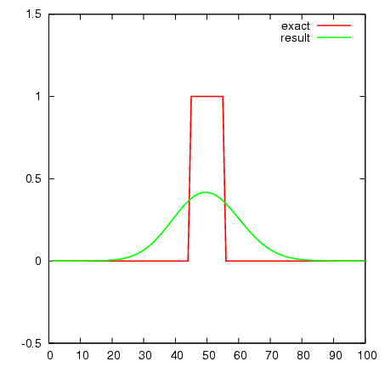
Advection scheme
Combining
3rd order upwind in smooth regions
Higher accuracy, non-monotonicity（Godunov’s theorem）
1st order upwind in sharp gradient regions
Monotonicity , lower accuracy
using flux limiter function proposed by Koren(1993)
1st order upwind
3rd order upwind
Koren(1993)
Monotonicity is preserved, no overshoot and no undershoot appeared.
Cycle advection test in a constant velocity field.
Green line is the result of after two cycles.

Slide 6
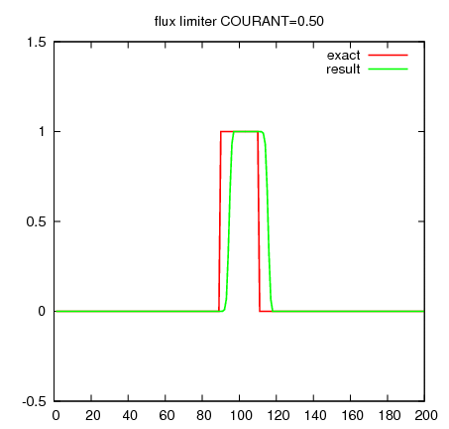
1D scalar advection test
- RK3 + flux limiter
- Slightly changing the Courant number
0.5
1.19
1.24
1.25
1.26
1.27
The stability condition of 1D advection is Cx≦1.25=C1
Cx: Courant number in x direction
This result corresponds to the result from von Neumann’s stability analysis of RK3 + 1st order upwind

Slide 7
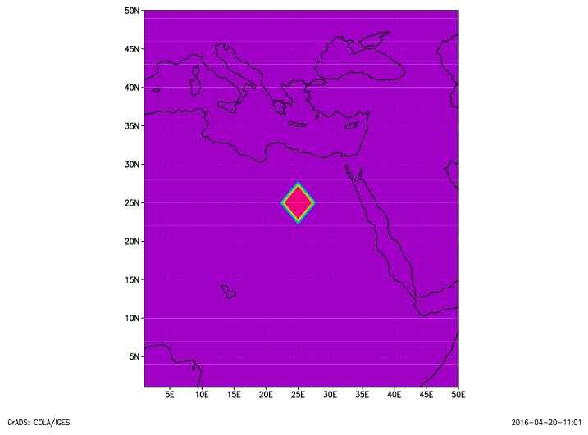
2D scalar advection test
y
nx=50, ny=50
Constant velocity in x, y direction
Cyclic lateral boundary condition in x, y direction
A cylinder placed at the center of the computation domain
Integrated for 60 minutes
Tests with various Courant number Cx and Cy
Final amplitude is checked to decide whether the computation completes stably or not.
Cy = 0.3
Cx = 0.3
x

Slide 8
2D scalar advection test
unstable ×
y
nx=50, ny=50
Constant velocity in x, y direction
Cyclic lateral boundary condition in x, y direction
A cylinder placed at the center of the computation domain
Integrated for 60 minutes
Tests with various Courant number Cx and Cy
Final amplitude is checked to decide whether the computation completes stably or not.
Cy = 0.9
Cx = 0.9
x

Slide 9
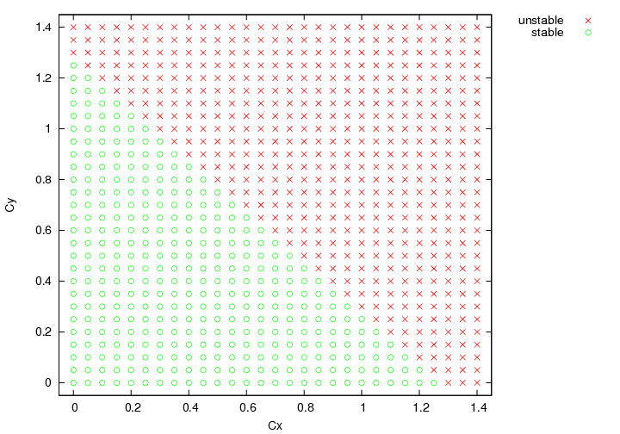
Computational stability
stable ○
unstable ×
Cx+Cy < 1.25=C1
⇒
stability condition for 3D advection:
Cx+Cy+Cz < C1

Slide 10
Cx+Cy+Cz < C1 can be severe to be met
because it depends
not only on wind velocity
but also on wind direction
v
e.g. U=V=10m/s requires severe limitation on the vertical velocity than the case where U=10√2m/s and V=0m/s
Cx+Cy = (10m/s + 10m/s) Δt / Δh
Cx+Cy = (10√2m/s + 0m/s) Δt / Δh
u
10 m/s
10√2 m/s

Slide 11
Example: Typhoon case
Horizontal wind velocity
Horizontal Courant number
Cx+Cy
水平風速は台風周辺のほうが大きい
y
y
x
x
Cz < 1.25 - (Cx+Cy) is required

Slide 12
Example: Typhoon case
Horizontal wind velocity
3D Courant number
Cx+Cy+Cz
y
y
x
x

Slide 13
Time-splitting of vertical advection
Considering computational efficiency and ASUCA’s memory alignment
where the vertical indices are put inner most
It is more reasonable
time integration of only vertical advection is divided into smaller substeps
because the number of substeps can be determined independently from its neighboring column
the number of substeps
2
2
2
2

Slide 14
Outline
Background
Motivation
Explanation of ASUCA’s
Time integration scheme(RK3)
Advection scheme
CFL condition (1D and 3D)
Time-splitting of vertical advection
How to time-split RK3?
Additional use of dimensional splitting

Slide 15
ASUCA’s time integration
Vertical advection
③
②
①
n
n+1
Δt
Horizontal advection
③
②
①
n
n+1
Δt

Slide 16
ASUCA’s time integration
Vertical advection
①
n
n+1
Δt
Horizontal advection
①
n
n+1
Δt

Slide 17
ASUCA’s time integration
Vertical advection
②
①
n
n+1
Δt
Horizontal advection
②
①
n
n+1
Δt

Slide 18
ASUCA’s time integration
Vertical advection
③
②
①
n
n+1
Δt
Horizontal advection
③
②
①
n
n+1
Δt

Slide 19
Time-splitting of vertical advection
Cx+Cy+Cz > C1
Vertical advection
Cz < C1
③
②
①
n
n+1
Δt
Horizontal advection
③
Cx+Cy < C1
②
①
n
n+1
Δt

Slide 20
Time-splitting of vertical advection
Cx+Cy+Cz/N < C1
The number of substeps
N = 2
Vertical advection
Cz < C1
③
②
①
n
n+1
Δt
Horizontal advection
③
Cx+Cy < C1
②
①
n
n+1
Δt

Slide 21
Time-splitting of vertical advection
Field values at t+Δt/3 and t+Δt/2
are required to evaluate tendencies in the other processes.
Vertical advection
n
t+Δt/3
n+1
Δt
Horizontal advection
③
②
①
n
t+Δt/3
n+1
Δt

Slide 22
Time-splitting of vertical advection
③
②
①
t+Δt/3
t+Δt/2
n
n+1
Δt
①
N①?
Dividing each of the RK3 stages(①,②,③) into N substeps is the simplest way
under the restriction where field values at t+Δt/3 and t+Δt/2 are required
②
N②?
③
N③?
n
n+1
Δt

Slide 23
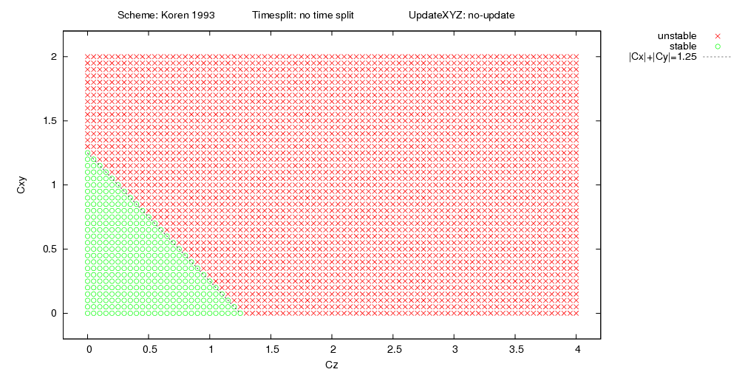
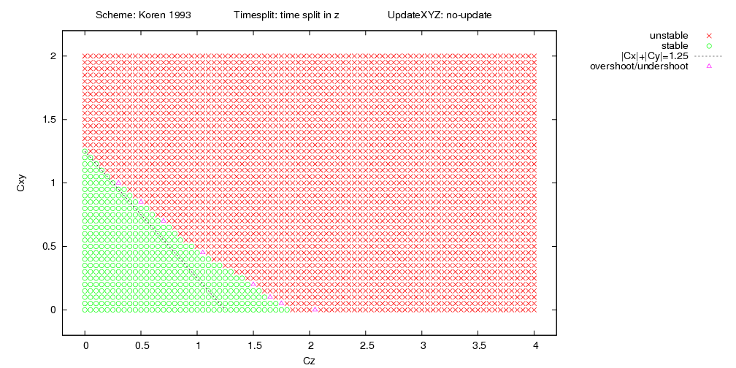
Cxy
2
1
unstable ×
stable ○
0
0
1
2
3
4
Cz
①
①
②
②
③
③
n
n+1
n
Δτ=Δt/2
n+1/2
Δτ=Δt/2
n+1
Δt
Replacing the forward form integration ③ with the 2 forward steps

Slide 24
2D scalar advection test
y
nx=50, ny=50
Constant velocity in x, y direction
Cyclic lateral boundary condition in x, y direction
A cylinder placed at the center of the computation domain
Integrated for 60 minutes
Tests with various Courant number Cx and Cy
Final amplitude is checked to decide whether the computation completes stably or not.
Cy = 0.3
Cx = 0.3
x

Slide 25
2D scalar advection test
with time-splitting in Z direction
xy
nx=50, ny=50
Constant velocity in xy, z direction
Cyclic lateral boundary condition in xy, z direction
A cylinder placed at the center of the computation domain
Integrated for 60 minutes
Time-splitting in Z direction
Tests with various Courant number Cxy and Cz
Final amplitude is checked to decide whether the computation completes stably or not.
Cxy = 0.3
Cz = 0.3
z
Time-splitting in this direction

Slide 26
Cxy
2
1
0
0
1
2
3
4
Cz
①
①
②
②
③
③
n
n+1
n
Δτ=Δt/2
n+1/2
Δτ=Δt/2
n+1
Δt
Replacing the forward form integration ③ with the 2 forward steps

Slide 27
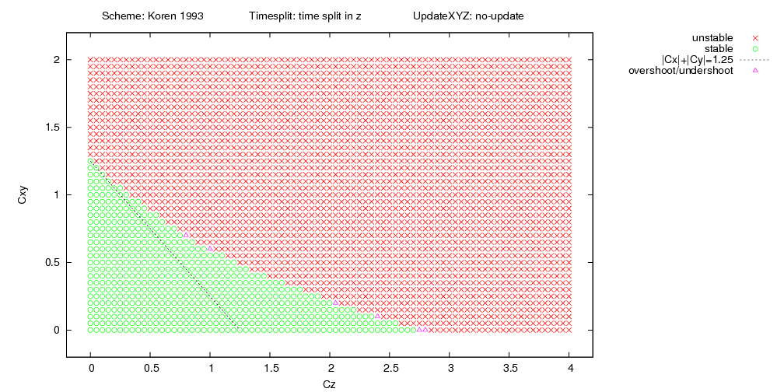
Cxy
2
1
0
0
1
2
3
4
Cz
More stable method is established, although computational cost is more expensive
①
①
②
②
③
③
n
n+1
n
Δτ=Δt/2
n+1/2
Δτ=Δt/2
n+1
Δt
Replacing the forward form integration at each of the RK3 stages with the RK3
( i.e. RK3 is nested in the original RK3 time integration)

Slide 28
Dimensional splitting
When the time-splitting is invoked,
fields are updated using the horizontal flux FH first,
Then the vertical flux FV is evaluated with the integrated field
=
+

Slide 29
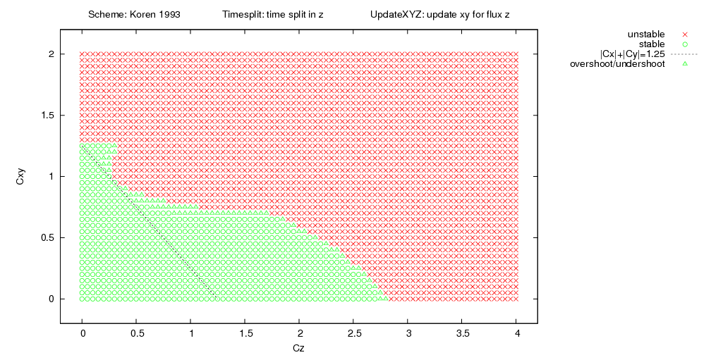
Cxy
2
1
Time-splitting
0
0
1
2
3
4
Cz
Dimensional splitting
(xy⇒z)
Only when the time-splitting is invoked,
dimensional splitting is additionally used.

Slide 30
summary
To improve computational stability
ASUCA has been launched into operation as the 2km LFM
introducing ASUCA into the 5km MSM
vertical resolution is finer than LFM
while longer time step is required because horizontal grid spacing is coarser than LFM
Time-splitting of vertical advection is adopted
The number of substeps N is chosen so as to satisfy Cx+Cy+Cz/N < C1
Replace the “forward form integration” of each of the RK3 stages with the RK3
(i.e. RK3 is nested in the original RK3)
to establish more stable method, although computational cost is more expensive.
In addition, when the time-splitting is invoked,
dimensional splitting method (X,Y⇒Z) is also used.
⇒ Many real-data simulations including severe storm cases such as typhoons have shown
the method provides sufficient computational stability for the operational use
as well as practical computational efficiency

Slide 31
Bkup

Slide 32
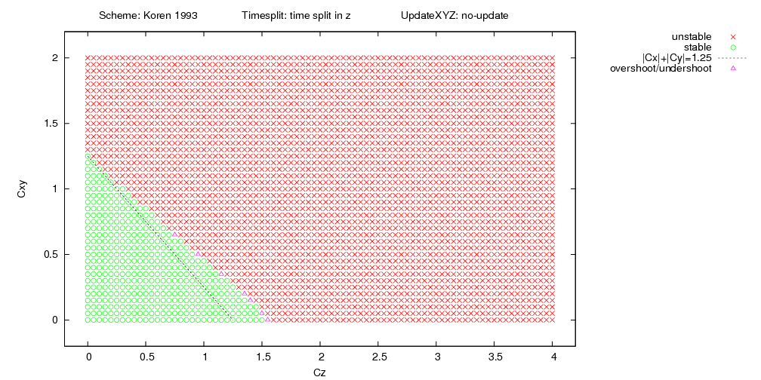
Cxy
2
1
0
0
1
2
3
4
Cz
①
①
②
②
③
③
n
n+1
n
Δτ=Δt/2
n+1/2
Δτ=Δt/2
n+1
Δt

Slide 33
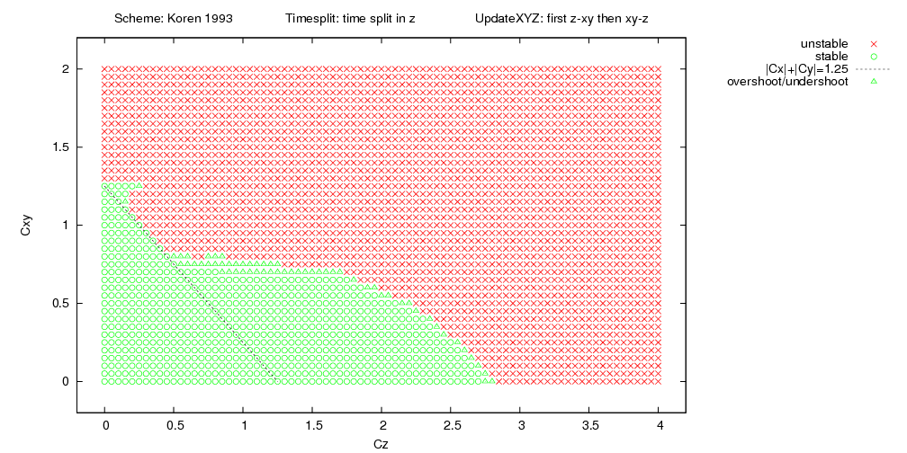
Cxy
2
1
Time-splitting
0
0
1
2
3
4
Cz
Additional MPI communication is needed in ASUCA.
Dimensional splitting
Dimensional splitting
(The order is exchanged
every time step)

