Slide 1
Simulated Convective-Radiative Properties in the MJO during DYNAMO/CINDY2011
C.-H. Sui, Yi-An Chen, Shu-Yu Hou
National Taiwan University

Slide 2
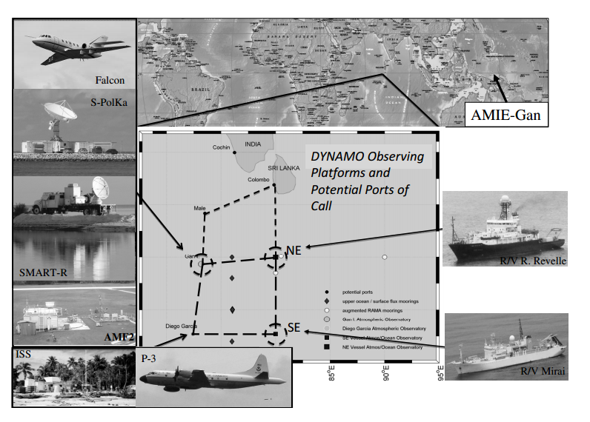
Moistening Process of MJOs during DYNAMO/CINDY2011
Tseng, Sui, Li (2015)
(73.5E,4.2N)
(79E,6.9N)
Male
NSA
Gan
(80.5E,0.07N)
(73.1E,0.7S)
SSA
(72E,-7.3N)
(80.5E,-8N)
Diego Garcia

Slide 3
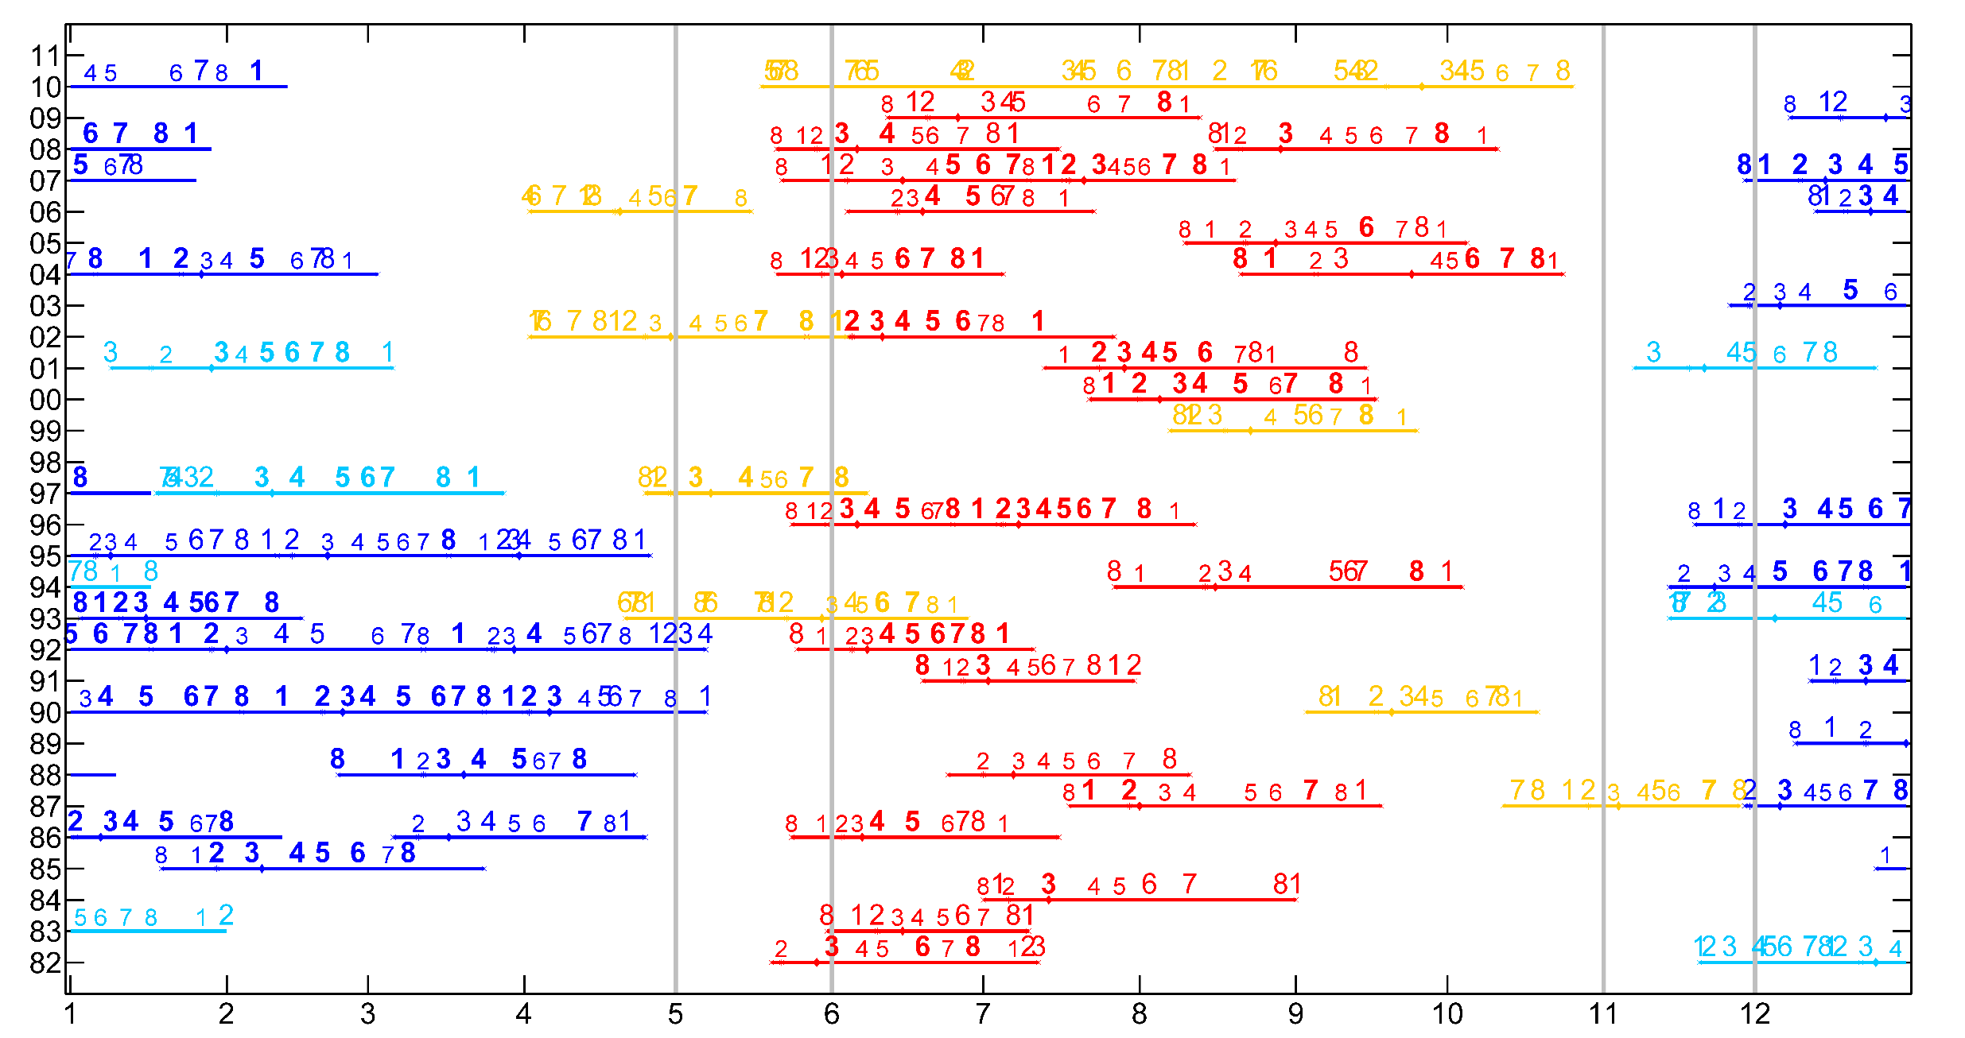
Successive & primary MJO events
Moisture & MSE budgets of successive MJOs
Hung and Sui (2016)
 | MJO | BSISO
Successive | 22 | 23
Primary | 5 | 8

Slide 4
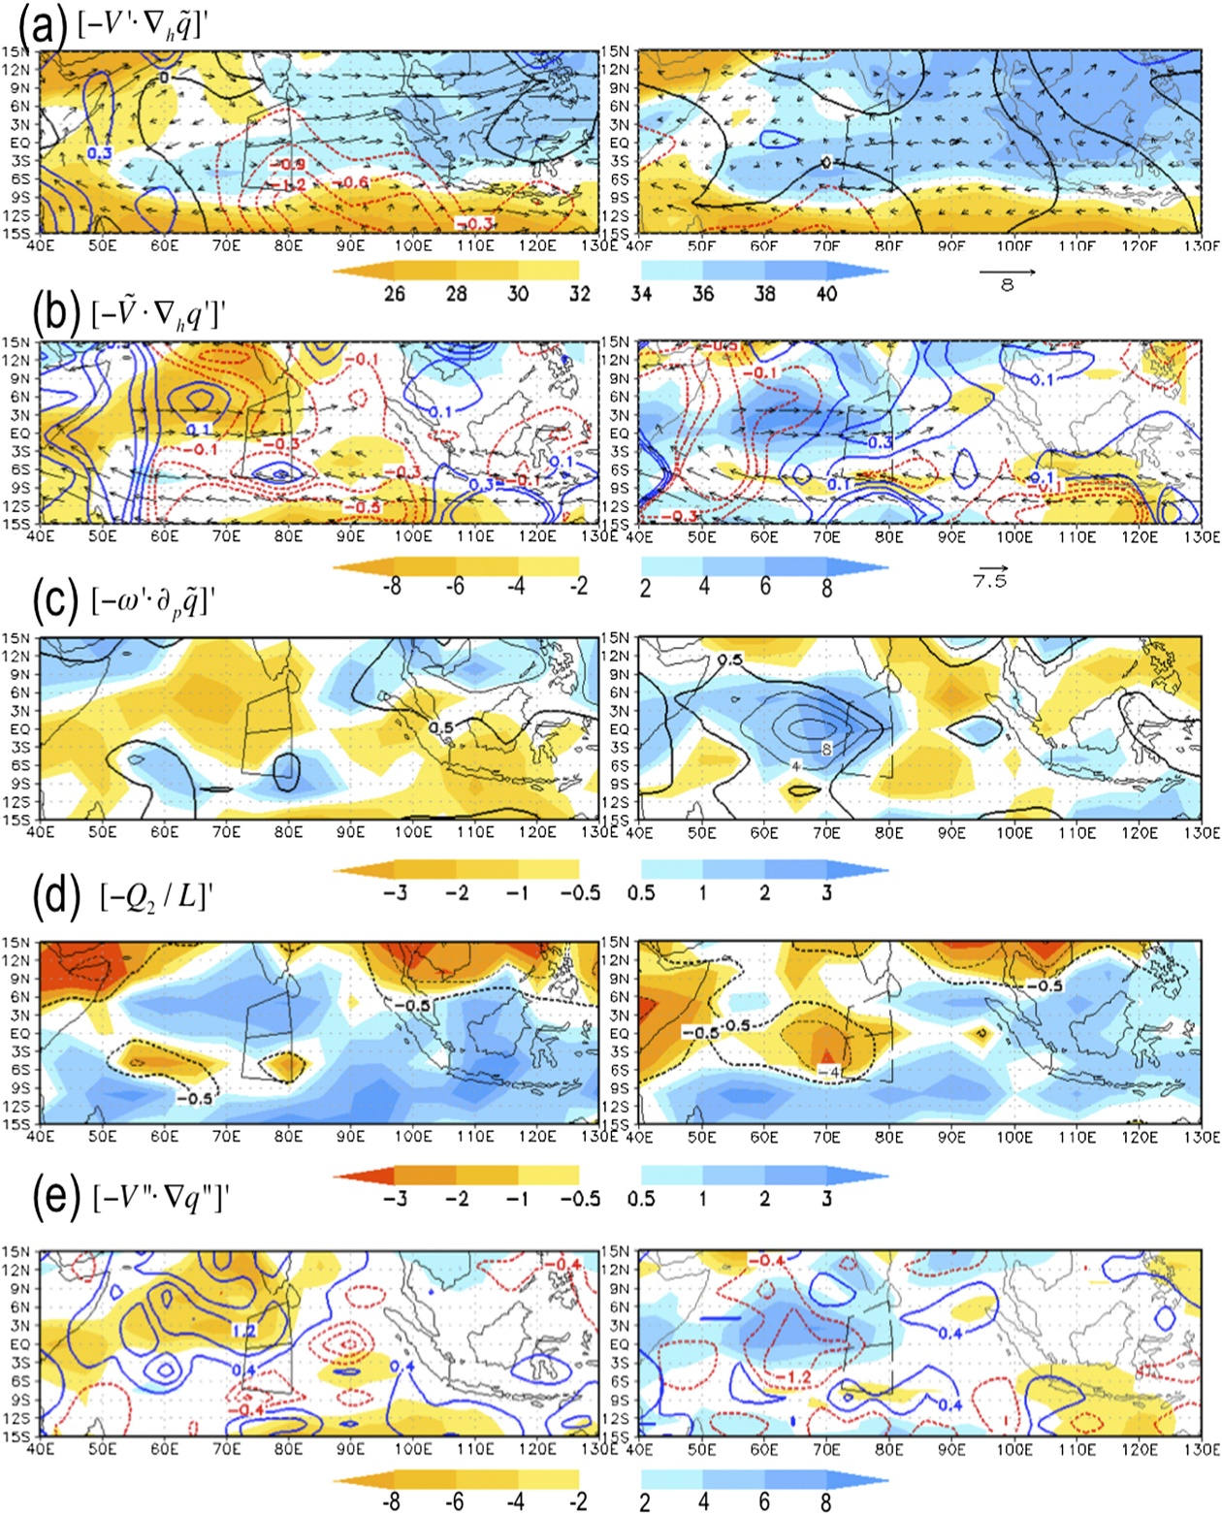
Scale-separated
[Moisture budget]₁₀₀₀₋₇₀₀
MJO Suppressed (2011/10/1-9) MJO developing (2011/10/10-19)
shaded
cont
vector
MJO flow advects mean
LF MM
(Moisture Mode,
primarily adv)
shaded
cont
vector
Mean flow advects MJO
shaded
cont
ISO CID
(Cumulus
Interaction
with Dyn.)
BL conv. precedes the MJO
shaded
cont
HF CID
(diffusion)
shaded
cont
High freq disturbances diffuse
EC operational data
(Tseng et al. 2015)
Notes:
/data5/mlinht/research-MJO/MPAS/MPAS-R2.1-x1.163842-GFS_RTGSST/kaizu/budget-ECoperational-test/Q2/large-divided

Slide 5
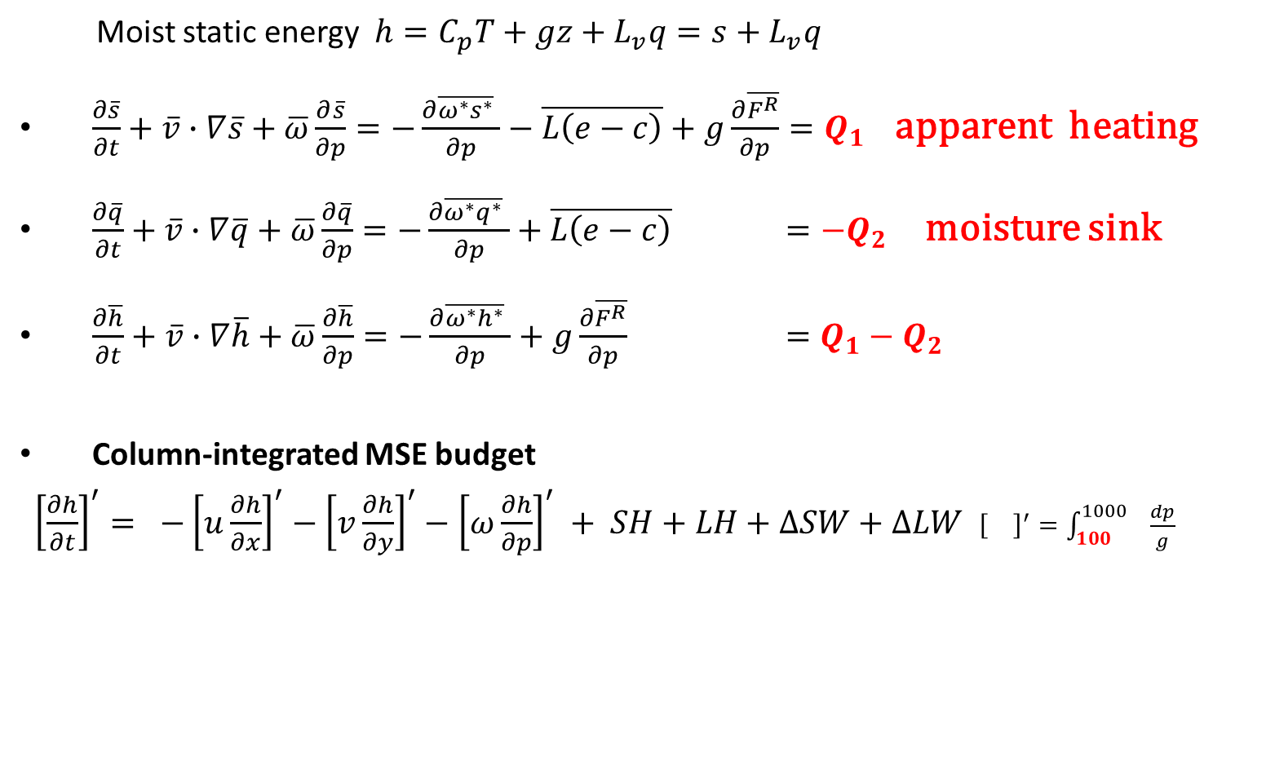
Moist static energy (MSE) budget
Moist static energy $h=C_{p}T+gz+L_{v}q=s+L_{v}q$
$\frac{∂\overline{s}}{∂t}+\overline{v}∙∇\overline{s}+\overline{ω}\frac{∂\overline{s}}{∂p}=−\frac{∂\overline{ω^{∗}s^{∗}} }{∂p}−\overline{L\left(e−c\right)}+g\frac{∂\overline{F^{R}}}{∂p}=Q_{1}$ apparent heating
$\frac{∂\overline{q}}{∂t}+\overline{v}∙∇\overline{q}+\overline{ω}\frac{∂\overline{q}}{∂p}=−\frac{∂\overline{ω^{∗}q^{∗}} }{∂p}+\overline{L\left(e−c\right)} ={−Q}_{2}$ moisture sink
$\frac{∂\overline{h}}{∂t}+\overline{v}∙∇\overline{h}+\overline{ω}\frac{∂\overline{h}}{∂p}=−\frac{∂\overline{ω^{∗}h^{∗}} }{∂p}+g\frac{∂\overline{F^{R}}}{∂p} =Q_{1}−Q_{2}$
Column-integrated MSE budget
${\left[\frac{∂h}{∂t}\right]}^{′}= −{\left[u\frac{∂h}{∂x}\right]}^{′}−{\left[v\frac{∂h}{∂y}\right]}^{′}−{\left[ω\frac{∂h}{∂p}\right]}^{′} + SH+LH+∆SW+∆LW$ ${\left[\right]}^{′}=\int_{100}^{1000}{ \frac{dp}{g}}$
circulation
(large-scale)
surface & radiative flux
(local processes)
Notes:
Horizontal average
A horizontal area that is large enough to contain the ensemble of clouds, but small enough to be regarded as a fraction of the large-scale system

Slide 6
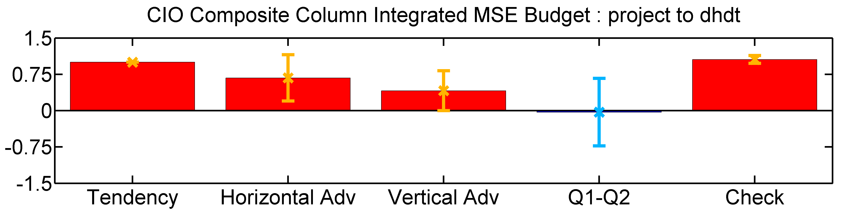
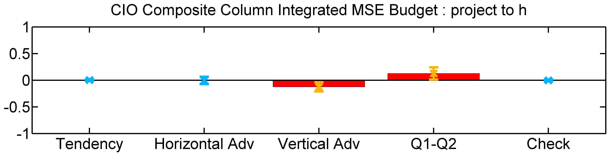
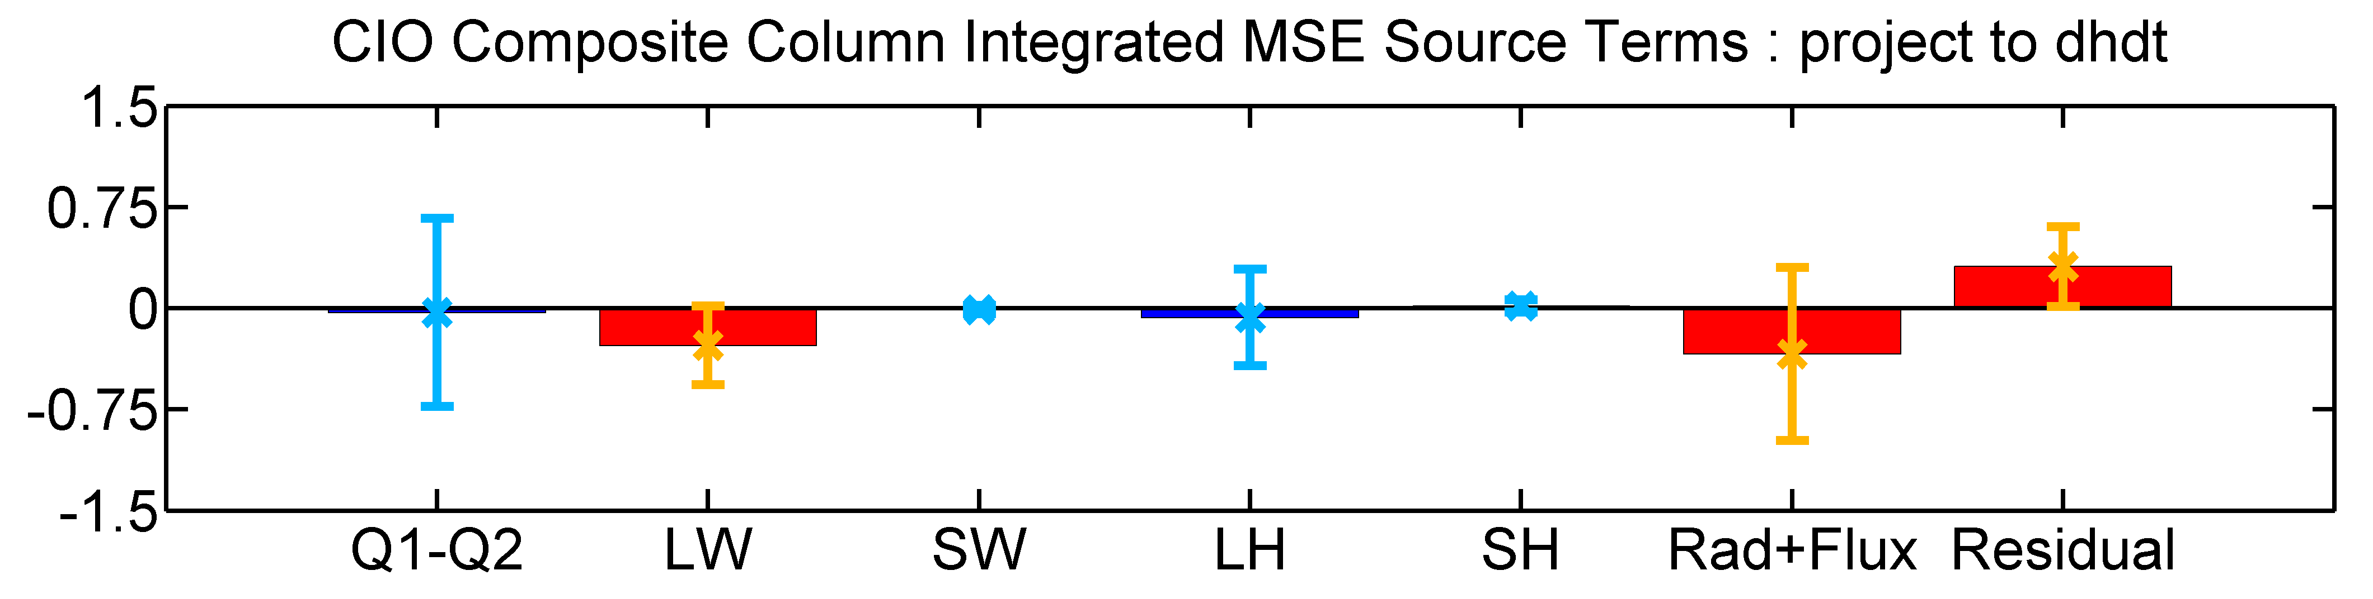
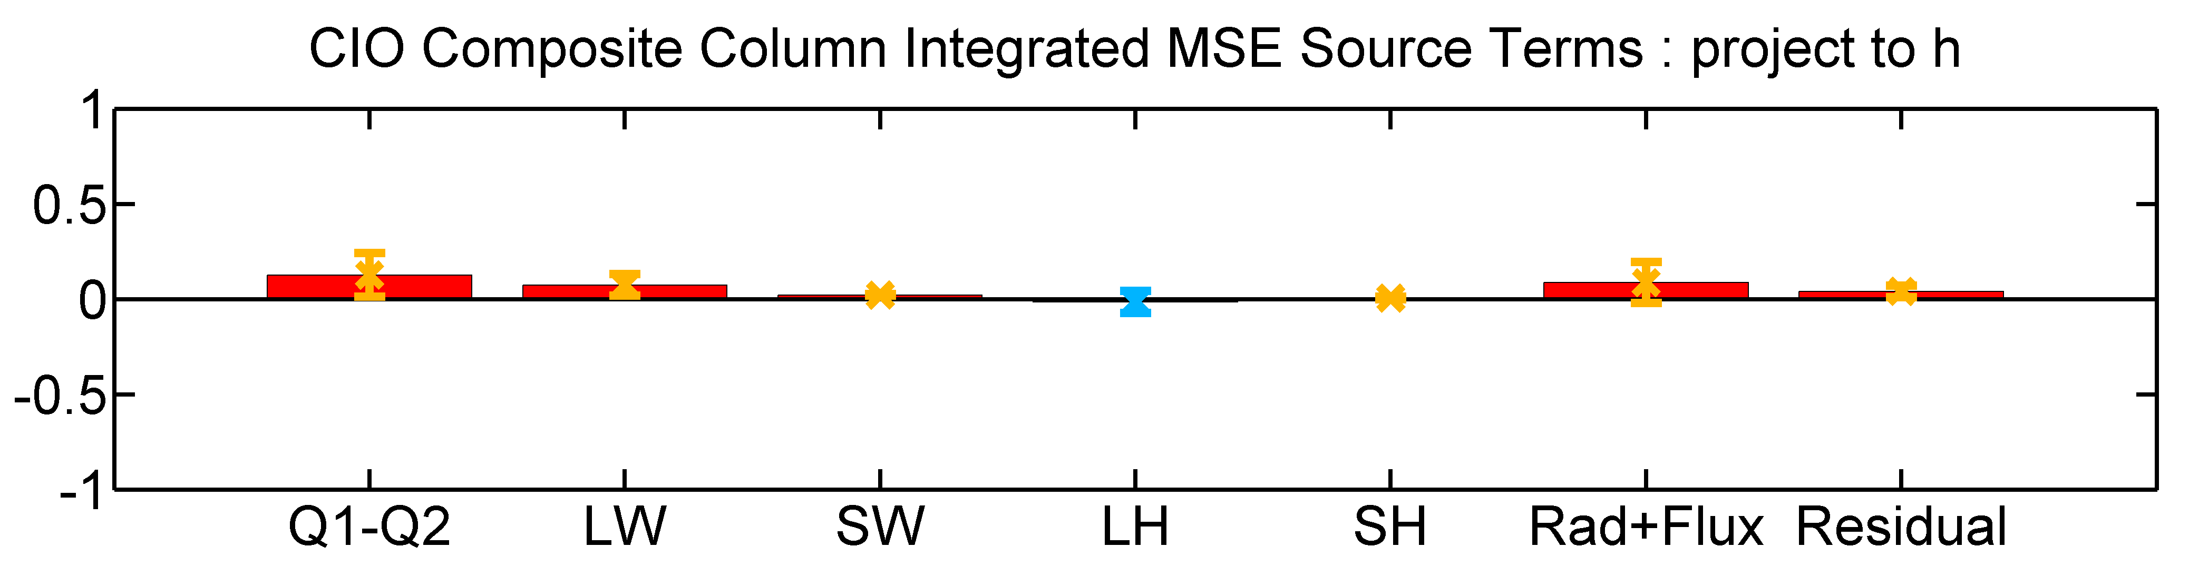
Central Indian Ocean (CIO)
Propagation
Growth rate
MSE tendency and horizontal advection term are consistent with the moisture budget analysis.
longwave heating acts to maintain MSE and retard the propagation.
Latent heat flux also slows down the propagation.

Slide 7
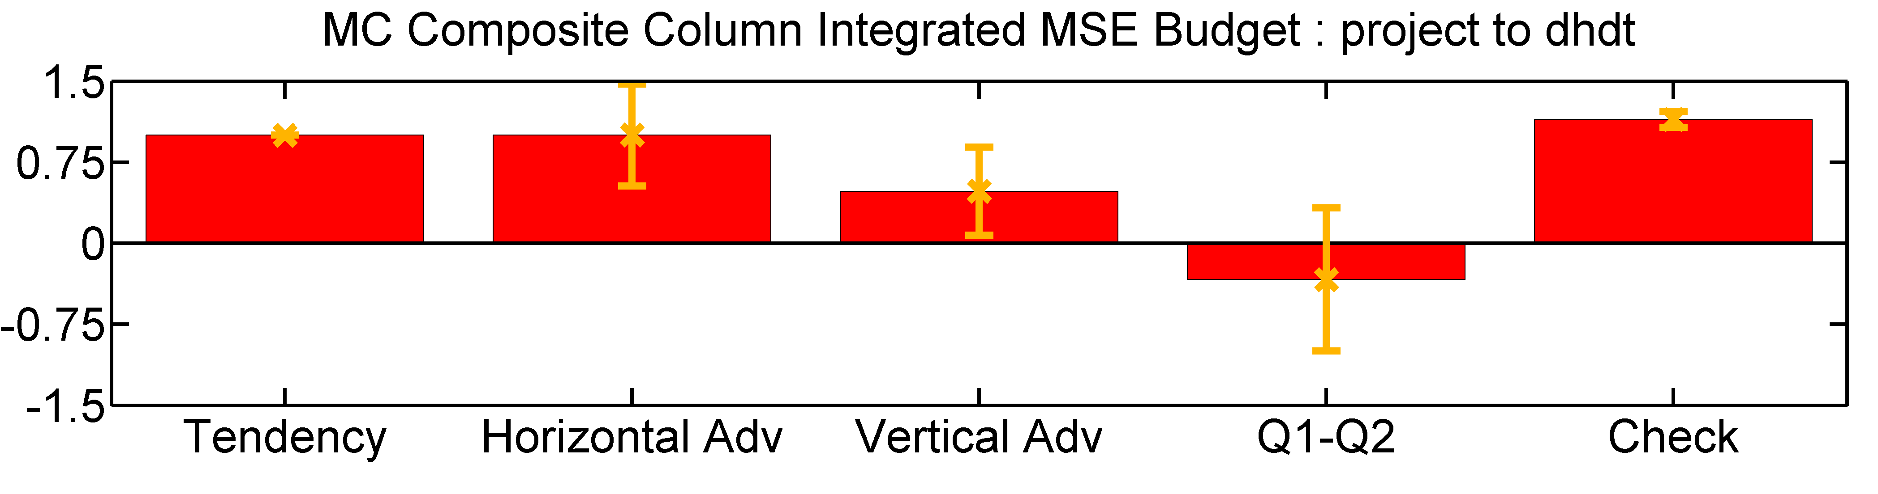
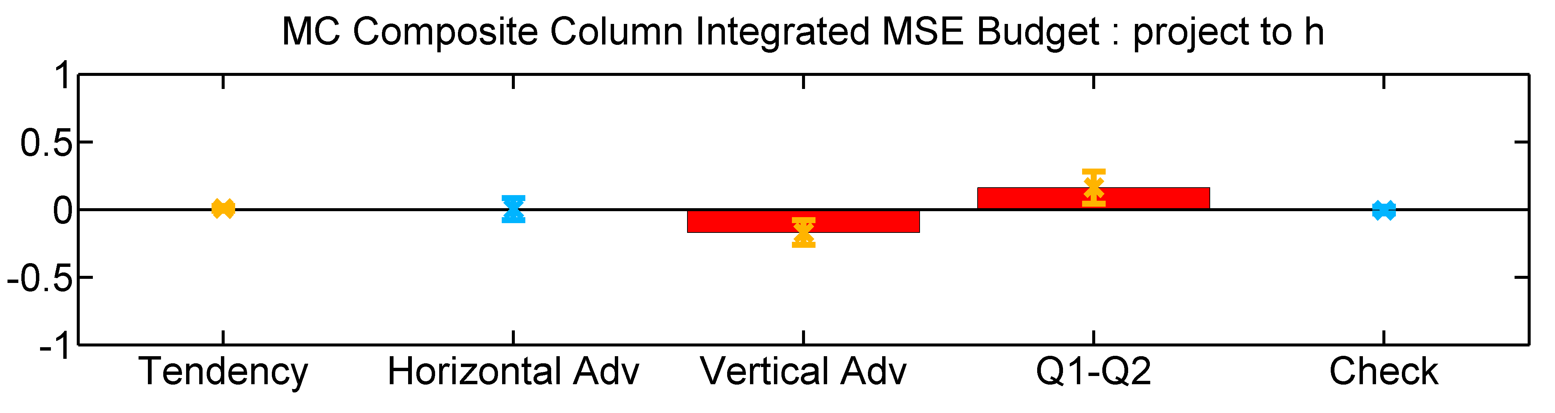
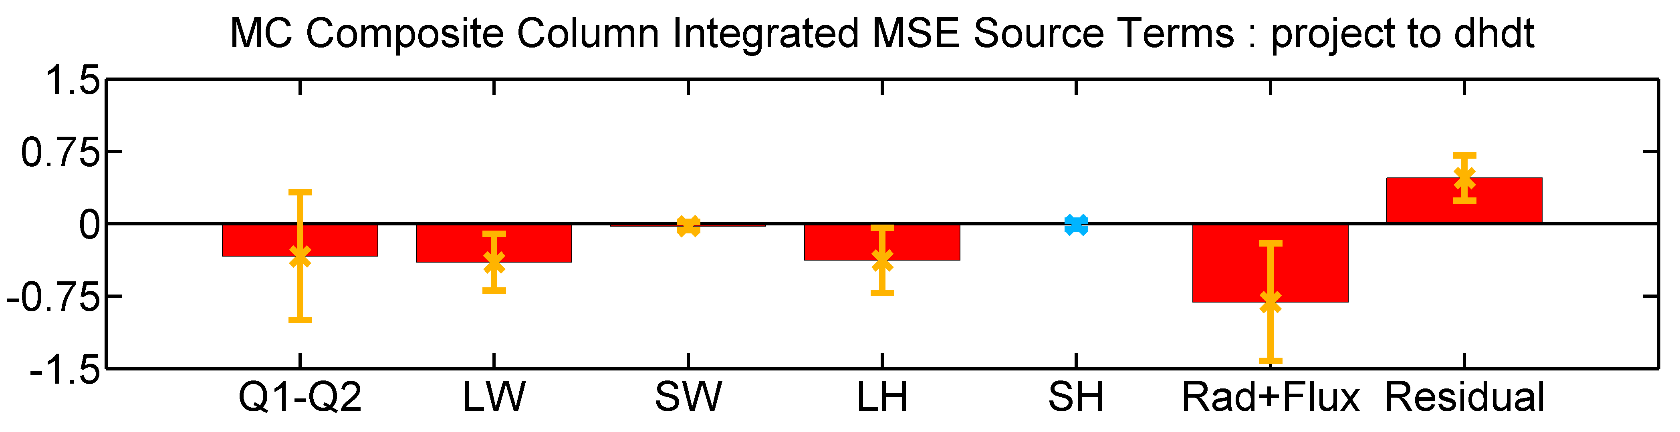
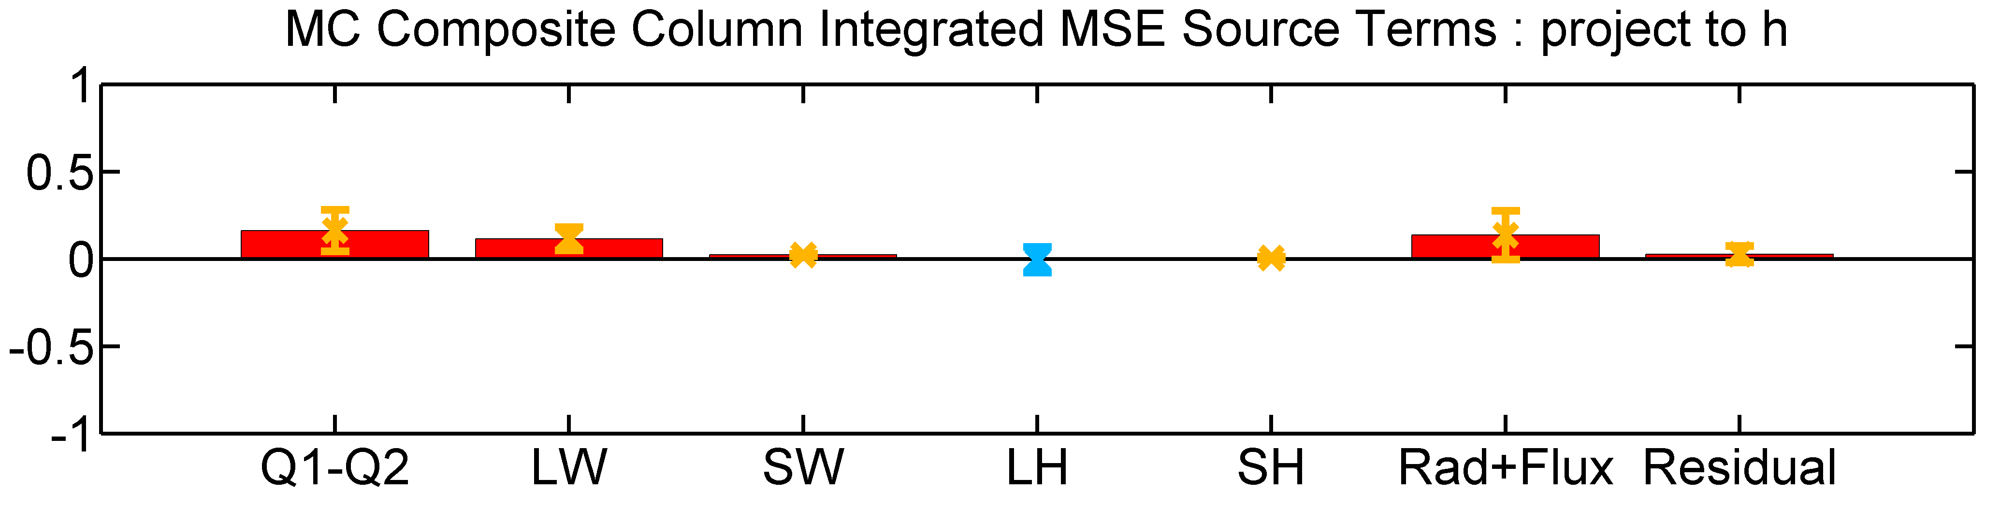
Maritime Continent (MC)
Propagation
Growth rate
The MSE budget analysis over Maritime Continent is generally consistent with that of Indian Ocean.

Slide 8
Summary
1. The suppressed convection of previous event is conducive to the initiation and propagation of the subsequent event.
2. Dominant moistening source in the IO to MC region,
• adv. by easterlies and poleward flows induced by the MJO cooling/heating;
• the boundary layer frictional moisture convergence exists at the east side of convection center;
• meridional adv. is more essential over the MC.
3. The role of radiative flux
• To maintain variability and retard the propagation.
• Enhances LW cooling in the MJO suppressed convection is expected to maintain sub-grid processes such as surface evaporation and shallow convection.

Slide 9
MPAS v4.0
Resolution
Horizontal : 60 km
Vertical Layers： 41 layers (top height 28km)
Parameterizations
PBL ： YSU Scheme
Cumulus ： Tiedtke Scheme
(default vs EC IFS cy40r1)
Radiation: RRTMG Scheme
Microphysics: WSM6 Scheme
Approach
Initial Condition： NCEP FNL
Boundary Condition : RTGSST (daily updated)
Simulation Period： DYNAMO 2011 ,10/01-12/31
(restart every 15 days)
Simulation Approach
Oct 1st
Oct 15th
Nov 1st
Nov 15th
Dec 1st
Dec 15th
Dec 31st
time

Slide 10
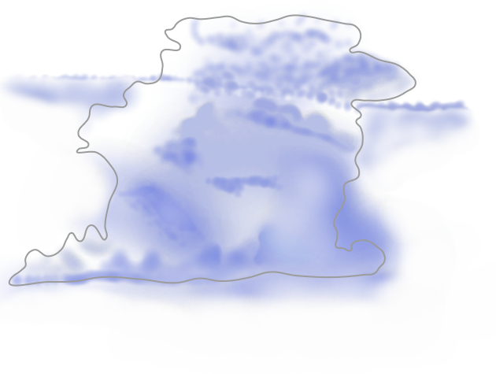
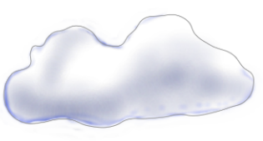
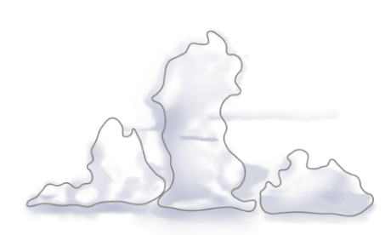
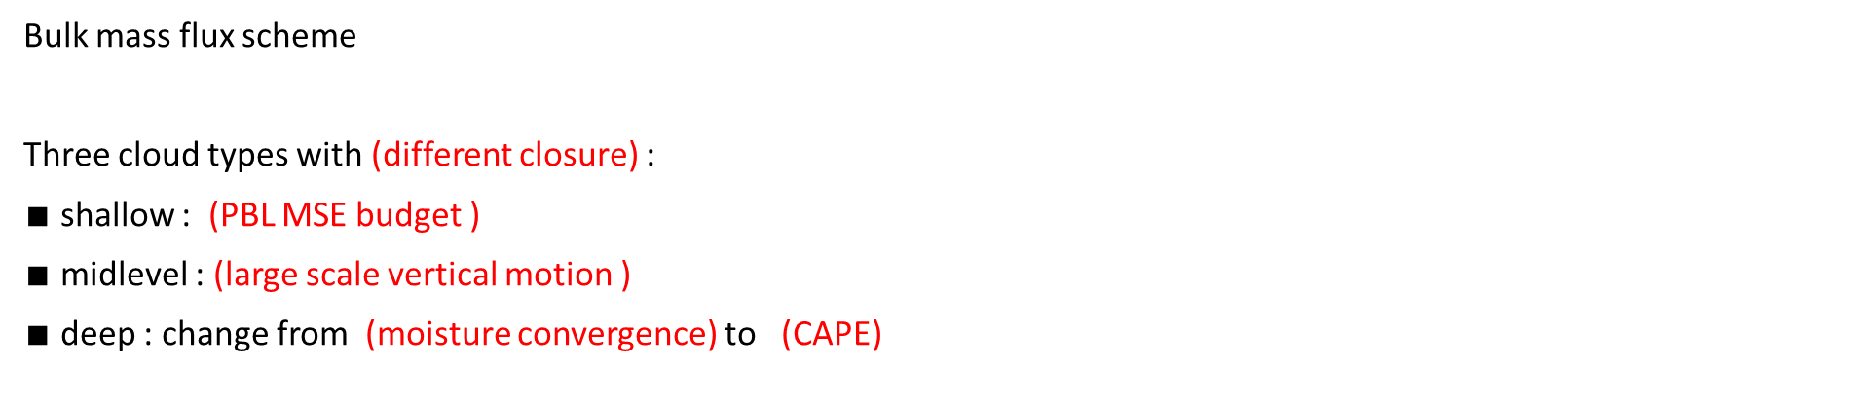
Tiedtke scheme
Bulk mass flux scheme
Three cloud types with (different closure) :
$∎$ shallow : (PBL MSE budget )
$∎$midlevel : (large scale vertical motion )
$∎$ deep : change from (moisture convergence) to (CAPE)
cloud type choosing , Jakob & Siebesma (2003)
M. Tiedtke (1989)
T. E. Nordeng (1994) , P. Bechtold (2014)
Shallow cloud
deep cloud
midlevel cloud
IFS DOCUMENTATION – Cy40r1 Operational implementation

Slide 11
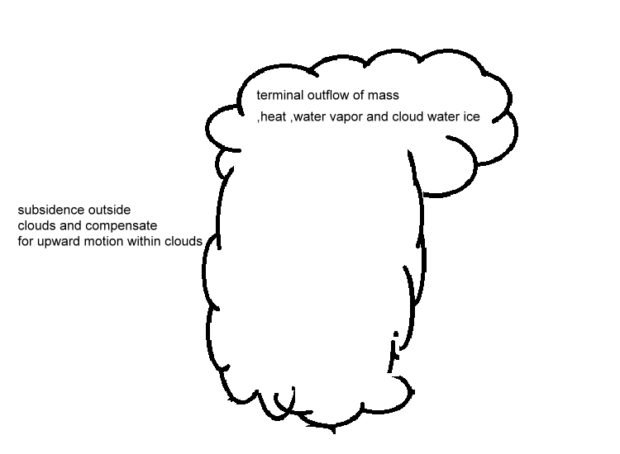


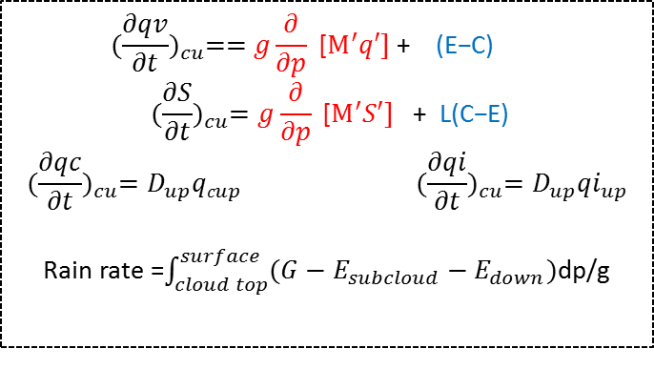

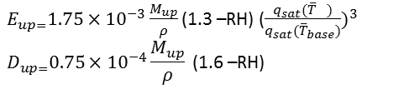
Tiedtke scheme
Organized detrainment from cloud
Using (Simpson 1969 )
cloud kinetic equation
$\frac{∂M_{u}}{∂z}$=E$−D$
Updraft
With
condensation
Conversion of cloud condensate to precipitation
Ex :Deep cloud
Entrain /detrain
(Sundqvist 1978)
$E_{up=}1.75×{10}^{−3}\frac{M_{up}}{ρ}$ (1.3 –RH) ($\frac{q_{sat}({\overline{T}}_{})}{q_{sat}({\overline{T}}_{base})})^{3}$
$$D_{up=}0.75×{10}^{−4}\frac{M_{up}}{ρ}\text{ (1.}\text{6}\text{ –}\text{RH}\text{)}$$
Downdraft
With
Evaporation
$${(\frac{∂qv}{∂t})}_{cu}==g\frac{∂}{∂p}\text{ [}M^{′}q′] \text{+ }\text{(}\text{E}\text{−}\text{C}\text{)}$$
$${(\frac{∂S}{∂t})}_{cu}=g\frac{∂}{∂p}\text{ [}M^{′}S′] \text{+ }\text{L}\text{(}\text{C}\text{−}\text{E}\text{)}$$
$${(\frac{∂qc}{∂t})}_{cu}=D_{up}{qc}_{up} {(\frac{∂qi}{∂t})}_{cu}=D_{up}{qi}_{up}$$
Rain rate =$\int_{cloud top}^{surface}{(G−E_{subcloud}−E_{down})}$dp/g
Evaporation of precipitation in subcloud layer
(Kessler 1969)

Slide 12
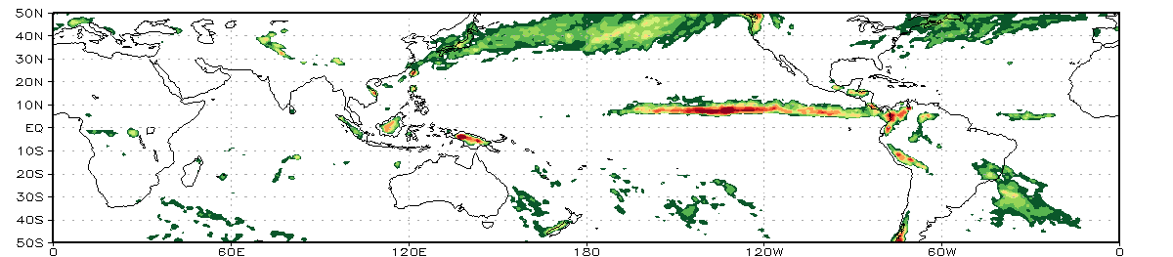
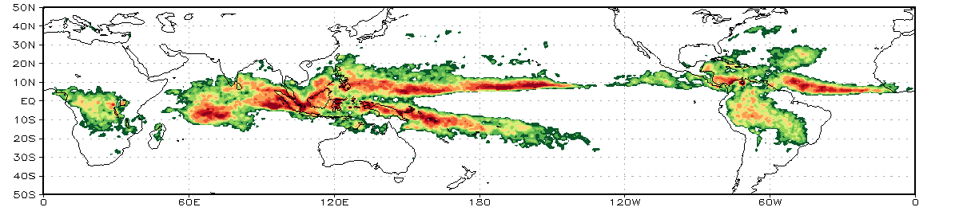
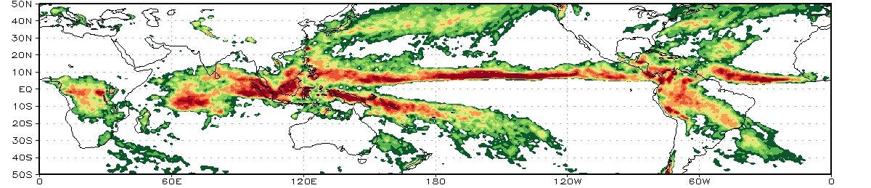
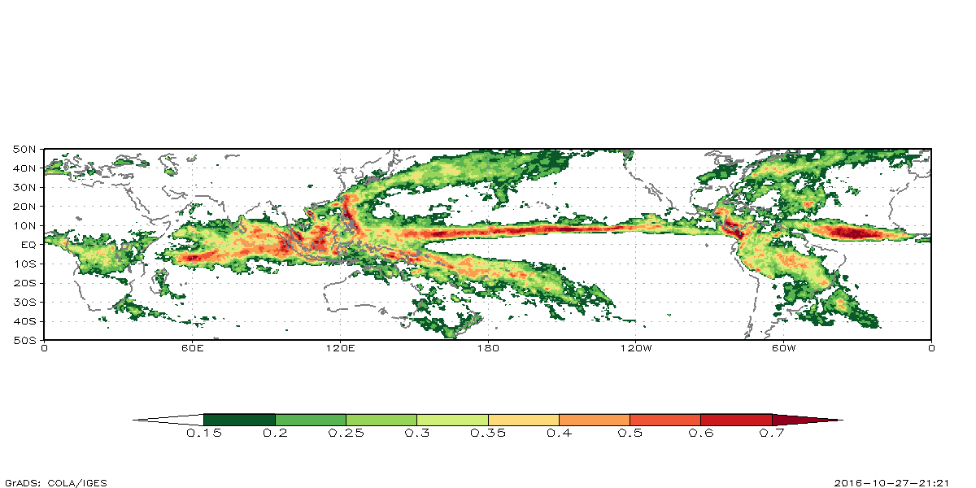

Three month mean Rain rate (mm/hr)
(MPAS default run)
Microphysics
max 2.7
Cumulus
max 3
Total
max 4
Trmm 3b42
$${\text{/}\text{0.25}}^{o}$$

Slide 13
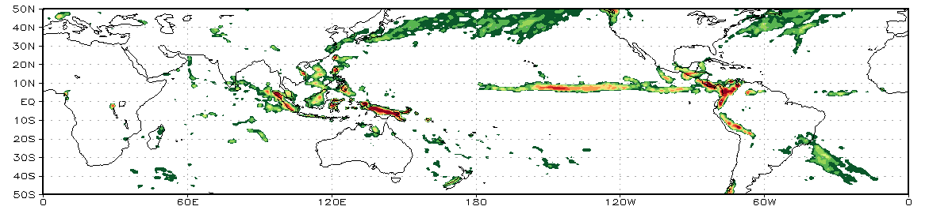
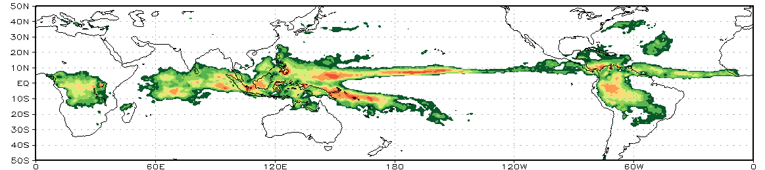
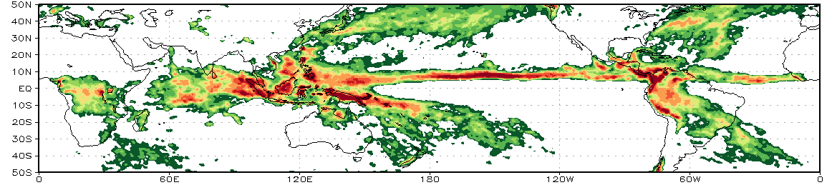
Three month mean Rain rate (mm/hr)
Cy40r1
Microphysics
max 4.5
Cumulus
max 1.3
Total
max 5
Trmm 3b42
$${\text{/}\text{0.25}}^{o}$$

Slide 14
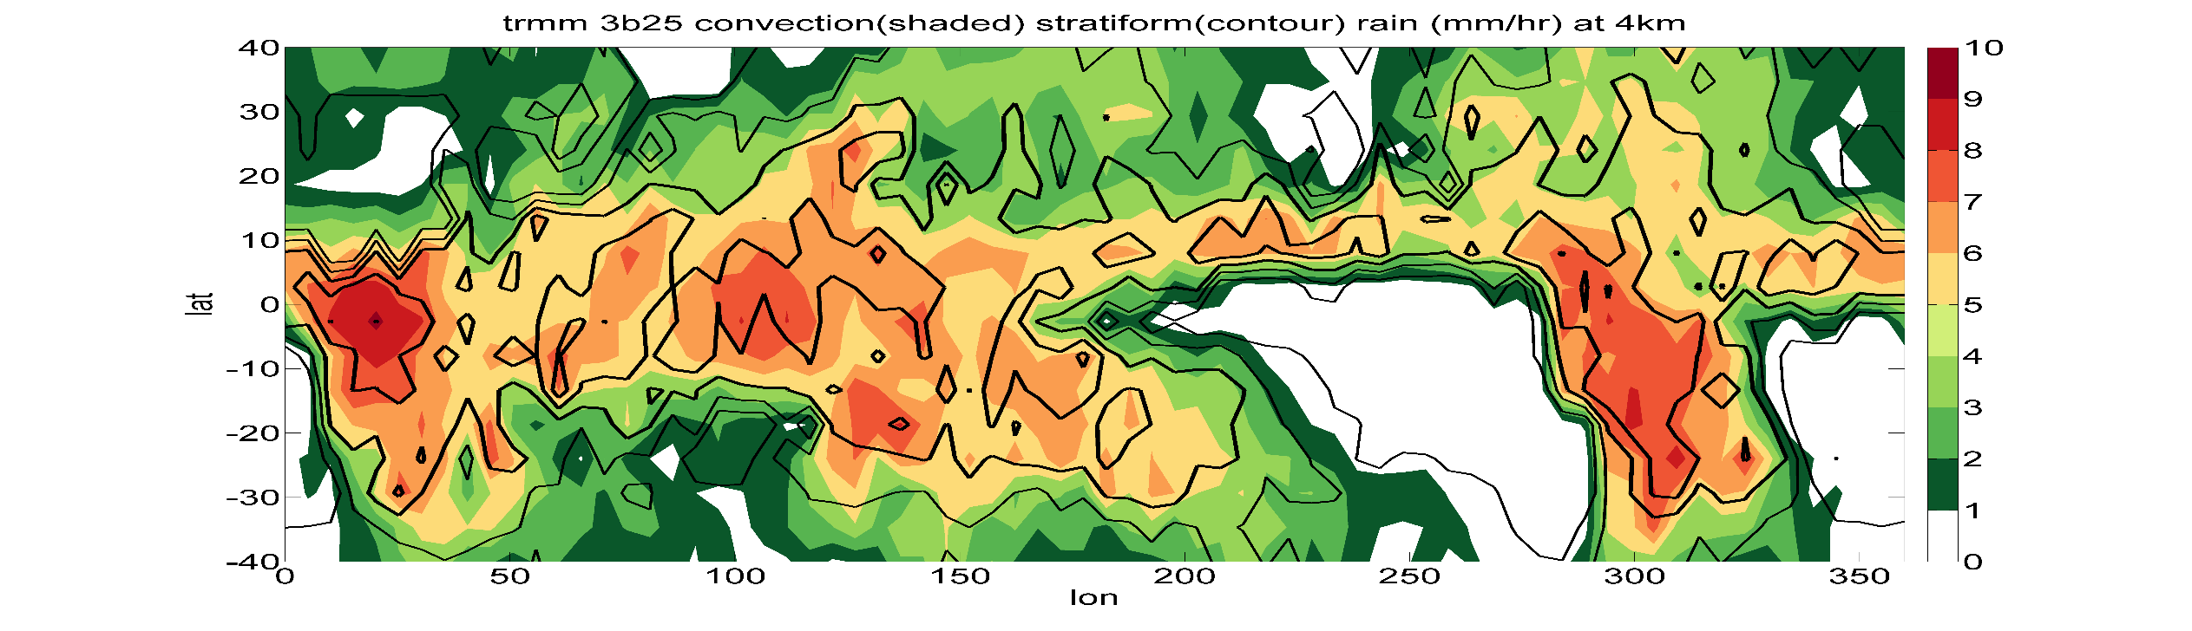


Trmm 3b25 Rain rate (mm/hr) at 4 km convective vs stratiform
${\text{5}}^{o}×{\text{5}}^{o}$
Contour [0.5 1 1.5 2 2.5]
Trmm 3b42 Rain rate (mm/hr)
$${\text{0.25}}^{o}$$

Slide 15
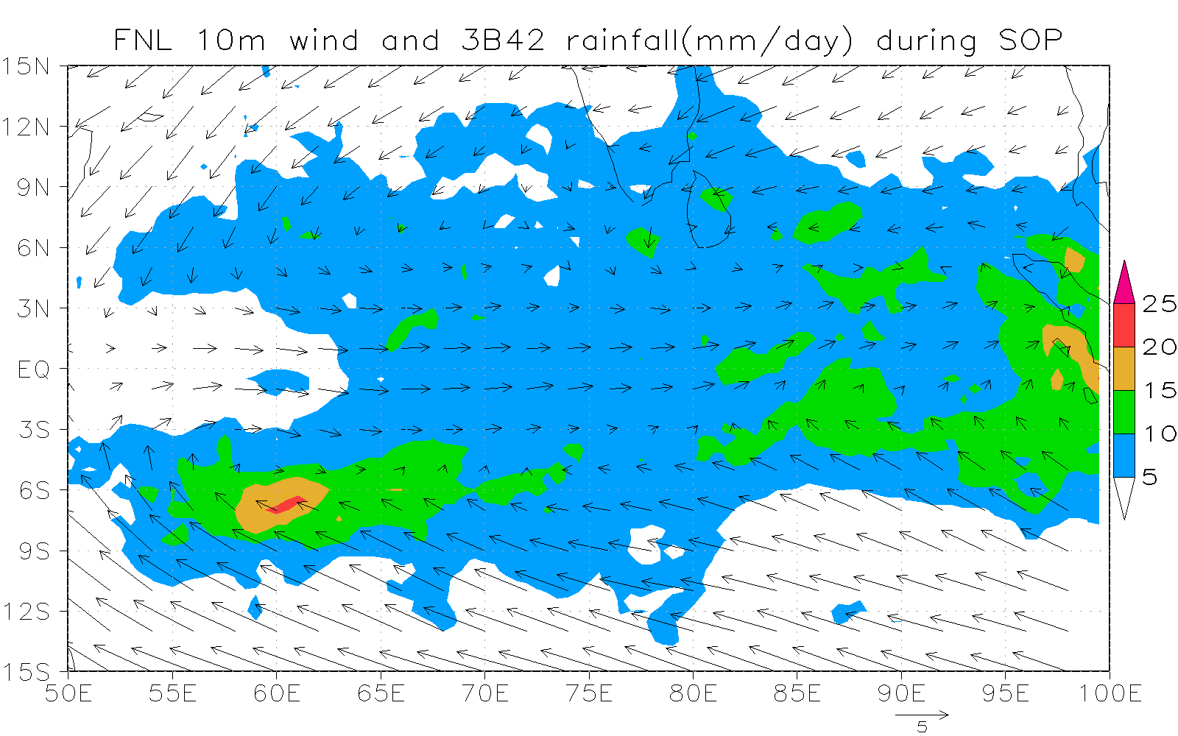
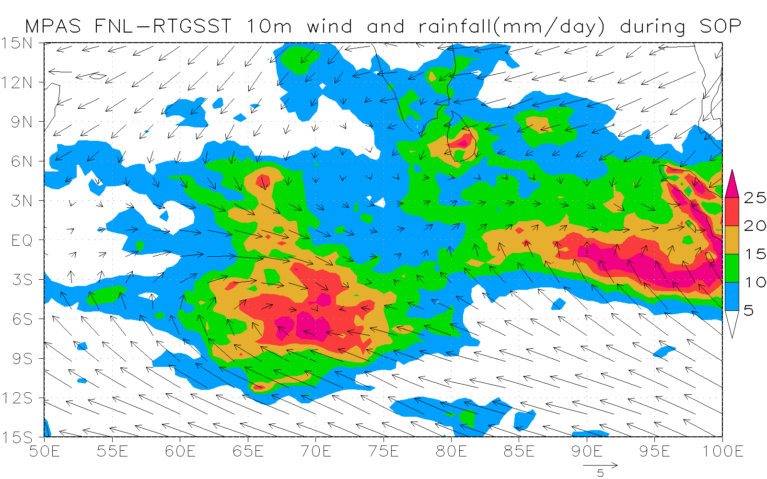
(MPAS default run)
Simulation Approach
DYNAMO SOP (Oct.1-Dec.15 2011)
Oct 1st
Oct 15th
Nov 1st
Nov 15th
Dec 1st
Dec 15th
Dec 31st
time
OBS
MPAS

Slide 16
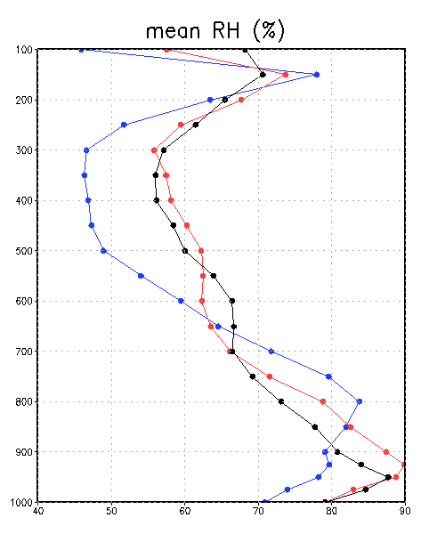
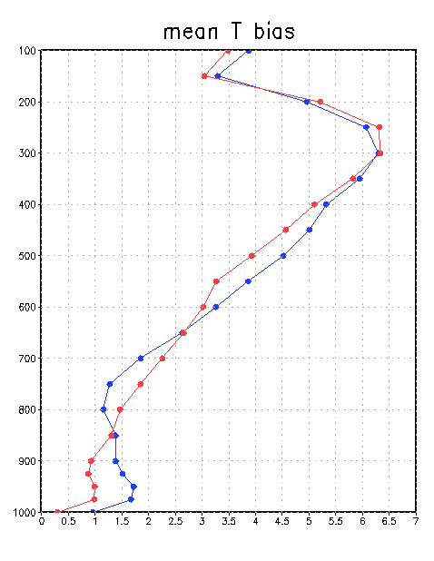
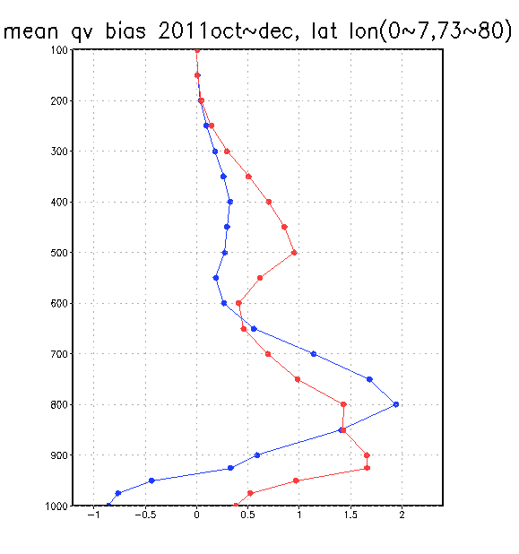
MPAS @ North sounding array
Black line observation data : Shaocheng Xie
Blue line MPAS simulation : default Tiedtke
Red line MPAS simulation : EC cy40r1 Tiedtke
40 50 60 70 80 90
g/kg
0 1 2 3 4 5 6 7
-1 0 1 2
%
K

Slide 17
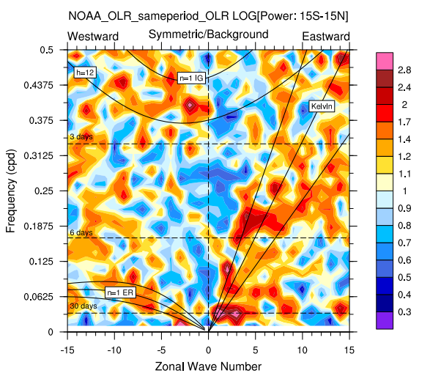
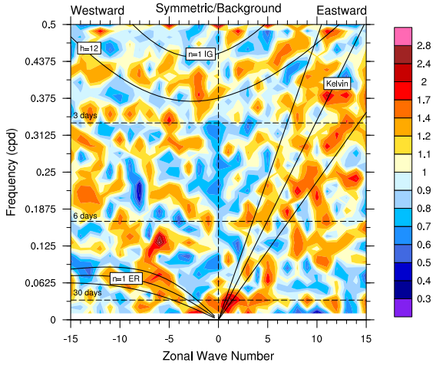
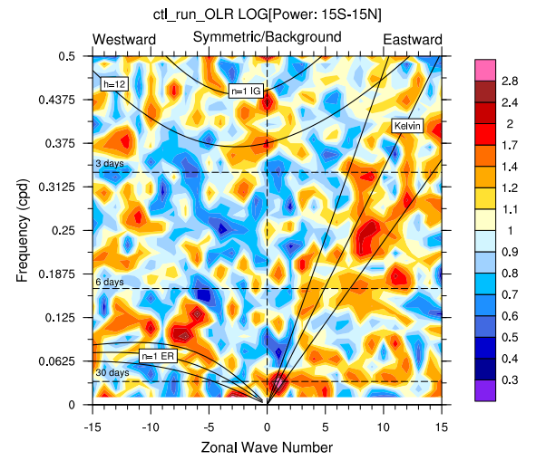
NOAA OR
Default
cy40r1

Slide 18
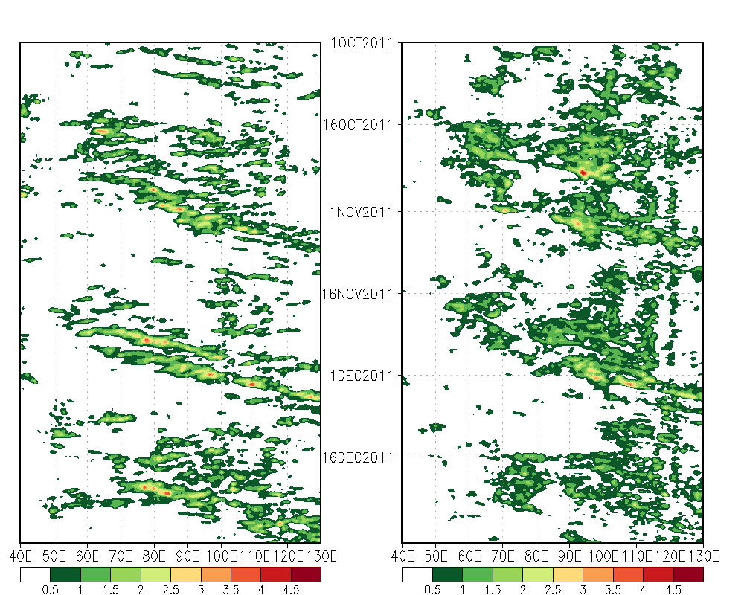
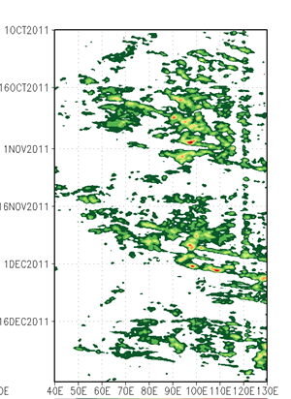
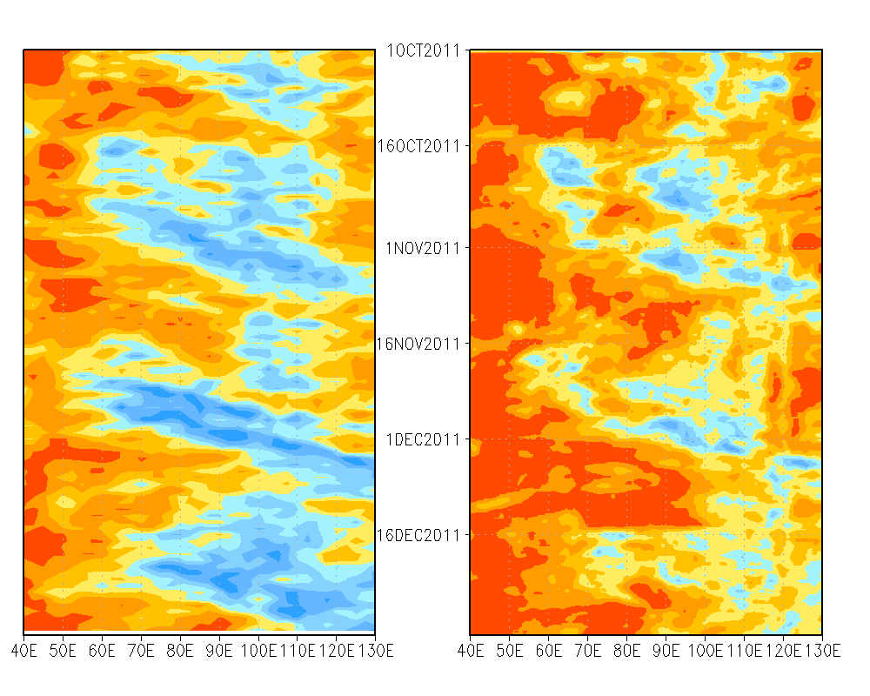
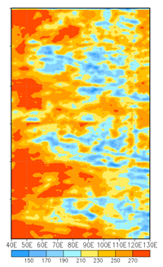
Obs trmm3b42
Default
cy40r1
Precipitation (mm/hr)
0.5 1 1.5 2 2.5 3 3.5 4 4.5
MJO 2 speed 9.5m/s
MJO 1 speed 4.5m/s
Olr (w/m^2)
NOAA
Olr
150 170 190 210 230 250 270

Slide 19
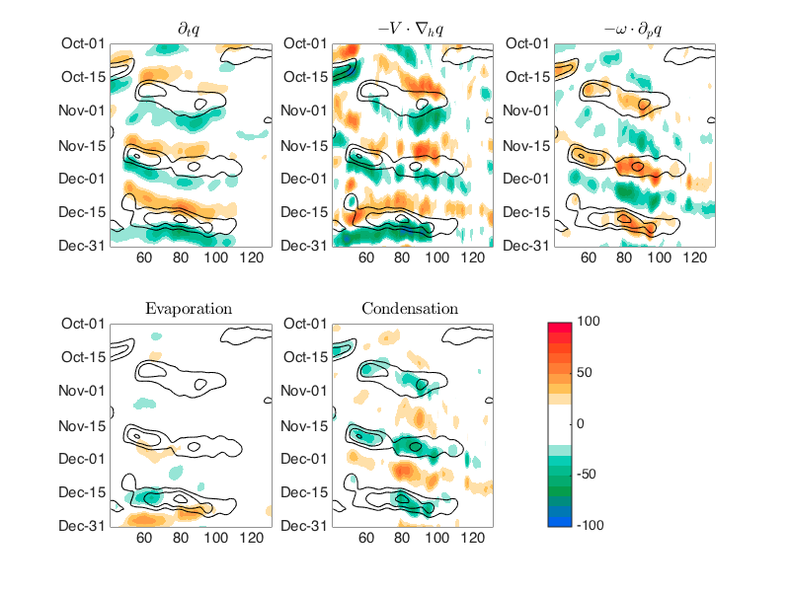
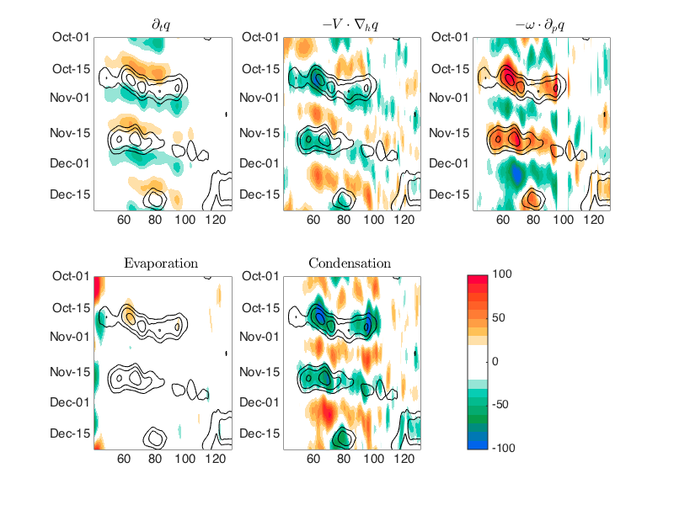
(MPAS default run)
20-60 days band pass filtered_q_budget
Contour = q anomaly (mm, every 3 mm )
Shading = moisture source (W/m²)
Vertical advection and Condensation are rescaled by 0.25
EC-Interim
MPAS

Slide 20
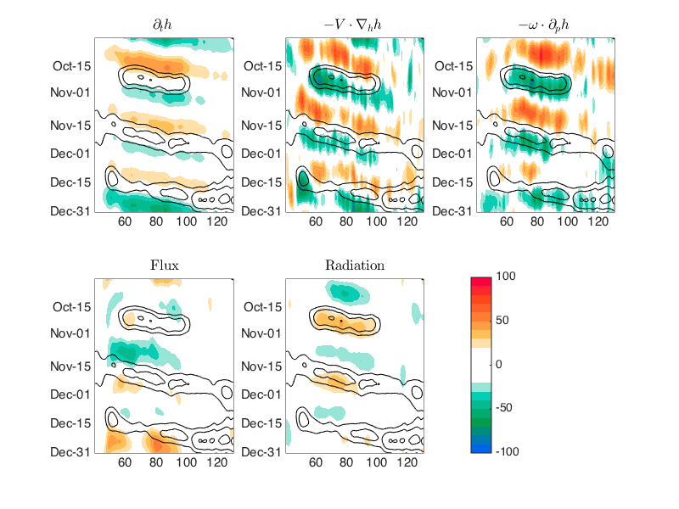
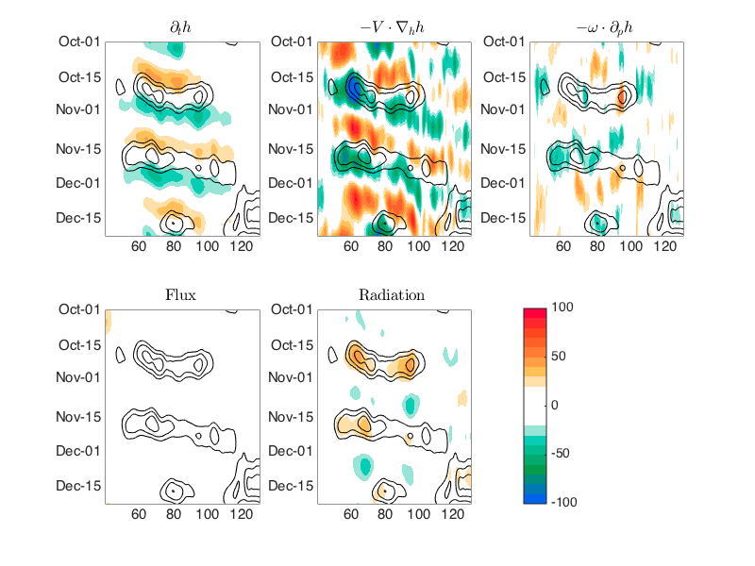
(MPAS default run)
20-60 days band pass filtered_MSE_budget
Contour = MSE anomaly (mm, every 3 mm )
Shading = MSE source (W/m²)
EC-Interim
MPAS

Slide 21
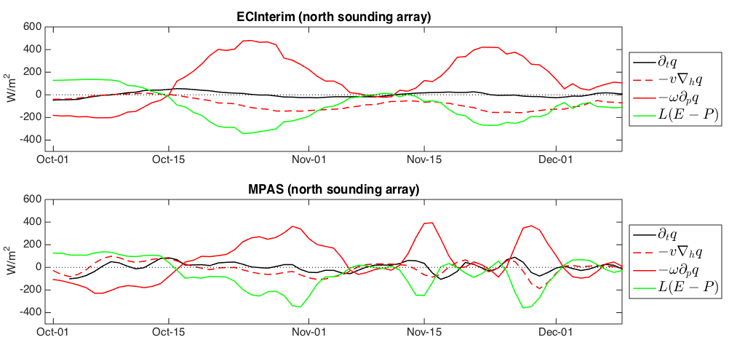
(MPAS default run)
3-day running mean column integrated q_{v} budget averaged over the NSA

Slide 22
Summary
For the MJOs in DYNAMO/CINDY, the MPAS simulation show:
Mean
circulation, water vapor and rainfall well simulated
[ moist (dry) bias below (above) 700 hPa;
warm bias near sfc and 600-350 hPa over Indain Ocean;
OLR & Precip. too strong ]
MJOs
Broad-scale evolution reasonably simulated (MM)
Cloud clusters (SCCs) too strong and less organized (CID?)
ΔF_{Rad} (contrast bet. suppress & convective phases) too weak
(Cloud-radiative interaction?)
High frequency
Synoptic disturbance too active (CID?)

Slide 23
Offline simulations by cumulus & radiation schemes
- within DYNAMO/CINDY North sounding array -
IFS DOCUMENTATION – Cy40r1
Operational implementation 22 November 2013

Slide 24
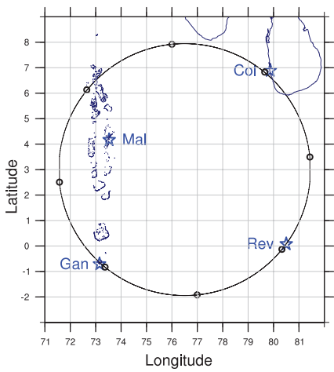
Dynamo-Tiedtke scheme offline analysis
Using EC gridded data (0~7N,73E~80E) and adjusting domain mean(q T q1 q2) to match Xie`s.
Forcing : Offline analysis (LH、SH、Q1、Q2) ;
MPAS (LH、SH、PBL ,Radiation , large scale convergence )
This model is half-diagnosis tool.
Radius
550km
Dt=2min
Initial condition
Integration for one hour
About 20min forcing and initial condition converge
restart every one hour
Description of the objective analysis of
large scale forcing data at North Sounding Array
during AMIE-Gan/DYNAMO field campaign
Shaocheng Xie

Slide 25
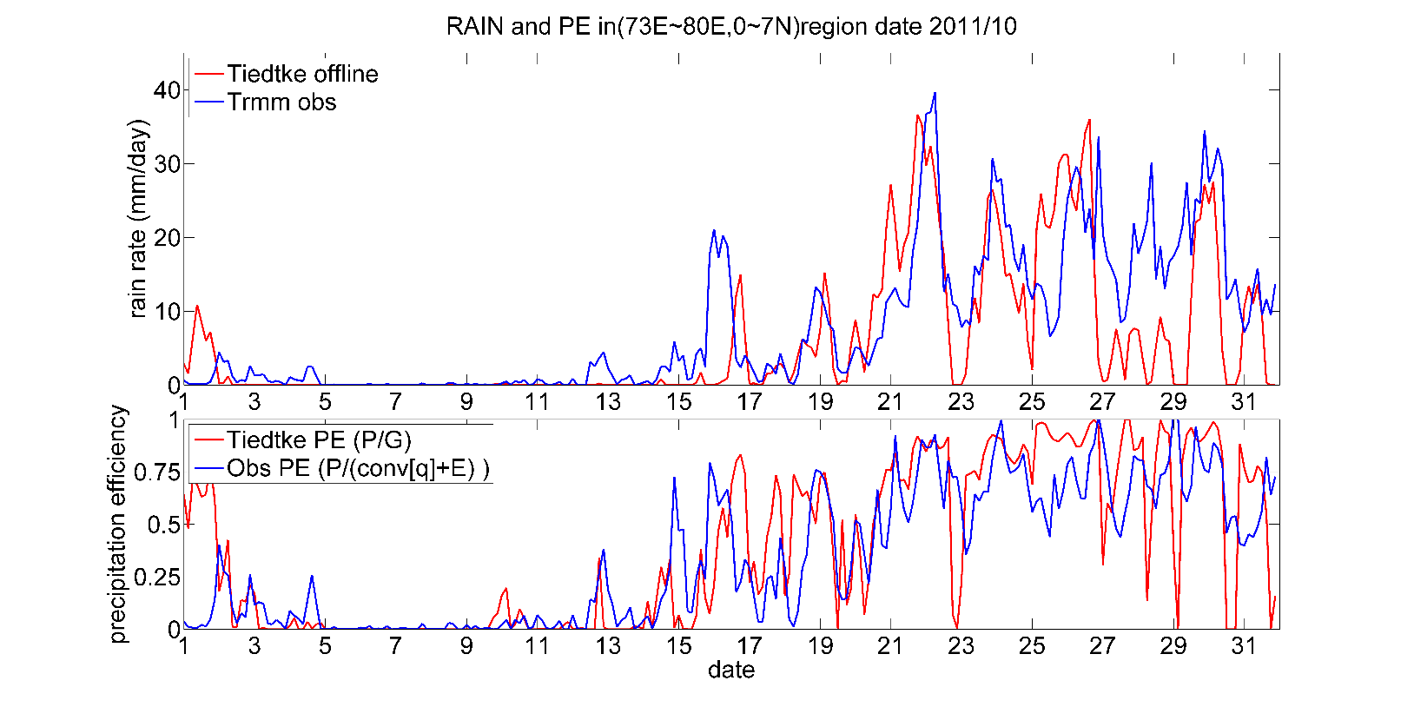
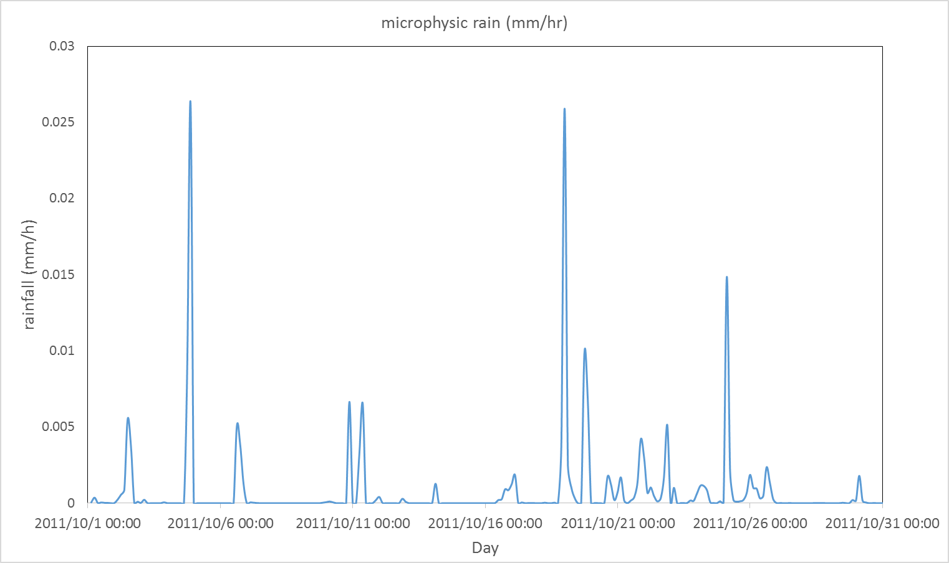
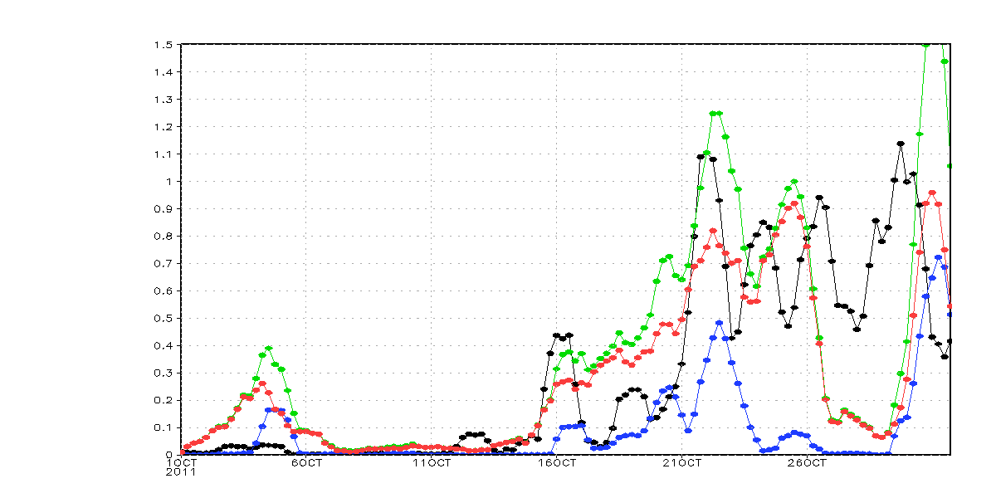
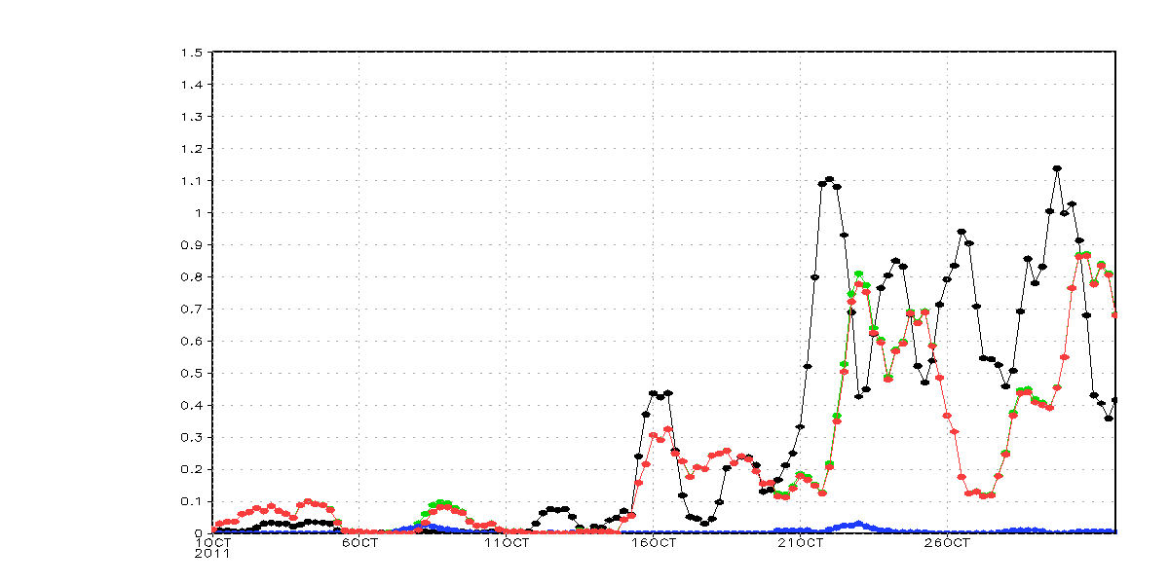
Oct NSA (0-7N, 73-80E) rain rate
Offline cumulus
Offline microphys
0.72
0.48
0.24
Cy40r1
default
30
microphysics
30
microphysics
cumulus
cumulus
(mm/day)
total
(mm/day)
total
20
20
trmm
trmm
10
10
Notes:
Cy40r1

Slide 26
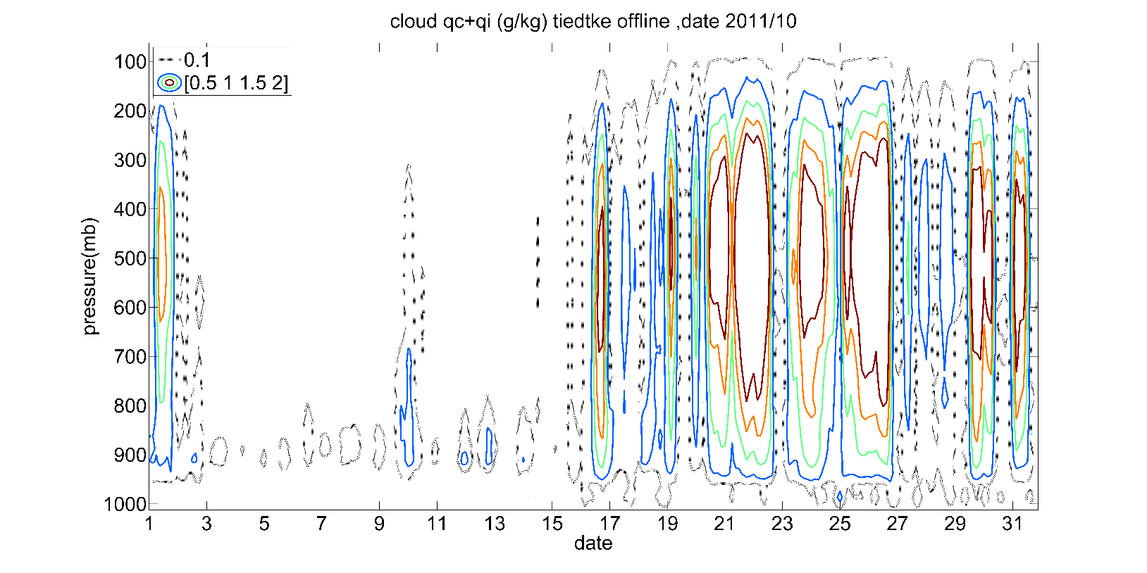



Slide 27
qv from observation
(qc qi) from Tietke scheme
Clear-sky (gas)
Cloud-property
Gas mixing ratio
Water vapor = qv
Co2 = 379 ppm
Ch4 = 1774 ppb
N2O = 319 ppb
O2 = 0.209
O3 from database
Surface Emission =1.0 (人為設定)
Cloud fraction(cldf)
= RH^0.25* (1-exp(100*qc*(qsat-qv)^0.49)
qice =Σqi /cldf (cloud ice water path)
qliq = Σqc/cldf (cloud liquid waterpath)
Cloud-size
Reliq = 8.0+ (14. – 8.)*(273.16 – Tem)
Reice =lookup table function of (Tem)
Main Program

Slide 28



OLR (LW) (Wm⁻²)
(0-7 N, 73-80 E)
Top
CERES
First 15 days close
Last 15 days large difference
Top-Sfc
model
Correlation =0.764
Sfc

Slide 29
Cloud-radiative simulation
DYNAMO/CINDY November event
Control Simulation
(cloud on)
Simulation without cloud-radiative interaction
(Cloud off)

Slide 30


ΔOLR (cooling) (Wm⁻²)
Nov 1
Nov 16
Dec 1
2011
Cloud on
Cloud off

Slide 31




Nov 01-15 (mm/hr)
Cloud on
Cloud off
Nov 16-30 (mm/hr)
Cloud on
Cloud off

Slide 32


6 hourly 60-km grid data in (0-7N, 73-80E) x 15 days
Cloud-radiative effect more evident in the 2nd half month
W (500hPa)
Rainfall
11/16-11/30
11/16-11/30
■ cloud on
□ cloud off
W (500) (ms⁻¹)

Slide 33





Rainfall (mm/hr)
Close Cloud radiation interaction inhibit convective rain.
(it may change atmosphere temperature profile and cause ill environment to convective activity.)
Cloud on
Cloud off

Slide 34




Difference (Cloud on)-(Cloud off) NSA

Slide 35
Discussion
Parameterized cumulus and radiative schemes at 60 km resolution:
Cumulus scheme vs Explicit cloud scheme
Convective rain vs Stratiform rain
Cloud optical properties & cloud fraction ?
(Cloud on) – (Cloud off) differences
Mean
Stronger (weaker) convection over oceans (land)
Associated winds, temp, moisture distributions
MJO
Cloud-radiative interaction significantly influences the MJO especially at scales beyond week 2:
Large-scale spatial and temporal structure weakened and less organzied

