Slide 1
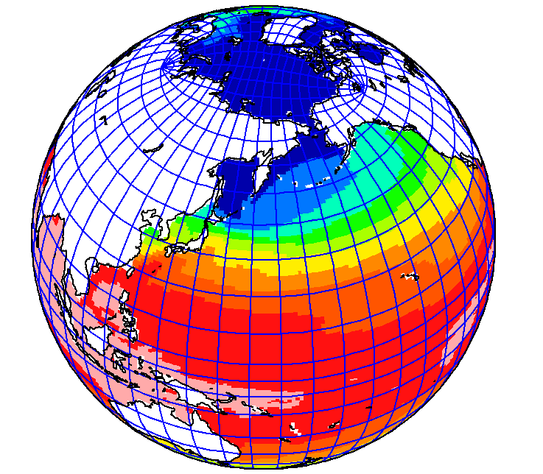
Current status of MJO simulations using NICAM and its 3D-ocean coupled version NICOCO
Tomoki Miyakawa & NICAM-team
(AORI, The Univ. of Tokyo)
＋
Ｅａｓｔｗａｒｄ
Ｍadden-Ｊulian Ｏscillation (MJO)
Simulated on the K computer, hp130010 Visualised by Dr Daisuke Matusoka (CEIST JAMSTEC)

Slide 2
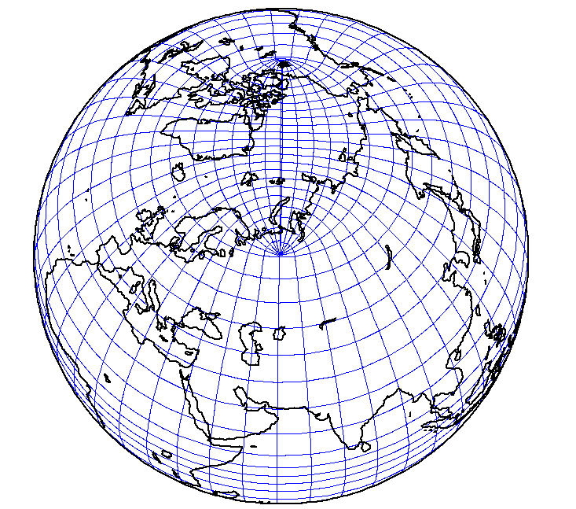
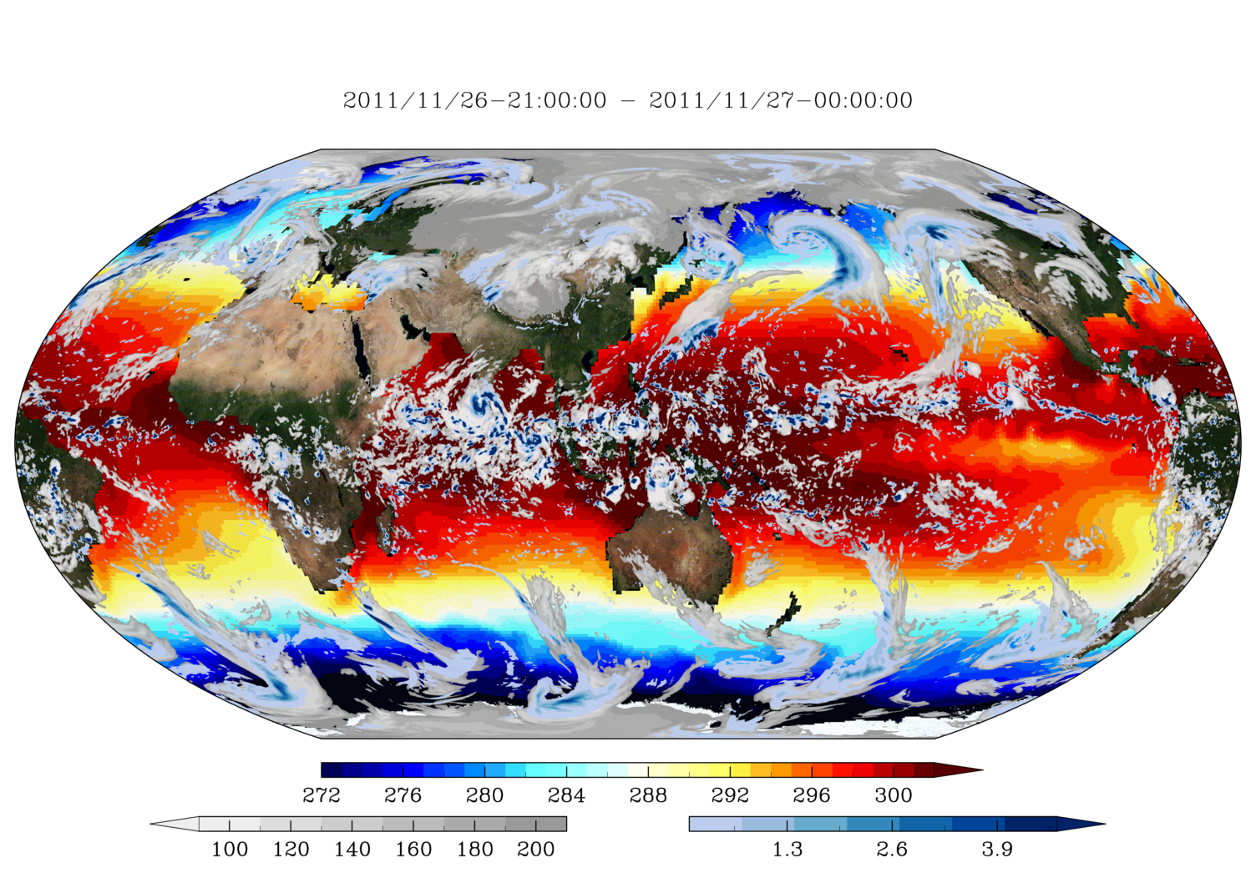
Coupler (J-cup)
COCO (ocean)
Tripolar grid system
NICAM (atmosphere) Icosahedral grid system
NICOCO
(new coupled model)

Slide 3
What should we use NICOCO for??
・ A major motivation for ocean coupling is climate studies.
→ A super-heavy task for NICAM at the moment, not quite suitable for a pilot experiment.

Slide 4
What should we use NICOCO for??
・ A major motivation for ocean coupling is climate studies.
→ A super-heavy task for NICAM at the moment, not quite suitable for a pilot experiment.
・ Ocean have longer time-scales than the atmosphere. → The effect of ocean-coupling is unlikely to appear in short-range weather simulations.

Slide 5
What should we use NICOCO for??
・ A major motivation for ocean coupling is climate studies.
→ A super-heavy task for NICAM at the moment, not quite suitable for a pilot experiment.
・ Ocean have longer time-scales than the atmosphere. → The effect of ocean-coupling is unlikely to appear in short-range weather simulations.
Target: subseasonal 〜 seasonal time-scale range

Slide 6
( MJO simulation by NICAM )
Bivariate correlation score of NICAM
a : RMMs of reference data
b : RMMs of Model
t : Lead time
i : case ID
Cor
RMM: Index for MJO phase & amplitude
COR
Phase 1 start (western Indian Ocean)
1.0
Phase 2 start
Eastern Indian Ocean
0.8
0.6
0.4
0.2
Phase 8 start (western hemisphere)
Overall
4 8 12 16 20 24 28 32 36 40 (days)
COR >0.6 maintained for 26 – 28 days
(Miyakawa et al. 2014, Nature Comm.)

Slide 7
SST used for atmospheric NICAM MJO skill evaluation
Model Configuration (NICAMK-2012)
SST used for nudging the mixed-layer ocean model
= time varying seasonal cycle + anomaly
SST
Observed SST
“anomaly” retained throughout the simulation
Climatological
seasonal cycle of SST (local)
-1 w
Initial date
Time
Allows “forecast mode” simulations, but performance get worse when ocean anomalies change rapidly.

Slide 8
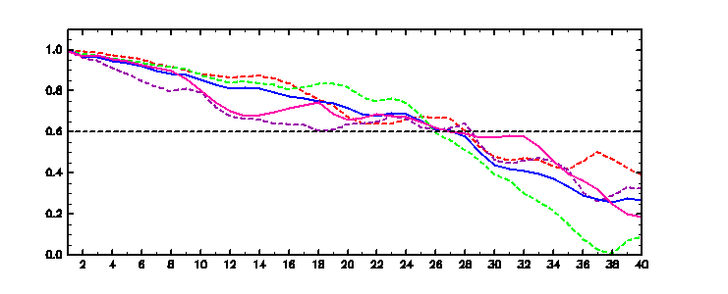
Better ocean = better MJO skill?
Nudged by observed SST
Not very likely, but perhaps a 2-4 day improvement? (based on a small sample size)

Slide 9
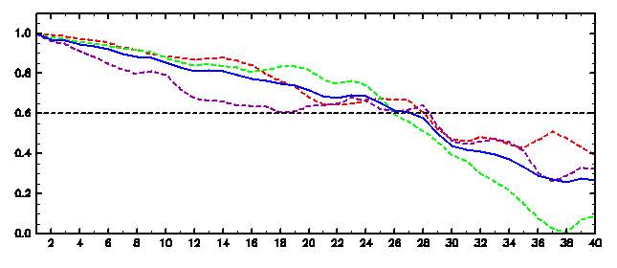
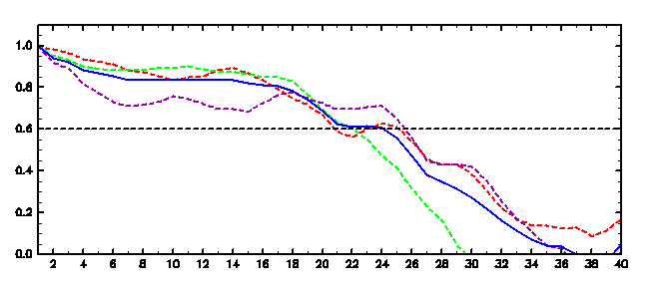
Phase 2 start
(Eastern IO)
NICAM 54 case
Overall
Phase 8 start
(western hemisphere)
Phase 1 start
(western IO)
NICOCO 54 case
Well….
Phase 8: Drops first, but stays aloft.
Phase 1, 2: Small impact at first, drops quickly later.
La-Nina bias ?

Slide 10
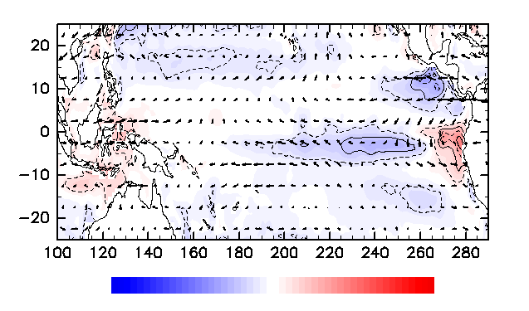
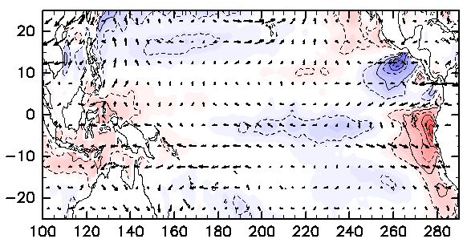
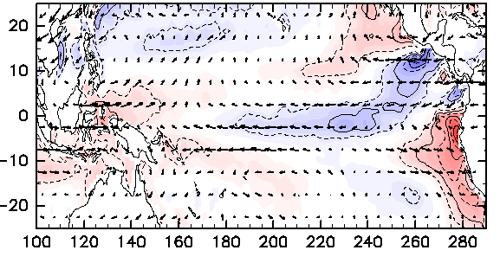
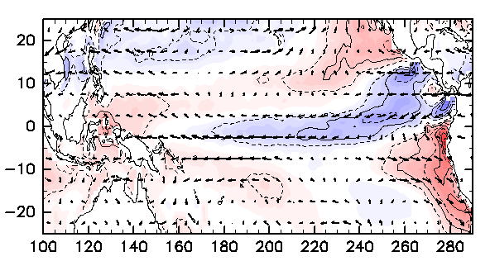
Mean drift (SST, 850 wind: NICOCO)
Day 10
Day 30
-0.5
Day 50
Day 70
-5 deg
5 deg

Slide 11
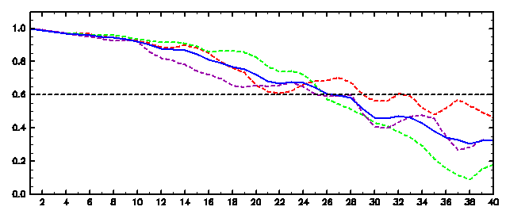
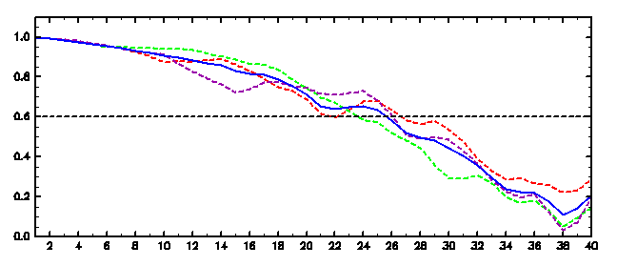
NICAM 54 case
Phase 2 start
NICAM 54 case, bias subtracted
Overall
Phase 8 start
Phase 1 start
NICOCO 54 case, bias subtracted
NICOCO 54 case
Skill spread between initial phases reduced.
Overall skill comparable to NICAM.

Slide 12
What should we use NICOCO for??
Target: subseasonal 〜 seasonal time-scale range
Overall MJO skill comparable to NICAM? No merit then?

Slide 13
What should we use NICOCO for??
Target: subseasonal 〜 seasonal time-scale range
Overall MJO skill comparable to NICAM? No merit then?
Disadvantage of having bias/drift.
VS Advantage of having varying oceanic signals
Advantage of NICOCO may show up if we focus on events that had large oceanic signals.

Slide 14
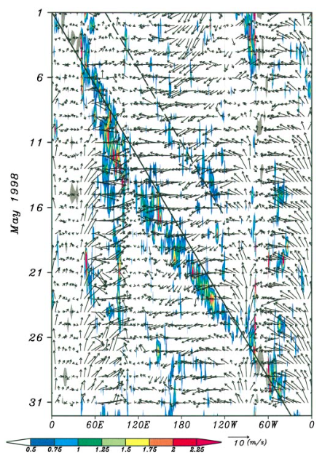
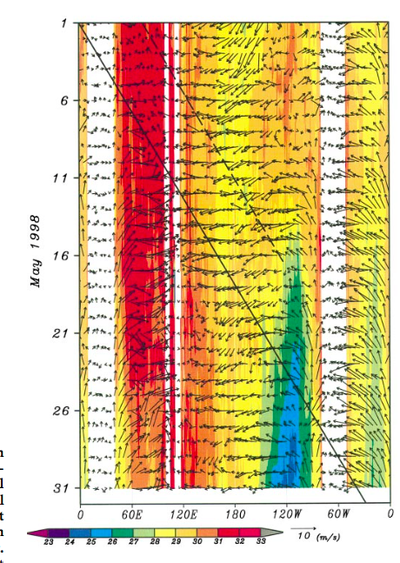
Target MJO event (May, 1998)
Takayabu et al. 1999,
MJO abruptly finishing off giant El Nino?

Slide 15
What caused the abrupt termination of the El Nino?
・MJO (or moist-KW emitted from the MJO)
associated easterly winds
Takayabu (1999), Straub et al. (2006)
・Seasonal shift of ITCZ
Vecchi (2006)
・Overlap of oceanic upwelling Rossby wave and Kelvin wave.
Picaut et al. (2002)

Slide 16
What caused the abrupt termination of the El Nino?
・MJO (or moist-KW emitted from the MJO)
associated easterly winds
Takayabu (1999), Straub et al. (2006)
・Seasonal shift of ITCZ
Vecchi (2006)
・Overlap of oceanic upwelling Rossby wave and Kelvin wave.
Picaut et al. (2002)

Slide 17
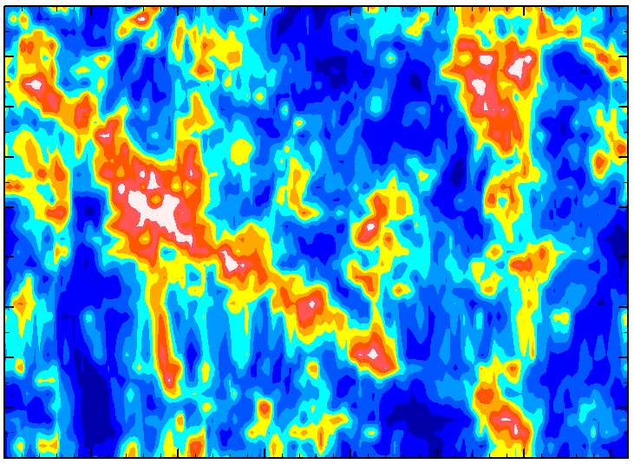
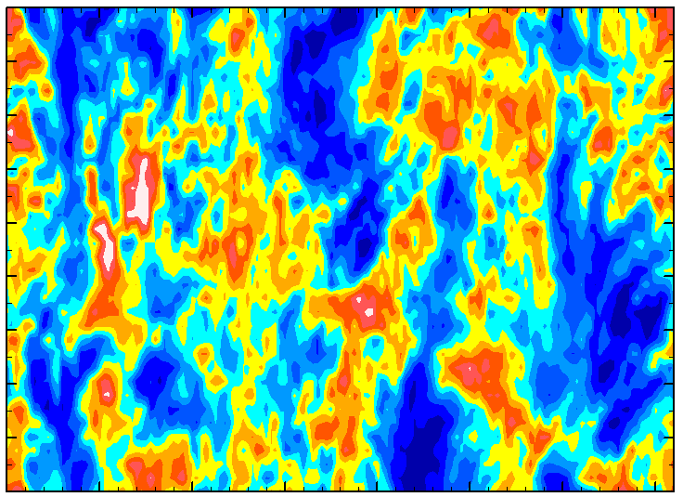
Apr. 20 – Apr. 28 NICOCO (1deg ocean)
1 daily interval initiation
・Do we get the Eastward propagation → Yes, more or less.
NOAA-OLR
NICOCO OLR (4/20 init)
4/26
5/8
5/20
5/31
0
180
360 (deg)
276
220
164 (W/m²)

Slide 18
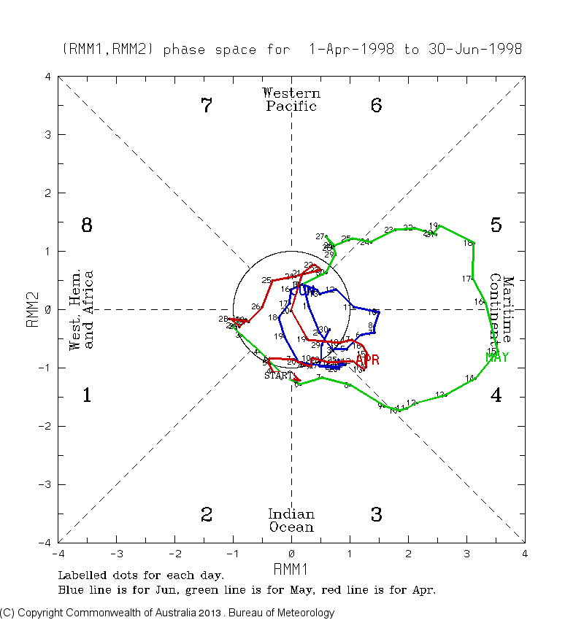

Slide 19
Target MJO event (May, 1998)

Slide 20
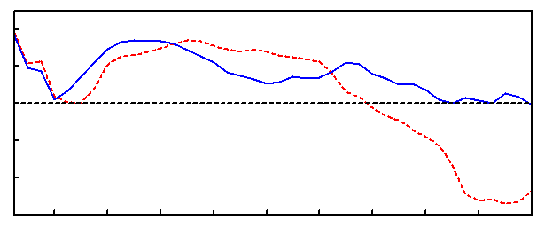
NICOCO, 9 members (Apr. 20 - Apr. 28, 1998 init)
(Drift defined from 54 simulations is removed)
1.0
0.8
Score
0.6
0.4
NICOCO
0.2
NICAM
4 8 12 16 20 24 28 32 36 40 (days)

Slide 21
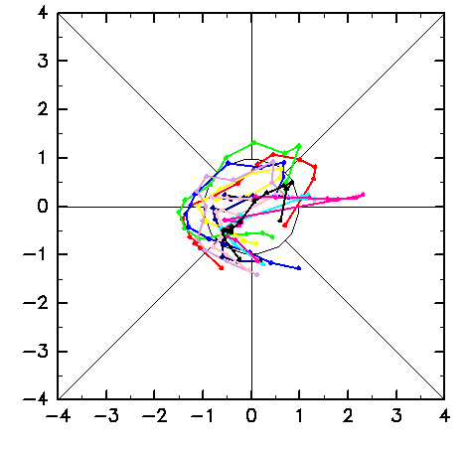
NICOCO, 9 members (Apr. 20 - Apr. 28, 1998 init)
(Drift defined from 54 simulations is removed)
1.0
0.8
Score
0.6
0.4
NICOCO
0.2
NICAM
4 8 12 16 20 24 28 32 36 40 (days)
Apr 20 - Apr 30

Slide 22
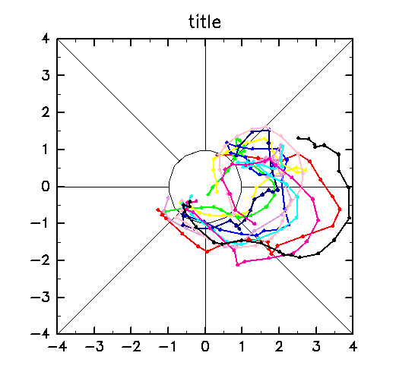
NICOCO, 9 members (Apr. 20 - Apr. 28, 1998 init)
(Drift defined from 54 simulations is removed)
1.0
0.8
Score
0.6
0.4
NICOCO
0.2
NICAM
4 8 12 16 20 24 28 32 36 40 (days)
Apr 20 - Apr 30
May 1 - May 20

Slide 23
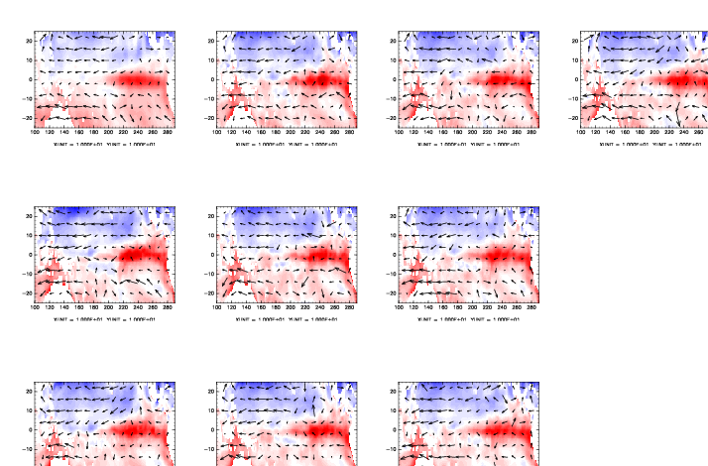
SST anomalies (May 2)
Obs
Apr 22 init
Apr 25 init
Apr 28 init
Apr 20 init
Apr 23 init
Apr 26 init
Apr 21 init
Apr 24 init
Apr 27 init
-7 deg
+7 deg

Slide 24
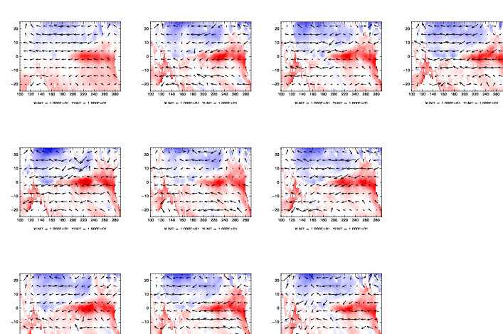
SST anomalies (May 10)
Obs
Apr 22 init
Apr 25 init
Apr 28 init
Apr 20 init
Apr 23 init
Apr 26 init
Apr 21 init
Apr 24 init
Apr 27 init
-7 deg
+7 deg

Slide 25
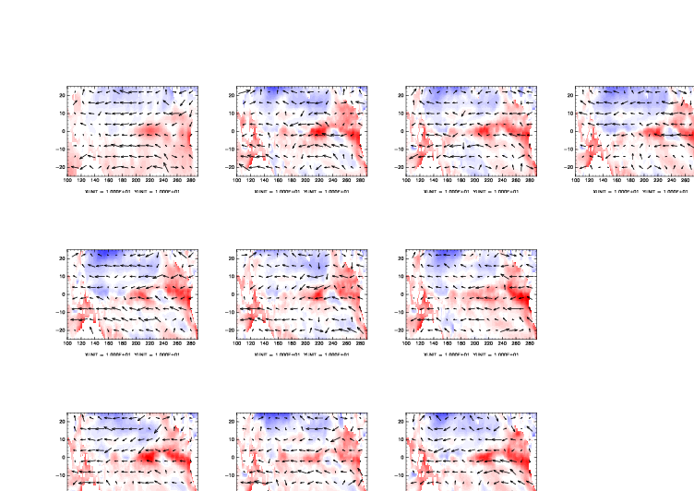
SST anomalies (May 18)
Obs
Apr 22 init
Apr 25 init
Apr 28 init
Apr 20 init
Apr 23 init
Apr 26 init
Apr 21 init
Apr 24 init
Apr 27 init
-7 deg
+7 deg

Slide 26
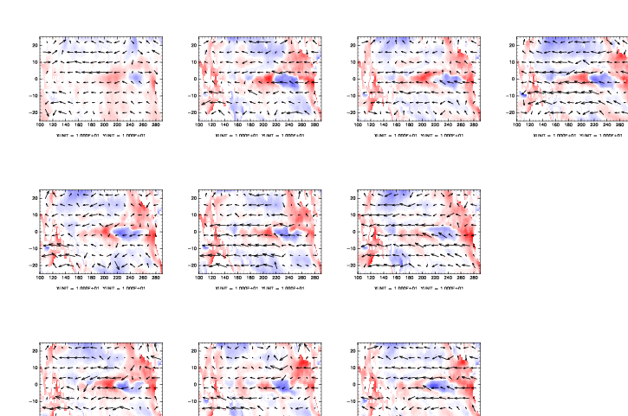
SST anomalies (May 26)
Obs
Apr 22 init
Apr 25 init
Apr 28 init
Apr 20 init
Apr 23 init
Apr 26 init
Apr 21 init
Apr 24 init
Apr 27 init
-7 deg
+7 deg

Slide 27
SST anomalies (June 3)
Obs
Apr 22 init
Apr 25 init
Apr 28 init
Apr 20 init
Apr 23 init
Apr 26 init
Apr 21 init
Apr 24 init
Apr 27 init
-7 deg
+7 deg

Slide 28
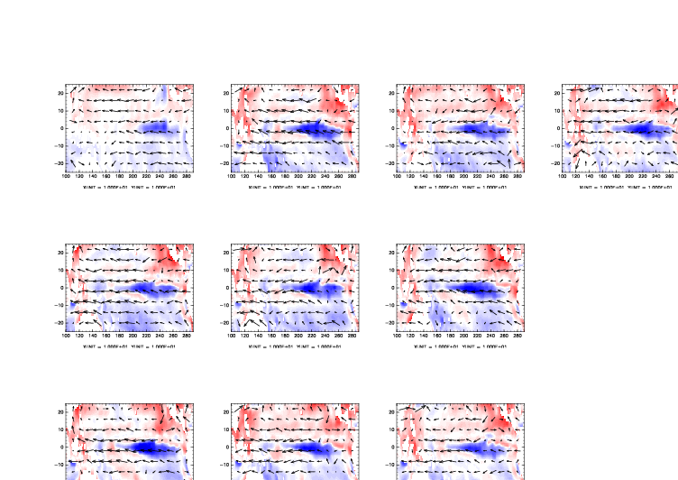
SST anomalies (June 11)
Obs
Apr 22 init
Apr 25 init
Apr 28 init
Apr 20 init
Apr 23 init
Apr 26 init
Apr 21 init
Apr 24 init
Apr 27 init
-7 deg
+7 deg

Slide 29
NICOCO, Apr. 20 init
Winds, currents, ocean T, currents
800 hPa
SST anomaly, 850hPa winds
1000 hPa
May 1
100 m
Depth
May 15
May 29

Slide 30
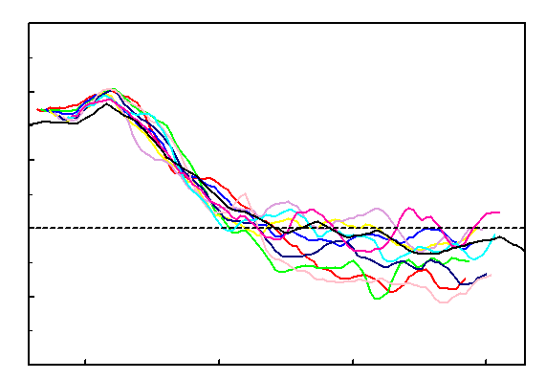
NICOCO, 9 members (Apr. 20 - Apr. 28, 1998 init)
(Drift defined from 54 simulations is removed)
3.0
2.0
1.0
NINO3.4 Index
0.0
-1.0
-2.0
May 1 Jun 1 Jul 2 Aug 2
1.0
0.8
Score
0.6
0.4
NICOCO
0.2
NICAM
4 8 12 16 20 24 28 32 36 40 (days)

Slide 31
Exploring the role of the MJO easterly winds May 1 - May 20

Slide 32
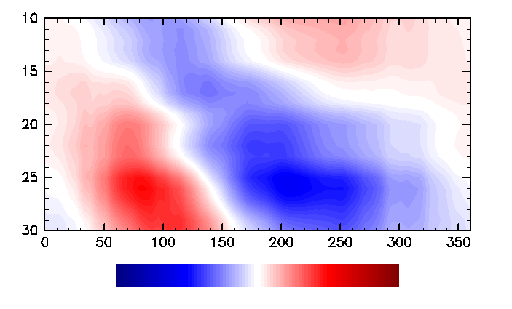
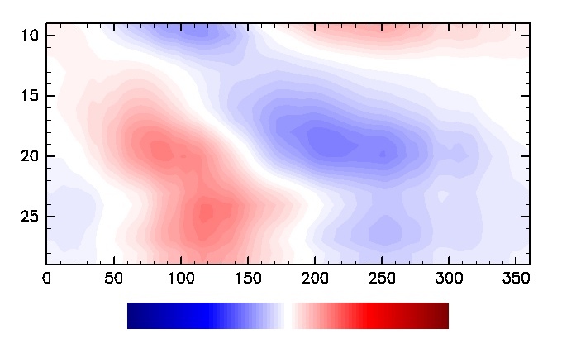
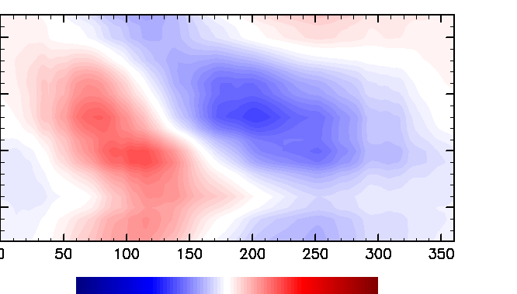
Reconstructed 850 hPa MJO zonal wind
SST anomaly
May 1
May 20
May 1
May 20
May 1
May 20

Slide 33
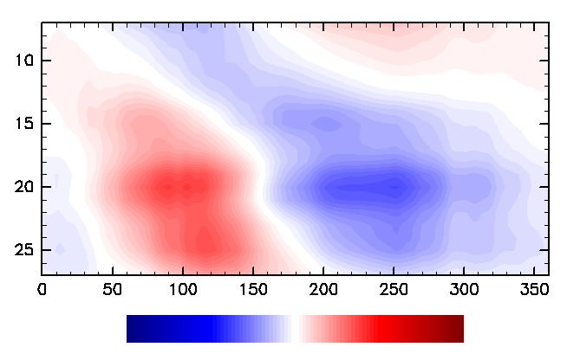
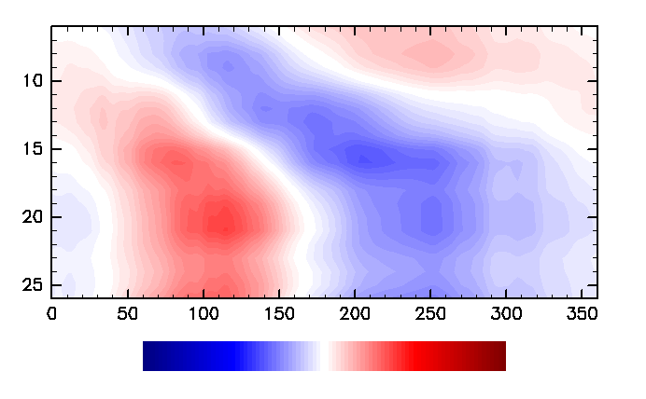
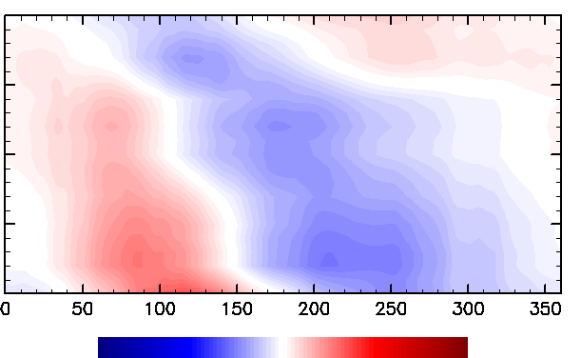
Reconstructed 850 hPa MJO zonal wind
SST anomaly
May 1
May 20
May 1
May 20
May 1
May 20

Slide 34
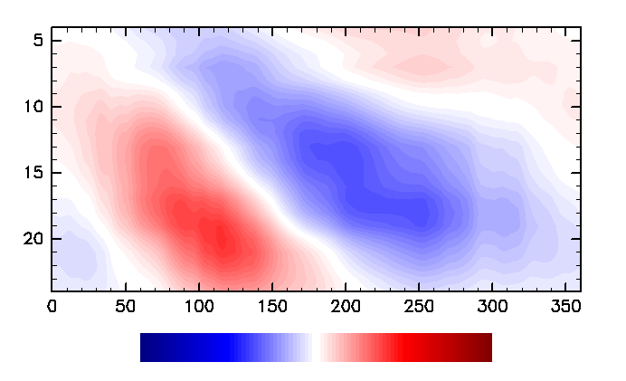
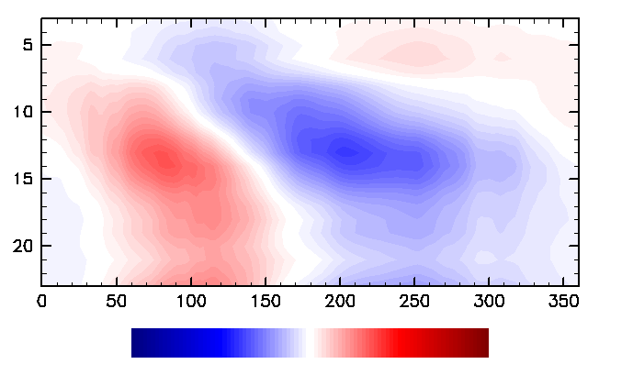
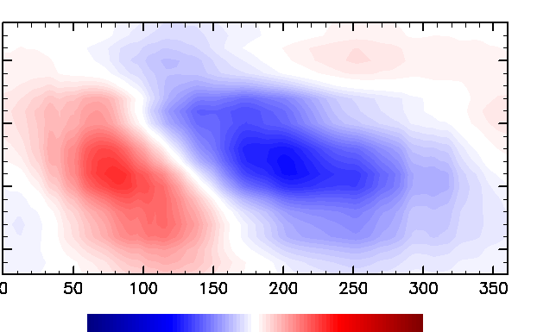
Reconstructed 850 hPa MJO zonal wind
SST anomaly
May 1
May 20
May 1
May 20
May 1
May 20

Slide 35
Summary
NICOCO is being tested for MJO simulations.
NICOCO overall MJO skill is comparable to NICAM. Drift exists, but does not destroy the MJO signals.
NICOCO performs better for events with large oceanic signals.
NICOCO results suggest that MJO associated easterly winds affected the abrupt termination of the 1998 El Nino.

Slide 36
Summary
NICOCO is being tested for MJO simulations.
NICOCO overall MJO skill is comparable to NICAM. Drift exists, but does not destroy the MJO signals.
NICOCO performs better for events with large oceanic signals.
NICOCO results suggest that MJO associated easterly winds affected the abrupt termination of the 1998 El Nino.
→ So it is nice to have a ocean coupled global cloud(-system) resolving model after all !

Slide 37
Thank you

