Slide 1
Development of a bulk parameterization scheme of warm rain using bin scheme model results Kozo Nakamura¹, Yasushi Fujiyoshi, Kazuhisa Tsuboki^{1,2,} and Naomi Kuba³ 1: Japan Agency for Marine-Earth Science and Technology, 2: Institute for Space-Earth Environmental Research, Nagoya University, 3: Atmosphere and Ocean Research Institute, the University of Tokyo
The 4th International Workshop on Non-Hydrostatic Model (NHM2016) 2016/12/02(1/17)
RICO
RF-09
17 Dec 04
2004
Fields of trade wind congestus
typical cloud base 600 m
typical cloud top 2000-3000 m

Slide 2
Ⅰ．Objectives: To improve bulk parameterization scheme
Target：bulk scheme for warm rain (for boundary layer clouds)
Cloud microphysics is one of most important processes in the atmospheric models. Bulk parameterization schemes are often used in many models.
However, there are many ambiguous parameters in the schemes.
➡ To improve the bulk schemes, we can use the results of bin scheme models.
In this study, only the basic warm rain process is considered.
The scheme is developed for boundary layer clouds.
Model：CReSS developed by Tsuboki, with Kuba-Fujiyoshi bin model (70bins and 2-moments for each bin)
The characteristic of the model is “the parameterization scheme of activated CCN number in terms of w” is used.
Case ：RICO(Bermuda area, trade wind cumulus) model intercomparison case
↑GCSS(GEWEX cloud system study)
Results：Layered structure (average potential temperature etc.), is well simulated,
A problem (two years ago): The number density of cloud droplets is small. ⇒ improved.
Bulk parameterization scheme is being developed by using the result of the bin model.
Problems and what to do：
There are many differences between the results of bin models.
Also in bin models, there are many ambiguities.
Improve the bin model by intercomparison experiments using KiD (Kinematic Driver for microphysics intercomparison) and comparison of the results with observations.

Slide 3
Ⅱ. Intercomparison experiments (GCSS-RICO)
RICO：Bermuda area, trade wind cumulus
Case of GEWEX Cloud System Study http://www.knmi.nl/samenw/rico/
Grid
Δｘ＝Δｙ＝100ｍ, Δｚ＝40m
Domain Size 12.8km×12.8km× 4.0km
Number of Grids 128 x 128 x 100
Geostrophic Wind（cyclic lateral B.C.）
u：constant vertical shear 2x10⁻³ s⁻¹
v：uniform
pot. temp., water vapor
Bottom surface B.C.
SST: 299.8Ｋ ΔT=0.6℃
Large scale forcings
Subsidence z> 2260m : w = -0.005[m/s]
z<2260m : Constant Divergence
Horizontal advection (depending on z)
Duration : 24hours (last 4 hrs are analyzed)
Basic wind is from right to left in the lower layer.
Figure shows liquid water.
Cloud microphysical models (15 models)
１moment bulk 2 moment bulk bin
MESO-NH DALES RAMS
SAM UCLA @NOAA
JAMSTEC WVU SAMEX
Utah COAMPS DHARMA
EULAG UKMO
2DSAM RAMS
Our Model: CReSS (Tsuboki et al.) with Kuba-Fujiyoshi bin scheme
Notes:
This slide shows the numerical set of the intercomparison.
The grid is 100m in horizontal and 40m in the vertical.
The bottom surface is a warm sea surface.
And the heat and moisture is supplied from the bottom,
And there assumed a subsidence, and horizontal advection causes drying and cooling.
The simulation is performed for 24 hours and the last..
15 models participated and there are 6 one-moment bulk scheme, …
We used CReSS and Kuba-Fujiyoshi bin scheme.

Slide 4
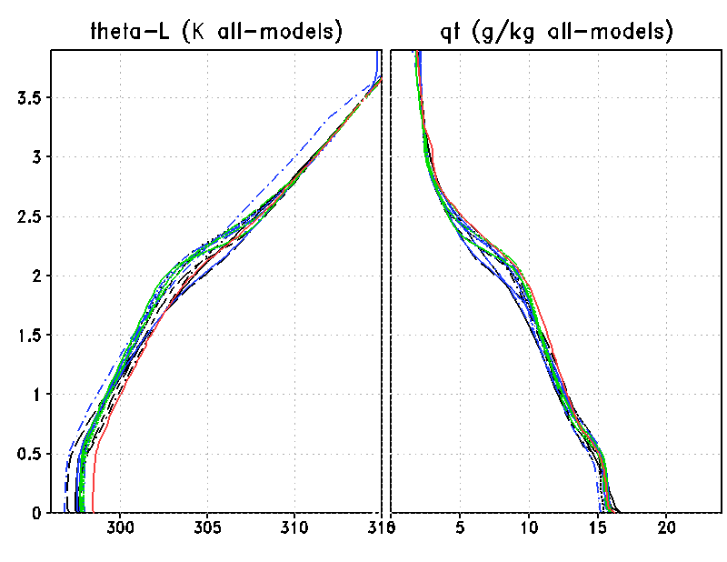
Ⅱ-2. Averaged vertical profiles (20-24 hr)
Liquid water Pot. Temp.
GCSS Models
1-moment
Bulk
2-moment
Bulk
Bin
CReSS＋
KFBin
Liquid water Pot. Temp.
Total water Mixing Ratio
Total water Mixing Ratio
Height (km)
Height (km)
(K)
(mg/kg)
(K)
(g/kg)

Slide 5
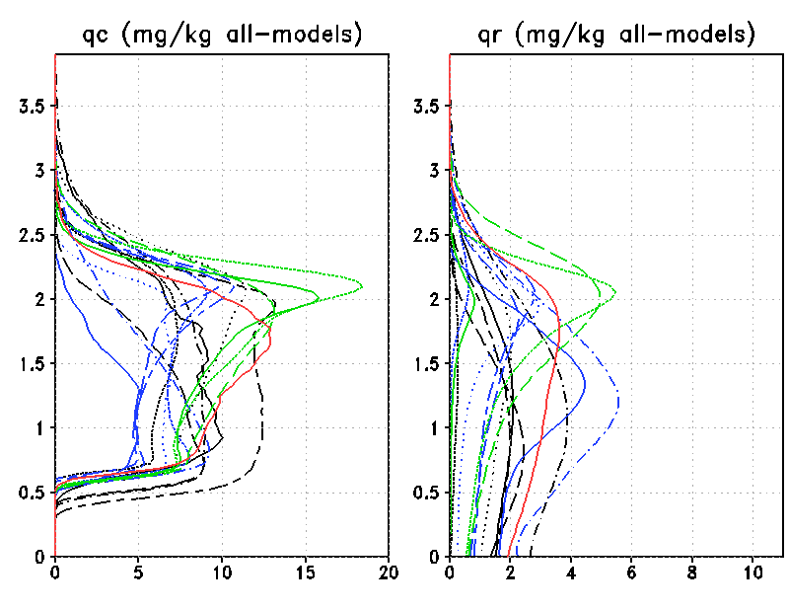
Ⅱ-3. Averaged vertical profiles (20-24 hr)
Cloud water Mixing ratio
Rain water Mixing Ratio
GCSS Models
1-moment
Bulk
2-moment
Bulk
Bin
CReSS＋
KFBin
Height (km)
Cloud：
r≦47.9μm
(mg/kg)
(mg/kg)

Slide 6
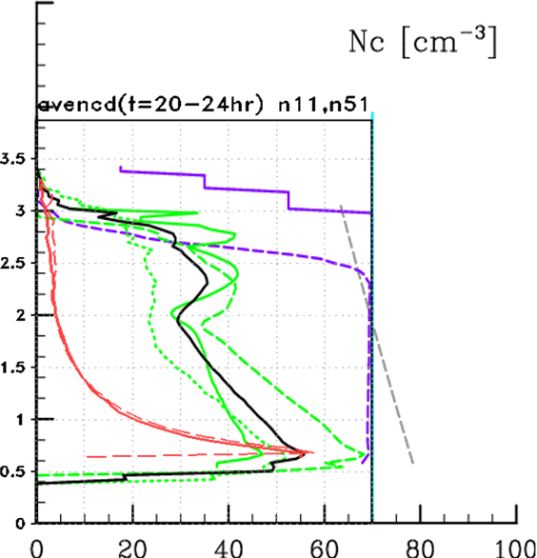
Ⅱ-4. Averaged vertical profiles (20-24 hr)
Number Density of Cloud Droplets in Cloud
GCSS Bin Models & CReSS+Bin
Bin
CReSS＋
KFBin
.
The rapid decrease of n_{c} with height in CReSS+KFBin is
related to
the activation process of CCN in KF bin model.
(the characteristic of the model)
Number Density of Cloud Droplets[cm⁻³]

Slide 7
Ⅲ. activation process of aerosols in the KF model
The number of activated CCN is important for the cloud growth.
The equation in terms of relative humidity is often used. n_{acti}∝exp(a*(rh-100))
However, grid value rh should not be used.
The number of activated CCN should be considered with very small time and space intervals,
because when large aerosols are activated, supersaturations is decreased, and ➡ small aerosols are not activated.
➡ In KF model, the number is parameterized in terms of S_{max}(w, CCN), where S_{max} is the maximum value of super saturation during upward motion.
S_{max} is determined by using a parcel model.
activation process
in a parcel with
upward displacement
rising
t time t+Δt

Slide 8
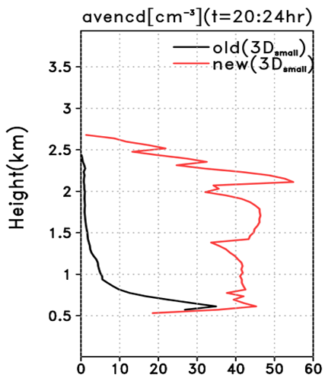
Ⅲ-2. Averaged vertical profiles (new-scheme)
In the old version of our model, activation process does not occur in cloud grids, because if there are cloud droplets, they use the super saturation water vapor for their growth.
However, in the results, there are a large number of super-saturation grids like s≧0.17.
Therefore, we introduce the activation in clouds in terms of w* which is estimated including drying effect due to condensation of cloud droplets.
Number Density of Cloud Droplets.
GCSS Bin Models & CReSS+Bin
Bin
CReSS＋
KFBin
.
$${\left(\frac{ds}{dt}\right)}_{w^{∗}}={\left(\frac{ds}{dt}\right)}_{w}−{\left(\frac{ds}{dt}\right)}_{cond}$$
Number Density of Cloud Droplets[cm⁻³]

Slide 9
Ⅳ. Development of a bulk scheme (two-mom. & two-classes)
Our bin model uses 70 bins from r(radius) =1μm to 2.9 mm. Two variables, mixing ratio and number concentration, are used for each bin.
As a first trial, developing a two-moment two-classes bulk scheme, we divided the 70 bins into two groups, i.e., cloud droplets and rain drops, by the boundary of r=47.9μm. We use two variables for each group
q_{c} and q_{r} : mixing ratios of cloud water and rain water, respectively.
n_{c} and n_{r} : number concentrations of cloud water and rain water, respectively.
In a bulk scheme, there are many microphysical processes, i.e., condensation, evaporation, falling, and in addition to these, the important conversion process from cloud to rain. There are three conversion processes
1. condensational growth of cloud droplets to rain. Autoconversion 1.
2. collision-coalescence between cloud droplets to make rain. Autoconversion 2.
3. collision-coalescence between cloud and rain. Collision-Coalescence.
In the bin model simulation, data for each process at each grid point at each time are stored during the last 4 hours. The number of the data is more than 10^9.

Slide 10
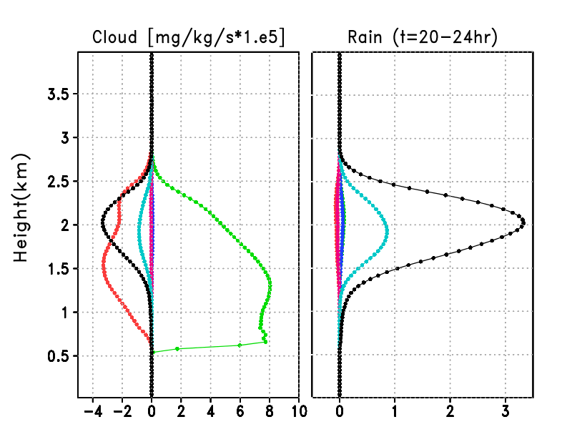
Ⅳ. Development of a bulk scheme (each process in Bin Model)
Cloud making process
(mg/kg/s*1.e5)
Rain making process
(mg/kg/s*1.e5)
cond.
eva.
Autop1
(c.of cloud → rain)
Auton1
(e.of rain → cloud)
Auto2
c＋c → rain
coll.-coal.
r＋c → rain
Height (km)

Slide 11
Ⅳ. Development of a bulk scheme (formula & variables)
Parameterization
Process(y) independent variables(x)
cond. & eva. of cloud cloud, environment
cond. & eva. of rain rain, environment
autop1 ( c → r by cond.)cloud, environment
auton1 ( r → c by eva.) rain, environment
auto2 (c+c → r) cloud, environment
coll.coal. (r+c → r) cloud, rain, environment
Variables (assuming a two moment bulk scheme)
cloud：q_{c}, n_{c}, m_{c}(average mass), r_{c}(average radius), σ_{logr}, etc.
rain：q_{r}, n_{r}, m_{r}(average mass), r_{r}(average radius), σ_{logr}, etc.
environment ：temp. , pot. temp., vapor mixing ratio, r.h., w, etc.
candidate
For each process y, in terms x₁ and x₂ using formulation
$$S=\sum_{i}{{\left(y_{i}−a_{0}x_{1i}^{a_{1}}x_{2i}^{a_{2}}\right)}^{2}}$$
the kind of variables and three coefficients $(a_{0},a_{1},a_{2})$ are determined which give minimum value of S.
Example ⇓
$${Auto}_{Lee}=e^{0.363}q_{c}^{2.184}{\left(q_{v}−q_{vs}\right)}^{0.173}$$

Slide 12
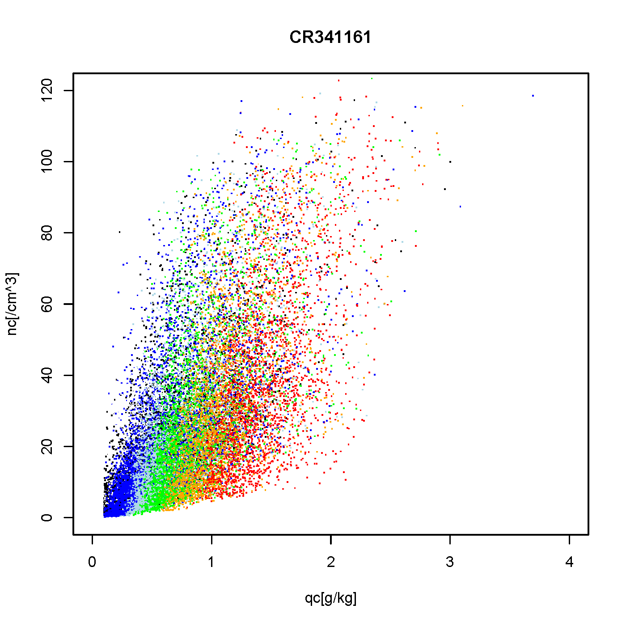
Ⅳ. Dependence of autoconversion 2 on q_{c} and n_{c}
For autoconversion2, the combination of (q_{c} and n_{c}) gives the minimum value of S, in all the combinations of the variables in the previous slide.
Right figure shows autoconversion2 in color using the axes of (q_{c}, n_{c}) .
The colors indicate the rate from small to large; black, blue, light blue, green, orange, red.
We can determine the coefficients in the formula as
Autoconversion-2 rate
n_{c} (/cm³)
$$Auto2=e^{9.210}q_{c}^{2.5358}n_{c}^{−0.6705}$$
q_{c} (g/kg)

Slide 13
Ⅳ. Development of a bulk scheme
Parameterization
Processes of q_{c}&q_{r} independent variables
cond. & eva. of cloud q_{c}&(q_{v}-q_{s}), q_{c}&(q_{s}-q_{v})
cond. & eva. of rain n_{r}&(q_{v}-q_{s}), q_{r}&(e_{s}-e_{v})
autop1 ( c → r by cond.) m_{c}&(q_{v}-q_{s})
auton1 ( r → c by eva.) n_{r}&e_{v}
auto2 (c+c → r) q_{c}&n_{c}
coll.coal. (r+c → r) r_{c}&q_{r}
Variables (assuming a two moment bulk scheme)
cloud：q_{c}, n_{c}, m_{c}(average mass), r_{c}(average radius), σ_{logr}, etc.
rain：q_{r}, n_{r}, m_{r}(average mass), r_{r}(average radius), σ_{logr}, etc.
environment ：temp. , pot. temp., vapor mixing ratio, r.h., w, etc.
determined
For each process y, in terms x₁ and x₂ using formulation
$$S=\sum_{i}{{\left(y_{i}−a_{0}x_{1i}^{a_{1}}x_{2i}^{a_{2}}\right)}^{2}}$$
the kind of variables and three coefficients $(a_{0},a_{1},a_{2})$ are determined which give minimum value of S.
Example ⇓
$${Auto}_{Lee}=e^{0.363}q_{c}^{2.184}{\left(q_{v}−q_{vs}\right)}^{0.173}$$

Slide 14
Ⅳ. Verification of the bulk formula (using bin-bulk comined model)
There are many bulk formulations proposed.
Question:
Is this new scheme better than others at least for this simulation case?
If possible, each formula for each process should be examined independently, because it is difficult to verify it by using a complete bulk model composed of all schemes for all processes because of the dependency on other processes.
So we try to verify the formula by using a bin-bulk combined model.
(If we focus on one process, for example, the autoconversion-2 process)
1 At each time step, for collision process, we run the bin model scheme.
2 Undo the collision processes corresponding to the autoconversion-2 process.
We calculate cloud-rain conversion rate by the bulk autoconversion scheme, and remove them from cloud bins and add them to rain bins. The distribution within each group is determined by the bin model results. The number concentrations are also removed from cloud bins and added to rain bins.
4 Go to the next process in the microphysical model.
Then we can verify the proposed scheme using a bin-bulk combined model.

Slide 15
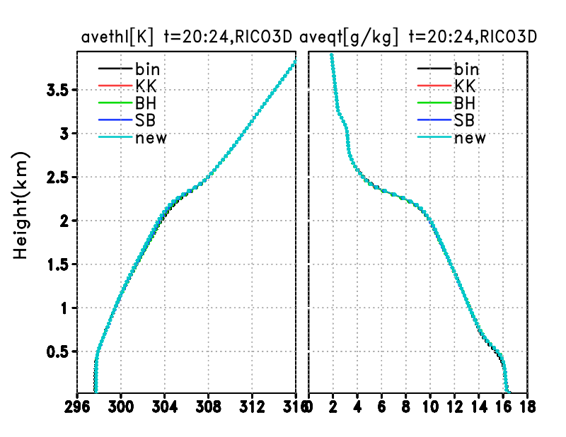
Ⅳ. Bin-bulk combined model results with replacing A2.
liquid potential temperature total water mixing ratio (t=20～24hr)
Cloud water Mixing ratio (t=20～24hr)
We try to use autoconversion schemes proposed by Khairoutdinov and Kogan, Beheng, Seifert and Beheng using 3 parameters, and our new scheme.
The figure shows vertical profile of Θ_{l}, and q_{T}.
Results : All bulk autoconversion schemes give similar profiles of Θ_{l}, and q_{T} to the bin model results.
Height (km)
Height (km)
(K)
(g/kg)

Slide 16
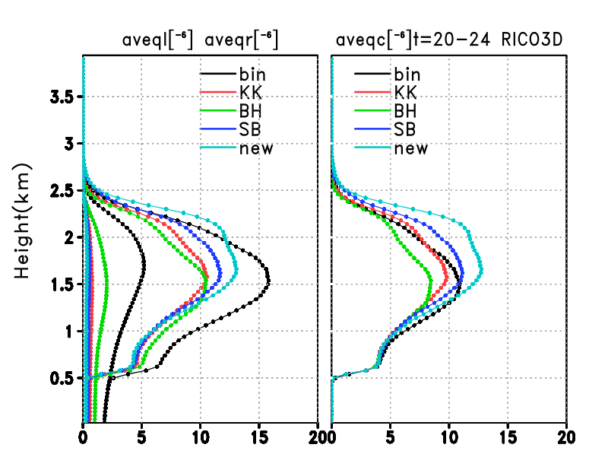
Ⅳ. Bin-bulk combined model results with replacing A2.
Rain water, Total water, and Cloud water Mixing ratio (t=20～24hr)
Cloud water Mixing ratio (t=20～24hr)
We try to use autoconversion schemes proposed by Khairoutdinov and Kogan, Beheng, Seifert and Beheng using 3 parameters, and our new scheme.
The figure shows vertical profile of q_{r}, q_{l}, and q_{c}.
Results : All bulk autoconversion schemes give much smaller q_{r} stored in clouds compared with the bin model result. (this result is uncertain.)
Height (km)
(mg/kg)
(mg/kg)

Slide 17
Summary
A numerical experiment of cumulus convection observed during RICO was performed using a bin microphysical model for warm rain developed by Kuba and Fujiyoshi.
In this model, the number of activated aerosols is determined by a parameterization scheme in terms of w.
The results of the simulation becomes well if we include the aerosol activation process in clouds in the model.
A 2-moment 2-classes bulk scheme is developed by using the Bin model results.
The exponential formulae are assumed and the variables and coefficients are determined from the condition of minimum of RMS errors.
Verification of the bulk schemes will be done by using a bin-bulk combined model. Tentative results indicate that the bulk autoconversion schemes including our new scheme give much smaller q_{r} stored in clouds compared with the bin model. (bug?)

